Slide 1











Principles of Feature Modeling
Damir Nešić
KTH Royal Institute of Technology,
Stockholm, Sweden
damirn@kth.se
Jacob Krüger
Otto von
Guericke University,
Magdeburg, Germany jkrueger@ovgu.de
Ştefan Stănciulescu
ABB Corporate Research,
Baden-Dättwil, Switzerland
scas@itu.dk
Thorsten Berger
Chalmers | University of Gothenburg,
Gothenburg, Sweden thorsten.berger@chalmers.se

Slide 2
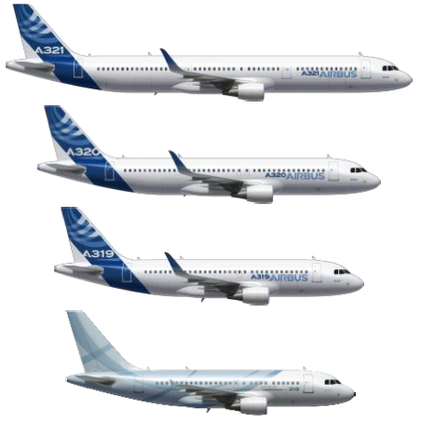
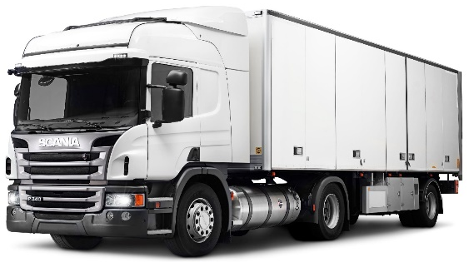
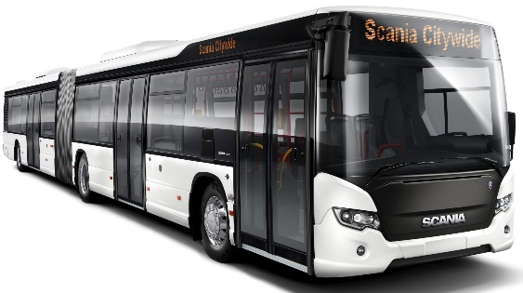
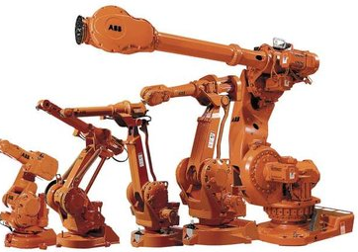

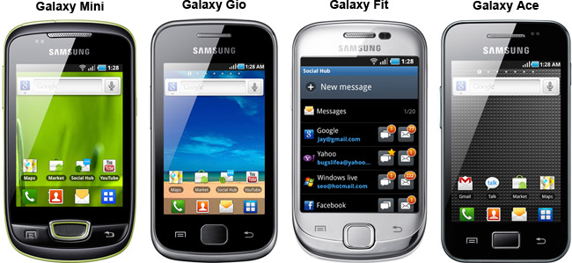
Variability is everywhere

Slide 3
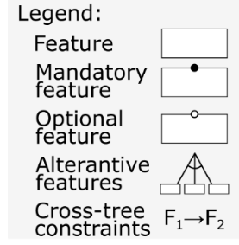
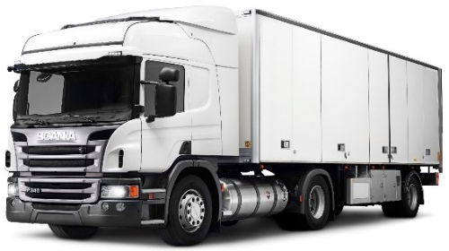



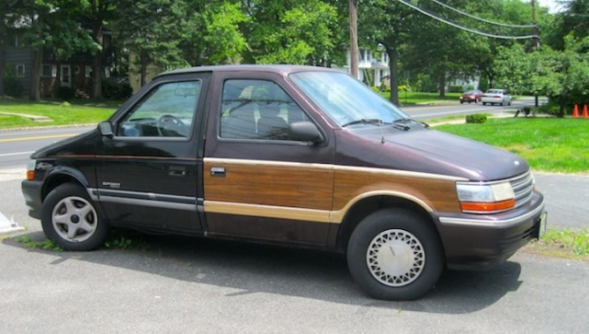
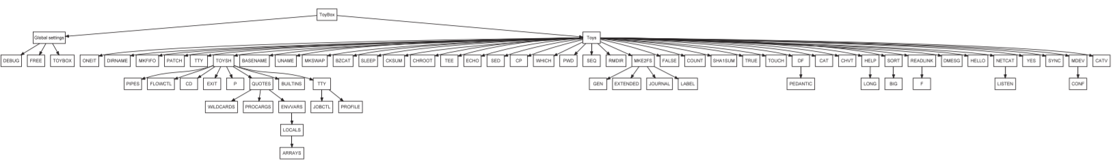
Managing variability
Petrol
Engine
Engine
Electric
Example feature model
ToyBox feature model with 71 features
Notes:
Varibility is moving from HW to SW.

Slide 4

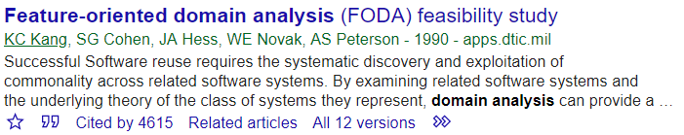
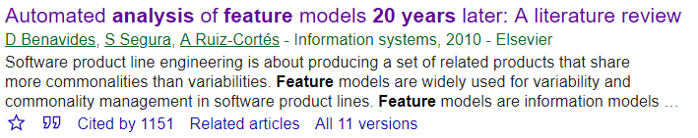
30 years of feature-model research
Refactoring
Quality assurance…
As a step towards a feature-modeling methodology, we contribute:
  34 general feature-modeling principles organized into eight categories
  Detailed discussion of each principle with guidelines for their use
Notes:
- Research focused on improving already well-engineered product line, but experience showsn that industry rarely has even a feature model

Slide 5
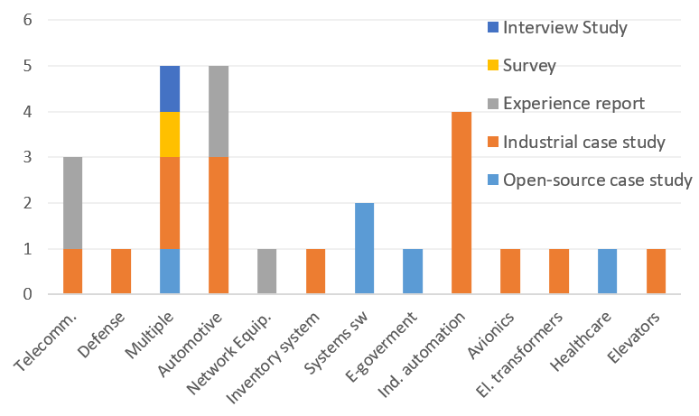
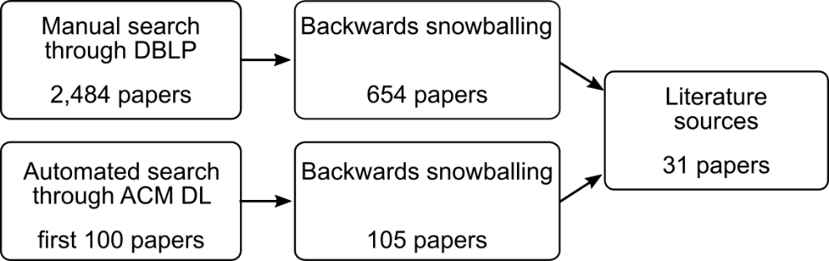
Literature sources
Analyzed venues: ASE, ESEC/FSE, FOSD, ICSE, ICSME, ICSR, MODELS, SANER, SPLC, and VaMoS.
Included empirical studies and experiences from practitioners, tool-vendors, educators
Identified 31 paper across 26 years
11 different modeling notations
14 different application domains
Methodology for the identification literature sources
Domains and types of identified papers
Notes:
Specialized and general venues

Slide 6
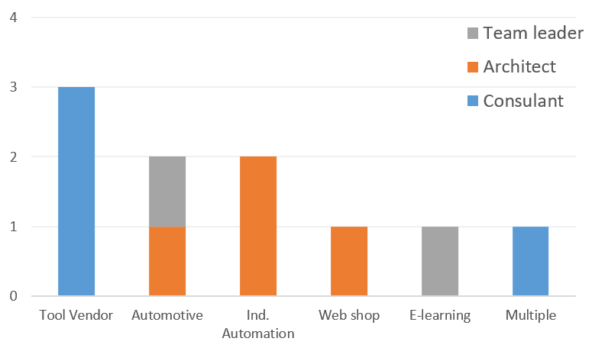
Interviews
Semi-structured interviews (~1h)
Included experienced practitioners, tool vendors, and consultants
10 interviews from nine companies
Company size 50 to 150.000 employees
Feature model size 40 to >1000 features
Implementation: C, C++, Java, model-based
Modeling context
Domain
Feature model properties
Size
Shape
Modeling process
Creation
Company struc.
Implementation
Constraints
Maintenance
Evolution
…
…
…
Interview guide
Domains and roles of interviewees

Slide 7
Synthesizing the principles
Practice 1
Practice 2
Practice 190
Category | # Principles
Planning and Preparation | 6
Training | 3
Information sources | 1
Model Organization | 5
Modeling | 11
Dependencies | 2
Quality Assurance | 3
Model Maintenance and Evolution | 3
Candidate 1
Candidate 2
Candidate 2
Candidate 1
Candidate 3
34 principles
Notes:
Table for categories and number of pr.
The sequence of steps is most probable for a modeling process.
Prepare the transition: let’s imagine a company

Slide 8

How should we go about the creation of a feature model?

Slide 9
Planning and Preparation
Identify relevant stakeholders (PP6)
  Who are the modelers (keep the number low PP6)
  Who are the users, maintainer
Unify the domain terminology (PP2).
Define the purpose of the feature model (PP3).
Define feature to sub-feature decomposition criteria (PP4).
  Functional, technical decomposition?
Propulsion
Engine
Product configuration support!
Product planning support!

Slide 10
Training
Conduct a pilot project (T3). (The “why, why, why” process)
Identify differentiating features (M2)
Why do the differences exist?
Visualize the identified features
Transform into a feature diagram
I1: ”…keep asking why until they come up from implementation level detail which is usually where they are thinking up until the essential features.”
Notes:
Engineers never learned to think in terms of their domain [Krueger, Danfos]. Developers are used to a single abstraction level (code) but in PL they have think of code as a FM model also.

Slide 11
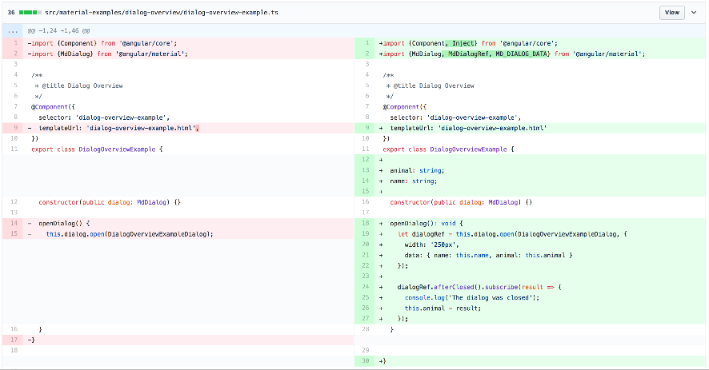

Information Sources and Modeling
Use domain knowledge from artifacts (IS1), in workshops with domain experts (M1).
First identify distinguishing features (M2).
Apply bottom-up modeling to artifacts (M3).
Apply top-down modeling to the domain (M4).
Apply bottom-up and top-down modeling (M5).
Emission
monitor
Battery management
Petrol
Electric

Slide 12
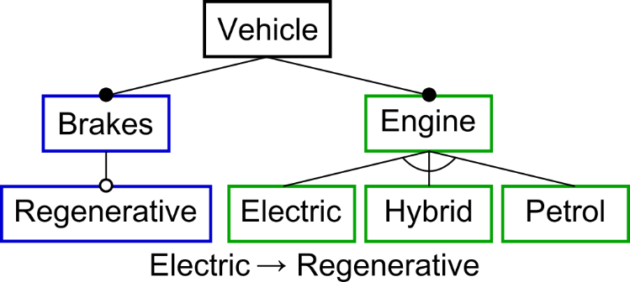


Modeling (continued)
A feature is typically a functional abstraction (M6) and Boolean features should be preferred (M10).
Define default feature values (M8).
Define feature-model views (M9).
DC7-Kw Motor
1.5l
2l
3l

Slide 13
Model Organization
Model hierarchy not deeper than 8 levels (MO1).
Abstract features should be higher in the hierarchy (MO2).
Split large models and ensure consistency with ‘interface’ models (MO3).
Avoid complex cross-tree constraints (MO4).
Maximize cohesion and minimize coupling with feature groups (MO5).
More abstract
8 levels
requires
More technical
A
2
1
3
exclude
exclude
exclude
Notes:
Improve figure for intuition for MO5.

Slide 14
Model Organization
Model hierarchy not deeper than 8 levels (MO1).
Abstract features should be higher in the hierarchy (MO2).
Split large models and ensure consistency with ‘interface’ models (MO3).
Avoid complex cross-tree constraints (MO4).
Maximize cohesion and minimize coupling with feature groups (MO5).
More abstract
8 levels
requires
More technical
A
2
1
3
Notes:
Improve figure for intuition for MO5.

Slide 15

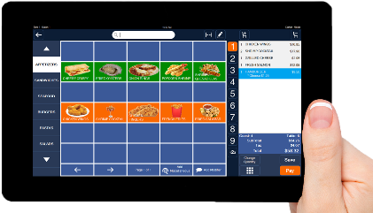
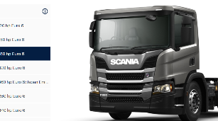
Dependencies
D1: If the models are configured by (company) experts, avoid feature-dependency modeling
  ~50% of features involved in a dependency
  Add custom dependencies, e.g. recommends
D2: If the main users of a feature model are end-users, perform feature-dependency modeling.
  Support choice-propagation
  Avoid invalid configurations
Notes:
Recommends because defects and people got used to it

Slide 16
Quality Assurance, Maintenance and Evolution
Validate the feature model in workshops (QA1).
Use the obtained feature model to derive configurations (QA2).
Use regression tests to check for invalid configurations (QA3), if D1 applied.
Use centralized model governance (MME1) and version manage the entire model (MME2).
MME3: New features should be defined and approved by domain experts.
Relation on SW architecture unclear
We can configure SW
Selecting features in this order is not intuitive!
Add
Specify the feature
Change-impact analysis
Impact on verification
Do not add

Slide 17
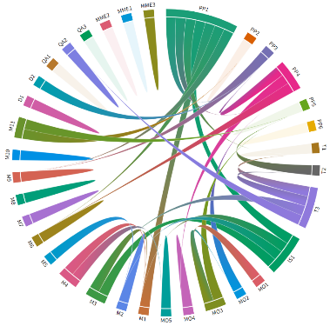
Towards a methodology for feature modeling
The principles are ordered in the most probable sequence but we do not claim that this represents a feature-modeling process.
Some principles depend on the modeling context (e.g. D1 vs D2, M9 vs MO3).
15 principles impact/are impacted by the application of other principles.
Dependencies between
principles

Slide 18
Conclusion
Feature modeling principles
Maintenance & Evolution
Quality Assurance
Planning and Preparation
Information Sources
Model Organization
Training
QA3
Modeling
Dependencies
PP1
PP6
M1
M11
D1
D2
requires
Thank you!

Slide 19
END

Slide 20

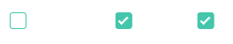
Training
Familiarize with the basics of product-line engineering (T1).
  Establish intuition!
Conduct a pilot project (T3). (The why, why, why process)
= Boolean
= Enumeration
Identify differences between variants (M2)
Why do the differences exist?
Visualize the identified features
Transform into a feature diagram
I1: ”…keep asking why until they come up from implementation level detail which is usually where they are thinking up until the essential features.”
Notes:
Engineers never learned to think in terms of their domain [Krueger, Danfos]. Developers are used to a single abstraction level (code) but in PL they have think of code as a FM model also.

Slide 21
Conclusion and Future Work
We synthesized 34 general feature modeling principles:
  Based on a systematic literature review and interviews with practitioners,
  Covering 16 different domains,
  Considering 11 modeling notations,
  Including feature models of different sizes and purposes
We complemented the principles with in-depth discussion about mutual dependencies and applicability
Future work aims at applying the principles in real projects and synthesizing a methodology for feature modeling.
Thank you!

Slide 22
Maintenance and Evolution
MME1: Use centralized feature model governance.
  Safe evolution, strict access control.
MME2: Version the feature model in its entirety.
  Avoid inconsistencies.
MME3: New features should be defined and approved by domain experts.
  What are the requirements?
  What is the impact of adding a feature?
  How does it impact verification activities?

Slide 23
Most supported principles
Preparation:
  PP2: In immature or heterogeneous domains, unify domain terminology. (15/41)
Information sources
  IS1: Rely on domain knowledge (from experts or artifacts) to construct a feature model.
Modeling
  M2: Focus first on identifying features that distinguish variants.
  M3: Apply bottom-up modeling to identify differences between artifacts.
  M6: A feature typically represents a distinctive, functional abstraction.
  M10: Prefer Boolean type features for comprehension.
Model organization
  MO1: The depth of the feature-model hierarchy should not exceed eight levels.
  MO2: Features at higher levels in the hierarchy should be more abstract.
  MO3: Split large models and facilitate consistency with interface models.
  MO4: Avoid complex cross-tree constraints.
Notes:
Explain briefly each, give examples from the paper

Slide 24
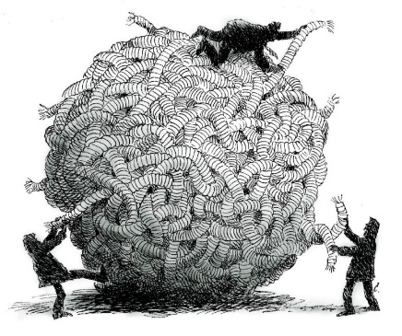
Training
T1: Familiarize with the basics of product-line engineering.
  Establish intuition!
T2: Select a small (sub-)system to be modeled for training.
  What is sufficiently simple/complex?
T3: Conduct a pilot project. (Why, why, why process)
= Boolean
= Enumeration
Identify differences between variants (M2)
Why do the differences exist?
Visualize the identified features
Transform into a feature diagram
Notes:
Engineers never learned to think in terms of their domain [Krueger, Danfos]. Developers are used to a single abstraction level (code) but in PL they have think of code as a FM model also.

Slide 25
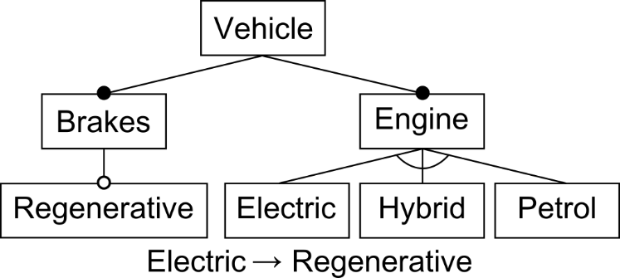
Context-dependent principles
Depending on the feature model purpose (PP3)
  D1: If the models are configured by (company) experts, avoid feature-dependency modeling

Slide 26
Context-dependent principles
Depending on the feature model purpose (PP3)
  D1: If the models are configured by (company) experts, avoid feature-dependency modeling
recommends

Slide 27
Context-dependent principles
Depending on the feature model purpose (PP3)
  D1: If the models are configured by (company) experts, avoid feature-dependency modeling.
  D2: If the main users of a feature model are end-users, perform feature-dependency modeling.

Slide 28
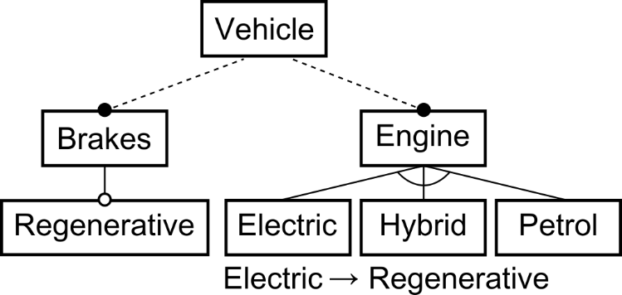
Context-dependent principles
Depending on the feature model purpose (PP3)
  D1: If the models are configured by (company) experts, avoid feature-dependency modeling.
  D2: If the main users of a feature model are end-users, perform feature-dependency modeling.
Depending on the level of tool-support:
  MO3: Split large models and facilitate consistency with interface models.

Slide 29
Context-dependent principles
Depending on the feature model purpose (PP3)
  D1: If the models are configured by (company) experts, avoid feature-dependency modeling.
  D2: If the main users of a feature model are end-users, perform feature-dependency modeling.
Depending on the level of tool-support:
  MO3: Split large models and facilitate consistency with interface models.
  M9: Define feature-model views.

Slide 30
Principles identified from interviews
MME1: Use centralized feature model governance.
  Dedicated person or a team ensure safe evolution and strict access control.
MME2: Version the feature model in its entirety.
  Avoid inconsistencies. If needed, mark features as deprecated.
MME3: New features should be defined and approved by domain experts.
  Beforehand write specification, perform change-impact analysis, plan verification.
D1: If the models are configured by (company) experts, avoid feature-dependency modeling.
  QA3: Use regression tests to ensure that changes to the feature model preserve previous configurations.

