Slide 1



Modular Safety Cases for Product Lines based on
Assume-Guarantee Contracts
Damir Nešić, Mattias Nyberg
KTH Royal institute of technology, Stockholm, Sweden
Rigorous Systems Engineering group: www.kth.se/itm/rse

Slide 2
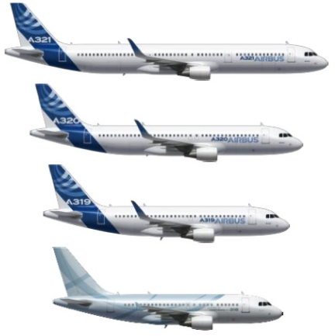
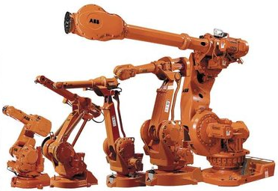
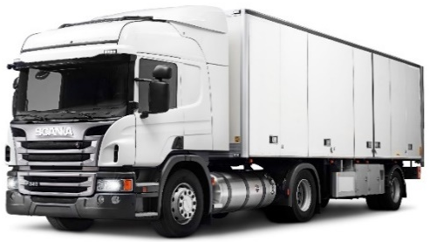
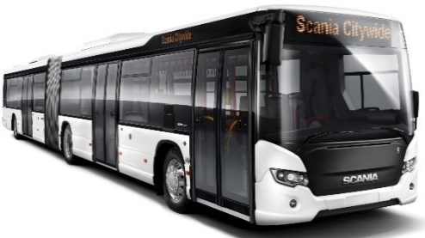
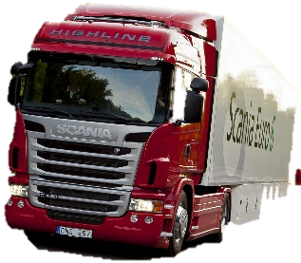
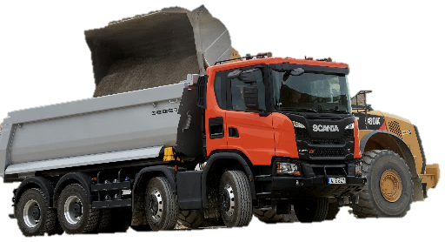
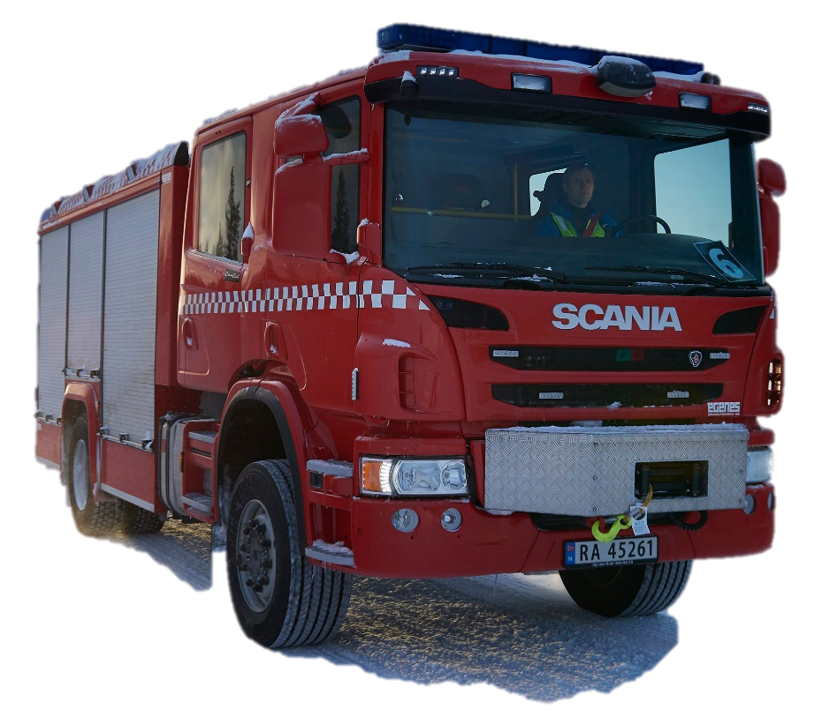
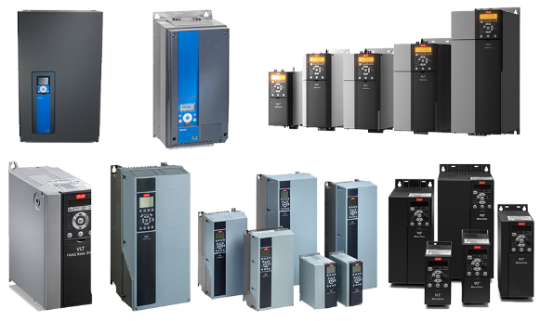
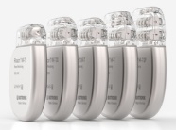
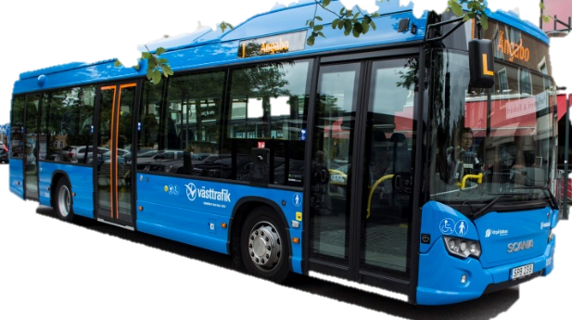
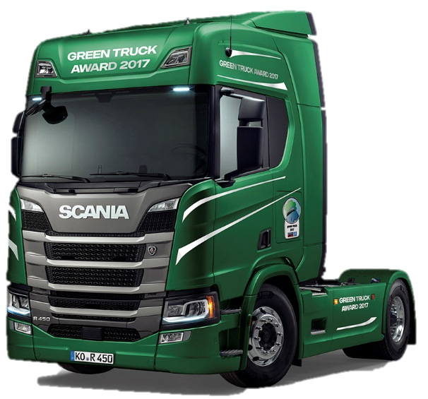
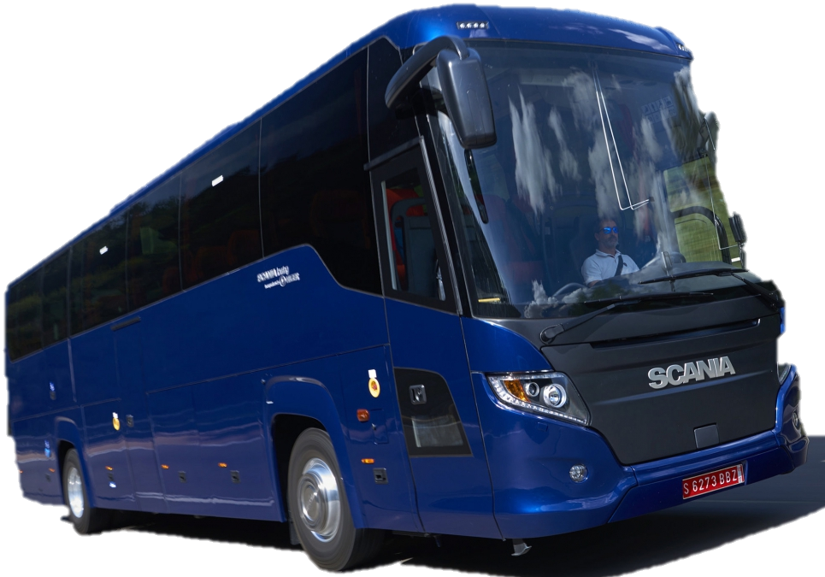
Product lines are everywhere
Tens of configurations
Billions of configurations
2

Slide 3
Modular Safety Cases
G₁
Top claim
G₂
G₃
Sub-claim 1
Sub-claim 2
Sn₁
Sn₂
Sn₃
Evidence
Evidence
Evidence
GSN community standard version 2, Origin Consulting, 2018

Slide 4
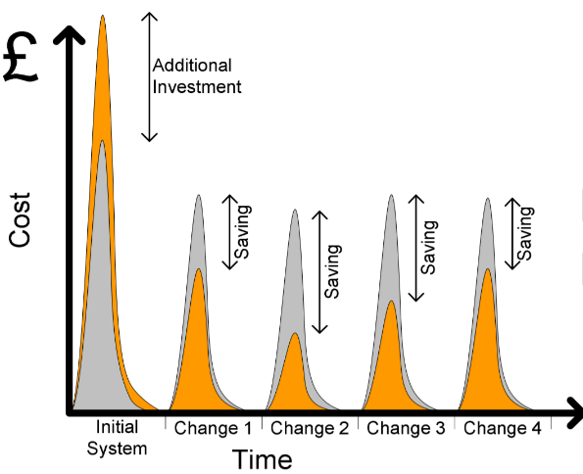

Modular Safety Cases
G₁
“Modular Safety Cases”, white paper, 2012 AMS DE-RISC
Top claim
M₁
M₂
G₂
G₃
Sub-claim 1
Sub-claim 2
Sn₁
Sn₂
Sn₃
Evidence
Evidence
Evidence
GSN community standard version 2, Origin Consulting, 2018

Slide 5
Previous work and contribution
Kelly et al. ’06 – Principles of modular, compositional safety-case construction
  High cohesion, low coupling, information hiding, aligned with system entities etc.
Fenn et al. ’07 – ”The Who, Where, How, Why and When of Modular safety cases”
  Informal ’dependencies’ among systems components guide the modularization
de Oliveira et al. ’15 – ”Automated Generation of Modular Product Line Safety Case”
  Amalgamation of per-configuration safety cases
  Modules aligned with abstract system-entities (features)
Nešić et al. ’19, “Constructing Product-Line Safety Cases from Contract-Based Specifications”
  One safety case for all configurations of the product line
This paper presents a method to modularize a safety case for from Nešić et al. ’19
  Modules aligned with abstract and concrete system-entities to reach benefits of modularization
  ‘Dependencies’ that guide the modularization formally defined in the Contract-Based Specification framework

Slide 6
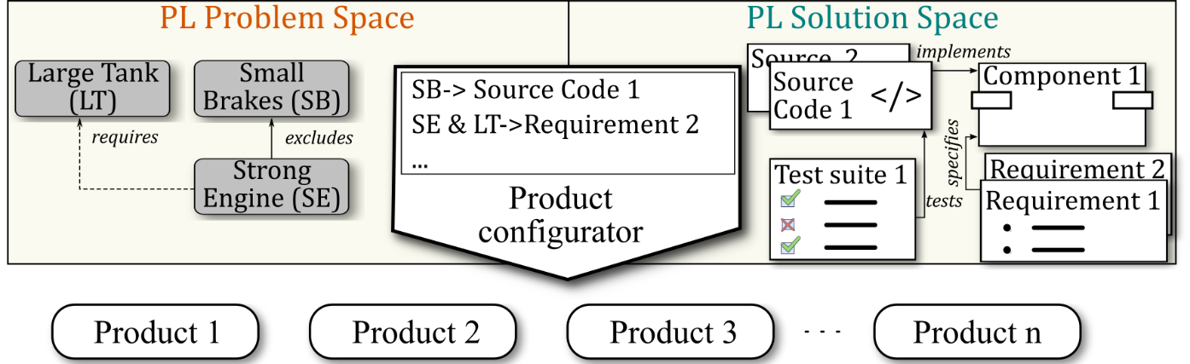
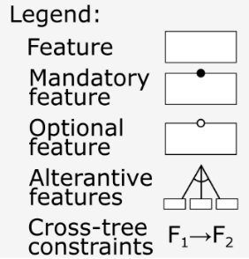
A model of a product line
Truck
Contract-based specification
Formalize systems engineering
Purpose compositional reasoning
Tool and format independent (allows various levels of formality)
Instruments
Fuel Tank
Fuel Type
Advanced
Right
Left
Diesel
Gas
Gas → Right
Example feature model

Slide 7

Contract-Based Specification (CBS) Framework
φ
C_{FLD}
Component
Specification
Component implements specification
Composition of components
Specification refines specification
Specifications form contracts
Contracts allocated to components
Components satisfy contracts
Specifications and components labeled
with presence conditions
C_{Tank}
φ₁
φ
φ
φ
G₂
a
A₂
r
a
r
A₁
G₁
φ
r
r
φ
C_{COO}
φ
C_{BMS}
φ
φ
φ
a
r
A₃
G₃
a
φ
A₆
G₆
C_{E-SW}
φ
r
r
r
C_{ICL}
φ
φ
φ
a
φ
A₄
G₄
a
A₅
G₅
G₁: ”The indicated fuel volume corresponds to ±10% of the volume in the fuel tank”.
φ₁: Right Fuel Tank OR Left Fuel Tank

Slide 8
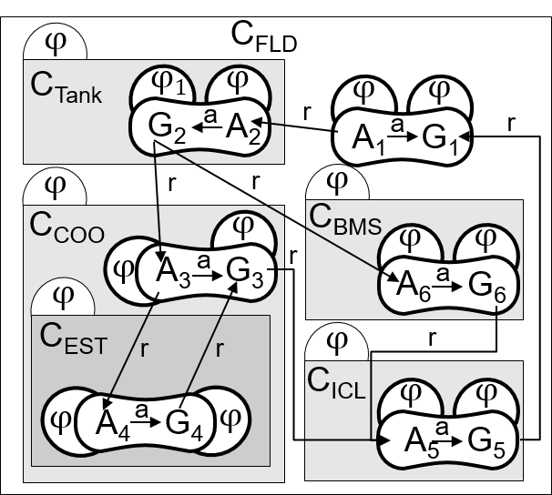
Basis for a Product Line Safety Case
Theorem. C_{FLD} satisfies (A₁,G₁) in each configuration defined by the feature model if,
The CBS model satisfies structural constraints (10 types of constraints)
  For example, information hiding, layering & encapsulation etc.
The CBS model does not contain configuration mismatches (6 types of constraints),
  For example, presence conditions of A₁,G₁, and C_{Vehicle}, match
Contracts allocated to atomic-components are satisfied,
  Verify, e.g. test, that SW and HW satisfy their contracts
Each refinement relation corresponds to logical entailment,
  Verify that the breakdown of safety requirements is complete
How to modularize a safety case based on CBS?
  Per feature, per component, per development team…?

Slide 9
Architecture of a Modular Safety-Case
Argument about the PL
M₁
All configurations in the PL are safe
C_{Vehicle} composed of C_{FLD}…
Argument about most abstract implementation entities (feature, item, function…)
M₂
C_{FLD} is safe w.r.t. identified hazards
Modularization according to different concerns
M₃
G₁ mitigates hazard H₁
M₄
C_{FLD} satisfies (A₁,G₁) in each config.
M₅
C_{FLD} independence
Modularization according to contracts and their allocation

Slide 10
Architecture of a Modular Safety-Case
M₁
All configurations in the PL are safe
M₁:G₁
PL is safe
M₂
C_{FLD} is safe w.r.t. identified hazards
M₁:G₄
M₁:G₃
M₁:G₂
C_{FLD} is safe w.r.t. identified hazards
Problem space contains only valid configurations
Problem to solution mapping space is correct
M₃
G₁ mitigates hazard H₁
M₄
C_{FLD} satisfies (A₁,G₁) in each config.
M₅
C_{FLD} independence
D. Nešić, M. Nyberg, ” Multi-view modeling and automated analysis of product line variability in systems engineering”, SPLC ’16

Slide 11
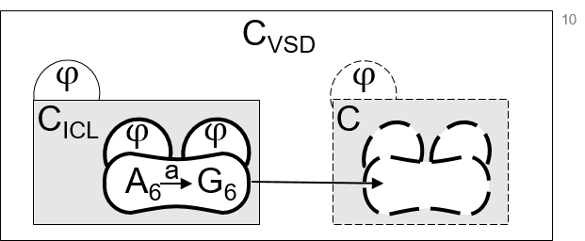
Contract-based modules
C_{Vehicle}
C_{FLD} composed of w.r.t. allocated contract
M₄
C_{FLD} satisfies (A₁,G₁) in each config.
M₆
C_{ICL} satisfies (A₆,G₆) in each config.
M₈
C_{BMS} satisfies (A₆,G₆) in each config.
M₆
C_{COO} satisfies (A₃,G₃) in each config.
M₅
C_{ICL} satisfies (A₅,G₅) in each config.
M₇
C_{Tank} satisfies (A₂,G₂) in each config.
M₈
C_{EST} satisfies (A₄,G₄) in each config.
11

Slide 12
Contract-based modules
C_{Vehicle}
C_{FLD} composed of w.r.t. (A₁,G₁)
M₄
C_{FLD} satisfies (A₁,G₁) in each config.
M₆
C_{ICL} satisfies (A₆,G₆) in each config.
At most one
M₈
C_{BMS} satisfies (A₆,G₆) in each config.
M₆
C_{COO} satisfies (A₃,G₃) in each config.
M₅
C_{ICL} satisfies (A₅,G₅) in each config.
M₇
C_{Tank} satisfies (A₂,G₂) in each config.
M₈
C_{EST} satisfies (A₄,G₄) in each config.
12

Slide 13
Contents of a contract-based module
()
M₆:G₁
C_{COO} satisfies (A₃,G₃) in each configuration
M₆:G₂
M₆:G₃
M₆:G₄
M₆:G₅
No configuration mismatches exist
Refines relations to A₃,G₃ correspond to entailment
CBS of C_{COO} for (A₃,G₃) satisfies structural constr.
Subcomponents of C_{COO} satisfy allocated contracts
⊧
⊧
(10)
(6)
M₆:Sn₁
M₆:G₆
M₆:Sn₁
M₆:Sn₁
M₆:Sn₁
C_{EST} satisfies (A₄,G₄) in each configuration
SMT
check
SMT
check
Expert review
Review /
auto. checks

Slide 14
Comparison to previous approaches
New configuration added
F1 is safe
F1 is safe
F1
F1
a)
At most one
At least one
F2
F3
F2
F3
F3 → Fx
F2 is safe
F3 is safe
F2 is safe
F3 is safe
F1
F1
F1
F1
b)
F2
F2
Lane keep
F2
F2
Lane keep
is safe

Slide 15
Comparison to previous appraoches
New configuration added
M₁
All configurations in the PL are safe
M₁:G
Mapping to solution space correct?
F1
F1
a)
F2
F3
F2
F3
F3 → Fx
M₁:G
No mismatches w.r.t. F2,F3,Fx?
F1
F1
Lane keep
is safe…
b)
F2
F2
Lane keep

Slide 16


Comparison to de Oliveira & in general
A safety requirement changes
M₄:G
G₃⊧G’₁?
C_{FLD}
C_{FLD}
M₄
C_{FLD} satisfies (A₁,G’₁) in each configuration
φ
φ
φ
φ
a
a
A₁
G₁
A₁
G’₁
M₅:G
M₄:G
G’₃⊧G’₁?
C_{COO} satisfies (A₃,G’₃)?
G₁: ”The indicated fuel volume corresponds to ±10% of the volume in the fuel tank”.
G’₁: ”The indicated fuel volume corresponds to ±8% of the volume in the fuel tank”.
M₆
C_{COO} satisfies (A₃,G’₃) in each config.
Verification OR reason about subcomponents

Slide 17
Discussion
Arbitrary granularity of safety case modules
Double separation of concerns
  Functional and technical division of safety work
  Additional grouping via containment¹ (safety case views?)
The proposed architecture can be reduced to a per-configuration safety case
Component 1
Function 1
Function 2
¹ E. Denney, G. Pai, ”Towards a Formal Basis for Modular Safety Cases”. Technical report, NASA ’15.

Slide 18
Conclusion and future work
Presented a method to modularize a safety case for a product line
  Dependencies that guide the modularization formally defined in the CBS framework,
  Dependencies corresponds to concrete relations between engineering artifacts,
  Modules aligned with abstract and concrete system entities.
Future work is to develop modules about component independence.
Thank you!

Slide 19

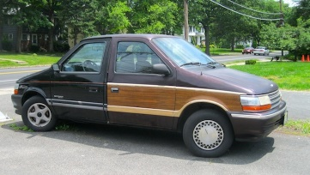
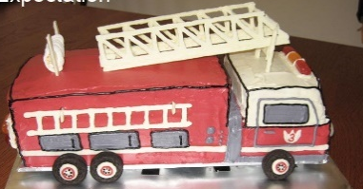


Types of modules
PL problem space related modules
  Invalid configurations cannot be selected (from feature model)
PL problem-to-solution space related modules
  If brakes selected they will actually be included (from CBS model)
PL solution space related modules
  Hazards identified, risk assessed, safety requirements defined (out of scope)
  The system implements the safety requirements (from CBS model)

