Slide 1

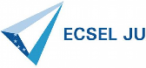
Building a Web-Based Federated Toolchain
Lessons Learned From a Four-Year Industrial Project
Damir Nešić^{a,1}, Jad El-Khoury^{a,b}, Jonas Westman^{b,1}, Mattias Nyberg^{a,b,1}
ª KTH Royal institute of technology, Stockholm, Sweden
^{b} Scania CV AB, Södertälje, Sweden
¹Rigorous Systems Engineering group: www.kth.se/itm/rse

Slide 2


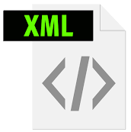

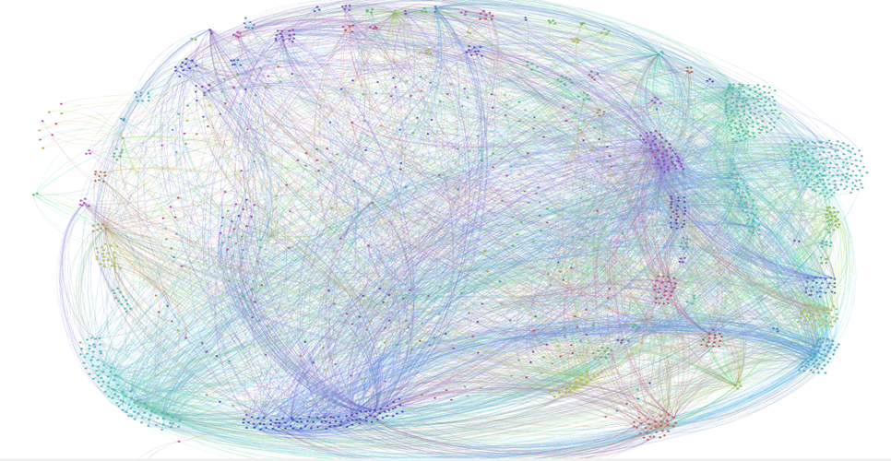



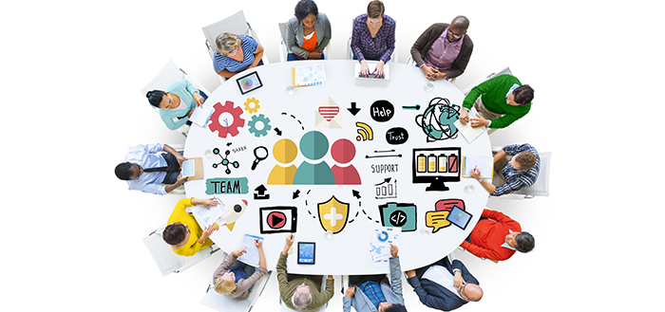
The need for consistent, unambiguous data
“Absence of unreasonable risk due to hazards caused by malfunctioning behavior of electronic/electrical systems”¹
Logical components and dependencies of a Scania truck (2013)
¹ ISO 26262: Road-Vehicles Functional safety
2

Slide 3
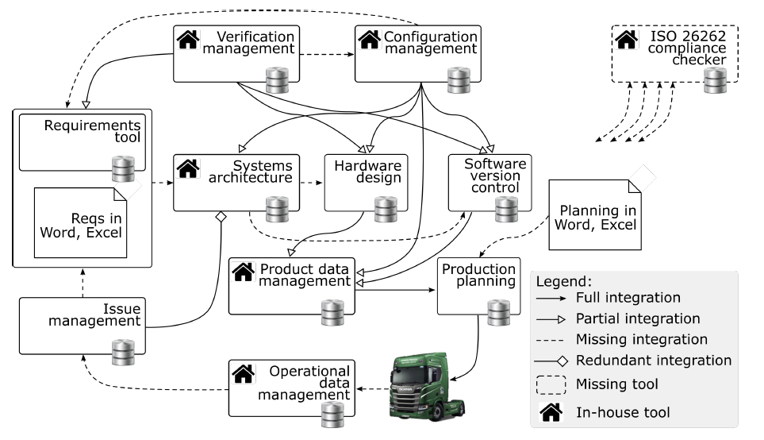
Status of the legacy toolchain
Only some relevant artefacts accessible
Interfaces perform unwanted transformations
Semantics and authority over artifacts unclear
Part of a toolchain at the beginning of the project

Slide 4
Project goals*
Goal 1: Explicitly define the semantics, and tool-authority for relevant artifacts.
Goal 2: Create uniquely identifiable digital representation of relevant artifacts.
Goal 3: Enable machine-readable access and automated analysis of relevant artifacts.
Read
Analyze
Display Result
Initiate action
* Detailed toolchain-requirements can be found in the paper

Slide 5
Project goals and requirements
Goal 1: Explicitly define the semantics, and tool-authority for relevant artifacts.
Goal 2: Create uniquely identifiable digital representation of relevant artifacts.
Goal 3: Enable machine-readable access and automated analysis of relevant artifacts.
ID | Requirement
R1 | Support Read operation of arbitrary artifacts.
R1.1 | Support Create operations on arbitrary artifacts.
R1.2 | Support Update and Delete operations on arbitrary artifacts.
R2 | Tool-independent, toolchain-wide information model.
R3 | Data quality assurance against R2.
R4 | Use standardized principles and technologies for tool interfaces.
R5 | Support frequent evolution of tool interfaces.
Read
Analyze
Display Result
Initiate action

Slide 6
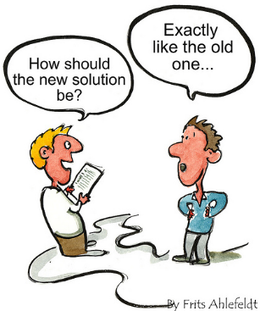
Technology and Tool Support

Slide 7



Integration technology
Open Service for Lifecycle Collaboration² (OSLC)
= Linked Data Platform³ (LDP) + OSLC domains
HTTP response
HTTP request
LDP
oslcRequirement
dcterms:title [1..1]
oslc:specifies [*]
…
OSLC Requirements domain
² https://open-services.net/, ³ https://www.w3.org/TR/ldp/

Slide 8

Integration technology
Open Service for Lifecycle Collaboration² (OSLC)
= Linked Data Platform³ (LDP) + OSLC domains
HTTP response
HTTP request
LDP
oslcRequirement
dcterms:title [1..1]
oslc:specifies [*]
…
OSLC Requirements domain
² https://open-services.net/, ³ https://www.w3.org/TR/ldp/

Slide 9
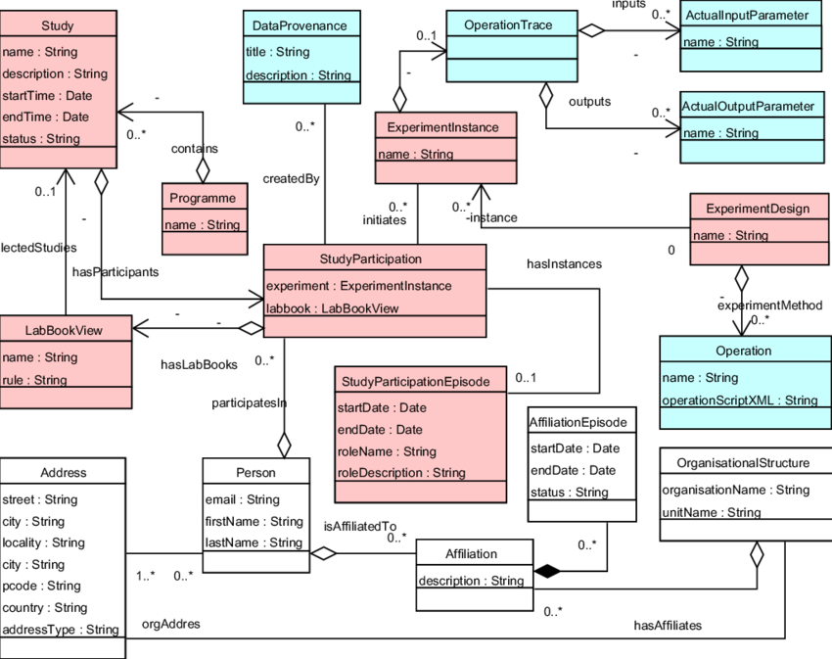
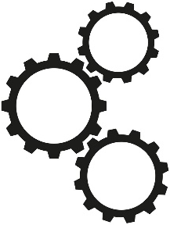
Tool supported, model-driven adapter development
Class-diagram information modeling instead ontologies, vocabularies etc.
LDP compliant
server
Manual
HTTP response
Conforms to the model?

Slide 10

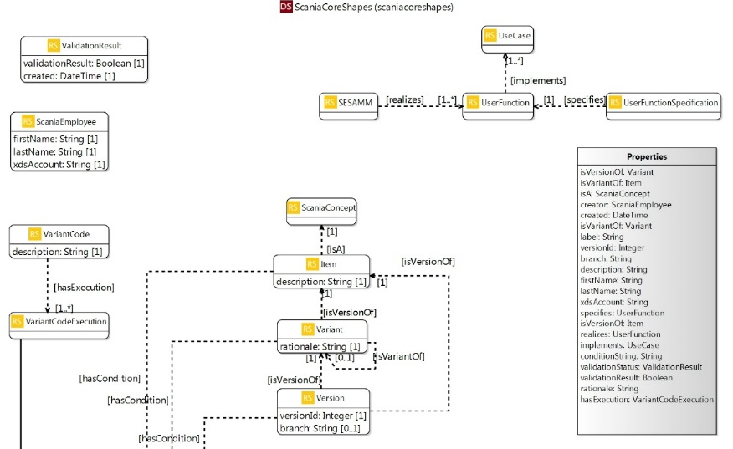

Tool supported, model-driven adapter development
Eclipse Lyo⁴
LDP compliant
server
Lyo code
generator
Lyo Validation
(SHACL⁵)
Lyo Designer
HTTP response
⁴ https://www.eclipse.org/lyo
⁵ https://www.w3.org/TR/shacl/

Slide 11

Adapter (tool-interface) development

Slide 12
Development process
Distribute the creation of information models and adapters
  Right people doing the right job
Use-case driven, continuous development
  Focus on existing problems
Centralized toolchain deployment and maintenance
  Only common concerns should be solved centrally

Slide 13
Information models
Data and Its Semantics Stay Together
  Serialized the class-diagram information models as RDF Schema⁶ (RDFS)
Class
Control-Unit Generation
introduced : String
Information Models are Multi-Level Models⁷
  RDFS natively supports such models
instanceOf
Class & Object
EngineManagementUnit
SN : 12345
introduced = ”Q3 2018”
instanceOf
Object
EngineManagementUnit-1
SN = 12345
⁶ https://www.w3.org/TR/rdf-schema/
  ⁷ ”The Essence of Multilevel Metamodeling”, C. Atkinson, T. Kühne, 2001

Slide 14


Adapter characteristics
C.U.D. controlled by the host-tool application-software
  Avoid unwanted side-effects
Loose coupling between the adapter and the tool
  Decouple functional and non-functional concerns
Adapters conform to REST architecture
  Follows from adopting LDP
Store RDF resources
  Ensure good performance
Support SPARQL⁸ queries
  Search and explore stored RDF resources
REST
C.U.D request
  ⁷ https://www.w3.org/TR/rdf-sparql-query/

Slide 15
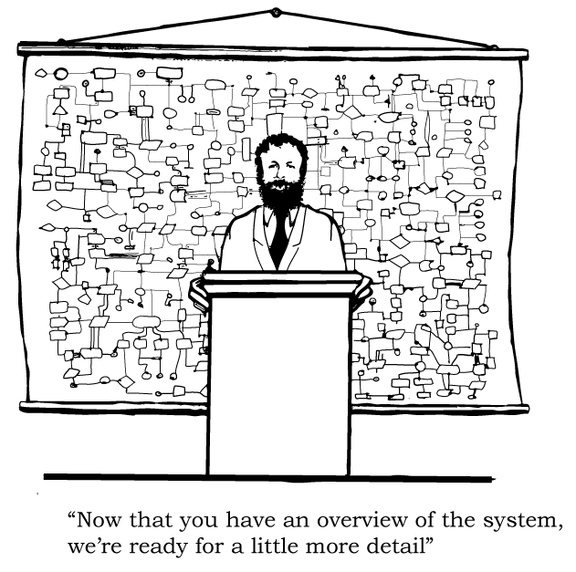
Toolchain and adapter architecture

Slide 16
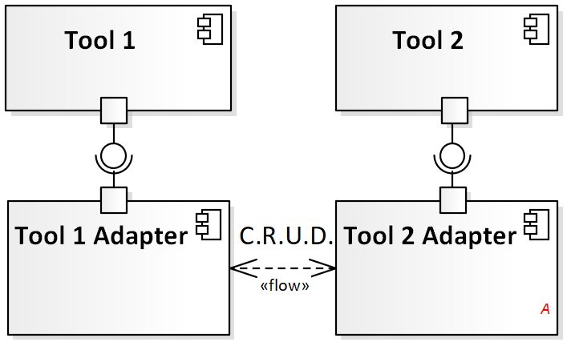
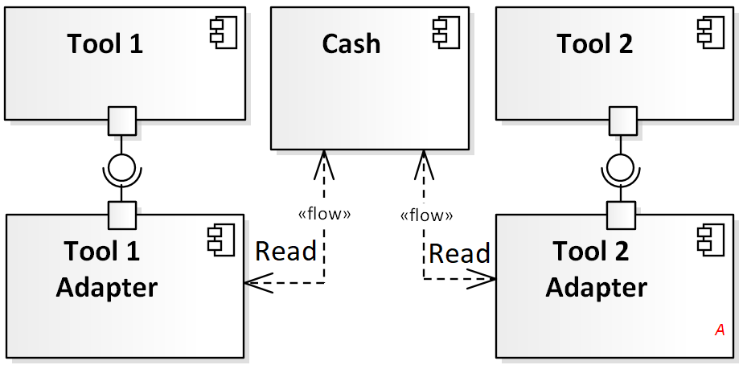
Two toolchain architectures
Goal 1: Explicitly define the semantics, and tool-authority for relevant artifacts.
Goal 2: Create uniquely identifiable digital representation of relevant artifacts.
Goal 3: Enable machine-readable access and automated analysis of relevant artifacts.
Centralized-cache architecture
Distributed-cache architecture

Slide 17
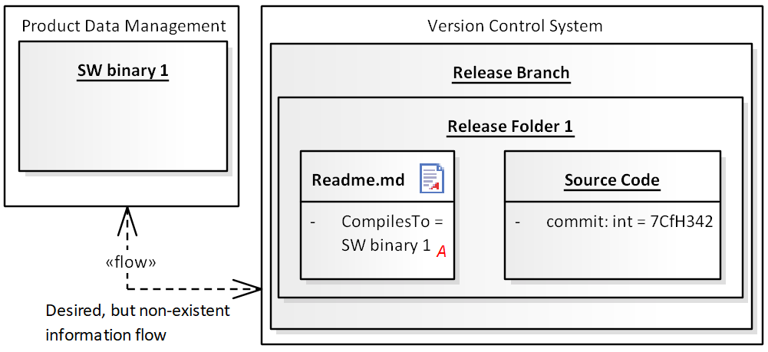
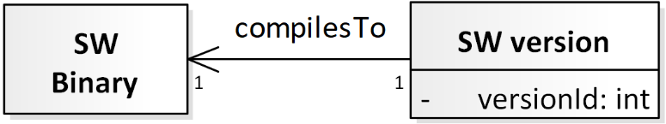
Two toolchain architectures
a)
Centralized-cache architecture
b)
Toolchain scenario: a) two tools, b) information model
G1: Define the semantics, and tool-authority
G2: Create unique digital representation
G3: Enable machine-based access and analysis
Distributed-cache architecture

Slide 18
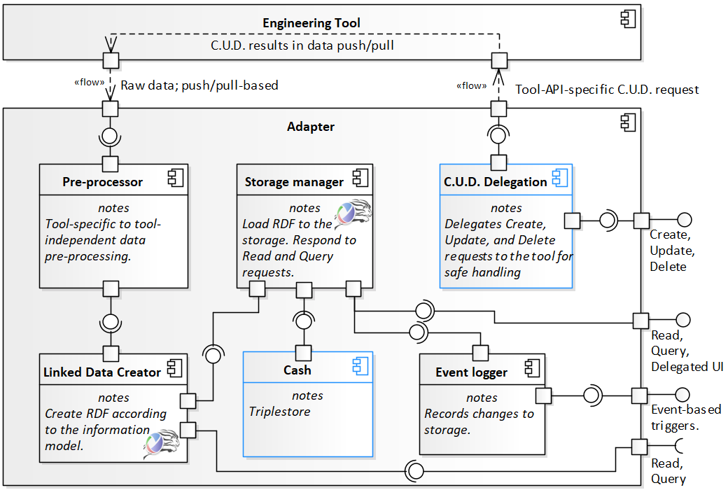
Adapter architecture

Slide 19
Discussion
Unclear which one of the two toolchain architectures should be adopted.
Separation of technical concerns should follow the organizational structure.
Information modeling was, and still is, very challenging.
Support for large-scale adoption of Semantic Web technologies is missing.

Slide 20
Summary
A four year industrial project about a web-based federated toolchain:
  Nine major lessons about technologies, development process, information modeling
  Two toolchain architectures, and a generic adapter architecture
Using our ideas leads to a service-oriented toolchain, based on information models, and semantic-web-based tool adapters
Future work is to get the authorities to accept a safety arguments produced by this toolchain.
Thank you!

