Slide 1
Formative feedback in basic mathematics courses
Maria Shamoun & Niclas Hjelm
CBH, Biomedical Engineering And Health Systems

Slide 2
Mathematics courses at Technical
Preparatory Year, Campus Flemingsberg.
The setting

Slide 3
We have changed the last lecture before the test (sv kontrollskrivning).
Traditionally the teacher solved last year’s test on the whiteboard. Now we instead do this…
What?

Slide 4
In class, students are supposed to evaluate teacher-provided solutions to typical exam questions. The solutions may be incomplete or contain errors; we call them fictitious student solutions (FSS) as they can exemplify common errors or misunderstandings occurring at the final exam. The student’s task is to a) Use rubrics to assign scores to the proposed solutions b) Improve the proposed solutions
What?

Slide 5
We have implemented the method like this:
1. Project a FSS on screen.
2. Are there errors / is something missing?
3. How to assess this solution? What is stated in the assessment instructions?
4. Do we need to change something to have a solution that gives maximum score? Are there other ways to solve this problem?
How?

Slide 6
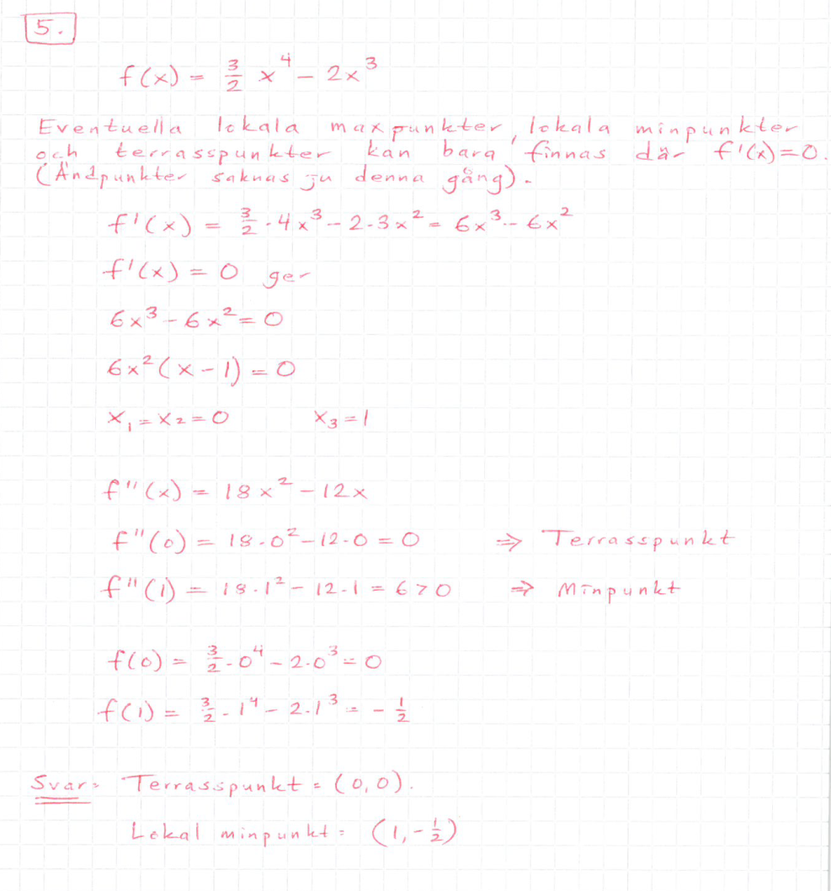
An example!

Slide 7
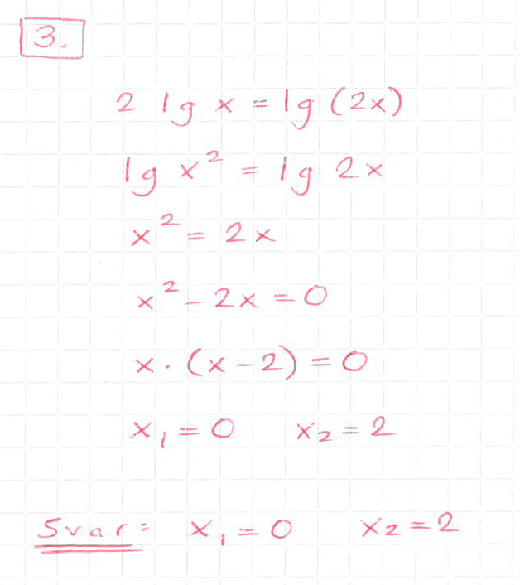
An example!

Slide 8
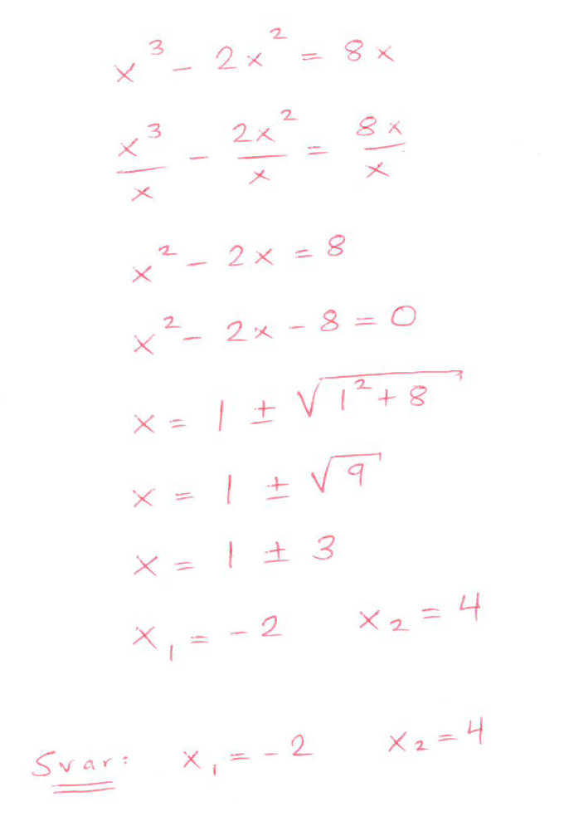
An example!

Slide 9
Community of Practice
The learning activity evaluation of fictitious student solutions was developed by the authors in 2017 and has in 2018-2019 also been used by two other colleagues. (The courses are given every semester, in two or three parallel groups, often with different teachers in spring and fall.)
The two others colleagues that have used FSS
have expressed that students were activated, and that they will use FSS in coming course rounds!

Slide 10
Effects?
Qualitative survey (2019). Both parallell groups, having different teachers, participated. The students were asked to respond to the statement "Todays exercise in evaluating fictious student solutions was...(1 = Not instructive at all, 5 = Very instructive )". Average=4.51 (35 respondents. No difference between groups.)
The authors have observed increased student activity during the sessions
The authors have observed reduced frequency of some types of errors at the final exam.
Notes:
Clearly reduced frequency of formal errors!

Slide 11
General conclusions
Can we activate the students even more?
Add peer learning – distribute the problems in advance, ask the students to bring their solutions to class and let them grade the solutions from a peer student!
Can this be used in other courses?
This can be used in plenty of courses. Important things to consider:
Do students need rubrics/guidelines for assessing the solutions?
How can the teacher moderate the discussion in an effective way?

Slide 12
References
Booth, J.L., Lange, K.E., Koedinger, K.R. & Newton, K.J. (2013). Using example problems to
improve student learning in algebra: Differentiation between correct and incorrect examples. Learning
and instruction, 25, 24-34.

