Slide 1
Creating Behavior Trees using Decision Tree design
An Introduction to Behavior Trees in AI (part 3)
by Petter Ögren
Notes:
Hello everyone!
In this video I will explain how to create backward chained Behavior Trees.
This is the second lecture in the series ”Introduction to Behavior Trees”.
And my name is Petter Ögren

Slide 2
Using Decision Tree design
Behavior Trees (BTs) Generalize Decision Trees (DT)
  every DT can be written in the form of a BT
If a DT design is appropriate - We can easily transfer it into a BT
But, since DTs do not allow return status from Actions/Subtrees we assume that all “leaves” of the DT always return “Running”
Why not just use a DT?
  Lack of return status reduces modularity
  A DT design might be used as a sub-tree of a larger BT, using other design principles (such as backward chaining)
Let’s see some examples…

Slide 3

Packman DT design
?
Ghost Close
→
Eat Pills
yes
no
Eat Pills
Ghost Close
Ghost Scared
?
yes
no
→
Avoid Ghost
Chase Ghost
Avoid Ghost
Ghost Scared
Chase Ghost

Slide 4
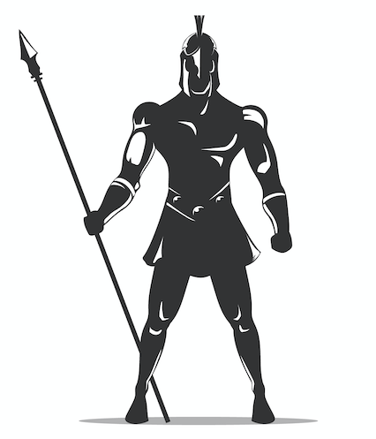
Warrior DT design
Enemy Nearby
yes
no
Enemy very close
Hungry
yes
no
yes
no
Attack
Health Low
Has Food
Tired
yes
no
yes
no
yes
no
Hide
Approach
Eat
Hunt
Sleep
Wander

Slide 5
Warrior DT design of BT
?
→
Enemy Nearby
?
?
→
→
Enemy very close
Attack
?
Hungry
?
?
5
→
Approach
→
Hunt
→
Wander
Health Low
Hide
Has Food
Eat
Tired
Sleep
5

Slide 6
Take home message
If action choices can be broken down into Yes/No cases
  Use DT design
If you want a deliberative system that pursues sub-goals
  Use Backward chaining designs (see other video)
Combine when needed…
Thanks for watching!
Designed by Freepik

