Slide 1
Behavior Trees vs FSMs
An Introduction to Behavior Trees in AI (part 4)
by Petter Ögren
Notes:
Hello everyone!
In this video I will explain how to create backward chained Behavior Trees.
This is the second lecture in the series ”Introduction to Behavior Trees”.
And my name is Petter Ögren

Slide 2


Similarities FSM - BT
Grasp
Recharge
Drop
Lock
Both answer the question: What to do next?
Walk
Unlock
Open
Pull
Close
Push
Search
Kick
Clean
Speak
Speak
Record
Run
Throw
Notes:
This abstraction of “Action” → Modularity

Slide 3
Pros and Cons
Finite State Machine (FSM)
Pros
  Easy to implement
  Easy to understand
Cons
  Does not scale well (n^2 transitions)
  GOTO analogy problem
  State feedback is optimal
    Next Action should only depend on current World State, not on current Action (FSM state)
Behavior Tree (BT)
Pros
  Modular (weak dependence between subtrees)
  Function call analogy
  Generalizes
    Decision Trees
    Subsumption architecture
    Teleo-reactive approach
Cons
  Somewhat harder to implement
  Somewhat harder to understand
Good for smaller problems!
Good for larger problems!

Slide 4
FSMs
Recharge
Lock
Grasp
Speak
Unlock
Pull
Open
Walk
Push
Kick
Drop
Close
Search
Speak
Finite State Machine
Clean
Record
Each action needs to know “What to do next”…
Notes:
256 transitions (49 transitions)
This is very natural to humans.
This is how we teach stuff
(after opening the bottle, you pour the water into the glas)

Slide 5
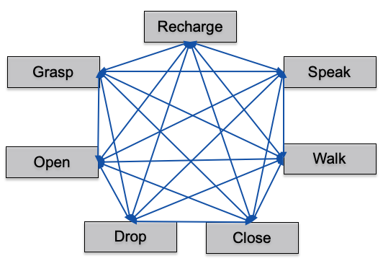
Pros and Cons
Finite State Machine (FSM)
Pros
  Easy to implement
  Easy to understand
Cons
  Does not scale well (n^2 transitions)
  GOTO analogy
  State feedback is optimal
    Next Action should only depend on current System State, not on current Action

Slide 6
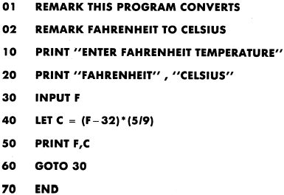
GOTO analogy
Problem 1: (50 years ago)
“The GOTO statement should be abolished from all higher level programming languages”
  Paper by E. Dijkstra, 1968
Reason: GOTO harms Modularity
Solution: GOTO not used anymore
Problem 2:
Finite State Machines are full of GOTO statements (transitions)

Slide 7

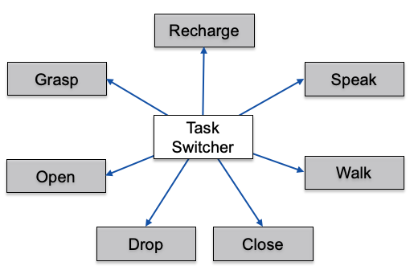
State Feedback is Optimal
From Reinforcement Learning
The optimal policy is a function of the world state s
It does not depend on the previous action (the internal FSM-state)
The optimal transition structure is identical for all FSM-states
A degenerate FSM…
s

Slide 8
Pros and Cons
Behavior Tree (BT)
Pros
  Modular (weak dependence between subtrees)
  Function call analogy
  Generalizes
    Decision Trees
    Subsumption architecture
    Teleo-reactive approach
Cons
  Somewhat harder to implement
  Somewhat harder to understand
(parent)
Success,
Failure,
or Running
(tick)
Grasp
Behavior Tree
Each action needs to know “Did I Succeed or Fail?”

Slide 9
Pros and Cons
Bye!
Finite State Machine (FSM)
Pros
  Easy to implement
  Easy to understand
Cons
  Does not scale well (n^2 transitions)
  GOTO analogy
  State feedback is optimal
    Next Action should only depend on current World State, not on current Action (FSM state)
Behavior Tree (BT)
Pros
  Modular (weak dependence between subtrees)
  Function call analogy
  Generalizes
    Decision Trees
    Subsumption architecture
    Teleo-reactive approach
Cons
  Somewhat harder to implement
  Somewhat harder to understand
Designed by pch.vector / Freepik
Good for smaller problems!
Good for larger problems!

