Slide 1
Behavior Trees that avoid checking All conditions All the time
An Introduction to Behavior Trees in AI (part 5)
by Petter Ögren
Notes:
Hello everyone!
In this video I will explain how to create backward chained Behavior Trees.
This is the second lecture in the series ”Introduction to Behavior Trees”.
And my name is Petter Ögren

Slide 2
Common question about checking conditions
How often should conditions be checked?
Can the sensor processing be done in parallel?
Will it work for large BTs?
What about conditions that are difficult to check?
You decide! (how fast reactions are needed?)
Yes! ✅
Yes! ✅
Think of it as “beliefs”…
Let’s look at an example…

Slide 3
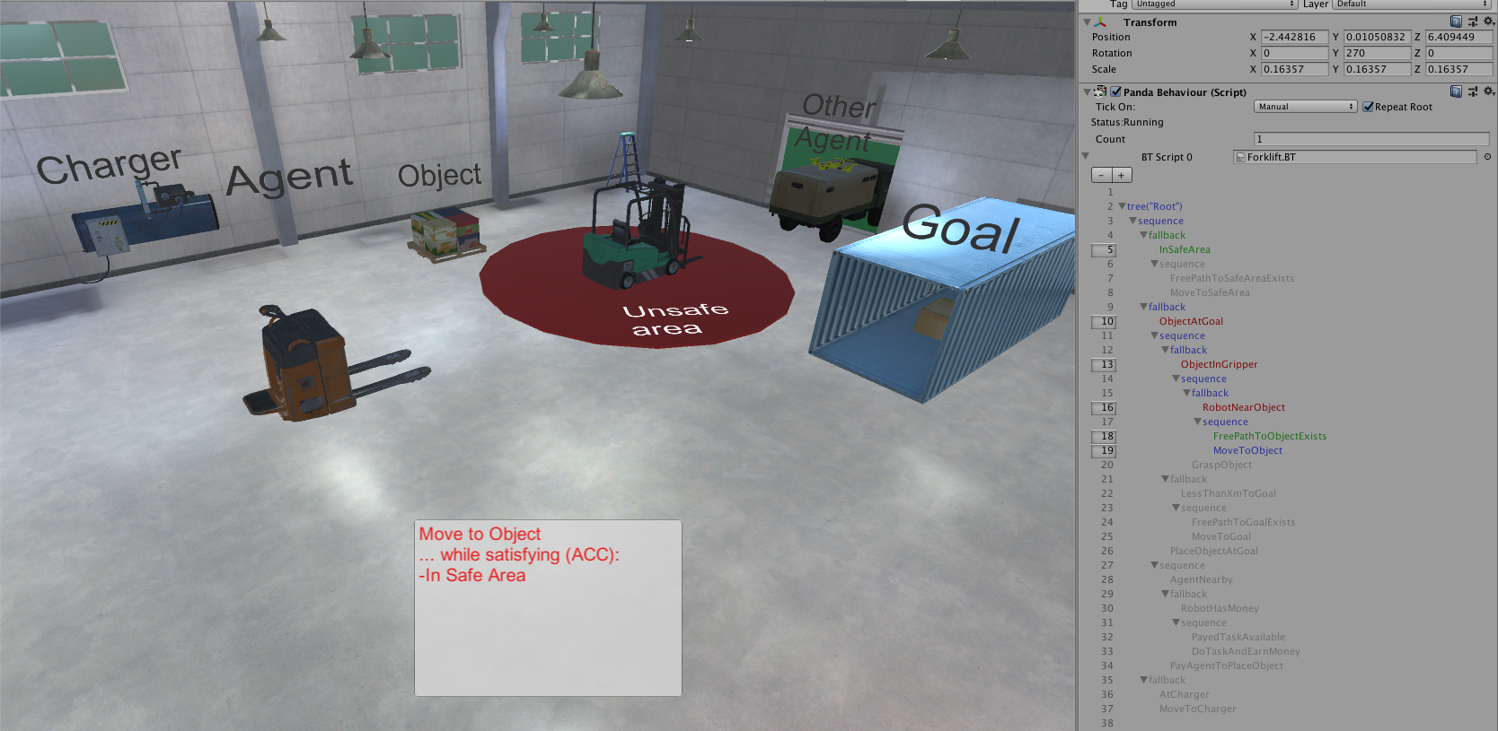
The example

Slide 4
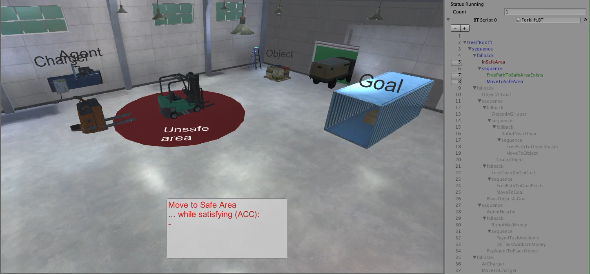
The example
Success
Running
Failure

Slide 5
The Backward Chained Behavior Tree (separate video)

Slide 6
Can use a bit vector
1
1
0
0
1
1
0
1
0
1
0
Think of as Belief
Separate checking condition in BT from updating Belief
Ticking only when needed (event based)
Update options
  in same thread (if fast)
  in separate thread
  update frequency?
    as often as possible
    with given (other than tick) frequency
    when uncertainty/risk too big (active sensing)
      long time since last check
      consequence of error big

Slide 7
Event based ticking
1
1
0
0
1
1
0
1
0
1
0
Idea:
  if nothing changes we do not need to tick the BT
Only tick when
  Bit vector changes
  Action returns success/failure
  (i.e. an event occurs)
Event based ticking instead of frequency based

Slide 8
Active Sensing
Update…
  when uncertainty/risk too big
    long time since last check
    consequence of error big

Slide 9

Conclusions
1
1
0
0
1
1
0
1
0
1
0
How often should conditions be checked?
Can the sensor processing be done in parallel?
Will it work for large BTs?
What about conditions that are difficult to check?
You decide! (how fast reactions are needed?)
Yes! ✅
Yes! ✅
Think of it as “beliefs”
Bye!
Designed by pch.vector / Freepik

