Slide 1
Why Behavior Trees are Optimally Modular
(have Unit Essential Complexity)
An Introduction to Behavior Trees in AI (part 7)
by Petter Ögren
Notes:
Hello everyone!
In this video I will explain how to create backward chained Behavior Trees.
This is the second lecture in the series ”Introduction to Behavior Trees”.
And my name is Petter Ögren

Slide 2
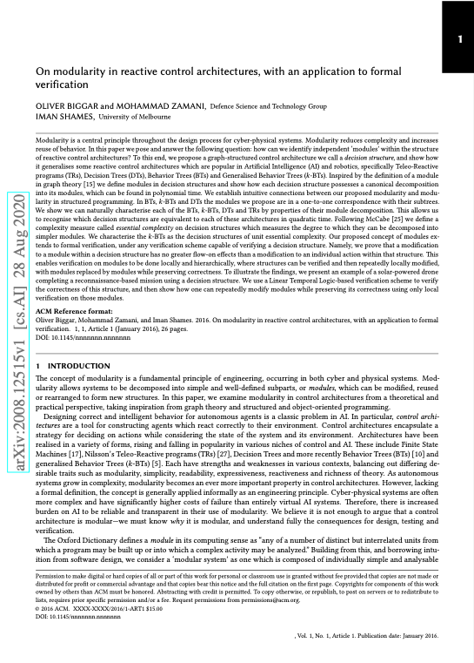
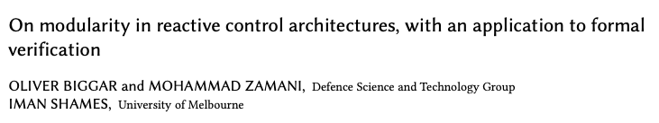
This video is based on the work of Biggar, Zamani and Shames
Notes:
DST and Melbourne University

Slide 3
Outline
Modularity
Decision Structures (generalizes BTs)
Modular decomposition of Graphs
Modular decomposition of Decision Structures (and BTs)
Measures of complexity
  Cyclomatic complexity
  Essential complexity (taking modules into account)
Main result: BTs are optimally modular (have unit essential complexity)

Slide 4

Modularity is important
Intelligent systems are often complex
Complexity drives cost of development and testing
Modularity is a key principle for handling complexity
  create simple subparts (modules) with well defined interfaces
  build complex systems from modules
  develop, test, reuse, replace, update modules (not entire system)

Slide 5
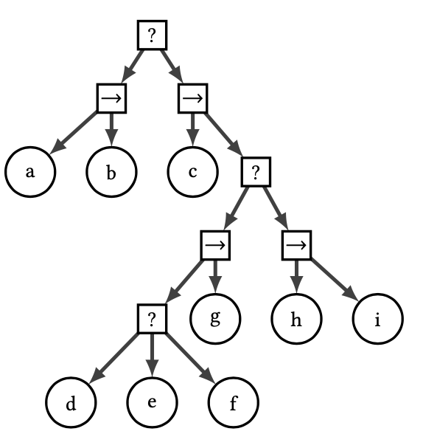
How Modular are BTs?
One of the key advantages of BTs is modularity
Tick and return status are similar to Function Calls
Can we measure modularity?
  Yes!
How Modular are BTs?
  Optimally modular!
Any Decision Structure with Essential Complexity 1 is equivalent to a BT!
Let’s look at the details…

Slide 6
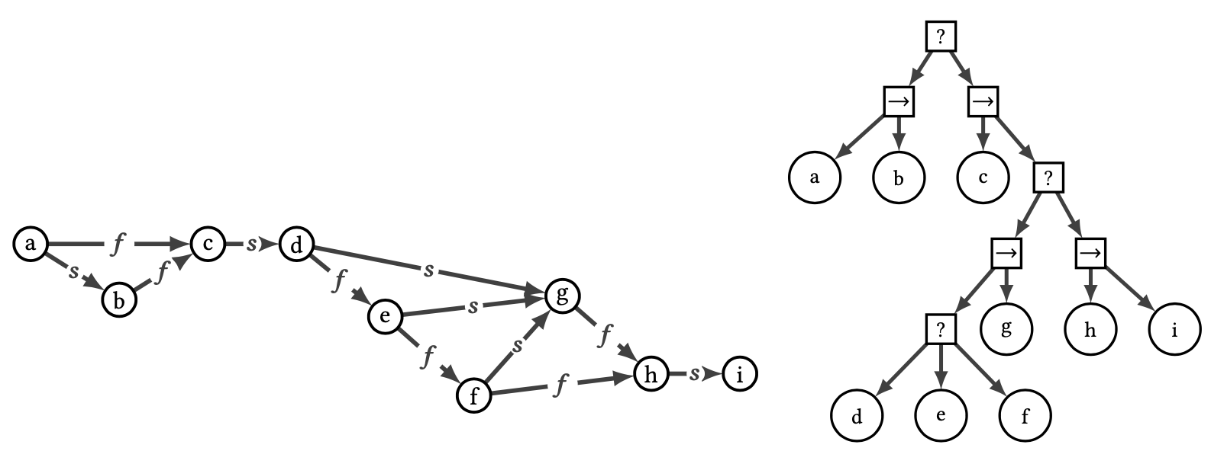
Converting a BT to a Decision Structure (DS)
Each “tick” starts from (a)
  very important, the DS is not an FSM
If return status is “running” that node executes
  no arcs are labeled “running”
Else follow s/f arc and repeat
  If arc is missing then idle (BT returns s/f)

Slide 7

Why use decision structures (DS)?
DSs generalize many structures
  BTs, Decision Trees, and the Teleo-Reactive approach
DSs can capture structures that are not realizable by BTs
DS have unique representations
  BTs do not: (a->(b->c)) and ((a->b)->c) are equivalent
Enables formal analysis of modularity…
Key idea: Labels of out arcs provide metadata of action execution
  Note that arbitrary many labels can be used (BTs use 2: s/f)

Slide 8
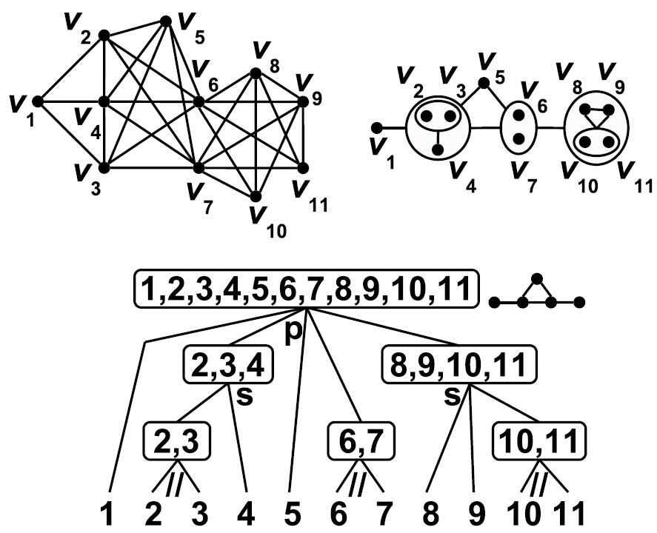
Module Decomposition of a Graph
A module has uniform interface to rest of graph
Subgraphs are Factors
Can form Quotient Graph
…

Slide 9
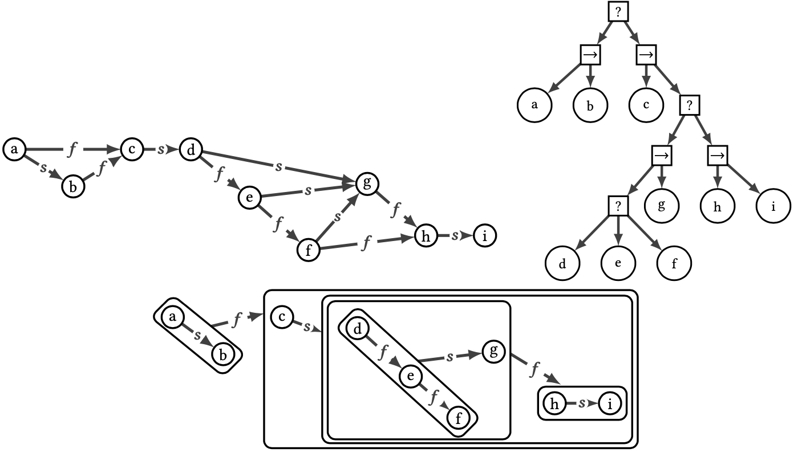

Module Decomposition of DS
A module X
In-edge
  goes to Source in X
Out-edge
  same label goes to same vertex
  use out-edge when no internal edge with that label

Slide 10
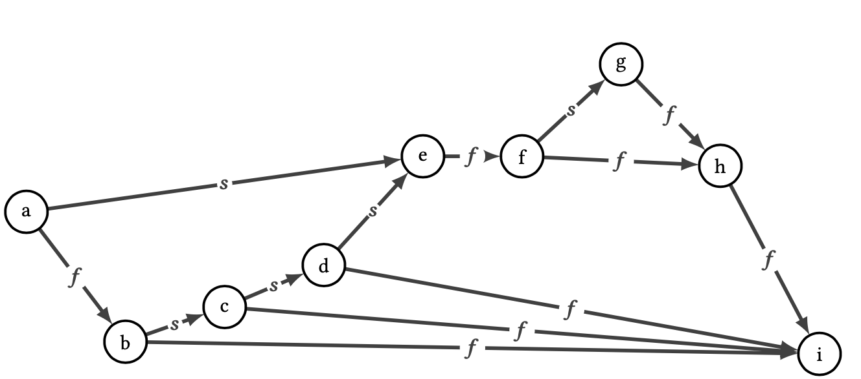
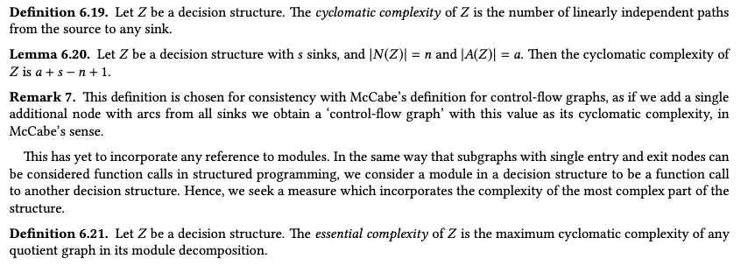
Cyclomatic Complexity (CC)
CC=6
Linear independent paths
  cannot be created by linear combinations of the others
CC
  Count number of linearly independent paths
  CC = a - n + s + 1
  (arcs) - (nodes) + (sinks) + 1
source
sink

Slide 11
Cyclomatic Complexity (CC)
Linear independent paths
  cannot be created by linear combinations of the others
CC
  Count number of linearly independent paths
  CC = a - n + s + 1
  (arcs) - (nodes) + (sinks) + 1
CC=5
source
sink

Slide 12
Essential complexity (after applying modularity)
CC_{TOT}=5
CC=1
Essential complexity: Maximum cyclomatic complexity of any quotient graph in its module decomposition
Module decomposition
  Find P as
    Maximal partition (if unique)
      Partition such that no module is subset of another module except Z
    Longest path partition (else)
  Construct quotient graph Z/P
  Repeat on each factor
EC=max(CC)=1
CC=1
CC=1
CC=1

Slide 13
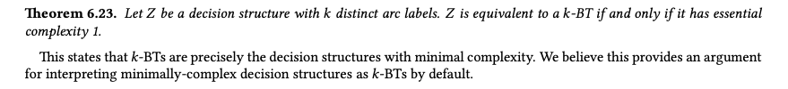
BTs have minimal complexity (after applying modularity)
CC=1
CC=1
CC=1
CC_{TOT}=5
CC=1
EC=max(CC)=1

Slide 14
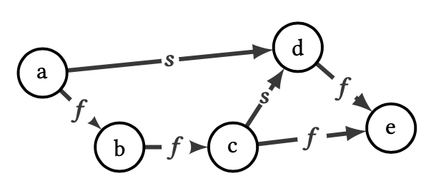
Complexity of other Decision Structures
CC_{TOT}=3
EC=max(CC)=2
Thus, this DS cannot be written as a BT

Slide 15
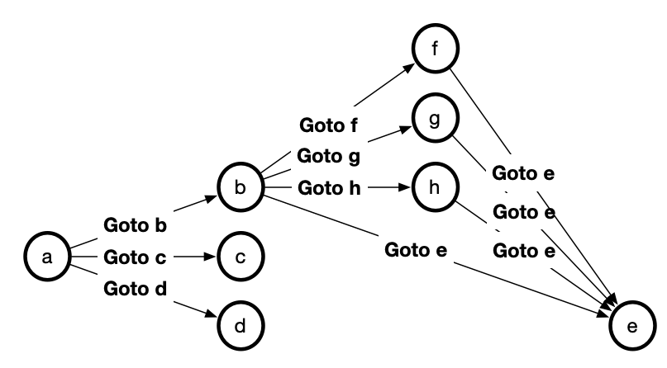
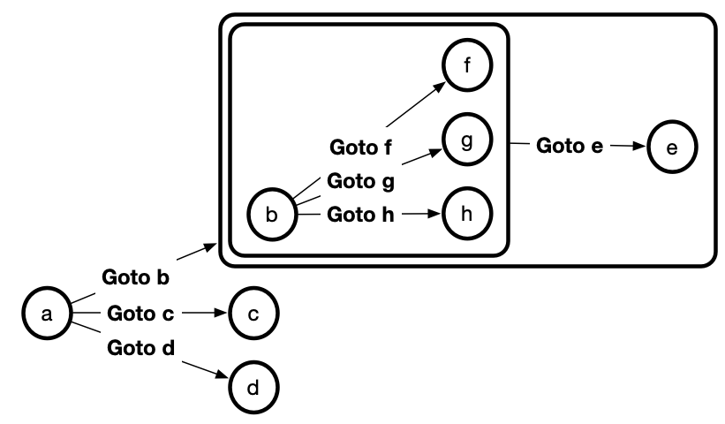
Complexity of other Decision Structures
CC_{TOT}=6
EC=max(CC)=3
CC=3
CC=3

Slide 16
Modularity is important
Intelligent systems are often complex
Complexity drives cost of development and testing
Modularity is a key principle for reducing complexity
  create simple subparts (modules) with well defined interfaces
  build complex systems from modules
  develop, test, reuse, replace, update modules (not entire system)
BTs have Essential Complexity=1
Notes:
EC = 1
This means that even though the Decision Structure or BT looks complex, you can always collapse the structure into a set of modules and submodules, and on each level of detail, the structure you get is actually quite simple.
The fact that you can divide the structure into all these modules, enables us to say that the structure itself is modular.
And to clarify that not all DS have this high degree of modularity, we also looked at two examples with an Essential Complexity > 1.

Slide 17

Thank you for watching…
Notes:
We hope we have provided some answers to the questions:
What is a behavior tree?
When are they useful?

