Slide 1
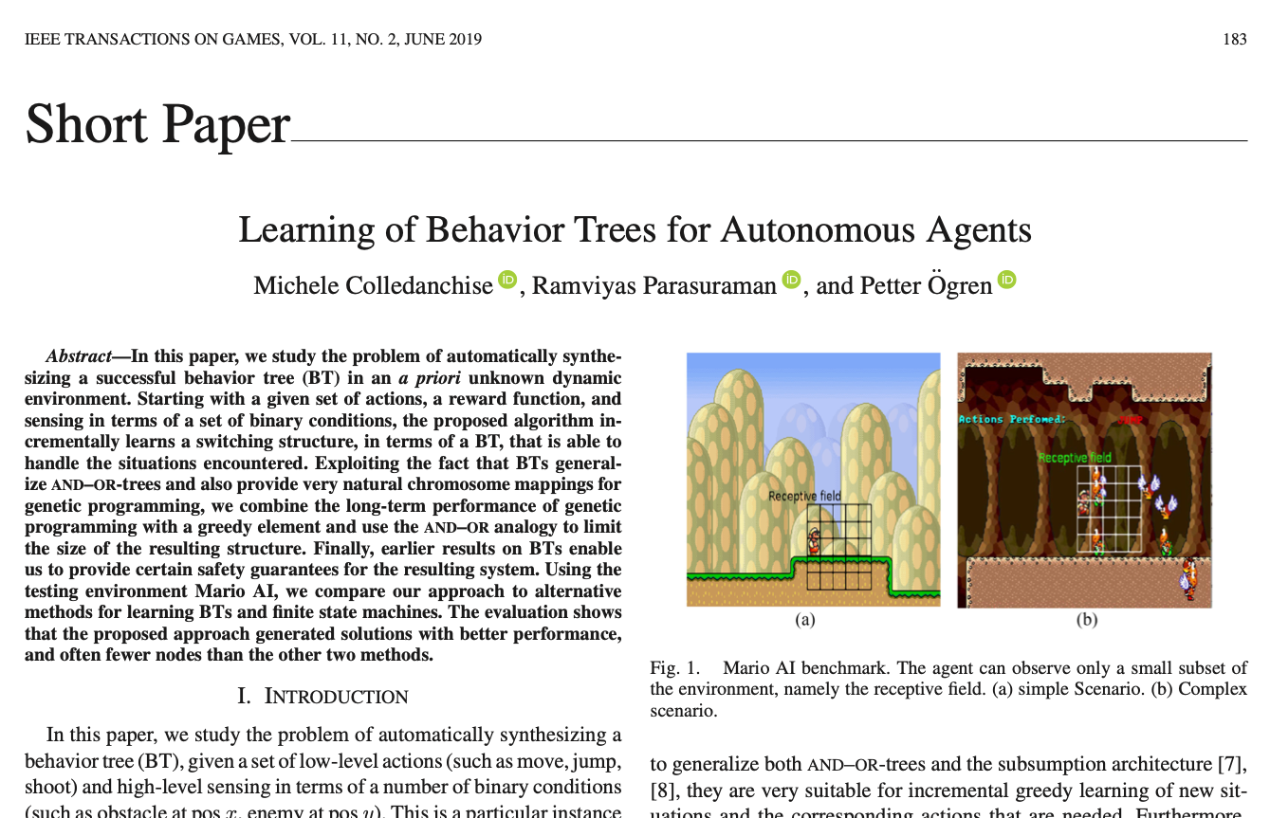
Learning Behavior Trees using Genetic Algorithms
An Introduction to Behavior Trees in AI (part 8)
by Petter Ögren
Notes:
Hello everyone!
In this video I will explain how to create backward chained Behavior Trees.
This is the second lecture in the series ”Introduction to Behavior Trees”.
And my name is Petter Ögren

Slide 2
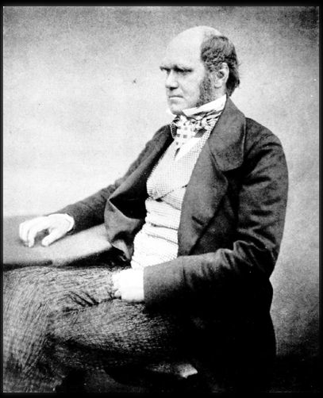
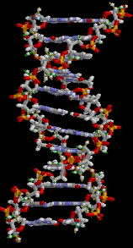
Genetic Algorithms
Mutation
(small random changes)
Applies to
  Viruses
  Humans
  Any Optimization problem
  Behavior Trees
Iterate…
fitness
Pick a (random) starting generation
Crossover (breed new)
design
Select the best

Slide 3
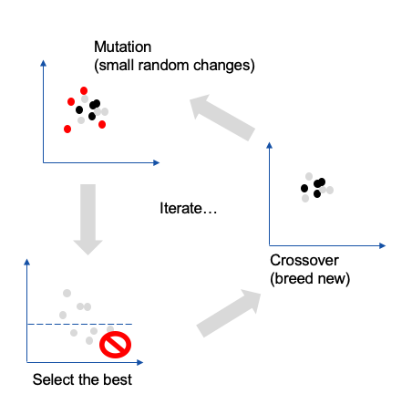
What is needed to apply GA?
DNA (solution representation)
Fitness function
Selection
  Best X%
  Higher fitness → Higher probability
Crossover function
  Create new from two existing
Mutation function
  Make “small” changes
Works well if
  “small design changes give small performance changes”
Rothlauf F, Oetzel M. 2006. On the locality of grammatical evolution. In European Conference on Genetic Programming. Springer
Notes:
It has been shown that locality, in terms of small changes in design giving small changes in performance, is important for the performance of evolutionary algorithms (41)
Rothlauf F, Oetzel M. 2006. On the locality of grammatical evolution. In European Conference on Genetic
Programming, pp. 320–330. Springer

Slide 4
Crossover on a FSM?
Recharge
Grasp
Speak
Open
Walk
Drop
Close
Recharge
Throw
Walk
Crossover is non-trivial on a Finite State Machine…
Open

Slide 5
Crossover on a BT?
?
→
→
→
i
?
l
m
?
?
?
j
k
→
c
d
→
g
h
a
b
e
f

Slide 6
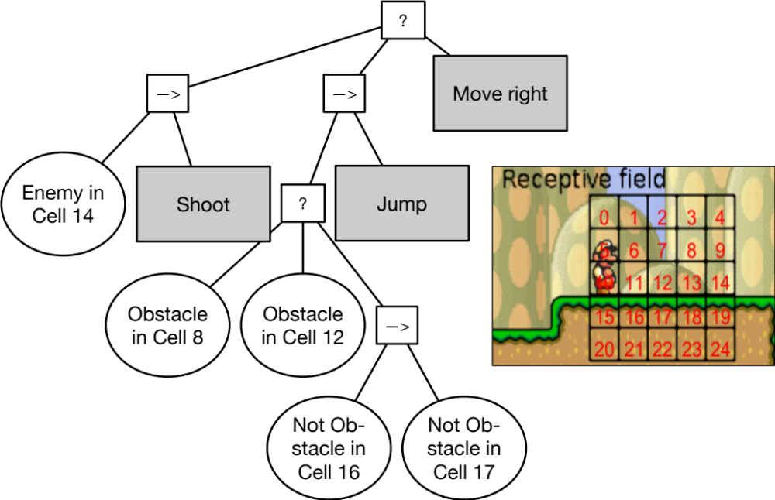
Mario AI

Slide 7
Bloating is often a problem
Bloating
  “Increase in mean program size without a corresponding improvement in fitness”
Lose readability
How can we remove “useless” subtrees?
  Random pruning with fitness test
  Check for empty operating regions
  Exploit And-Or analogy on conditions
→
?
?
?
→
→
→
→
?
?
→
→

Slide 8
Random pruning with fitness test
Pick random subtree
Remove it
See if fitness is the same
Iterate…
→
?
?
?
→
→
→
→
?
?
→
→

Slide 9
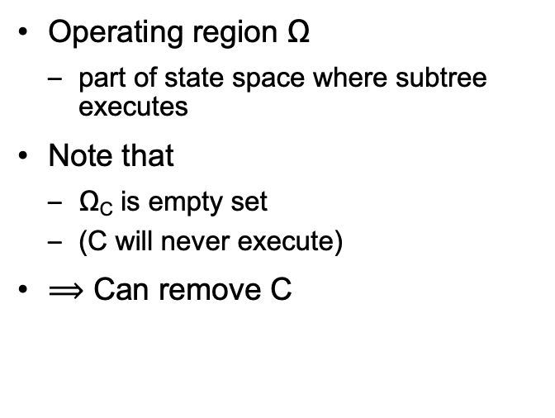
Check for empty operating region
Operating region Ω
  part of state space where subtree executes
Note that
  Ω_{C} is empty set
  (C will never execute)
$⟹$ Can remove C
?
→
→
→
x > 0
Do A
y > 0
Do B
x > 0
Do C

Slide 10
Exploit And-Or analogy on conditions
If same action (subtree) appears several times
Merge pre-conditions as And-Or expression
→
?
x > 0
y > 0
z > 0
Do A
?
→
→
→
x > 0
Do A
y > 0
Do A
z > 0
Do A

Slide 11
Mario AI

Slide 12
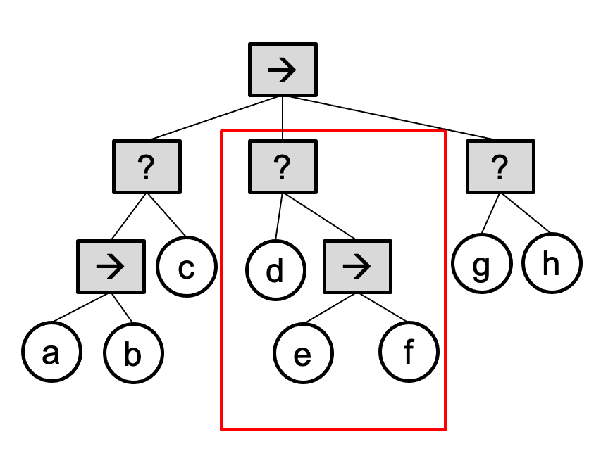
Genetic Algorithms
Good way of optimizing BT structure
Easy
  BT → DNA
  Cross over and mutation
Avoid bloating
  Random pruning with fitness test
  Check for empty operating region
  Exploit And-Or analogy on conditions

Slide 13

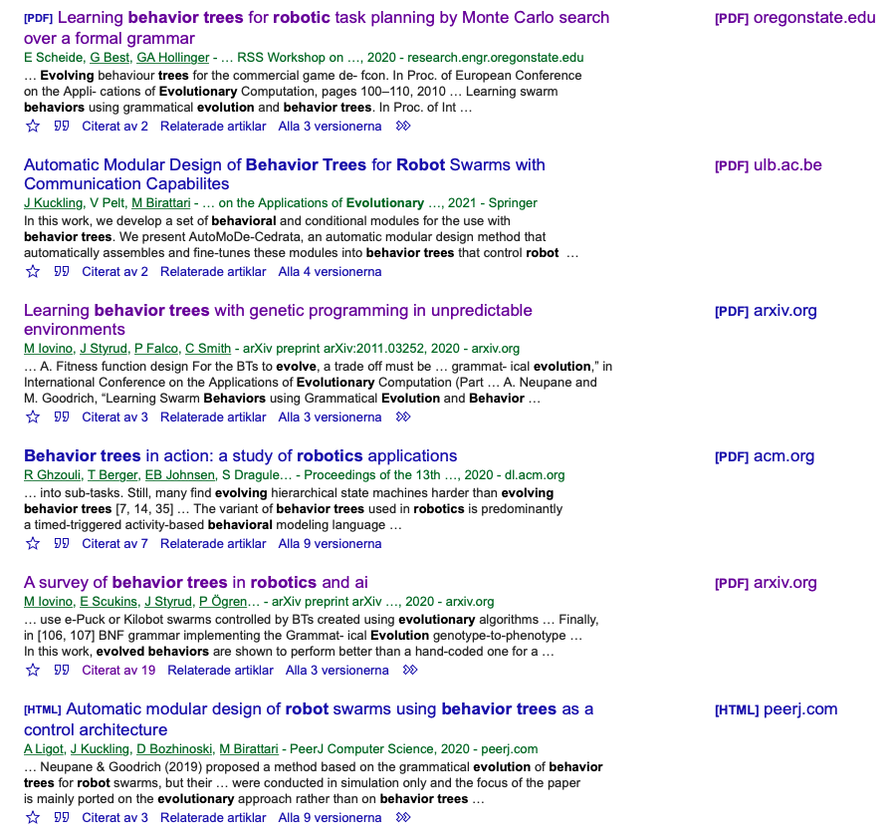
Thank you for watching…
Notes:
We hope we have provided some answers to the questions:
What is a behavior tree?
When are they useful?

