Slide 1
Behavior Trees and Explainable AI
Why naming subtrees is a good idea
An Introduction to Behavior Trees in AI (part 11)
by Petter Ögren
Notes:
Hello everyone!
In this video I will explain how to create backward chained Behavior Trees.
This is the second lecture in the series ”Introduction to Behavior Trees”.
And my name is Petter Ögren

Slide 2
Explainable AI (XAI)
Two types of explanation:
Proactive
  I do X because I want Y to be true
Reactive
  I do X because Z is true
Trust in AI can either be too high or too low
  This is odd, but I’m sure there is a good reason…
  This system sucks, I’ll ignore it …
If decisions of the AI can be explained, users can:
  agree when decision makes sense
  notice when decision does not make sense
    assumptions not valid
    corner case
  Human can build proper trust in AI
  Human can predict AI actions → Collaborate more efficiently
Notes:
yes it’s Thursday, but it also happens to be Thanksgiving, so everyone will be at home eating turkey
I'm going home - because I want to eat
I'm going home - because its 6pm

Slide 3

Human-Autonomy Teaming Guidelines (Endsley 2015)
The AI should:
Be congruent with how humans parse problems and form solutions
Avoid anthropomorphism (human face)
Be transparent and traceable
  “the system must be able to explicitly explain its reasoning in a concise and usable format”.
Support robust visualizations
  at different levels of resolution and abstraction
Enable self health assessment (info updated)
Support joint training
Backward Chained BTs
Decision Tree designs
All BTs

Slide 4
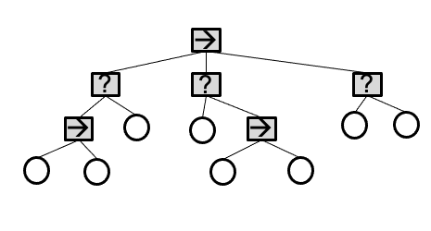
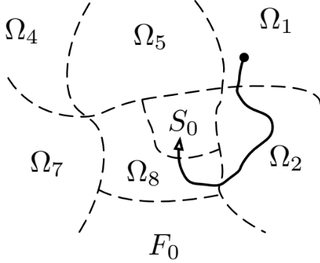
Can a BT provide explanations?
We can see what conditions returned True/False…
We can see what Operating region the state is in…
What about Hierarchies and Modularity?
  Few dependencies between subtrees (modules)
    Explanation should be found in current subtree
  Natural hierarchical order of actions
    Prepare food – Get Milk – Open Fridge – Grasp Handle
  How do we use this?
Does the BT design principle matter?
  yes…

Slide 5

Warrior BT using Decision Tree design
?
→
Enemy Nearby
?
?
→
→
Enemy very close
Attack
?
Hungry
?
?
5
→
Approach
→
Hunt
→
Wander
Health Low
Hide
Has Food
Eat
Tired
Sleep
Designed by Freepik
5

Slide 6
Give Names to subtrees!
?
→ (Enemy Nearby)
Enemy Nearby
? (Enemy not Nearby)
Reactive
(the objective is implicit…)
?
→ (Enemy very close)
→ (Hungry)
Enemy very close
? (Enemy not very close)
Hungry
?
? (Not hungry)
Attack
6
→ (Health Low)
Approach
→ (Has Food)
Hunt
→ (Is Tired)
Wander
Health Low
Hide
Has Food
Eat
Tired
Sleep
(Health High)
(No food)
(Not tired)
6

Slide 7
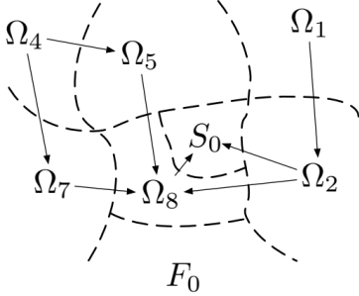
Explanations from operating regions?
Reactive…
S₀: Object at goal
Ω₂: Object not at goal, in hand
Ω₃: Object not at goal, not in hand, near agent
Ω₄: Object not at goal, not in hand, not near agent
1
0
?
4
Object at goal
Goto Object
2
3
→
→
Object in hand
Drop object at goal
Near Object
Grasp Object
Notes:
We can do Markov chain analysis if only drop at 10% of attempts

Slide 8
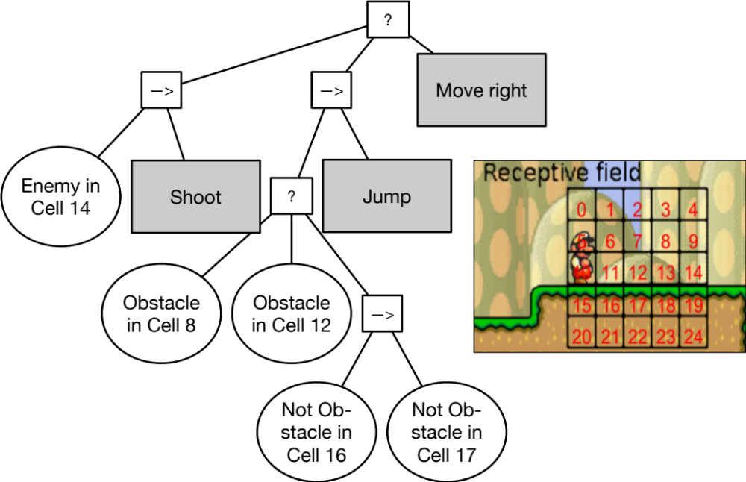
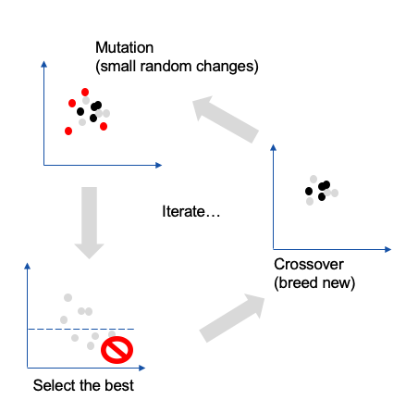
Genetic Algorithms can produce “unstructured” designs
(Anti-bloating by collecting conditions helped a lot)

Slide 9
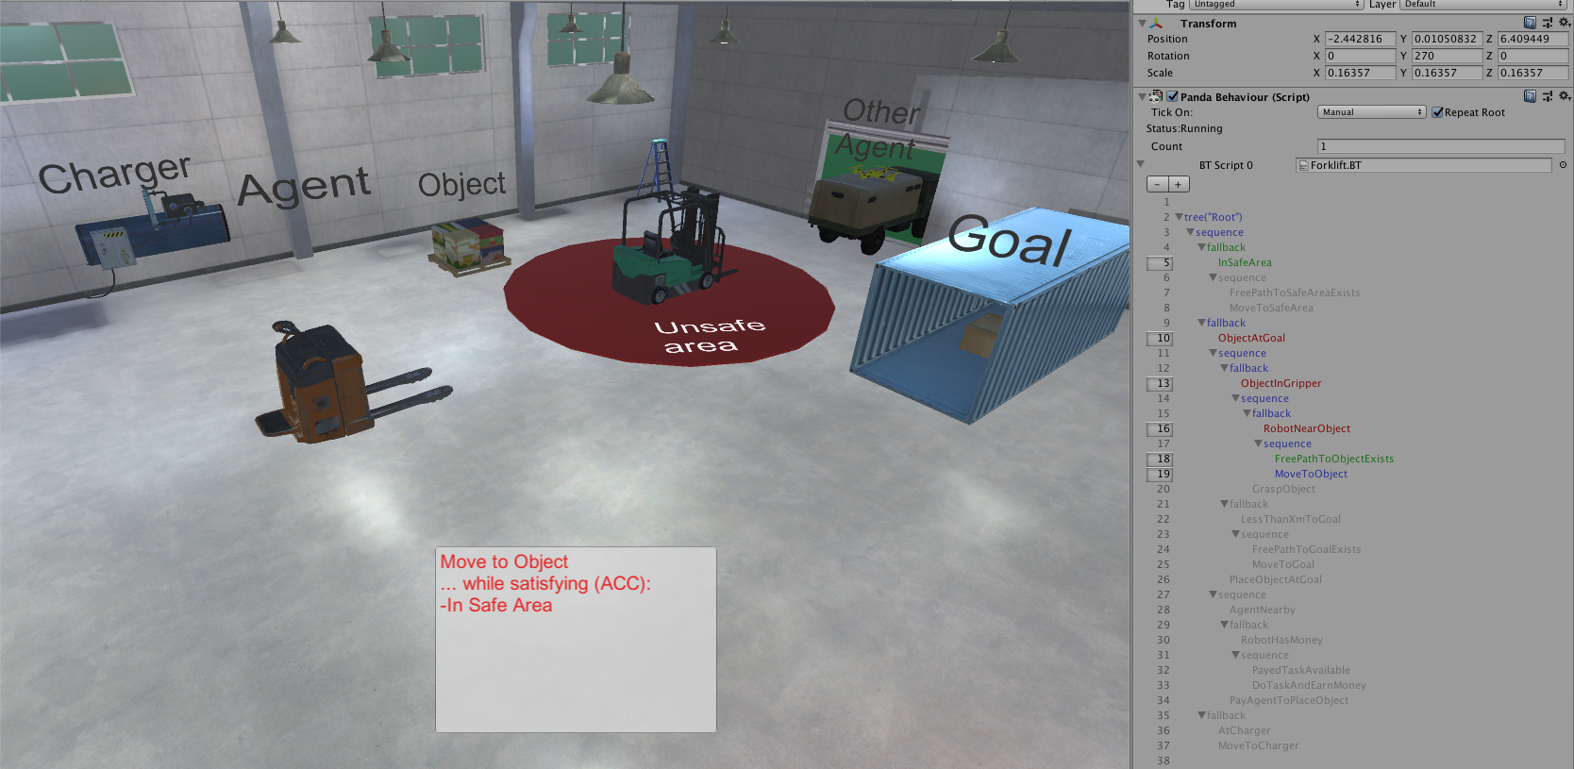
Backward Chained BTs

Slide 10
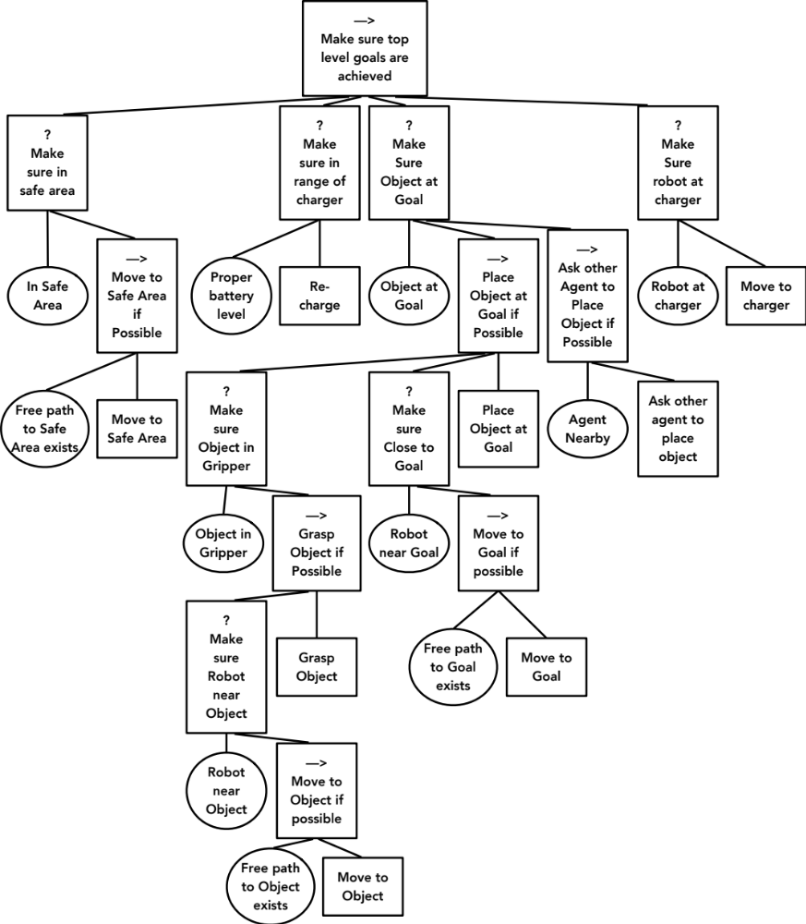
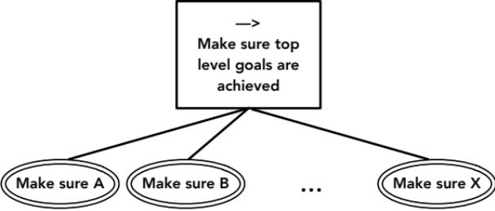

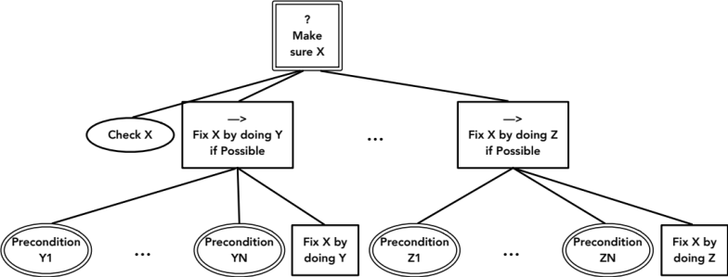
Backward chaining…
Proactive!
Note: All subtrees have descriptive names
Notes:
Make sure we have icecream
Check if we have icecream
Buy ice cream

Slide 11
Explainable?
Action: Move to object
Why: (read bottom up)
  ? Make sure object at goal
  → Place object at goal if possible (to)
  ? Make sure object in gripper (to)
  → Grasp Object if possible (to)
  ? Make sure robot near object (to)
  → Move to Object if possible (to)
reading just fallbacks also works (less text)
  ? Make sure object at goal
  ? Make sure object in gripper (to)
  ? Make sure robot near object (to)
This works at any level of detail/abstraction
Notes:
We hope we have provided some answers to the questions:
What is a behavior tree?
When are they useful?

Slide 12


Explainable?
Action: Move to Goal
Why:
  Subgoals (ACCs) achieved:
    In Safe area
    Proper battery level
    Object in gripper
  Current action
    Move to Goal (to)
    Make sure robot close to goal (to)
    Make sure object at goal
  Subgoals to be addressed:
    Robot at charger
Notes:
We hope we have provided some answers to the questions:
What is a behavior tree?
When are they useful?

Slide 13
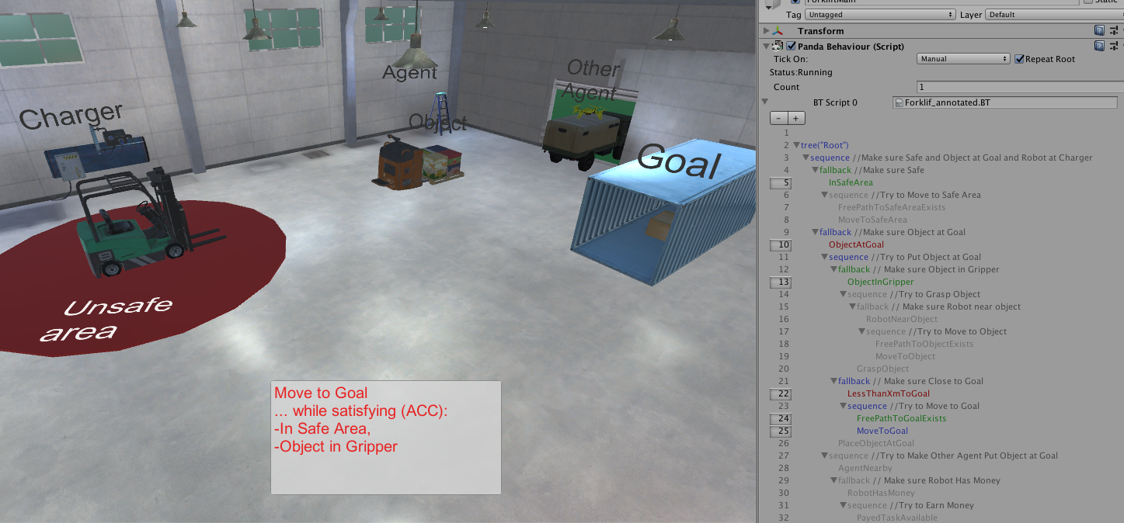
Explainable?
Action: Move to Goal
Why:
  Subgoals (ACCs) achieved:
    In Safe area
    Proper battery level
    Object in gripper
  Current action
    Move to Goal (to)
    Make sure robot close to goal (to)
    Make sure object at goal
Notes:
We hope we have provided some answers to the questions:
What is a behavior tree?
When are they useful?

Slide 14
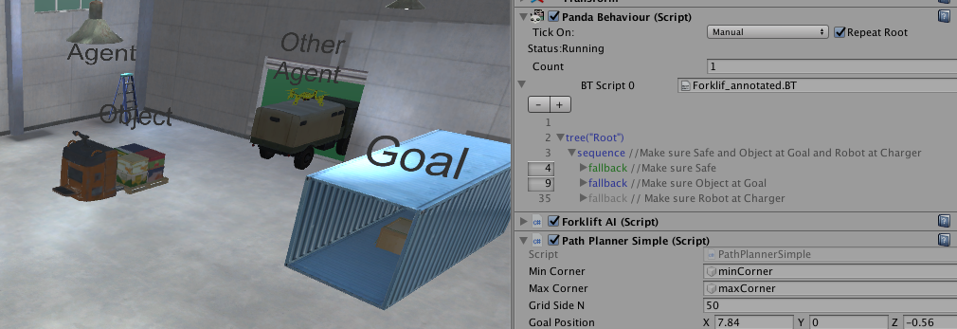
Different levels of abstraction?
Collapse subtrees that are not interesting
Notes:
We hope we have provided some answers to the questions:
What is a behavior tree?
When are they useful?

Slide 15
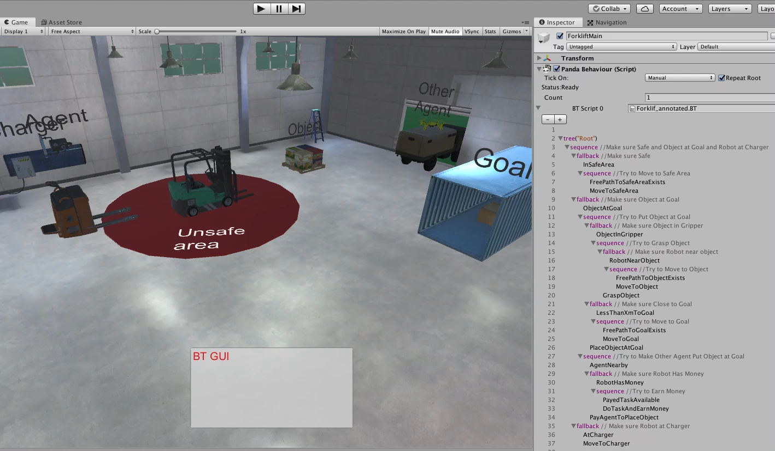
Running the example…
Notes:
We hope we have provided some answers to the questions:
What is a behavior tree?
When are they useful?

Slide 16
Human-Autonomy Teaming Guidelines (Endsley 2015)
The AI should:
Be congruent with how humans parse problems and form solutions
Avoid anthropomorphism (human face)
Be transparent and traceable
  “the system must be able to explicitly explain its reasoning in a concise and usable format”.
Support robust visualizations
  at different levels of resolution and abstraction
Enable self health assessment (info updated)
Support joint training

Slide 17

Thank you for watching…
Notes:
We hope we have provided some answers to the questions:
What is a behavior tree?
When are they useful?

