Slide 1
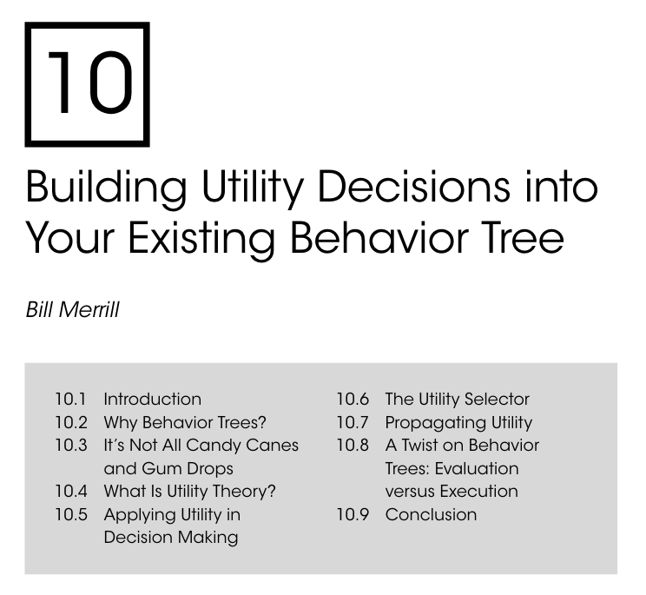
Utility Behavior Trees
An Introduction to Behavior Trees in AI (part 12)
by Petter Ögren
Notes:
Hello everyone!
In this video I will explain how to create backward chained Behavior Trees.
This is the second lecture in the series ”Introduction to Behavior Trees”.
And my name is Petter Ögren

Slide 2



Utility BTs
The order of siblings in a BT is
  important
  fixed
Can we change the order on the fly?
  Yes: Utility BTs
  Fallbacks (most of the time)
  Sequences (sometimes)
?
→
→
→
Health low
Retreat
Enemy far
Use longbow
Enemy close
Use sword
2
Notes:
Transparent: Chris Paxton
Provably robust: Francesco Rovida

Slide 3

Drawbacks of fixed order…
What if enemy has even lower health?
What if you have your back against the wall?
What if enemy has no long range weapons?
What if …?
What if we could measure the utility of each option?
Then we just choose the best one!
?_{U}
utility value
utility value
→
→
→
utility value
Health low
Retreat
Enemy far
Use longbow
Enemy close
Use sword
3
Notes:
Transparent: Chris Paxton
Provably robust: Francesco Rovida

Slide 4

Utility?
What if we could measure the utility of each option?
Then we just choose the best one!
What is the utililty of an action?
  Fast is good! (1/ completion time)
  Cheap is good (1/cost)
  Success is good (P(success) )
  Reward is good
  ”something reasonable”
A
B
C
?_{U}
utility value
utility value
utility value
→
→
→
Health low
Retreat
Enemy far
Use longbow
Enemy close
Use sword
4
Notes:
Fast: Get food by going to store A, B, C
Cheap: (same)
Success
Rare Brazilian Tomatoes

Slide 5

Success is good (Hannaford 2016)
What if we could measure the utility of each option?
Then we just choose the best one!
Keep track of attempts and successful attempts
Estimate success probability
(condition on sensor data)
A
B
C
?_{U}
= $\frac{\#successes}{\#attempts}$
utility value
utility value
utility value
Shop at Store A
Shop at Store B
Shop at Store C
5
Notes:
Rare Brazilian Tomatoes
Wider selection --> success
What if store is closed
Opening hours --> success

Slide 6
Reward is good
What if we could measure the utility of each option?
Then we just choose the best one!
What is the utililty of an action?
What if we have access to a reward…
Use: Expected accumulated future reward of an action
  Solve RL problem:
  Solve MCTS problem
  …
?_{U}
utility value
utility value
utility value
→
→
→
Health low
Retreat
Enemy far
Use longbow
Enemy close
Use sword
6
Notes:
q_\pi(s,a)=\mathbb{E}_\pi[\Sigma_{k=0}^\infty \gamma^k R_{t+k+1}|S_t=s, A_t=a]
discount factor gamma

Slide 7


Can we aggregate Utility up the BT?
Cost
  fallback: smallest
  sequence: sum
Time
  same as cost
Success probability
  sequence:
  fallback:
Reward?
  unclear
  RL assumes running forever
  possibly as above
utility value
→ _{U}
utility value
utility value
Eat
?_{U}
utility value
utility value
utility value
Shop at Store A
Shop at Store B
Shop at Store C
Notes:
Transparent: Chris Paxton
Provably robust: Francesco Rovida

Slide 8
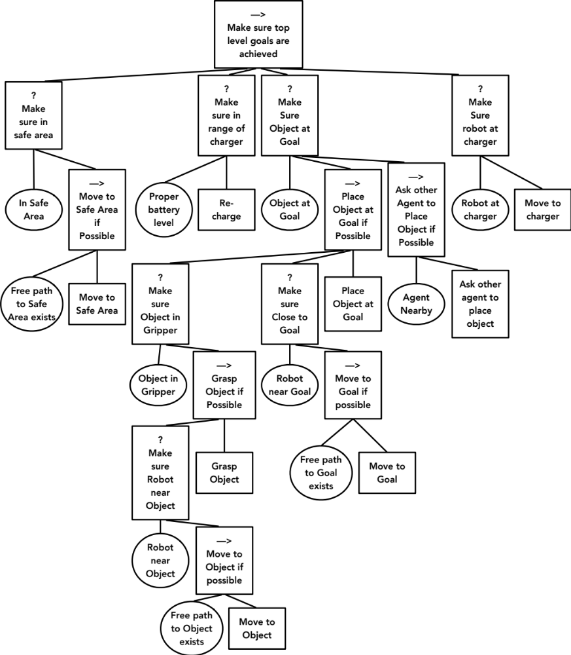
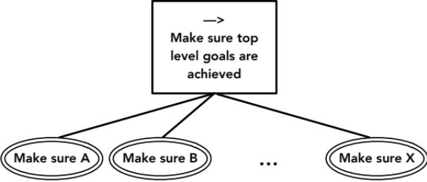
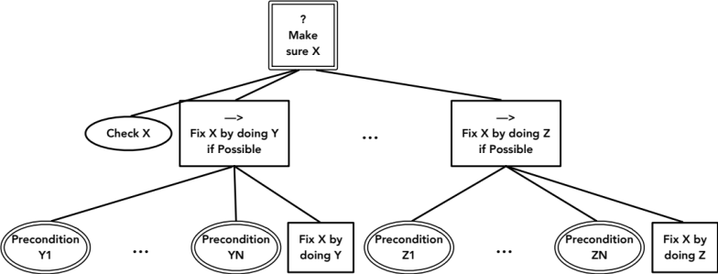



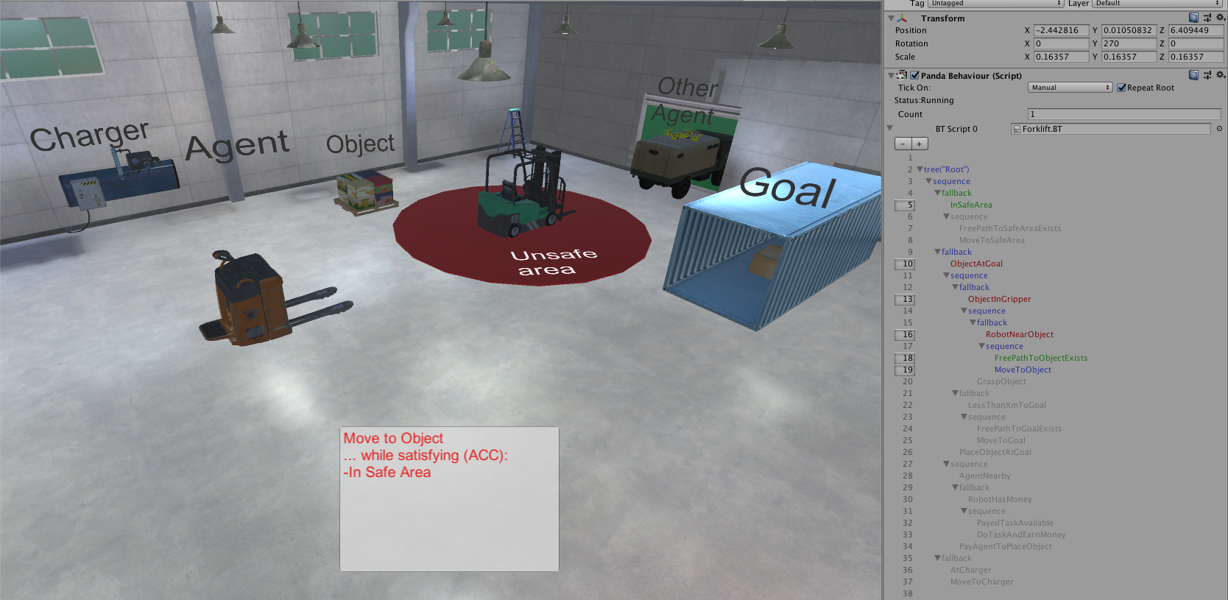
Backward chaining and Utility
Notes:
Make sure we have icecream
Check if we have icecream
Buy ice cream

Slide 9
Converting a Utility BT to a standard one
By choosing the conditions we can create an equivalent BT
(possibly less transparent)
(difficult for utility of subtrees)
What if we could measure the utility of each option?
Then we just choose the best one!
?_{U}
utility value
utility value
→
→
→
utility value
Health low
A: Retreat
Enemy far
B: Use longbow
Enemy close
C: Use sword
Util. A > Util. B AND
Util. A > Util. C
Util. B > Util. C
True
9
Notes:
Transparent: Chris Paxton
Provably robust: Francesco Rovida

Slide 10
Utility BTs
The order of siblings in a BT is
  important
  fixed
Can we change the order on the fly?
  Yes: Utility BTs
  Fallbacks (most of the time)
  Sequences (sometimes)
?
→
→
→
Health low
Retreat
Enemy far
Use longbow
Enemy close
Use sword
10
Notes:
Transparent: Chris Paxton
Provably robust: Francesco Rovida

Slide 11

Thank you for watching…
Notes:
We hope we have provided some answers to the questions:
What is a behavior tree?
When are they useful?

