Slide 1
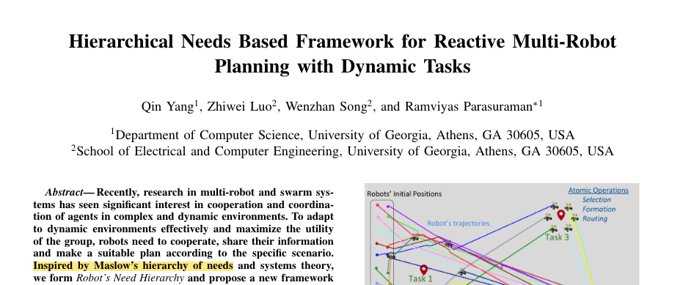
Behavior Trees and the Needs of Maslow, Asimov and Rosenberg
An Introduction to Behavior Trees in AI (part 13)
by Petter Ögren
What are the top level goals of my agent?
Notes:
Hello everyone!
In this video I will explain how to create backward chained Behavior Trees.
This is the second lecture in the series ”Introduction to Behavior Trees”.
And my name is Petter Ögren

Slide 2
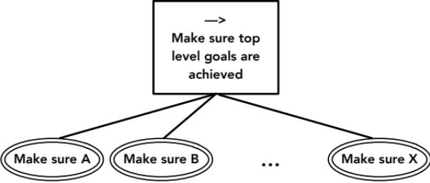
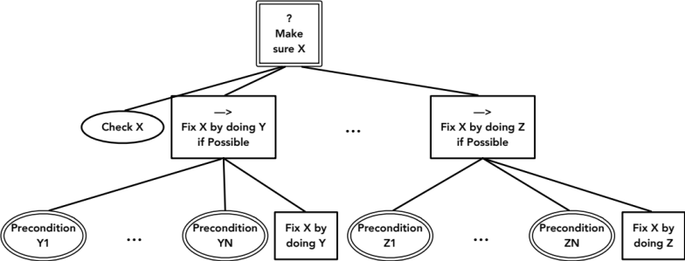
Choosing the top level goals of an agent
When doing Backchained designs, we start from the “top level goals” of an agent
What are those?
What motivates a human?
  Needs (ex: need rest)
  Feelings (ex: feel tired)
Can this be translated to agent AI?
What are the top level goals?

Slide 3
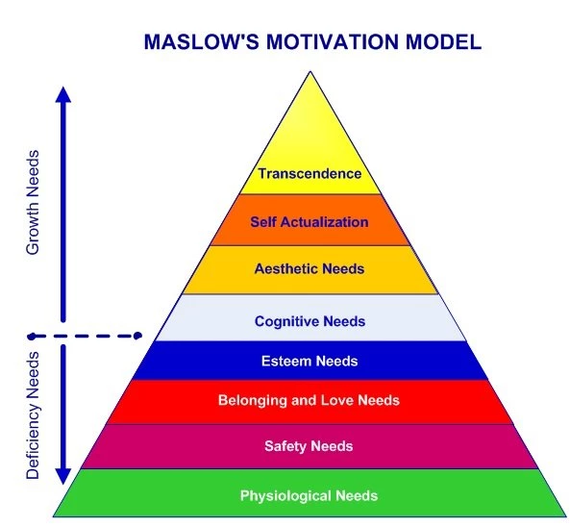

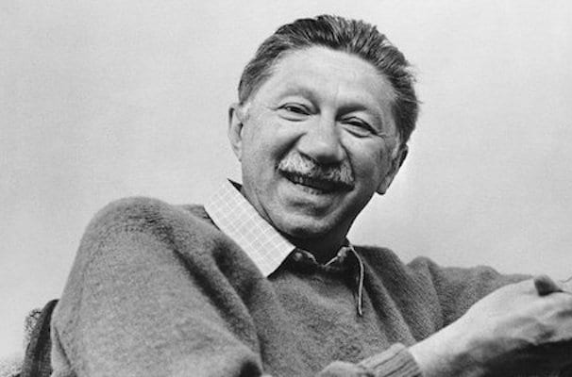







Maslow's hierarchy of needs
"A Theory of Human Motivation" in Psychological Review (1943)
Assumption: In order for motivation to arise at the next stage, the previous stage must be satisfied within the agent.
What are the top level goals?
→
Not hungry
Not homeless
Not lonely
High status
Have Knowledge
Have Spotify
What about feelings?

Slide 4
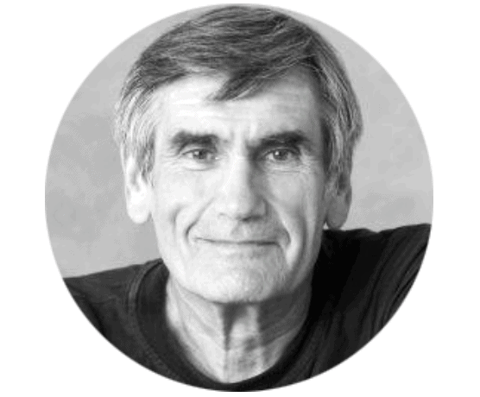
2 Fundamental assumptions
Everything we do is motivated by universal human needs
Feelings arise when needs are met or not met
Examples
  Need energy → Feel hungry → Eat
  Need sleep → Feel tired → Sleep
  Need companion → Feel lonely → Go on date
  Need shelter → Freezing → Buy a house
  → Worry about freezing in future → Get job to get € to buy house
  Healthy body → Back pain → Do exercise
  Need freedom → “feel trapped” → leave

Slide 5
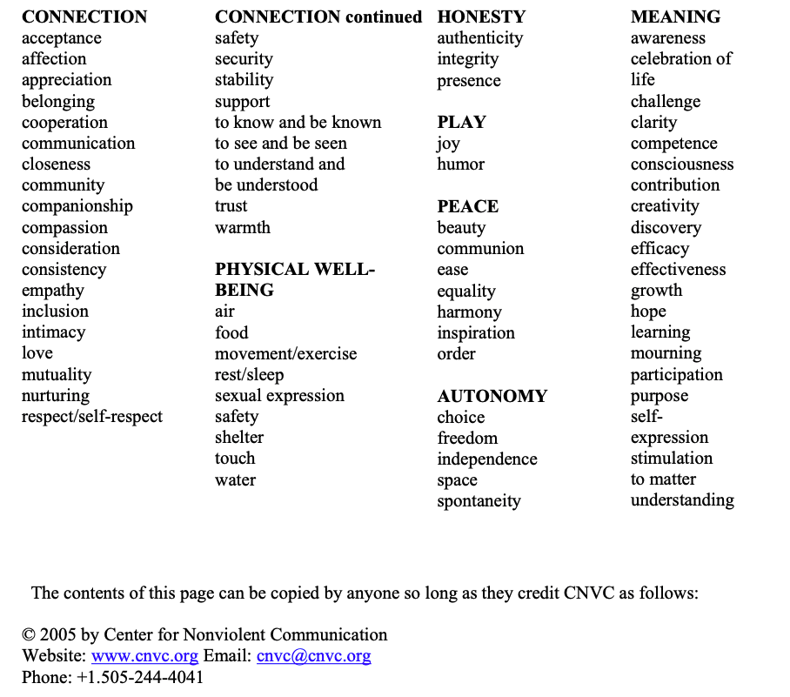
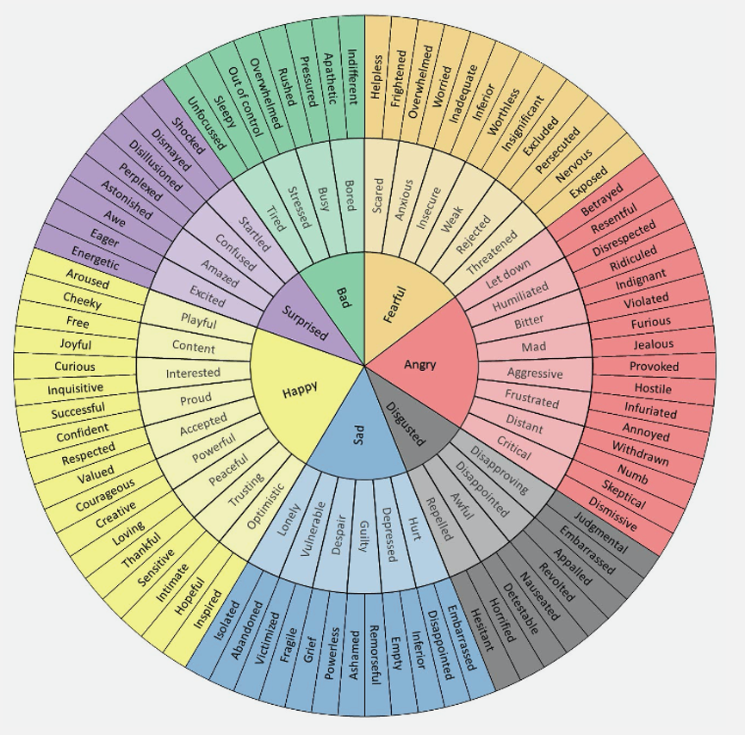
Needs and feelings
Notes:
Over 80 different feelings (did you know that?)
mourning

Slide 6
How to prioritize needs?
Everything we do is motivated by universal human needs
Feelings arise when needs are met or not met
Idea: Use feeling intensity as “Utility”
super hungry (utility of eating very high)
→
super tired (utility of sleeping very high)
Not hungry
Not tired
Not lonely
…
…
Not
free

Slide 7
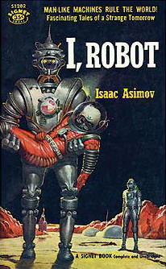
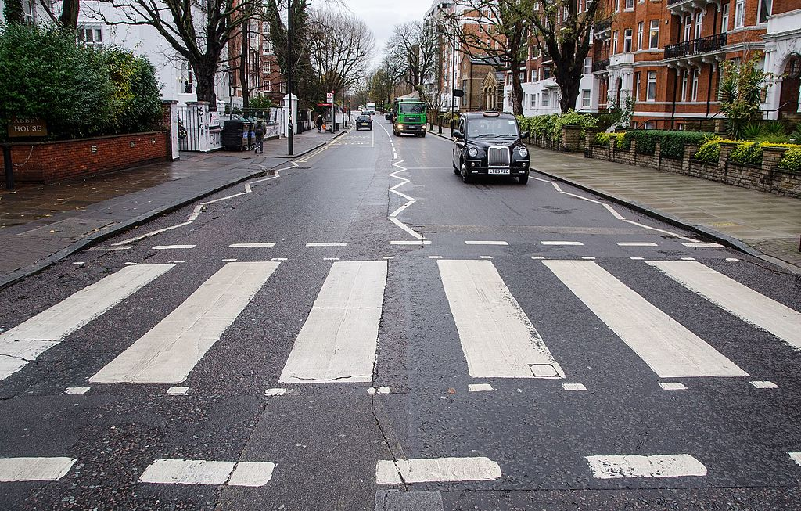
Asimov’s Laws
First Law: A robot may not injure a human being or, through inaction, allow a human being to come to harm.
Second Law: A robot must obey the orders given it by human beings except where such orders would conflict with the First Law.
Third Law: A robot must protect its own existence as long as such protection does not conflict with the First or Second Law.
→
?
?
?
Humans safe
Make humans safe
Orders executed
Execute orders
Robot safe
Make robot safe

Slide 8
Robot needs (Yang 2019)
→
Safety needs
  Avoid collisions, avoid harm
Basic needs
  Avoid running out of battery
Current task needs
  Execute task
Team task needs
  Help in executing team tasks
Self actualization
  Learn new skills using RL
?
?
Battery ok?
Recharge!
Team done?
Do team tasks!
?
?
?
Safe?
Make sure safe!
Own tasks done?
Do tasks!
Fully skilled?
Learn!

Slide 9

A common mistake…
Top level goals should be independent
Not: subgoals of other top level needs
The subgoals will appear as ways of achieving top level goals (if needed)
→
Oven is on
Food is warm
Not hungry

Slide 10
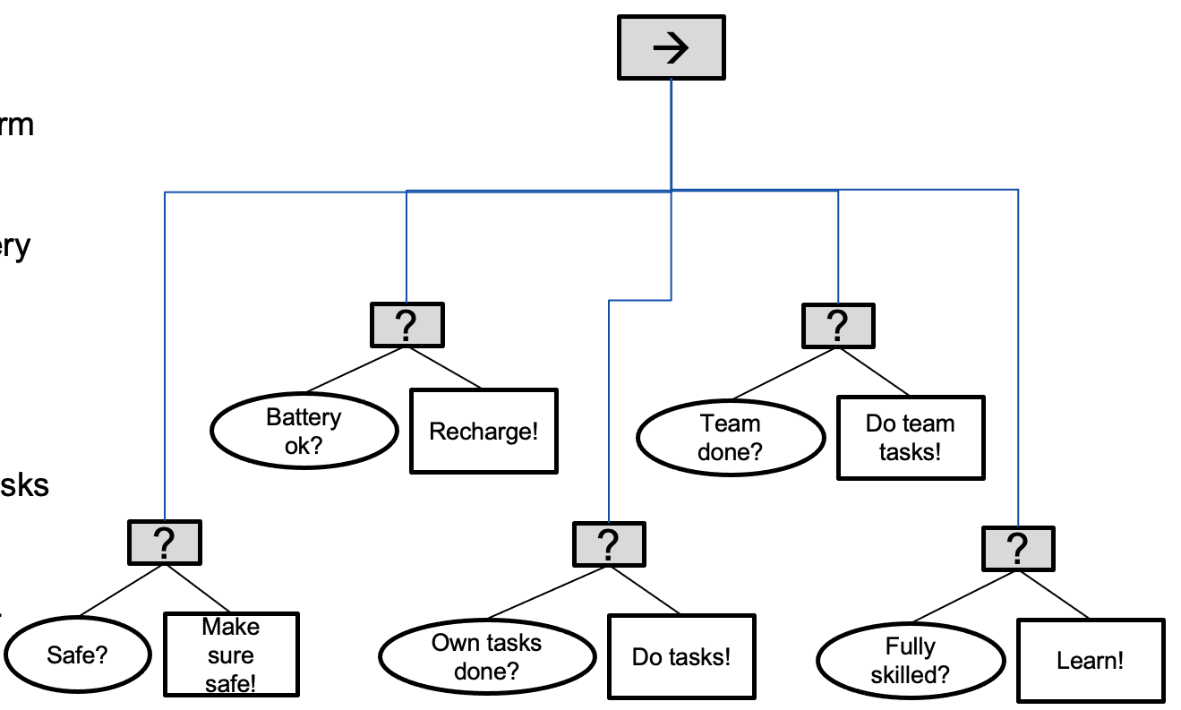
Choosing the top level goals of an agent
When doing Backchained designs, we start from the “top level goals” of an agent
What are those?
What motivates a human?
  Needs (need rest)
  Feelings (feel tired)
Can this be translated to agent AI?
  Yes…
    Maslow’s priority pyramid
    Use feeling intensity as utility (flexible priority)
  Robot needs…

Slide 11
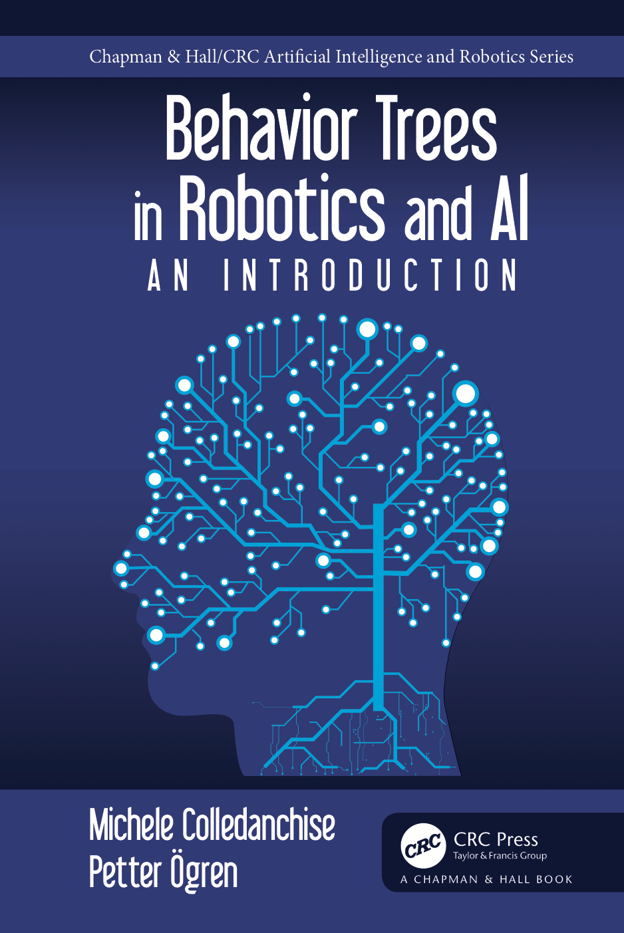
Thank you for watching…
Notes:
We hope we have provided some answers to the questions:
What is a behavior tree?
When are they useful?

