Slide 1
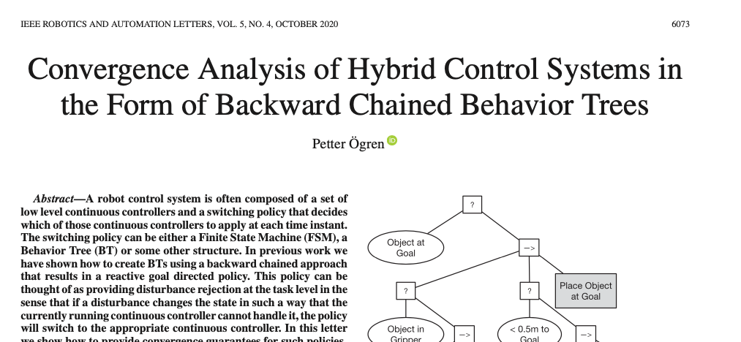
4 Common Bugs in Backward Chained Behavior Trees
An Introduction to Behavior Trees in AI (part 6)
by Petter Ögren
4 design criteria that needs to be checked to guarantee reaching all top level goals
Notes:
Hello everyone!
In this video I will explain how to create backward chained Behavior Trees.
This is the second lecture in the series ”Introduction to Behavior Trees”.
And my name is Petter Ögren

Slide 2
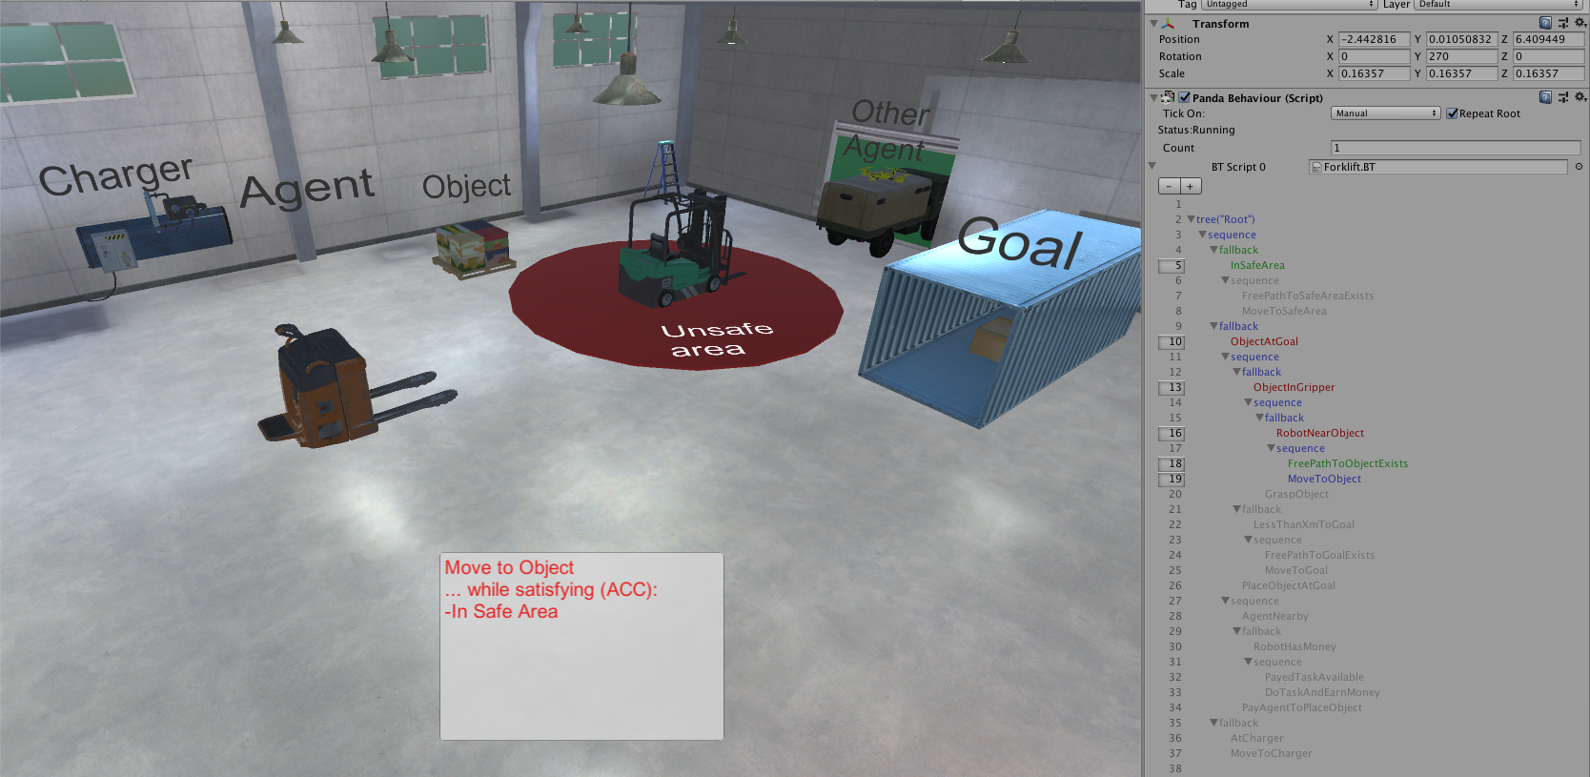
The warehouse example

Slide 3
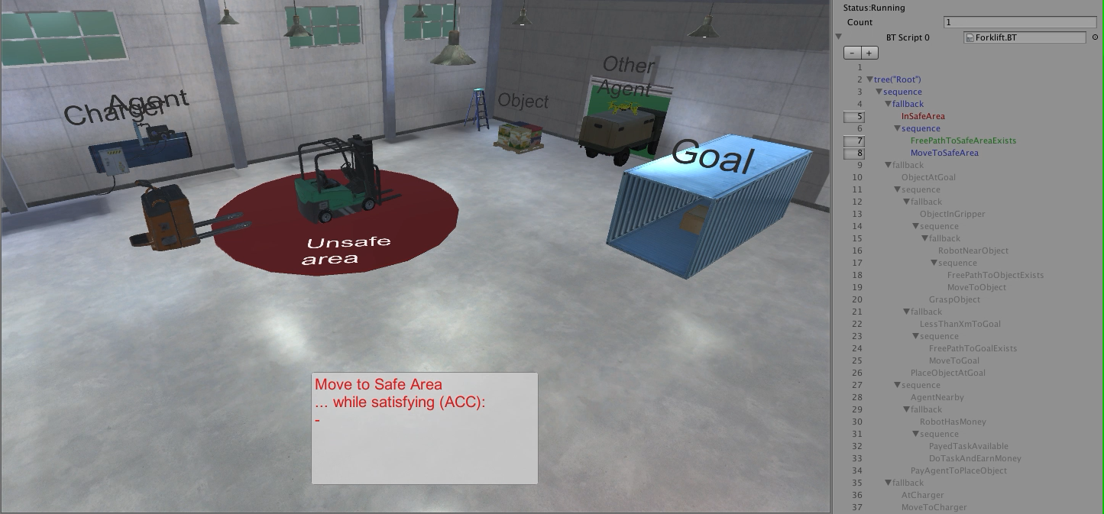
Execution without disturbances
Success
Running
Failure

Slide 4

Handling disturbances (by external agents)
Success
Running
Failure

Slide 5
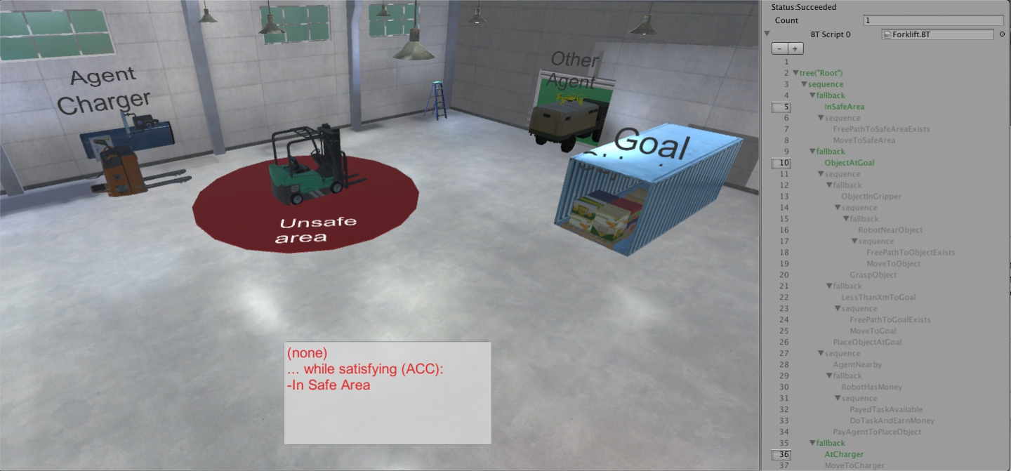

What about Performance Guarantees?
Can we guarantee Mission Accomplishment: InSafeArea AND ObjectAtGoal AND AtCharger?

Slide 6
Backward chaining: starting with 3 goal conditions
→
In Safe Area
Object at Goal
At Charger
?
?
?
In Safe Area
Object at Goal
At Charger
→
→
→
Free path exists
Gripper in Object
Near Goal
Free path exists
?
Move to Safe Area
?
Place Object
?
Move to Charger
Find BTs that achieve each

Slide 7
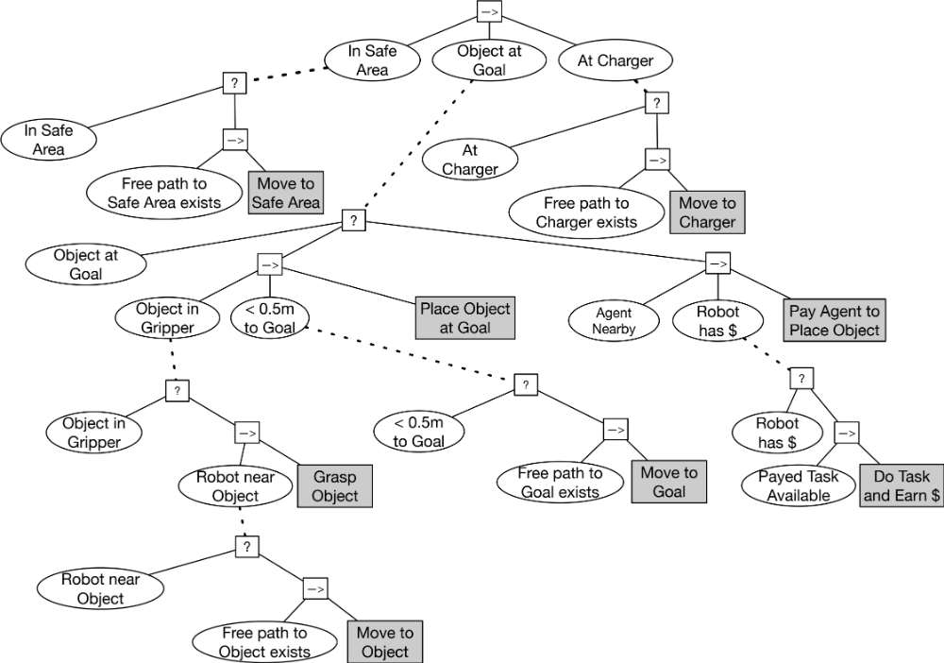
Backward Chained Behavior Tree

Slide 8
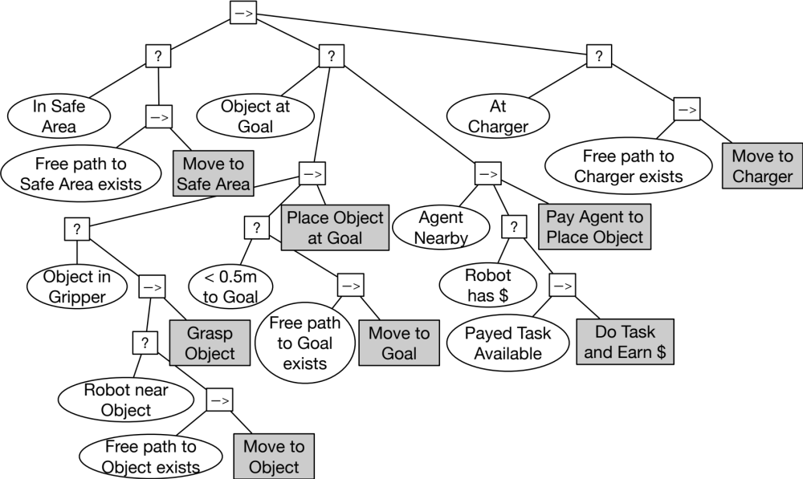
The Backward Chained Behavior Tree
Can we guarantee achieving all 3 goals?

Slide 9
Four Design Criteria for the guarantees to hold
Action achieves Post-condition in finite time
  Move to Object satisfies Robot near Object
Action does not violate key previously achieved subgoals
  Move to Object does not violate In Safe Area
Action does not violate conditions needed for later actions
  Move to Object does not destroy passage to goal area (Free path to object exists)
Action does not invoke previously failed subtree
  Do Task and Earn $ does not invoke Move to Object

Slide 10
Four Design Criteria for the guarantees to hold
Action achieves Post-condition in finite time
  Move to Object satisfies Robot near Object
Action does not violate key previously achieved subgoals
  Move to Object does not violate In Safe Area
Action does not violate conditions needed for later actions
  Move to Object does not destroy passage to goal area (Free path to object exists)
Action does not invoke previously failed subtree
  Do Task and Earn $ does not invoke Move to Object
Notes:
The action needs to achieve the post-condition. Always (when pre-conditions are satisfied).

Slide 11
Four Design Criteria for the guarantees to hold
Action achieves Post-condition in finite time
  Move to Object satisfies Robot near Object
Action does not violate key previously achieved subgoals
  Move to Object does not violate In Safe Area
Action does not violate conditions needed for later actions
  Move to Object does not destroy passage to goal area (Free path to object exists)
Action does not invoke previously failed subtree
  Do Task and Earn $ does not invoke Move to Object

Slide 12
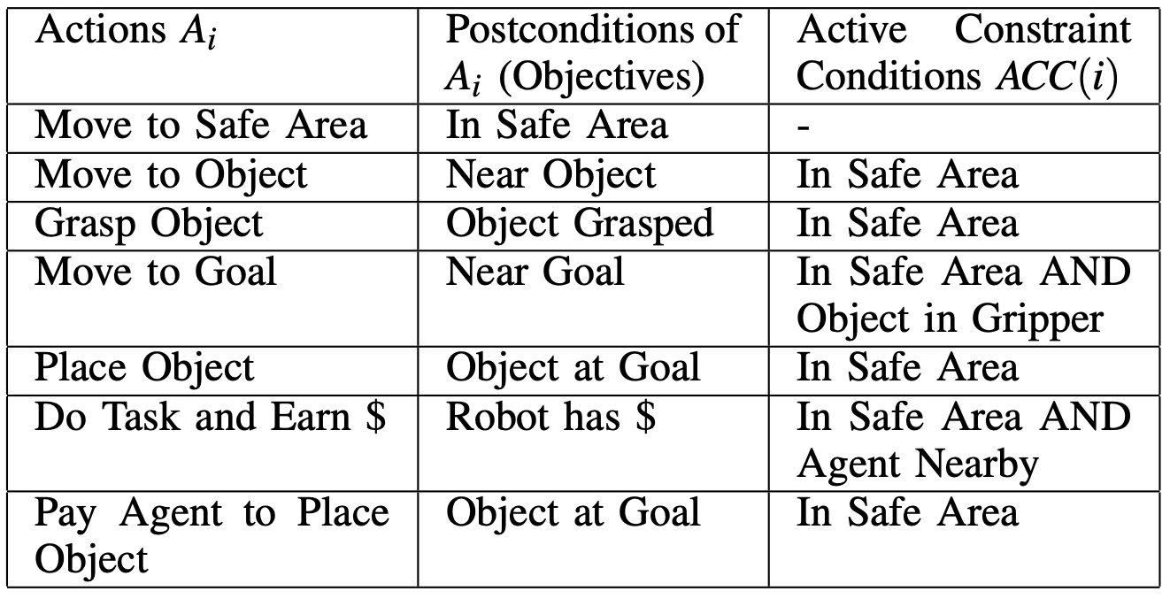
Preserve (some) earlier subgoals
“The actions satisfy their postconditions, without violating important achieved subgoals or Active Constraint Conditions (ACCs)”
How can we make this happen?
Examples
  Move to Object
    plans a path that avoids “Unsafe area”
  Move to Goal
    plans a path that avoids “Unsafe area”
    moves slowly to keep “Object in Gripper”
ACCs can thus be “Obstacles” in
  Configuration space
  Velocity/acceleration space
Assumption gives explicit “Design specifications” for Controllers/Actions

Slide 13
Which subgoals to Preserve?
Two ways to find the subgoals to preserve
  During execution find non-preconditions returning Success
  Analytically study BT to find the above
    Check Sequence nodes in the BT between Action and Root
    Look for older children of those nodes to the left
    Pre-conditions of the action can be violated at the instant of achieving the postcondition

Slide 14
Which subgoals to Preserve?
Two ways to find the subgoals to preserve
  During execution find non-preconditions returning Success
  Analytically study BT to find the above
    Check Sequence nodes in the BT between Action and Root
    Look for older children of those nodes to the left
    Ignore pre-conditions of the action considered
    … violation of those OK if goal achieved

