Slide 1
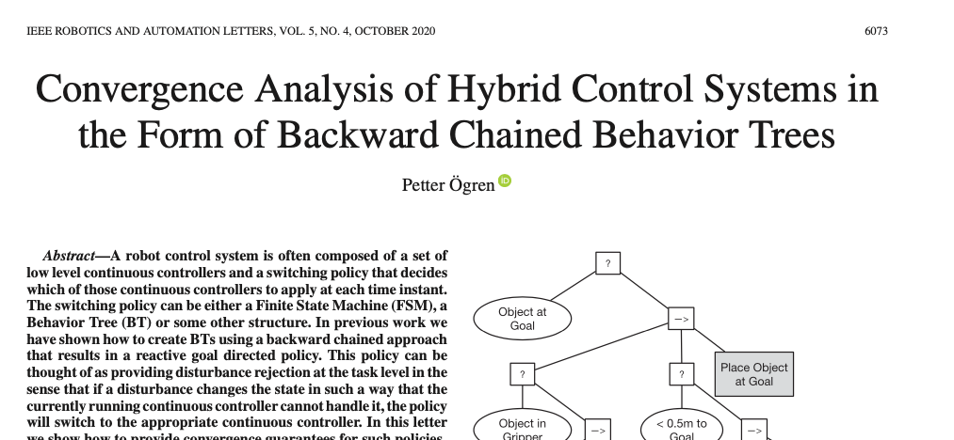
(2nd part of slides)
4 design criteria that needs to be checked to guarantee reaching all top level goals
Notes:
Hello everyone!
In this video I will explain how to create backward chained Behavior Trees.
This is the second lecture in the series ”Introduction to Behavior Trees”.
And my name is Petter Ögren

Slide 2
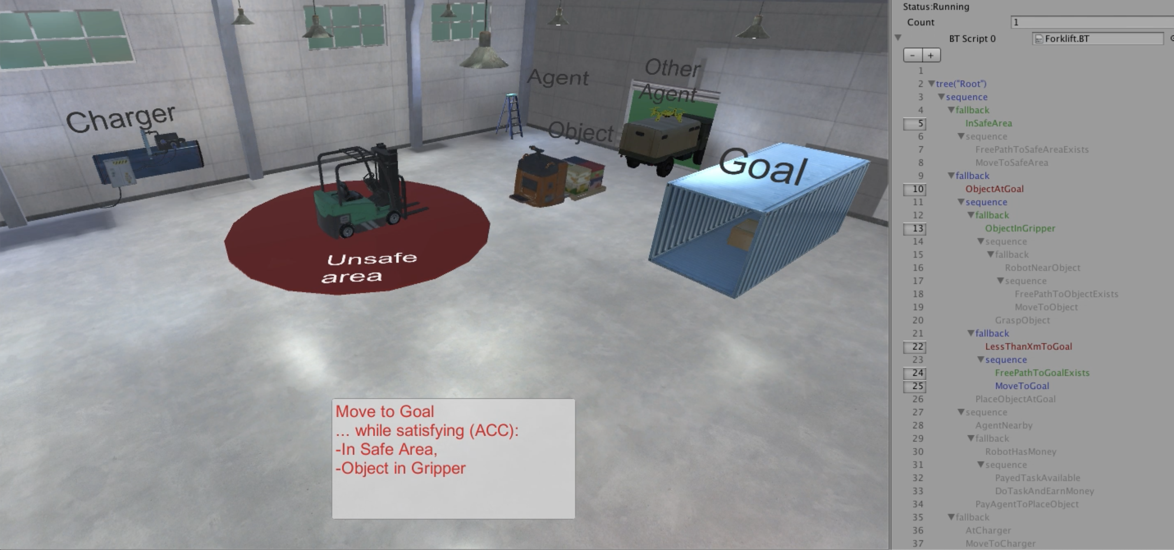
Illustration of ACCs
Success
Running
Failure

Slide 3
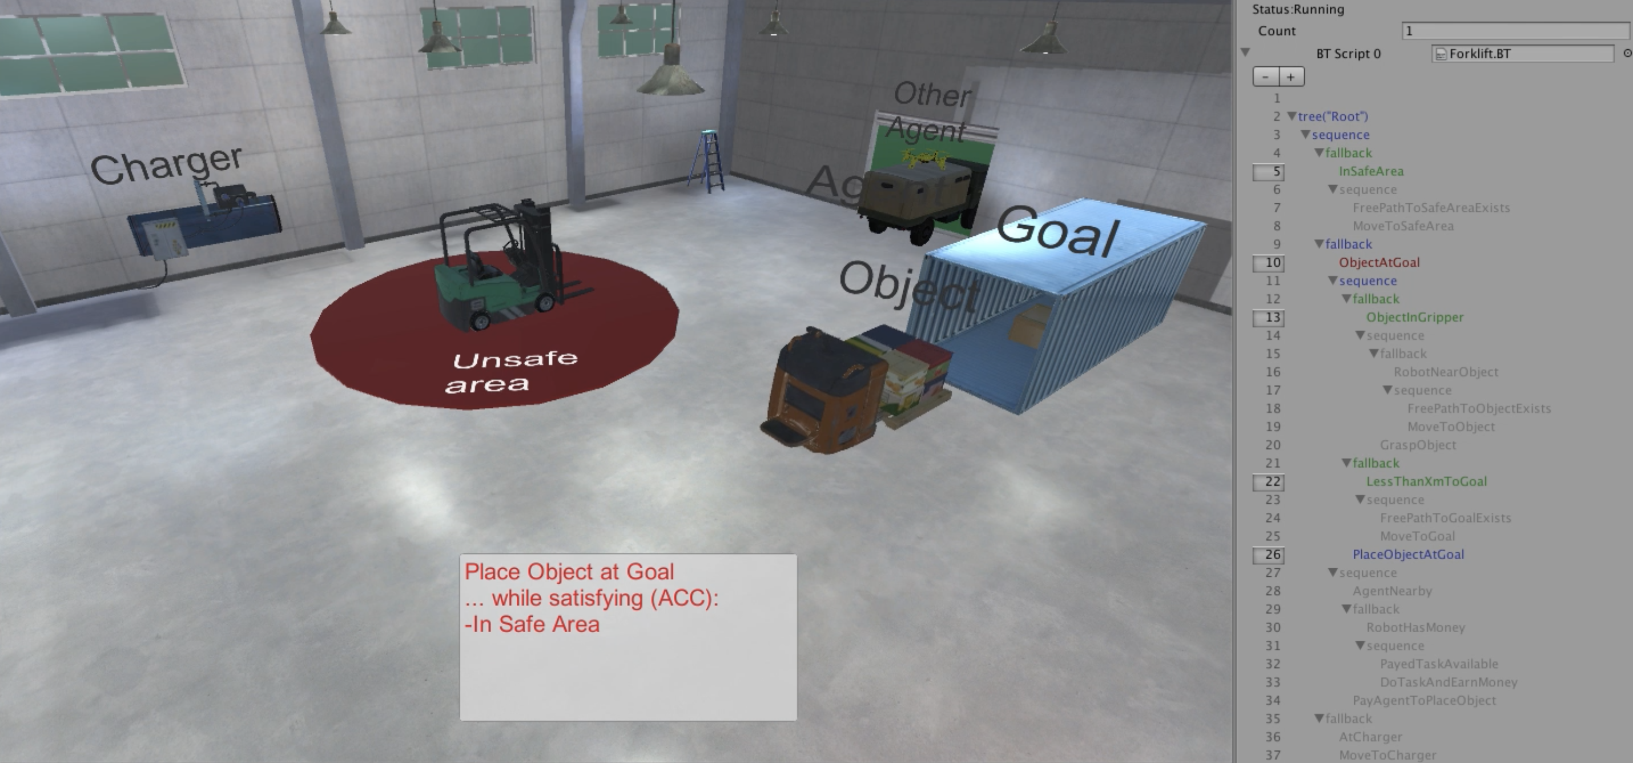
Illustration of ACCs
Success
Running
Failure

Slide 4
Four Design Criteria for the guarantees to hold
Action achieves Post-condition in finite time
  Move to Object satisfies Robot near Object
Action does not violate key previously achieved subgoals
  Move to Object does not violate In Safe Area
Action does not violate conditions needed for later actions
  Move to Object does not destroy passage to goal area (Free path to object exists)
Action does not invoke previously failed subtree
  Do Task and Earn $ does not invoke Move to Object

Slide 5
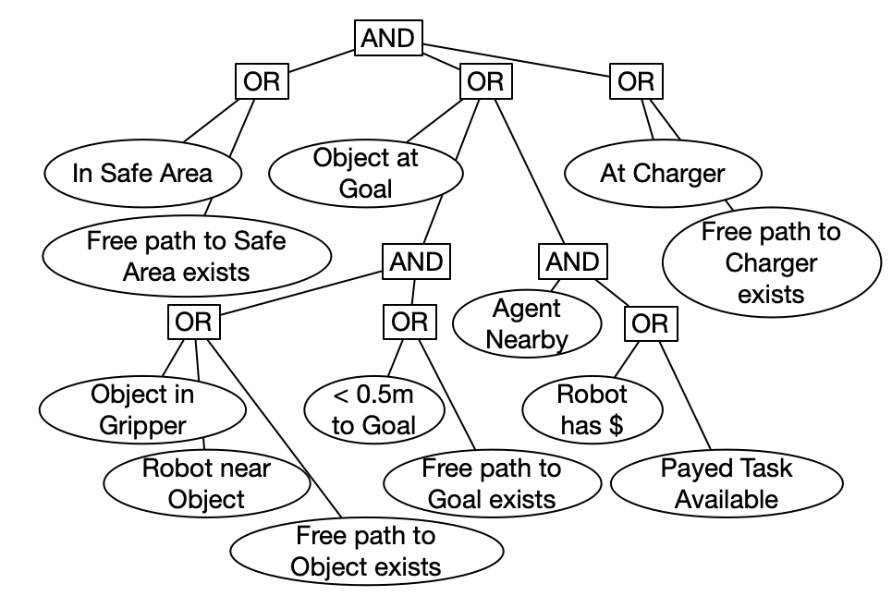

What are the conditions that are needed for later tasks?
Shows what kind of disturbances can be handled
Create And-Or-Tree
  Replace Actions with True
    (or remove if they have pre-cond)
  → becomes AND
  ? becomes OR

Slide 6
Four Design Criteria for the guarantees to hold
Action achieves Post-condition in finite time
  Move to Object satisfies Robot near Object
Action does not violate key previously achieved subgoals
  Move to Object does not violate In Safe Area
Action does not violate conditions needed for later actions
  Move to Object does not destroy passage to goal area (Free path to object exists)
Action does not invoke previously failed subtree
  Do Task and Earn $ does not invoke Move to Object

Slide 7

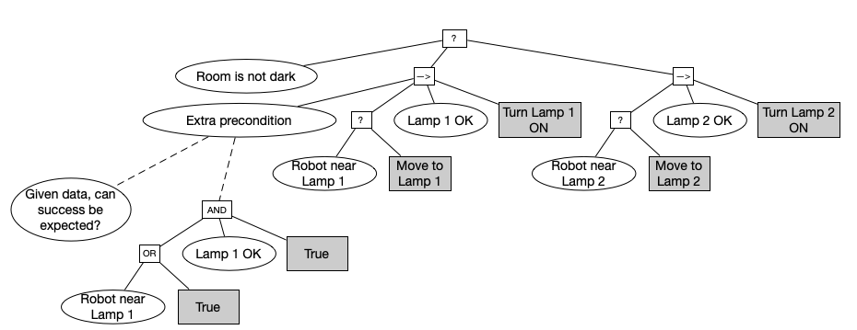


Example: Turn the light on
If Lamp 1 is broken…
… the policy will still try to move to Lamp 1 (execute initial part of subtree)…
Solution:
  Add precondition to deactivate first subtree
1
2

Slide 8
Four Design Criteria for the guarantees to hold
Backward chaining
very powerful design principle
when aware of the 4 design criteria
Action achieves Post-condition in finite time
  Move to Object satisfies Robot near Object
Action does not violate key previously achieved subgoals
  Move to Object does not violate In Safe Area
Action does not violate conditions needed for later actions
  Move to Object does not destroy passage to goal area (Free path to object exists)
Action does not invoke previously failed subtree
  Do Task and Earn $ does not invoke Move to Object

Slide 9

Thank you for watching…
Notes:
We hope we have provided some answers to the questions:
What is a behavior tree?
When are they useful?

