Slide 1

Behavior Trees and
Control Barrier Functions
An Introduction to Behavior Trees in AI (part 10)
by Petter Ögren
Notes:
Hello everyone!
In this video I will explain how to create backward chained Behavior Trees.
This is the second lecture in the series ”Introduction to Behavior Trees”.
And my name is Petter Ögren

Slide 2
Why combining BTs and Control Barrier Functions (CBFs)?
They are complementary
  BTs do hard switching between policies/controllers
    First one, then the other
  CBFs do soft merging of objectives
    Execute one, while taking the other into account
Convergence proof of BTs require not violating earlier sub-goals
  CBFs do exactly this
  But we need a way to handle tradeoffs (when some sub-goals have to be sacrificed to preserve others)
The combination of BTs and CBFs
  gives “Safety guarantees”
  can be seen as a generalization of “standard” use of CBFs

Slide 3



Key idea of CBF
The closer you are to the edge
The more careful you have to be
  slower speeds towards the edge
0
20
40
60
[0,60]
[-20,60]
[-40,60]
[-60,60]

Slide 4
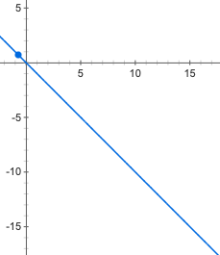
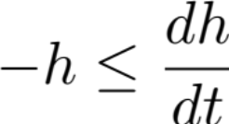

Key idea of CBF
The closer you are to the edge, the more careful you have to be
Can we formalize this?
  h(t) distance to edge
  dh/dt speed
  h > 0 acceptable set
  Speed limit:
  Guarantees safety
  Can we generalize this?
0
10
20
30
40
60
[0,60]
[-10,60]
[-20,60]
[-30,60]
[-40,60]
[-60,60]

Slide 5
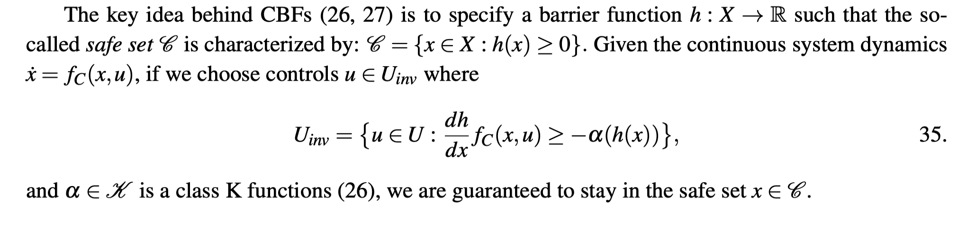


What is a Control Barrier Function (CBF)?
Generalizes
With:
What about BTs?

Slide 6

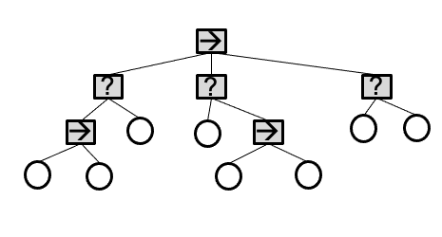





We need set invariance for BT convergence
We want the BT to
  progress to the “right” next action and avoid the “wrong” ones
  not violate achieved subgoals
Avoid moving into “unsafe” area
Avoid running out of batteries
Arrive on time
Stay inside communication range
Avoid “giving same fork to two guests”
Keep some set invariant
Earlier videos…

Slide 7
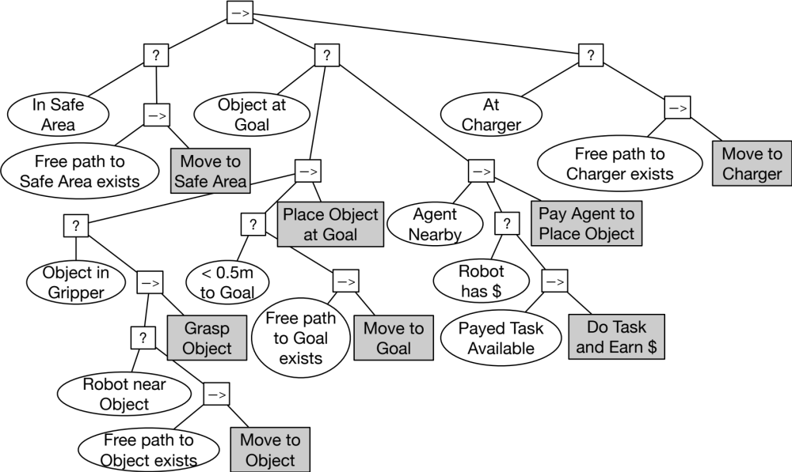
From: 4 Common Bugs in Backward Chained Behavior Trees
Action achieves Post-condition in finite time
  Move to Object satisfies Robot near Object
Action does not violate key previously achieved subgoals
  Move to Object does not violate In Safe Area
Action does not violate conditions needed for later actions
  Move to Object does not destroy passage to goal area (Free path to object exists)
Action does not invoke previously failed subtree
  Do Task and Earn $ does not invoke Move to Object

Slide 8
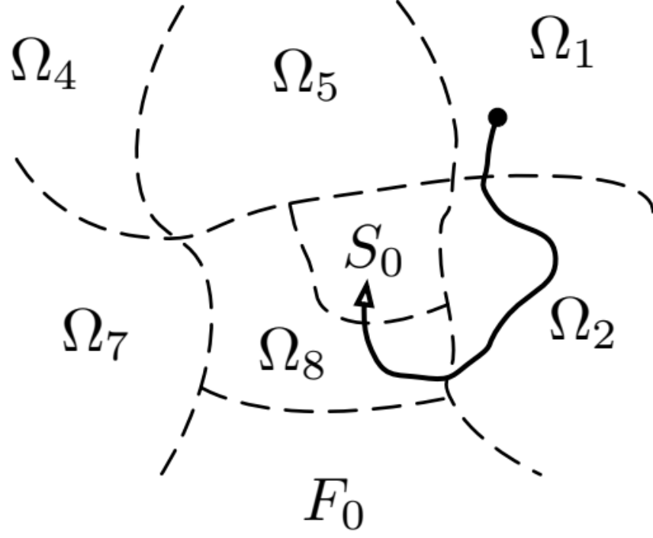
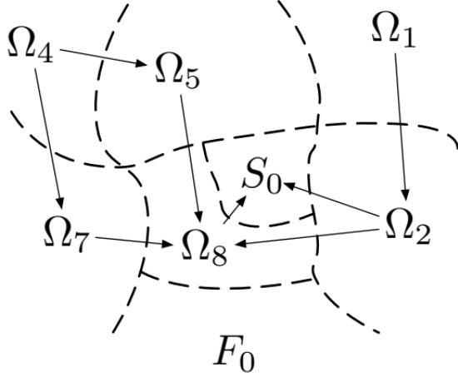
From: Analyzing Behavior Trees as Discontinuous Dynamical Systems
If we only have transitions as shown by arrows (in finite time)…
Then all executions lead to Success (S₀)
x₂
x ₁

Slide 9



Can we keep all sets invariant?
No…
Tradeoffs are needed…
Violate least important subgoal!

Slide 10
Control set illustrations (notation)
How do we illustrate a set of controls?
If control is velocity
  use vectors
  set of vectors (pie chart)

Slide 11
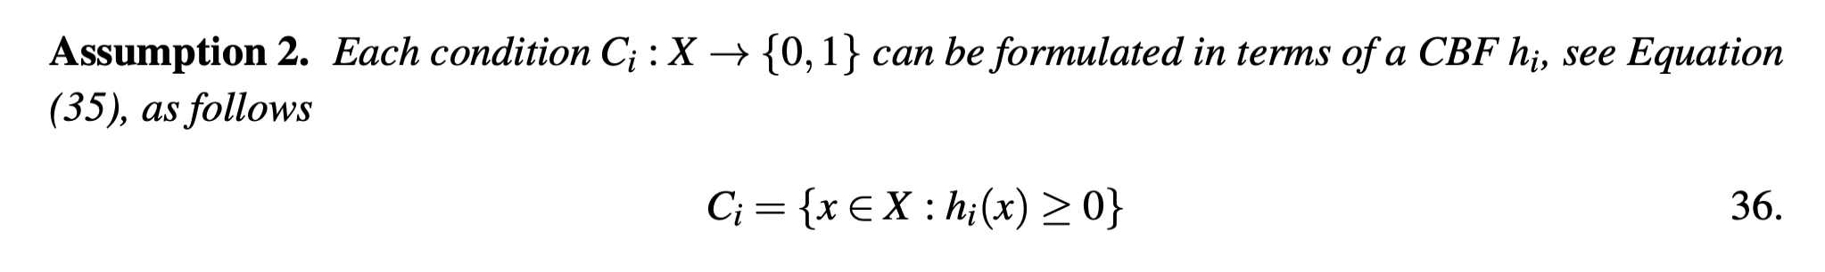
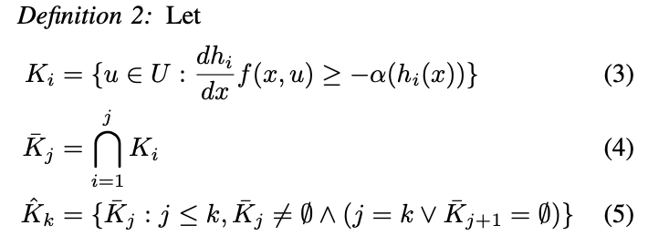
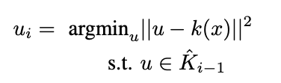

Handling tradeoffs
Preserves one C_{i}
Preserves all C_{i} (can be empty)
Preserves many C_{i} (never empty)
Notes:
%\alpha(y) = y
%\frac{dh}{dx}f_C(x,u)=\frac{dh}{dx}\dot x=\frac{dh}{dt}

Slide 12
The problem
Avoid unsafe areas
Get to charger before battery runs out
Avoid extended unsafe areas
12

Slide 13
The BT
Avoid unsafe areas
Get to charger before battery runs out
Avoid extended unsafe areas
→
Go to Charger
?
?
?
In safe area
Move to safe area
Battery margin ok
Go to charger
Extra safety margin ok
Achieve extra safety margin
13

Slide 14

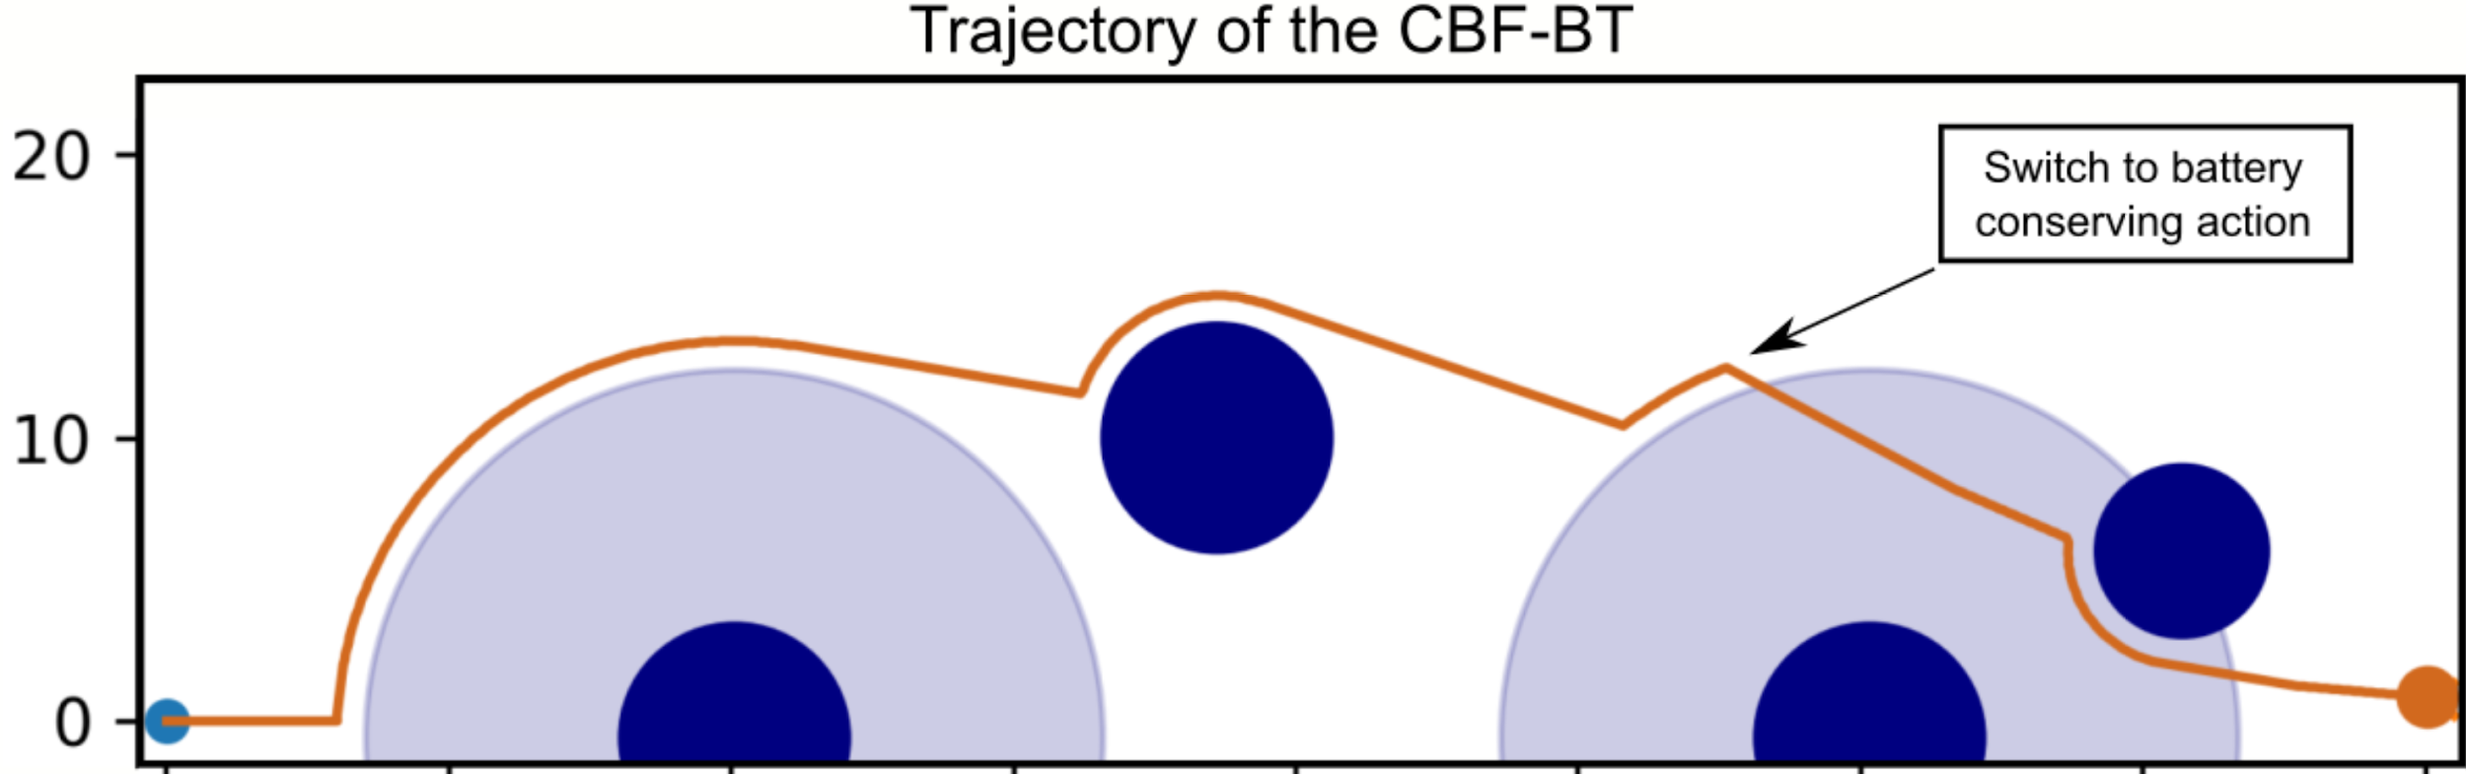




Execution…
Avoid unsafe areas
Get to charger before battery runs out
Avoid extended unsafe areas
→
Go to Charger
?
?
?
In safe area
Move to safe area
Battery margin ok
Go to charger
Extra safety margin ok
Achieve extra safety margin
14

Slide 15
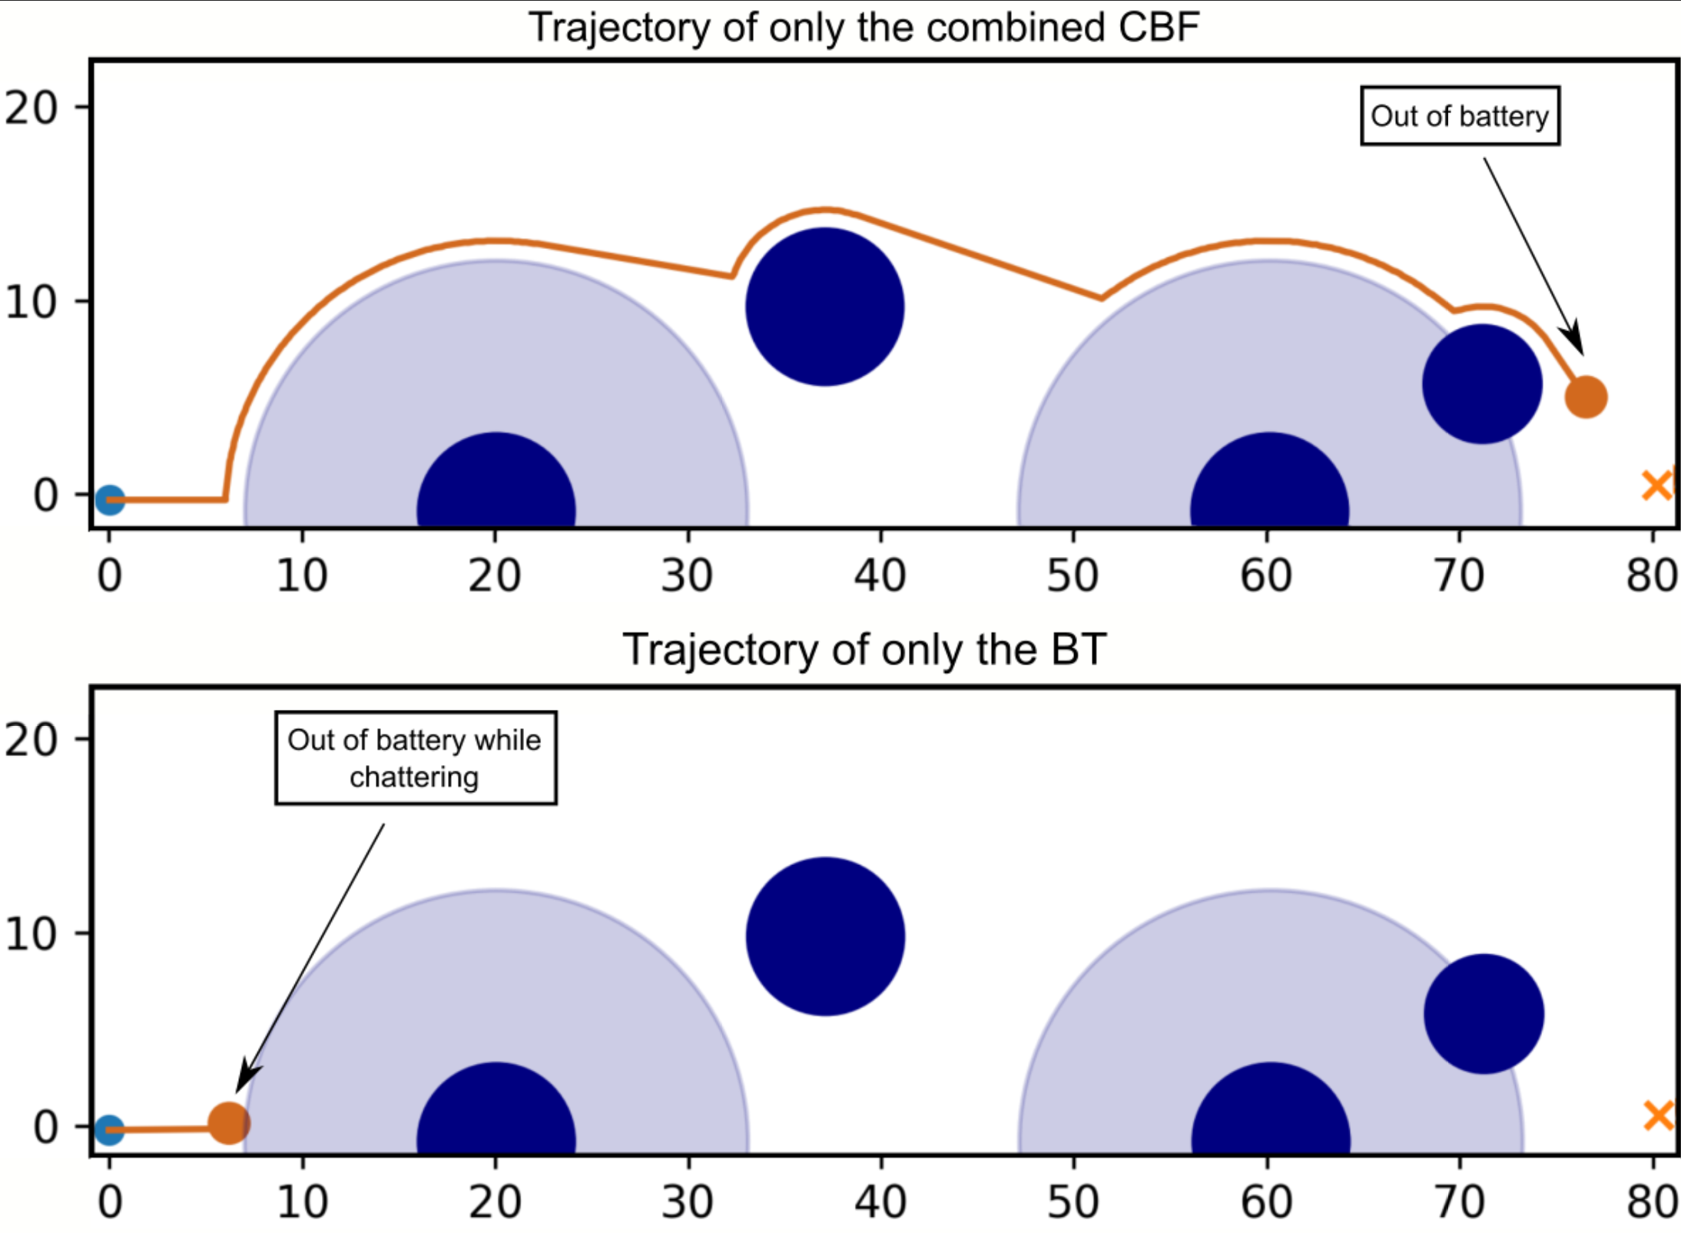
Naïve designs
No Battery check
No CBFs
→
Go to Charger
?
?
?
In safe area
Move to safe area
Battery margin ok
Go to charger
Extra safety margin ok
Achieve extra safety margin
15

Slide 16
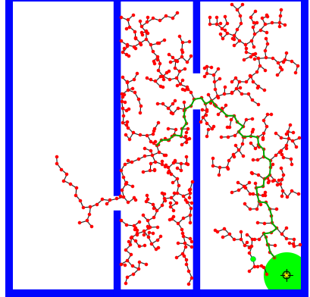
Using BT-CBFs to do planning
Standard CBF approach is “local”
Use path planner to find path that satisfies all BT-CBR constraints
  RRT(*)
  use as k(x)
This looks better!
→
Go to Charger
?
?
?
In safe area
Move to safe area
Battery margin ok
Go to charger
Extra safety margin ok
Achieve extra safety margin
16

Slide 17
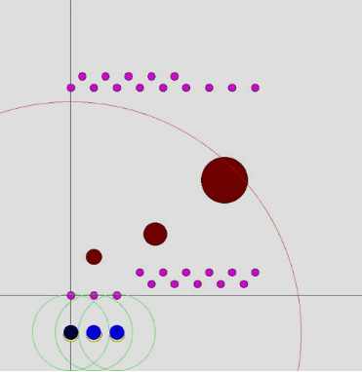

Patrolling with three vehicles
Objectives
Avoid collisions
Do not run out of battery
Stay within comms. range when patrolling
Go through waypoints
Notes:
Here is an example mission with three vehicles. Their constraints and goals are …
In the video, the colored circles are…

Slide 18
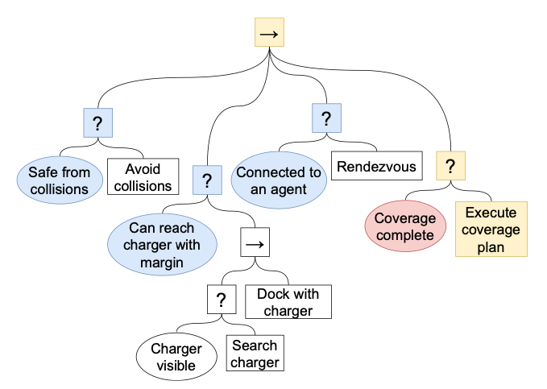
Patrolling with three vehicles
Objectives
Avoid collisions
Do not run out of battery
Stay within comms. range when patrolling
Go through waypoints
Notes:
Here is an example mission with three vehicles. Their constraints and goals are …
In the video, the colored circles are…

Slide 19
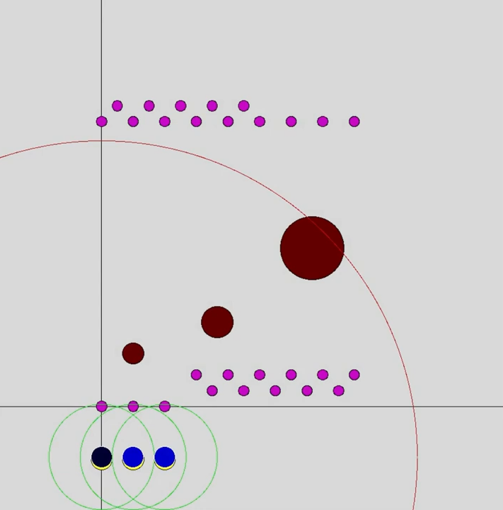
Patrolling with three vehicles
Objectives
Avoid collisions
Do not run out of battery
Stay within comms. range when patrolling
Go through waypoints
Notes:
Here is an example mission with three vehicles. Their constraints and goals are …
In the video, the colored circles are…

Slide 20

Note: Safety guarantees
Prio 1 objective is always guaranteed
Standard CBF designs are a special case of this approach
Notes:
Here is an example mission with three vehicles. Their constraints and goals are …
In the video, the colored circles are…

Slide 21
Why combining BTs and Control Barrier Functions (CBFs)?
They are complementary
  BTs do hard switching between policies/controllers
    First one, then the other
  CBFs do soft merging of objectives
    Execute one, while taking the other into account
Convergence proof of BTs require not violating earlier sub-goals
  CBFs do exactly this
  But we need a way to handle tradeoffs (when some sub-goals have to be sacrificed to preserve others)
The combination of BTs and CBFs
  gives “Safety guarantees” (of prio 1)
  can be seen as a generalization of “standard” use of CBFs

Slide 22


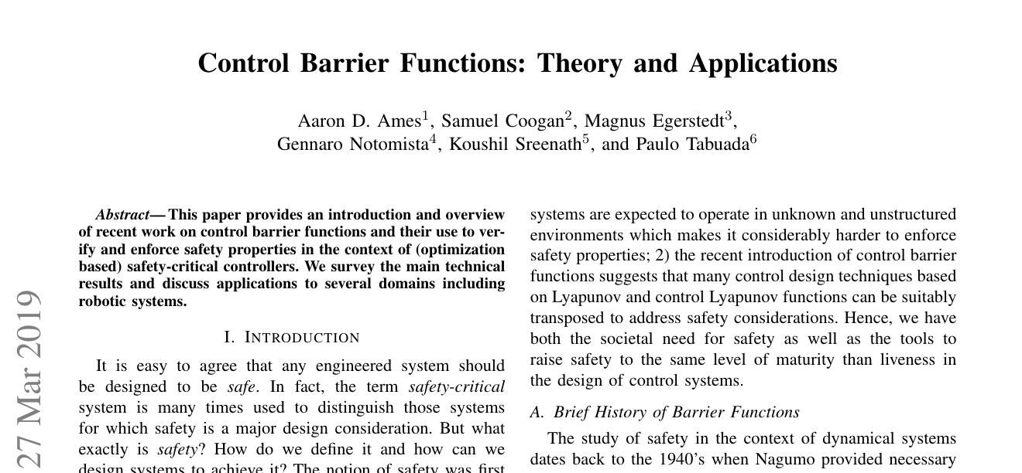
Thank you for watching…
Notes:
We hope we have provided some answers to the questions:
What is a behavior tree?
When are they useful?

