Slide 1
Behavior Trees and
Reinforcement Learning
An Introduction to Behavior Trees in AI (part 14)
by Petter Ögren
Notes:
Hello everyone!
In this video I will explain how to create backward chained Behavior Trees.
This is the second lecture in the series ”Introduction to Behavior Trees”.
And my name is Petter Ögren

Slide 2
Why BTs and RL?
  Modular
  Hierarchical
  Explainable AI
  Safety guarantees
  Convergence guarantees
Reinforcement Learning
  Near optimal performance
    Boardgame Go (Silver 2016)
    Starcraft II (Vinyals 2019)
    Quake III (Jaderberg 2019)
  ”Fast and easy” (no manual design)
Behavior Trees
  Modular
  Hierarchical
  Explainable AI
  Safety guarantees
  Convergence guarantees
Can we get the best of both worlds?
Notes:
Transparent: Chris Paxton
Provably robust: Francesco Rovida

Slide 3
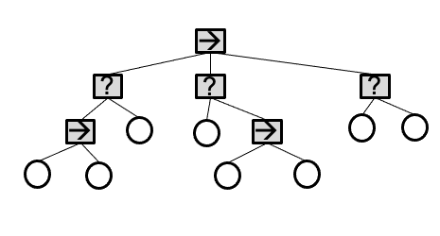
How to learn a BT?
  Modular
  Hierarchical
  Explainable AI
  Safety guarantees
  Convergence guarantees
Learn topology of BT
  Genetic Algorithms (video 8)
Replace subtree using RL (use modularity)
  A leaf
  subtree
  entire BT (end-to-end RL)
Learn interior nodes (order)
  Fallback
  (Sequence)
Notes:
RL on Fallback node
RL on Action node
Both, use Q-value of Action node to determine what actions should be ticked first (quite elegant)
(V(s) in Action becomes q(a,s) in Parent node…)

Slide 4
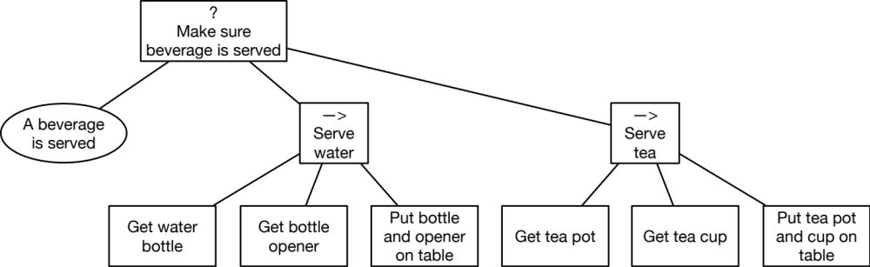


Learn Priority of Fallback nodes
(Hannaford 2016) estimated success probabilities from data
(Dey 2013, Pereira 2015, Fu 2016) used subtrees as “Actions” in Q-Learning
Rewards for actions
  defined manually
  use Success/Failure of subtrees
Q(s,a) gives value of subtree execution
Sort subtrees on Q(s,a)
$$a_{1}$$
$$a_{2}$$
Notes:
RL on Fallback node
RL on Action node
Both, use Q-value of Action node to determine what actions should be ticked first (quite elegant)
(V(s) in Action becomes q(a,s) in Parent node…)

Slide 5
Learn execution of Actions
(Pereira 2015)
  User specifies learning nodes
  User defines
    States
    Actions
    Rewards
    Letting the RL use a subsets of S, A reduces dimensionality
Can we use BT structure to find rewards?
Notes:
RL on Fallback node
RL on Action node
Both, use Q-value of Action node to determine what actions should be ticked first (quite elegant)
(V(s) in Action becomes q(a,s) in Parent node…)
States such as position of car is not relevant
Actions such as speaking is not relevant

Slide 6
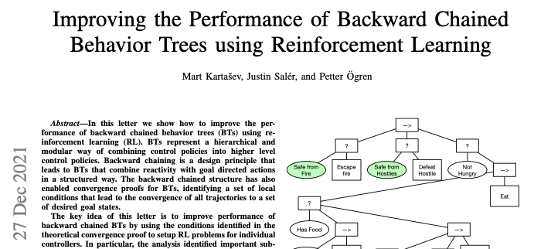
Idea: Convergence aware RL (Kartasev 2021)
We know sufficient conditions for BT to converge.
Use this to formulate RL rewards!
Can be done…
  Using operating regions (video 9)
  On backward chained BTs (video 6)

Slide 7
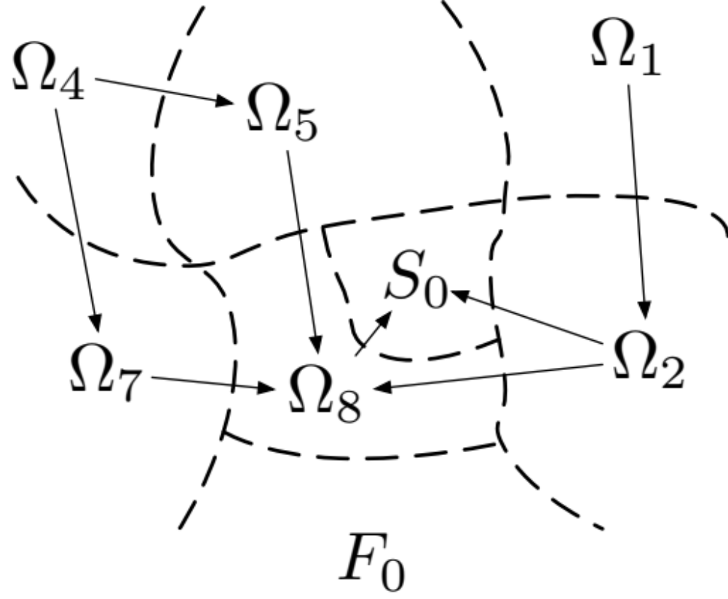
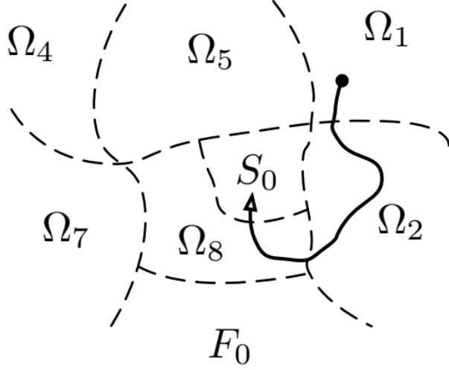
Look at operating regions
If we only have transitions as shown by arrows (in finite time)…
Then all executions lead to Success (S₀)
x₂
Negative Reward
Positive Reward
Negative Reward
x ₁

Slide 8
Pick and place BT
Positive Reward
Negative Reward
Put object outside goal
Put object at goal
S₀: Object at goal
Ω₂: Object not at goal, in hand
Ω₃: Object not at goal, not in hand, near agent
Ω₄: Object not at goal, not in hand, not near agent
1
0
?
4
Object at goal
Goto Object
2
3
→
→
Object in hand
Drop object at goal
Near Object
Grasp Object
Notes:
We can do Markov chain analysis if only drop at 10% of attempts

Slide 9
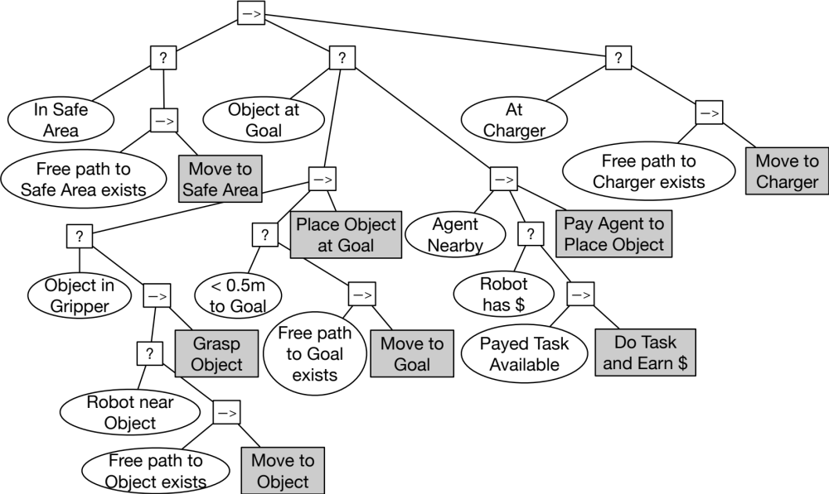
Four Design Criteria for the guarantees to hold
Negative Reward (for violating)
Action achieves Post-condition in finite time
  Move to Object satisfies Robot near Object
Action does not violate key previously achieved subgoals
  Move to Object does not violate In Safe Area
Action does not violate conditions needed for later actions
  Move to Object does not destroy passage to goal area (Free path to object exists)
Action does not invoke previously failed subtree
  Do Task and Earn $ does not invoke Move to Object
Positive Reward
Notes:
From video #6

Slide 10
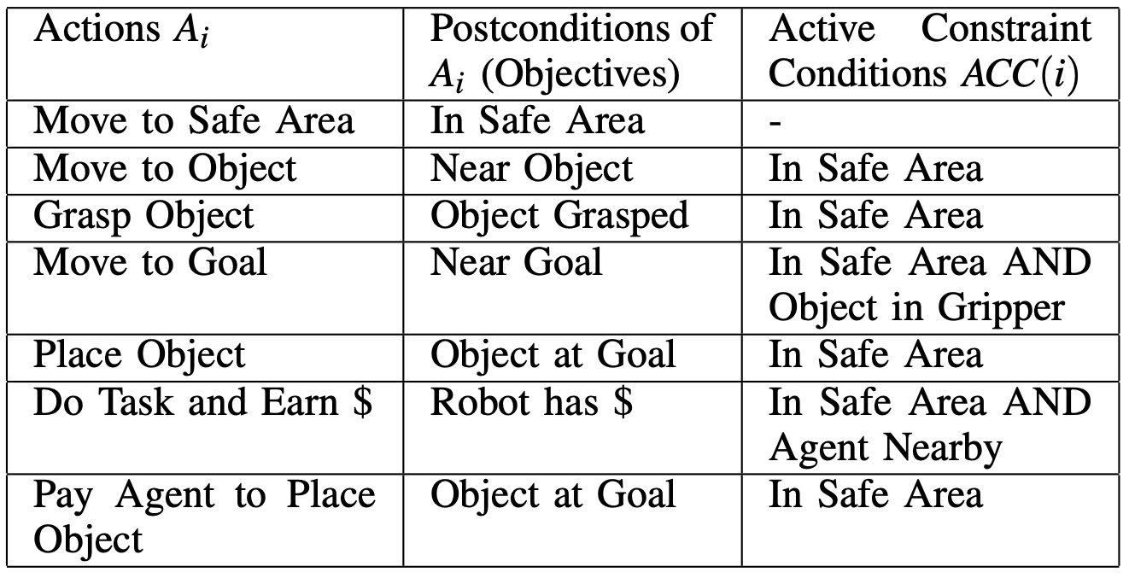
Which subgoals to Preserve?
  Modular
  Hierarchical
  Explainable AI
  Safety guarantees
  Convergence guarantees
Negative Reward (for violating)
Two ways to find the subgoals to preserve
  During execution find non-preconditions returning Success
  Analytically study BT to find the above
    Check Sequence nodes in the BT between Action and Root
    Look for older children of those nodes to the left
    Pre-conditions of the action can be violated at the instant of achieving the postcondition
Positive Reward
Negative Reward (for violating)

Slide 11
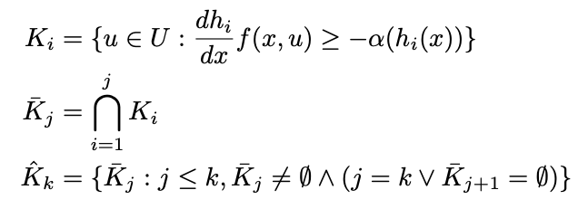
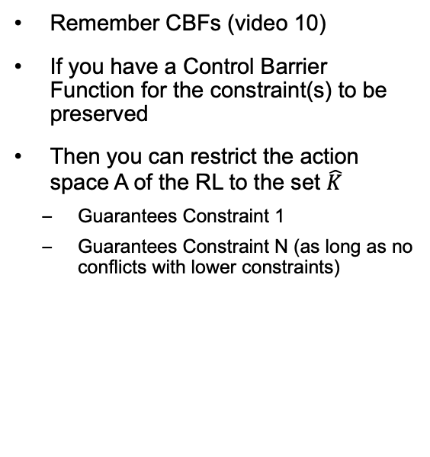
RL and Control Barrier Functions?
  Modular
  Hierarchical
  Explainable AI
  Safety guarantees
  Convergence guarantees
Negative Reward (for violating)
Remember CBFs (video 10)
If you have a Control Barrier Function for the constraint(s) to be preserved
Then you can restrict the action space A of the RL to the set $\hat{K}$
  Guarantees Constraint 1
  Guarantees Constraint N (as long as no conflicts with lower constraints)
Positive Reward
Negative Reward (for violating)

Slide 12
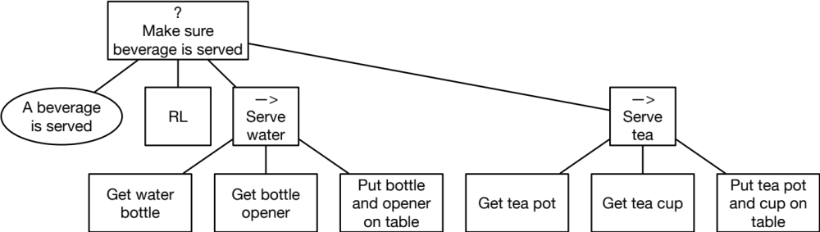
Keep Convergence Guarantees?
  Modular
  Hierarchical
  Explainable AI
  Safety guarantees
  Convergence guarantees
(Sprague 2018)
What if we know the existing design works?
Can we add RL to (possibly) improve performance and keep guarantees?
We need to:
  Avoid wrong transitions
  Make right transitions in given time
Notes:
RL on Fallback node
RL on Action node
Both, use Q-value of Action node to determine what actions should be ticked first (quite elegant)
(V(s) in Action becomes q(a,s) in Parent node…)

Slide 13
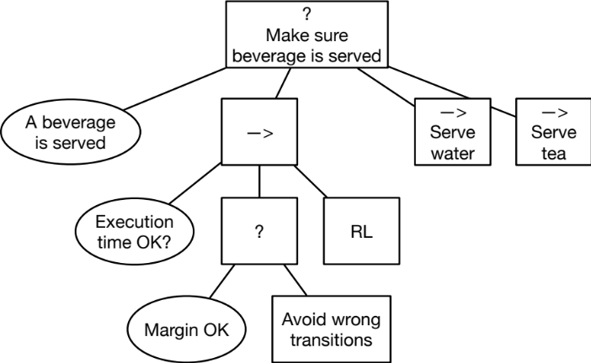

Keep Convergence Guarantees?
We need to:
  Avoid wrong transitions
  Make right transitions in given time
RL
RL
Notes:
RL on Fallback node
RL on Action node
Both, use Q-value of Action node to determine what actions should be ticked first (quite elegant)
(V(s) in Action becomes q(a,s) in Parent node…)

Slide 14
In summary
  Modular
  Hierarchical
  Explainable AI
  Safety guarantees
  Convergence guarantees
Adding RL can give
  Near optimal performance
  Easy design (?)
Replace any subtree
Replace interior node
Use CBF-BTs to keep safety guarantees
Chose reward based on convergence analysis
Use “timer and bounds” to keep convergence guarantees
Notes:
RL on Fallback node
RL on Action node
Both, use Q-value of Action node to determine what actions should be ticked first (quite elegant)
(V(s) in Action becomes q(a,s) in Parent node…)

Slide 15
Research on BTs and RL
[1] R. Dey and C. Child, “QL-BT: Enhancing behaviour tree design and implementation with Q-learning,” in 2013 IEEE Conference on Computational Intelligence in Games (CIG). Niagara Falls, ON, Canada: IEEE, Aug. 2013, pp. 1–8.
[2] Y. Fu, L. Qin, and Q. Yin, “A Reinforcement Learning Behavior Tree Framework for Game AI,” in Proceedings of the 2016 International Con- ference on Economics, Social Science, Arts, Education and Management Engineering. Huhhot, China: Atlantis Press, 2016.
[3] M. Kartasev, “Integrating Reinforcement Learning into Behavior Trees by Hierarchical Composition,” Master Thesis, KTH Royal Institute of Technology, Jul. 2019.
[4] B. Banerjee, “Autonomous Acquisition of Behavior Trees for Robot Control,” in 2018 IEEE/RSJ International Conference on Intelligent Robots and Systems (IROS), Oct. 2018, pp. 3460–3467.
[5] Q. Zhang, Q. Yin, and Y. Hu, “Modeling CGFs behavior by an extended option based learning behavior trees,” in 2017 IEEE International Conference on Cybernetics and Intelligent Systems (CIS) and IEEE Conference on Robotics, Automation and Mechatronics (RAM), Nov. 2017, pp. 260–265.
[6] Q. Zhang, L. Sun, P. Jiao, and Q. Yin, “Combining behavior trees with MAXQ learning to facilitate CGFs behavior modeling,” in 2017 4th International Conference on Systems and Informatics (ICSAI), Nov. 2017, pp. 525–531.
[7] M. Hölzl and T. Gabor, “Reasoning and Learning for Awareness and Adaptation,” in Software Engineering for Collective Autonomic Systems: The ASCENS Approach, ser. Lecture Notes in Computer Science, M. Springer International Publishing, 2015, pp. 249–290.
[8] M. Hölzl and T. Gabor, “Continuous Collaboration: A Case Study on the Development of an Adaptive Cyber-physical System,” in 2015 IEEE/ACM 1st Inter- national Workshop on Software Engineering for Smart Cyber-Physical Systems, May 2015, pp. 19–25.
[9] R. d. P. Pereira and P. M. Engel, “A Framework for Constrained and Adaptive Behavior-Based Agents,” arXiv:1506.02312 [cs], Jun. 2015.
[10] Q. Zhang, Q. Yin, and K. Xu, “Towards an Integrated Learning Frame- work for Behavior Modeling of Adaptive CGFs,” in 2016 9th International Symposium on Computational Intelligence and Design (ISCID), vol. 2, Dec. 2016, pp. 7–12.
[11] X. Zhu, “Behavior tree design of intelligent behavior of non-player character (NPC) based on Unity3D,” Journal of Intelligent & Fuzzy Systems, vol. 37, no. 5, pp. 6071–6079, Jan. 2019.
[12] Sprague, Christopher Iliffe, and Petter Ögren. "Adding neural network controllers to behavior trees without destroying performance guarantees." arXiv preprint arXiv:1809.10283(2018).
[13] Mayr, Matthias, et al. "Learning of Parameters in Behavior Trees for Movement Skills." IEEE ICRA (2021).
[14] Kartasev et al. “Improving the Performance of Backward Chained Behavior Trees using Reinforcement Learning” arXiv preprint arXiv:2112.13744 (2021)

Slide 16

Thank you for watching…
Notes:
We hope we have provided some answers to the questions:
What is a behavior tree?
When are they useful?

