Slide 1


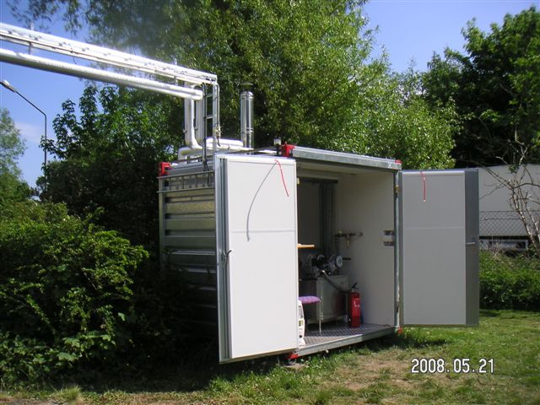
Externally Fired Micro Gas Turbine
(EFMGT)
Small energy production facilities.
They are called externally fired due to the combustion gases do not go directly through the turbine.
This makes the EFMGT flexible at the time of choosing a fuel.

Slide 2
Characteristics
Power 5 – 100 kW
Recovered Heat 20 – 400 kW
Electrical efficiency 15 – 25 %
Global efficiency 80 – 85 %
Other services: Cooling, drinking water, heat.
Relatively low maintenance and easy transport.

Slide 3
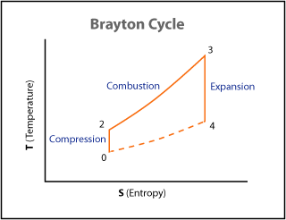
Operating principle

Slide 4
Main parts of an EFMGT
Compressor
Turbine Turbogenerator
Generator
Heat exchanger (Recuperator)
Combustion chamber

Slide 5
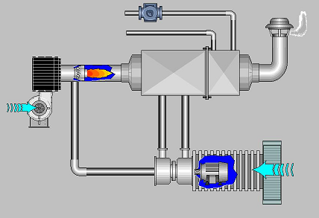

PATENTED DESIGN
Hot water
output
Fuel
Burner
Heat exchanger
Boiler
Air
Electricity
output
Air
intake
Turbogenerator

Slide 6
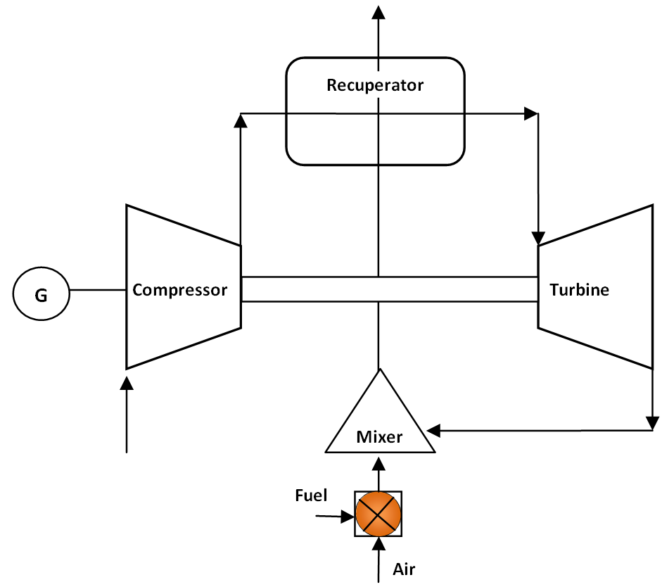
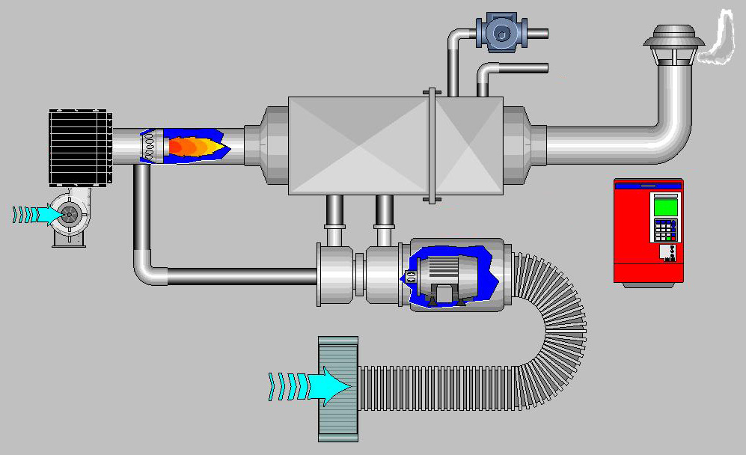
Main parts of Compower EFMGT
HEAT EXCHANGER
Water out
Fuel
Water in
BOILER
Air
BURNER
TURBOGENERATOR
Electrical power
Air intake

Slide 7
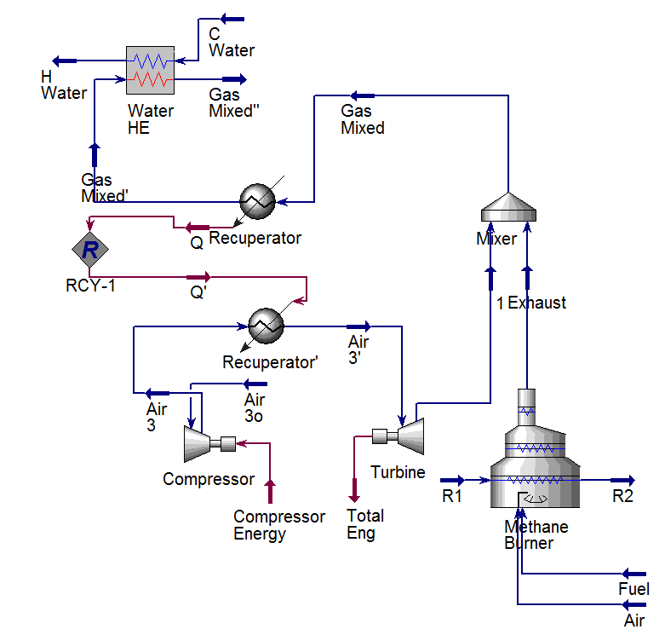

Slide 8
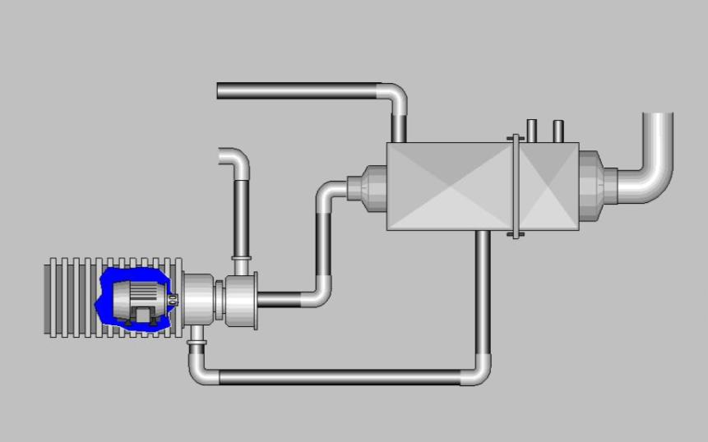
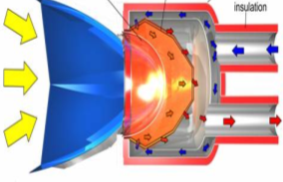

EFMGT Solar Driven Possibility
Concentrator
Receiver
Recuperator
Recitifier/inverter
for DC interconnection
or AC output
Turbogenerator

Slide 9


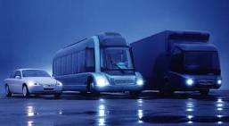
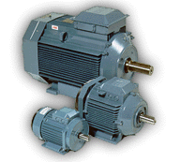

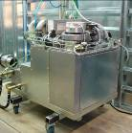
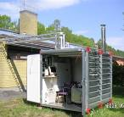
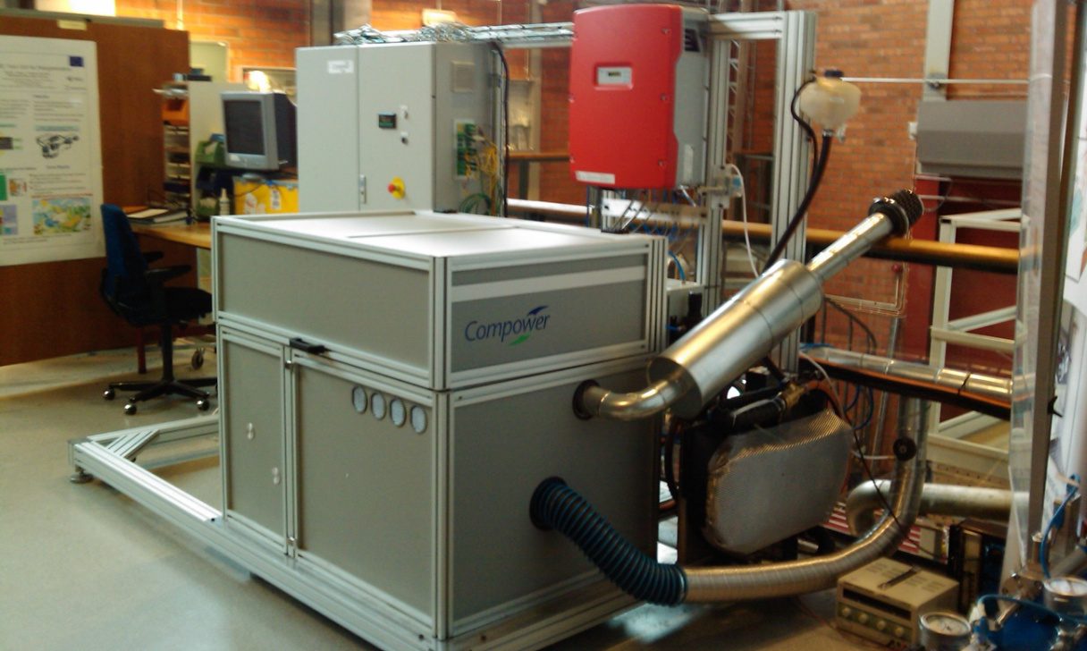





Development in time
1987 1992-1996 2001 2004 2007 2008 2010
Company formed
&
microturbine hybrids
Motors
Micro
Combined Heat and Power prototype
World’s 1st
micro turbine
with high speed permanent magnet
alternator
ET10 field trial unit at customer site. Biogas operation
ET10 field trial unit at KTH

Slide 10
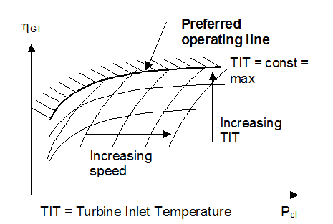
MGT efficiency map

Slide 11
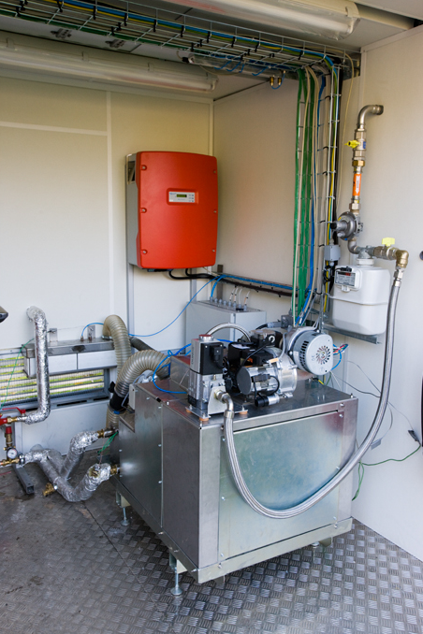
ET10 FIELD TEST PROTOTYPE

Slide 12
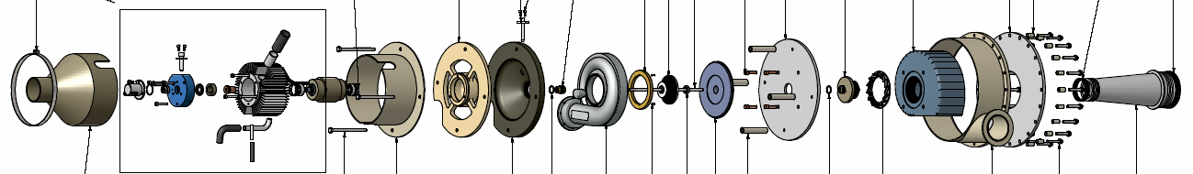
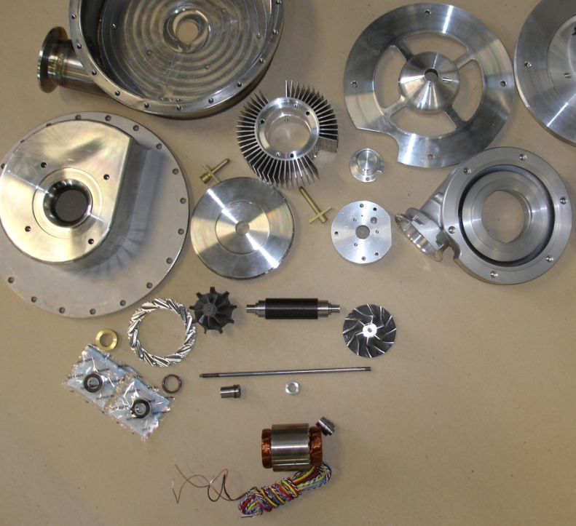
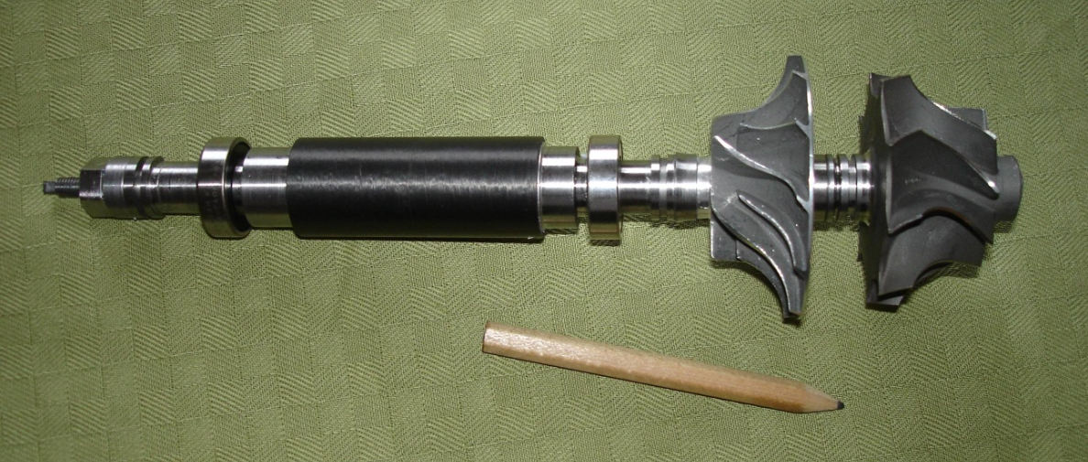
Turbogenerator
Parts and assembly

Slide 13
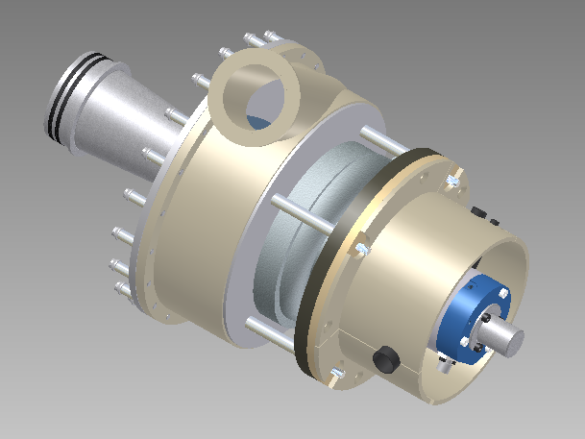
Turbogenerator ET10

Slide 14
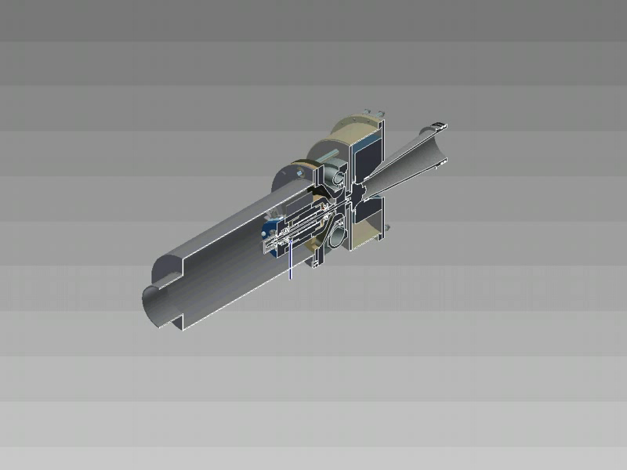
3D Turbogenerator Model

Slide 15
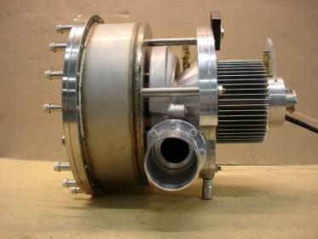
Turbogenerator parts
Compressor
Turbine
Bearing assembly
High speed
generator
Based on automotive turbocharger
technology
Integrated, highly efficient, permanent magnet generator, Air bearings.
Operating speed range 100,000 -160,000 rpm is the same as a turbocharger in a standard passanger car.
Bearing assembly
Compressor
outlet

Slide 16

Smallest Turbogenerator in the world
IHI Corporation Micro Gas Turbine
Power: 0,4 kW
Fuels: Gas and Liquid (Natural gas, propane, gasoline, diesel)
Speed: 350000 RPM
Source: NHK World (Japan TV Channel)

