Slide 1
Halftime presentation
Erik Branzén & Jesper Englund

Slide 2
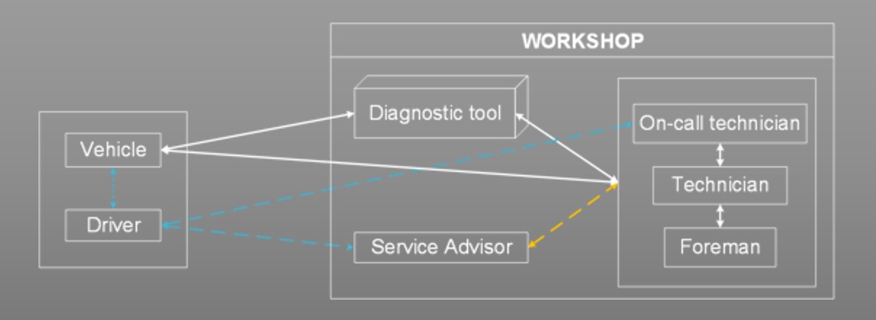
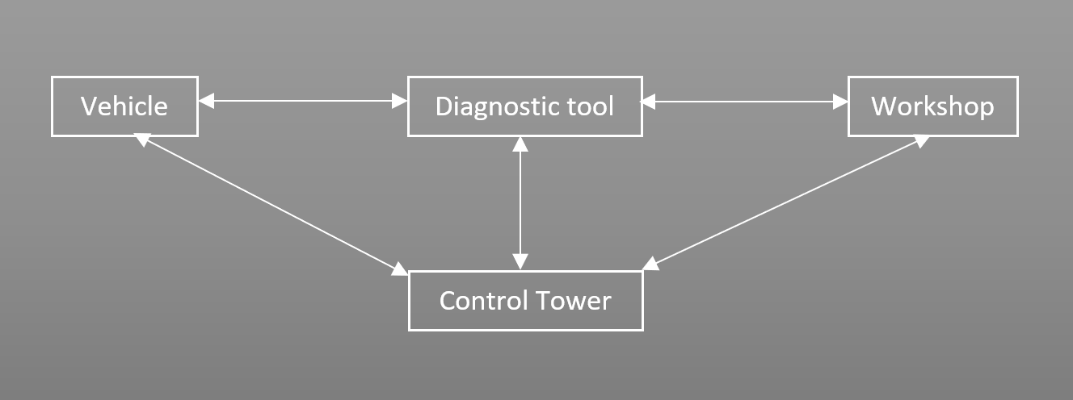
The Problem
Notes:
I den övre bilden ser vi olika nyckelaktörer i dagens diagnosprocess och hur information flödar mellan aktörerna.
Problemet är alltså i grund och botten att föraren har en väsentlig roll i den här processen, både vad gäller feldetektion och beslutsfattande. Det är en roll som på något sätt kommer behöva ersättas, till stor del av kontrolltornet, när föraren försvinner, men kanske också genom förbättrad feldetektion i fordonet t.ex. Men utmaningen blir då för mig att kartlägga kontrolltornets roll i det här informationsflödet.
The top image visualizes some of the key actors i today’s diagnosis process and how information flows between those actors. The problem for us is essentially that the driver has a crucial role in this process today, in terms of detection and decision making. This role has to be replaced to a certain degree by the control tower, and by improvements in the vehicle’s fault detection for example. So the challenge is therefore to map out the role of the control tower in this flow of information.

Slide 3
Implementation of fault scenarios in autonomous vehicle
ERIK BRANZÈN
MIDWAY Presentation
Notes:
tes test

Slide 4
Agenda
  Aims and research questions
  Key findings from pre-study
  Results so far
  System architecture and interactions
  Diagnostics: limitations and key concepts
  Minimizing technical downtime
  System evaluation
  Design of demonstrator
  Future work and new horizons
  Prognostics and situational awareness
  Planning

Slide 5
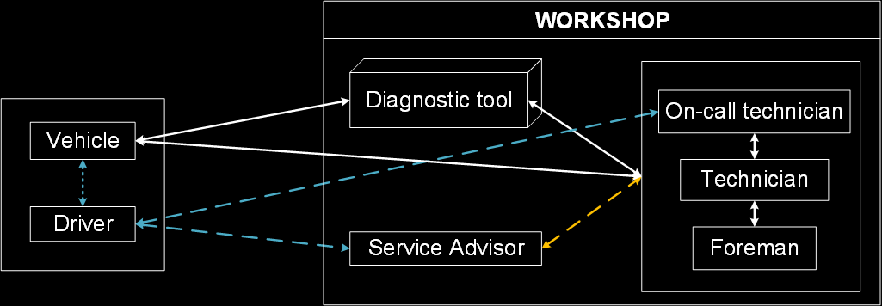
AIM:
To implement an algorithm that diagnoses faults based on measured symptoms and to use this diagnosis in an on-board decision-maker and planner that considers loss of uptime and safety. This system will be implemented in an AV.
RESEARCH QUESTIONS:
In an AV, how can uptime be considered in the handling of faults and potential faults?
What are the functional elements required to enable on-line diagnostics and decision-making on the SVEA platform
What can be generelized about smart diagnostics in AV:s from the demonstrated case study.

Slide 6

KEY FINDINGS FROM PRE-STUDY
The diagnosis will likely need to be more reliable and transparent in an AV than in conventional vehicles
New measurement devices could potentially help in diagnosing faults that previously required a human
Automatic decisions that try to minimize downtime might not be possible without some type of prognosis

Slide 7
SYSTEM ARCHITECTURE
Each node in the system uses the ROS network to communicate with other nodes. Data channels are published to and subscribed to and any node can publish or subscribe to any data channel
DETECTION
DIAGNOSE/PROGNOSE/PLAN
ACTUATION
Communication BUS via ROS
SIMULATION/WARNING GENERATION
COMMUNI-CATION CT
CT
Firebase database

Slide 8
What do we need?
Good models for RUL (remaining Useful Life)
Reliable diagnostics
Lots of data to estimate downtime
Fast detection of symptoms
1. Fault diagnosis
2. Fault Prognosis
3. Action feasability analysis
4. downtime analysis
5. uptime optimization
NEW FAULT
6. Plan update and actuation

Slide 9
Finish
W1
FAULT!
Start
W2

Slide 10
RESULTS - DIAGNOSTICS
Algorithm combines the list of symptoms/warnings and determines fault via probabilistic model.
The fault is not always correct but will fall in the correct category of faults i.e. flat tire, something stuck in tire and bearing fault are in the same category.
The diagnosis consists of the most likely singular fault but can easily be changed to output several likely faults.
The diagnosis is based on a probabilistic model between symptoms and faults. This model is not updated with data and the model parameters are estimated by me after thorough testing and workshops with experts.

Slide 11

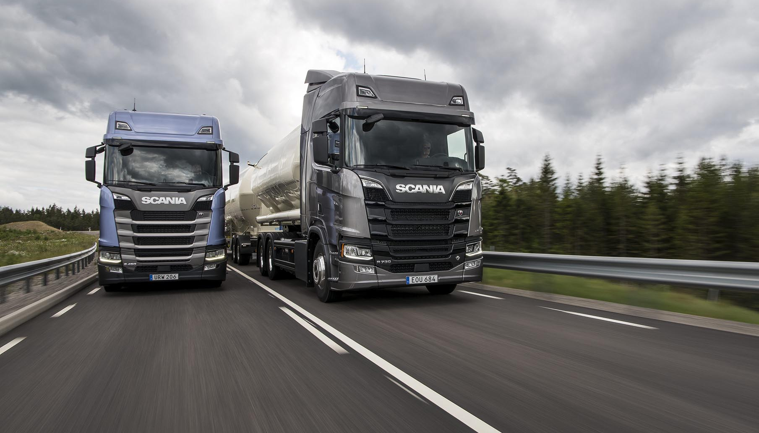
RESULTS – Minimizing technical Downtime
Downtime is measured by:
  Time lost by decreasing speed to a safe one
  Time lost by taking a detour to a workshop
  Time lost spent at workshop performing maintenance and repair
By calculating total travel time different scenarios can be compared.

Slide 12
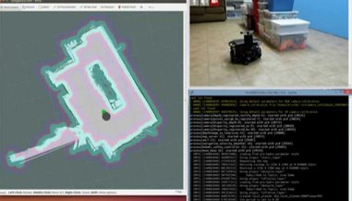
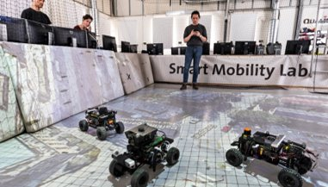
DEMONSTRATOR
The system will be implemented on the SVEA-vehicle
Test how the vehicle reacts to a set of scenarios
Control tower interaction with intervention capability

Slide 13
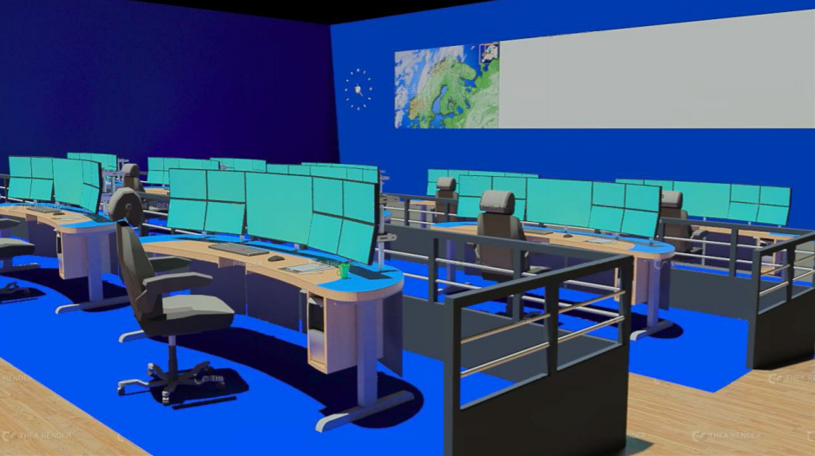

Future work and new horizons
PROGNOSIS
  More advanced models for fault propagation
  Minimize other types of downtime i.e. operational
Planning
  More advanced situational awareness can enable avoiding traffic jams, saving fuel etc
  More variables makes overall uptime harder to optimize

