Slide 1
Towards a data sharing eco-system
for a case of coordinated
distribution of goods
… and advanced benefits
Annette Hultåker

Slide 2
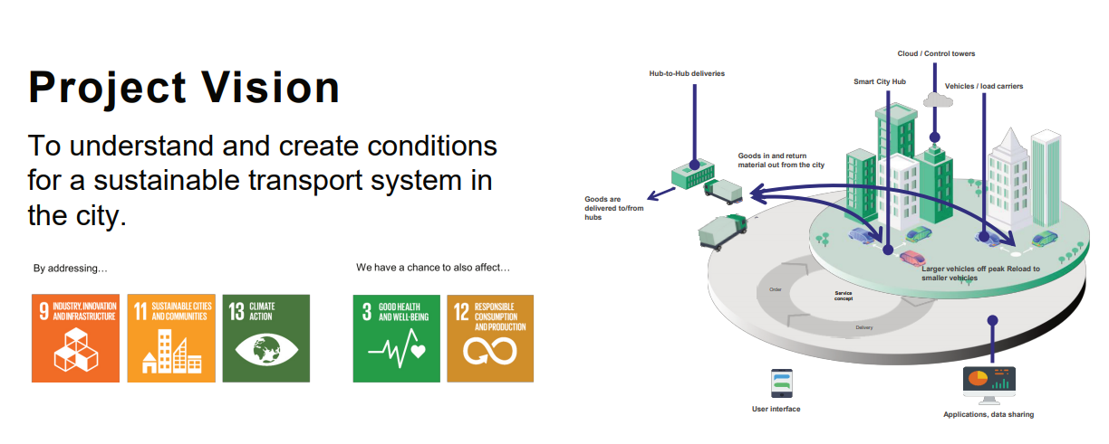

Slide 3
Agenda
Transportation data
Remedies for data sharing
Benefits of data sharing
Barriers for sharing data
Notes:
I will today briefly cover these 4 aspects today….
Let me also say that this is very preliminary work yet. I only started this work during the spring.

Slide 4
Transportation data
Remedies for data sharing
Benefits of data sharing
Barriers for sharing data
Structured data e.g.; shipment orders, vehicle and goods id:s with attributes, sensor data
Unstructured data; text, video, sound
Goods data
Public organization data e.g.;
traffic controls, toll stations, passenger
3rd party data e.g.; weather, roads
Vehicle data
Fleet data

Slide 5
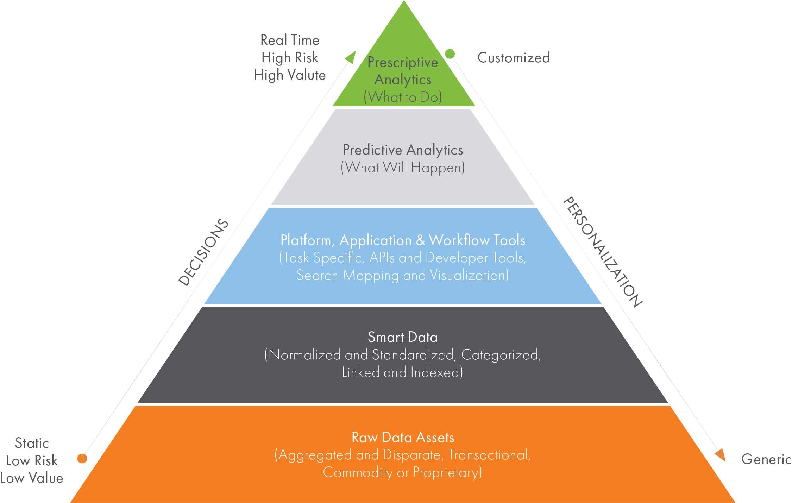
Transportation data
Remedies for data sharing
Benefits of data sharing
Barriers for sharing data
How data refinement enables
- enhanced decision support
- customized services
Source: Outsell analytics

Slide 6
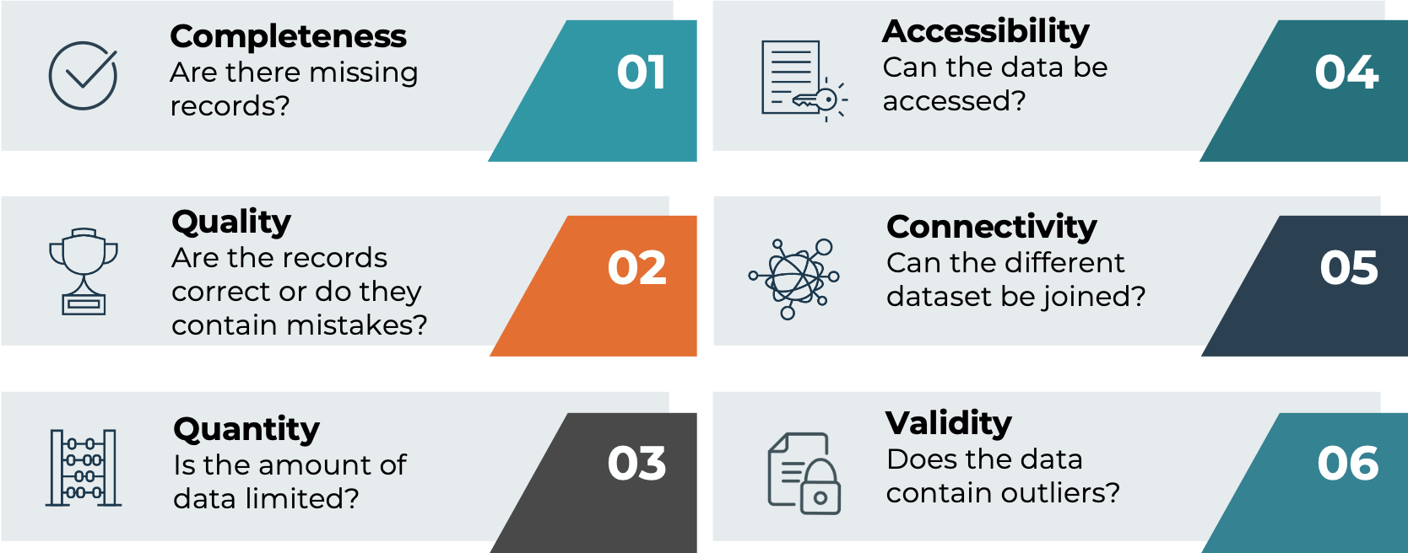
Transportation data
Remedies for data sharing
Benefits of data sharing
Barriers for sharing data
Requirements on data for Advanced analytics/AI applications
6 basic demands;
which aspect that is of most importance depend on the application
source: 2021.ai

Slide 7
Transportation data
Remedies for data sharing
Benefits of data sharing
Barriers for sharing data
Cultural and organizational barriers
- do not see potential benefits
- lack of trust and fear of competition
Legal and regulatory barriers
- restrictions of data location
- restrictions/uncertainty in lawful grounds to use or share data
- uncertainty about data ownership and data access
Technical and operational barriers
- lack of data interoperability
- lack of standards
- high costs of data curation to adapt it for sharing
Barriers might be perceived or real

Slide 8
Transportation data
Remedies for data sharing
Benefits of data sharing
Barriers for sharing data
Barriers
Cultural and organizational
Legal and regulatory
Technical and operational
Remedies >> enabling data sharing
Anonymised data
Share - what can be shared, and withhold the sensitive data
Aggregated data
Create sharing standard
Synthetic data, or data that carries the statistical properties of real data
Cloud technology can provide read-only data sharing
Remedies >> enabling data sharing
Train algorithms locally – without sharing the actual data; edge computing with federated learning
Create trust through closer collaboration
Secure (neutral/geo-restricted) platform
Create shareholder benefits
Regulate with agreement

Slide 9
Draft platform for secure sharing of transportation data
Transportation data
Remedies for data sharing
Benefits of data sharing
Barriers for sharing data
Data from
various actors
Data ingestion management
Data storage
Data preparation
Data view layer
Data sharing management
Visualization
Reporting/BI
AI
Analytics
view layer
Demands on platform
Scalability
Reliability
Versatile toolbox
Ownership
Cloud/on-prem
Geo-location
access control
encryption
workload management
auditing
Components
Analytics
Data flow and refinement
Data management

Slide 10
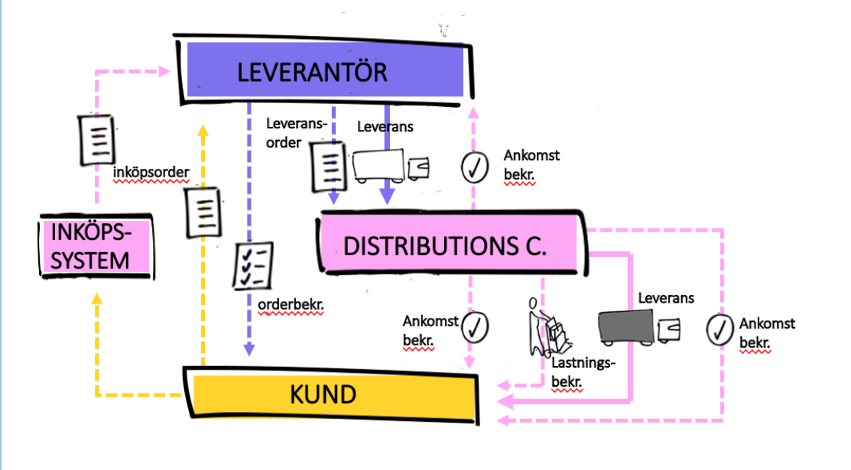
Transportation data
Remedies for data sharing
Benefits of data sharing
Barriers for sharing data
Södertörn - coordinated distribution of goods

Slide 11
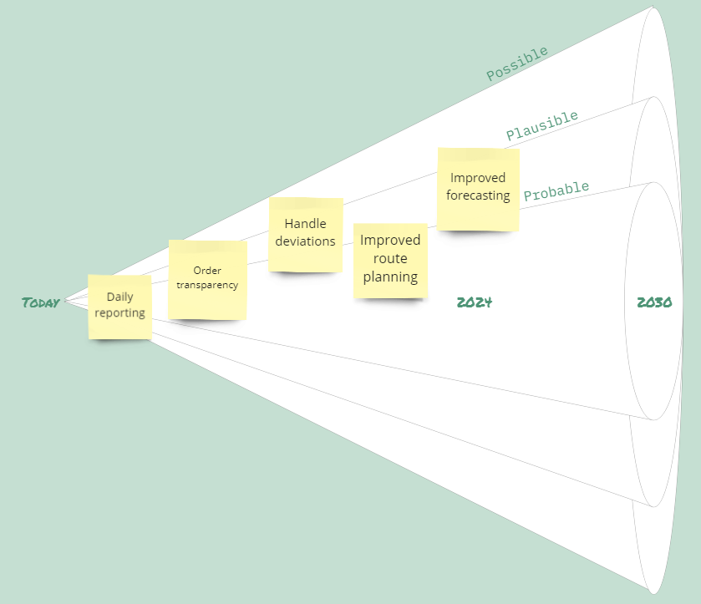
Transportation data
Remedies for data sharing
Benefits of data sharing
Barriers for sharing data

Slide 12
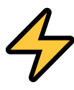
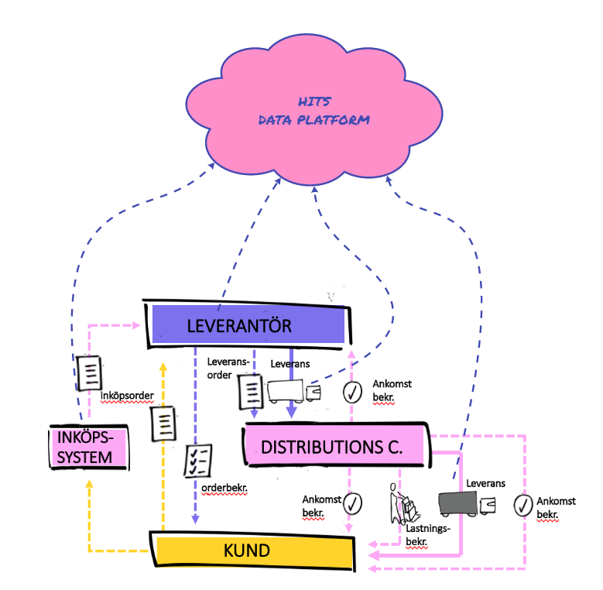
Transportation data
Remedies for data sharing
Benefits of data sharing
Barriers for sharing data
Cultural and organizational barriers
- do not see potential benefits
☑ lack of trust and fear of competition
Legal and regulatory barriers
☑ restrictions of data location
☑ uncertainty in lawful grounds to use or share data
- uncertainty about data ownership and data access
Technical and operational barriers
☑ lack of data interoperability
☑ lack of standards
- high costs of data curation to adapt it for sharing
with analytics
capabilities

