Slide 1
Performance Evaluation of the Arrival Operations in Terminal Area
ICAS, 2022-09-05
Henrik Hardell
Anastasia Lemetti
Tatiana Polishchuk

Slide 2
Presentation Outline
Introduction
Methodology
Results
Conclusions and Future Work

Slide 3
Introduction

Slide 4
Introduction
Terminal Maneuvering Areas (TMAs) main contributors to inefficiencies in air transportation
Due to capacity limitations as well as overall traffic complexity in the airspace
Influenced by factors such as geographical location of the corresponding airport(s), surrounding terrain, and to a large extent by the organization and distribution of the arriving flows

Slide 5
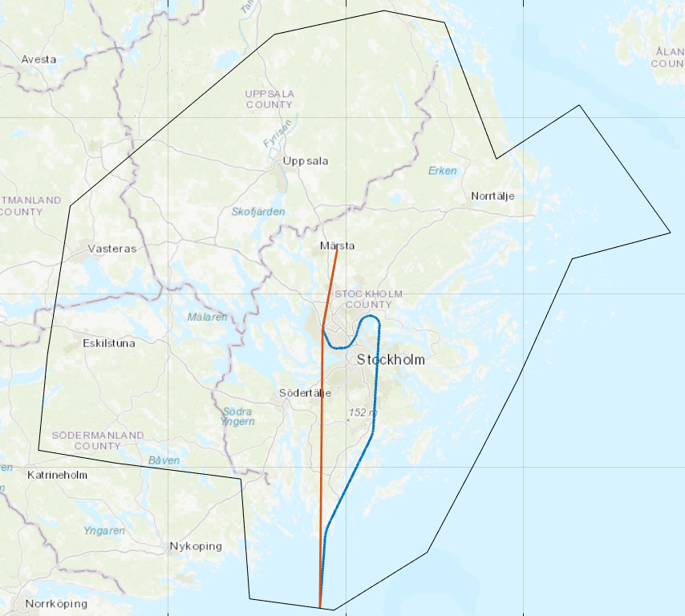
Introduction
Inefficient operations in the TMA may be attributed to both the horizontal and the vertical flight performance of an aircraft
Optimal horizontal trajectory: Fly shortest route from TMA entry to final approach
Optimal vertical trajectory: Engines operating at an idle thrust setting, in combination with no speed-brakes usage, at a continuous descent (CDO)

Slide 6
Introduction
In previous work [1] [2], significant performance inefficiencies were uncovered, resulting in excessive fuel consumption at Stockholm-Arlanda airport in 2019 and 2020
Can we identify areas of flight inefficiency by assessing horizontal, vertical and fuel efficiency for arriving aircraft, utilizing a clustering technique?
In addition, we analyze the impact of different factors, such as weather and traffic intensity, to understand which of the factors cause which aspects of performance degradation
[1] H. Hardell, T. Polishchuk, and L. Smetanova. Fine-Grained Evaluation of Arrival Operations. In SIDs, 2020
[2] A. Lemetti, T. Polishchuk, and H. Hardell. Arrival Flight Efficiency in Numbers: What New the Covid-19 Crisis is Bringing to the Picture? In SIDs, 2020

Slide 7
Introduction
Stockholm-Arlanda (ESSA) airport
$\sim$230.000 yearly movements
Situated below the airspace of Stockholm TMA
Four TMA entry points
Multiple-runway airport, operating with a parallel pair of runways and an intersecting, single runway
Open STARs (Standard Arrival Routes) for all runways and closed STARs for the runways 01L, 19R and 26

Slide 8
Methodology

Slide 9
Dataset
Historical database of the OpenSky Network
Open-source data in a form of aircraft state vectors for every second of the trajectories
Data transmitted by the Automatic Dependent Surveillance Broadcast (ADS-B) aircraft transponders
Cleaning and filtering to remove any incomplete or erroneous records and non-typical flights
Removing fluctuations in position and altitude
Smoothing of altitude inconsistencies with Gaussian filter
Removing incomplete or too damaged trajectories
Removing flights: go-arounds, not landing on the runway, departure and arrival at the same airport
01R, 19L and 26 the busiest runways for landings in 2019
For characterization of the horizontal, vertical and fuel performance, we consider only the busiest month in 2019 (October)

Slide 10
Weather Data
ERA5 reanalysis dataset provided via the C3S Data Store
NetCDF files with 0.25° granularity and temporal granularity of one hour
Used for evaluation of weather impact on flight efficiency as well as for creating reference continous descent (CDO) profiles and for fuel consumption calculation

Slide 11
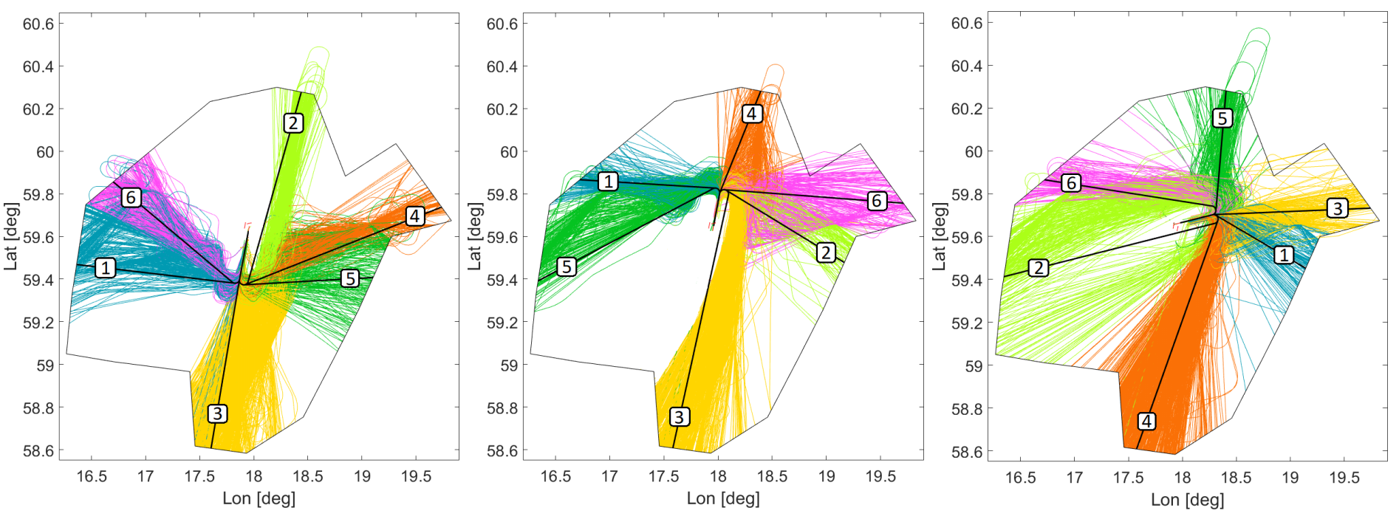
Clusters
Arriving aircraft clustered into 6 different clusters, for each runway
Horizontal reference trajectories starting at each cluster centroid
The reference trajectory goes directly to a 2 NM straight segment before the start of the final approach segment

Slide 12
Horizontal Flight Efficiency
Assessed through the horizontal deviation from a reference trajectory, denoted as Additional Distance
Reference trajectories are the direct routes created for each cluster
Expressed in percentage to the corresponding reference trajectory distance

Slide 13
CDO Profiles
CDO trajectories created for all arrivals to TMA, acting as reference vertical profiles
Performance of the CDO profiles modelled using Eurocontrol Base of Aircraft Data (BADA) v4.2
Idle thrust descent without using speedbrakes, utilizing the BADA idle rating model
Engine idle thrust and drag calculated at every timestamp and fed into the BADA Total Energy Model (TEM)
Aircraft type specific speed profiles designed according to the speed schedule formulas provided in BADA
From the TEM, the vertical speed (dh/dt) is obtained at every timestamp
By calculating the vertical speed along the trajectory, the full vertical profile is obtained
90% of the maximum landing weight for each aircraft type
TEM:

Slide 14
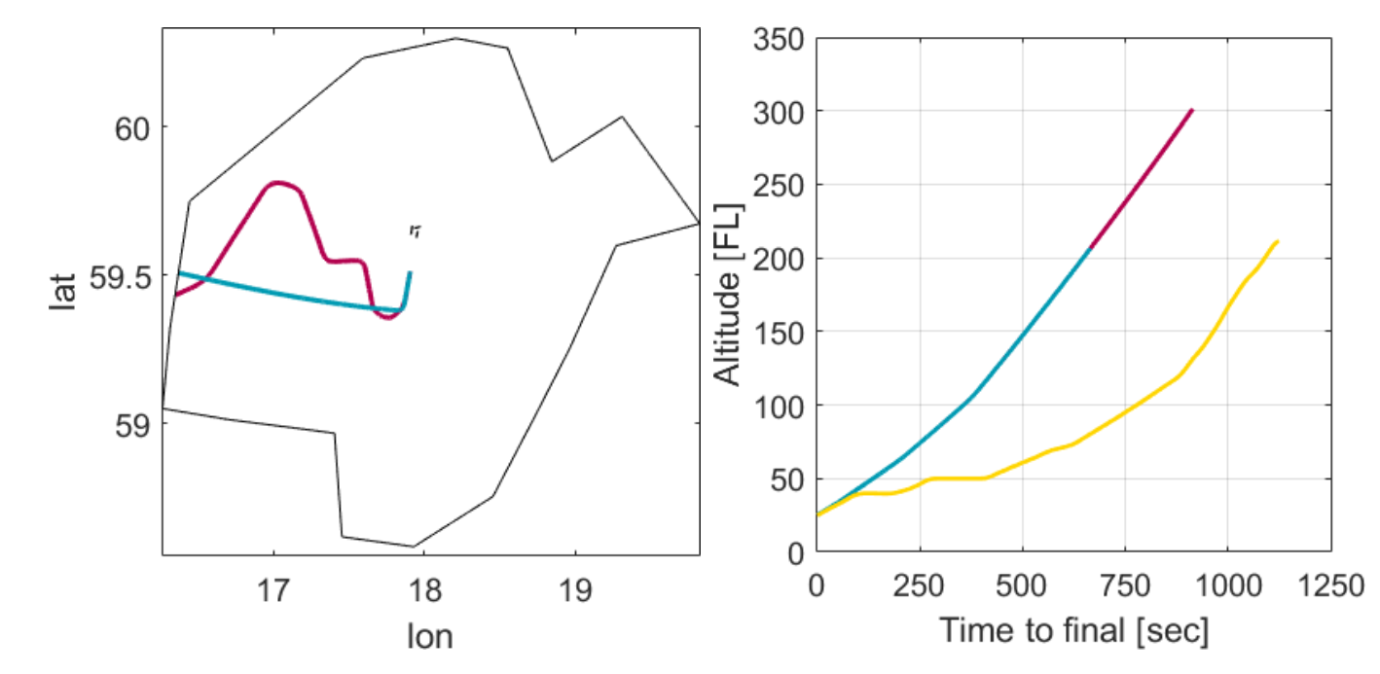
CDO Profiles
Two different CDOs: Reference Trajectory 1 (RT1) and Reference Trajectory 2 (RT2)
RT1 follows the same horizontal trajectory as the real flight
RT2 follows the trajectory of the horizontal reference trajectory of the corresponding cluster
Unrestricted descent assumed, i.e. any altitude restrictions not respected
CDOs not allowed to cross the TMA border at a higher altitude than the cruise altitude of the real flight

Slide 15
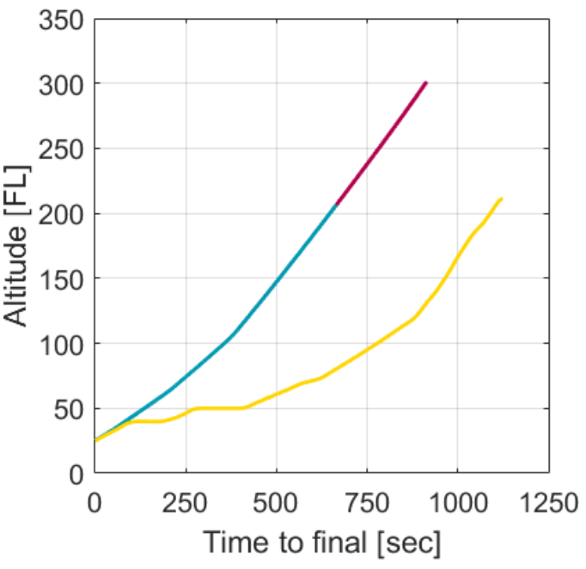
Vertical Flight Efficiency
1) Time Flown Level
Calculated using the technique proposed by Eurocontrol with small changes
A level segment is detected when the aircraft is flying with a vertical speed below a certain threshold
300 feet per minute used for this threshold
Minimum time duration of the level flight is considered 30 seconds
Calculated in percentage to the total time spent in TMA
2) Vertical Deviation
RT1 Reference CDO profile used
Vertical deviation from the Reference Profile metric as a function of time to final, and the area under the curve measured in ft·minutes constitutes the metric

Slide 16
Fuel Efficiency
For the reference CDOs, the idle thrust fuel coefficient from BADA is used
For the actual trajectories, the TEM is used as a reference for calculating the thrust, from which the thrust coefficient and the fuel coefficient is obtained
To ensure the calculated thrust stays within the feasible limits, the thrust at the maximum climb rating and idle rating is calculated, which bound the calculated thrust from below and above
Effects of deploying flaps at lower speeds, which will generate more drag and increase the fuel consumption, is not considered
Fuel flow:

Slide 17
Impact Factors
Weather Impact Factor
A unified condition metric representing the time period weather situation
Choose the time period (we take one hour)
Choose impact factors (we perform principal component analysis (PCA) of 24 weather metrics and take the principal components as weather factors)
Sum up normalized impact factors
Discretize the results (we discretize into 10 bins)
Traffic Impact Factor
Represents the time period traffic situation
Choose the time period (we take one hour)
Discretize the number of flights per period (we discretize into 10 bins)

Slide 18
Results

Slide 19
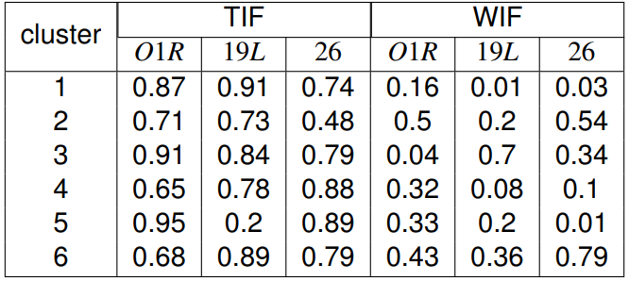
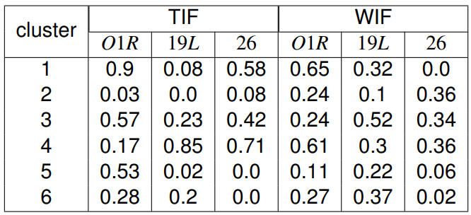
Impact Factors
Additional Distance
High impact of traffic intensity factor on the horizontal efficiency for all runways and all clusters, with exceptions:
Rwy 01R, clusters 4 and 6
Rwy 19L, cluster 5
Rwy 26, cluster 2
Low impact of traffic intensity factor on the vertical efficiency for all runways and all clusters, with exceptions:
Rwy 01R, cluster 1
RWY 19L, cluster 4
Time Flown Level

Slide 20
Impact Factors
Additional Distance
The impact of weather factor on the chosen PIs is noticeably lower than the impact of traffic intensity
Moderate correlation with additional distance:
Rwy 01R, cluster 2
Rwy 26 clusters 2 and 6
Moderate correlation with time flown level:
Rwy 01R, clusters 1 and 4
Rwy 19L, cluster 3
Time Flown Level

Slide 21
Flight Efficiency
Range of medians for the clusters
 | 01R | 19L | 26
Additional distance | 0% – 6.5% | 1.3% – 5.6% | 0% – 6.9%
Time flown level | 0% – 5.2% | 0% – 0.8% | 0% – 1.9%
Additional fuel burn | 56% – 125% | 42% – 108% | 37% – 82%

Slide 22
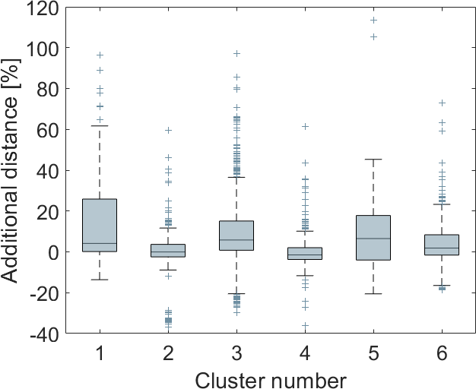
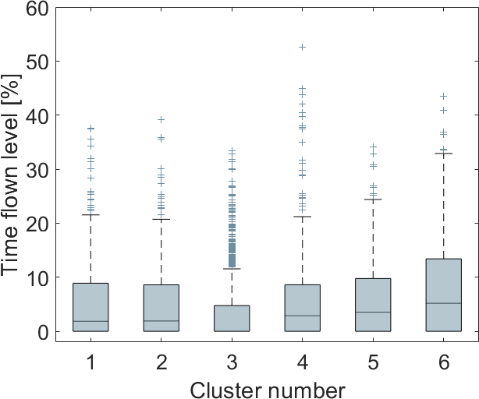
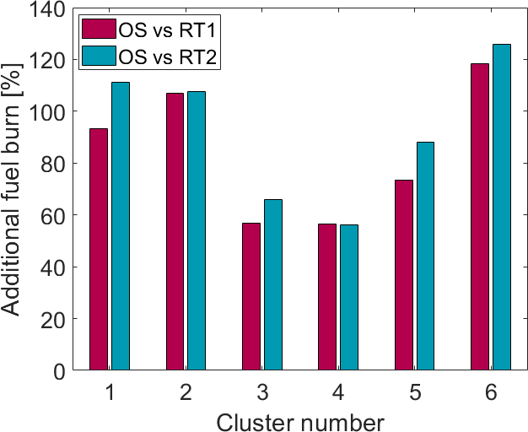
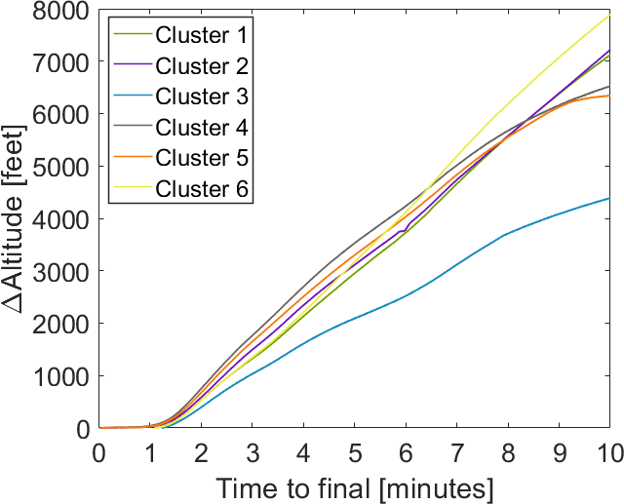
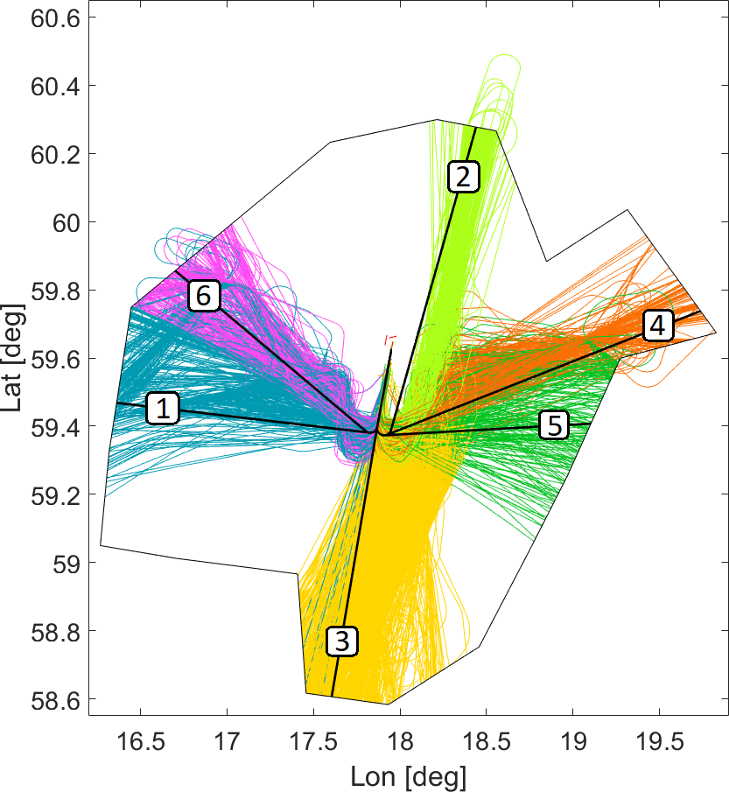
Flight Efficiency – 01R
Clusters 2 and 4
Low additional distance
Moderate time flown level
High vertical deviation
Almost identical RT1 and RT2 additional fuel burn
Cluster 1
High additional distance
Moderate time flown level
Significant difference between RT1 and RT2 additional fuel burn

Slide 23
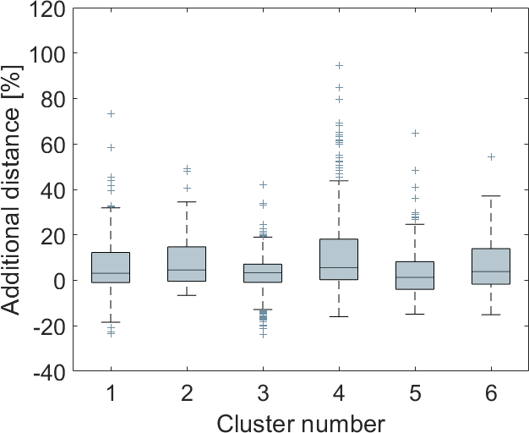
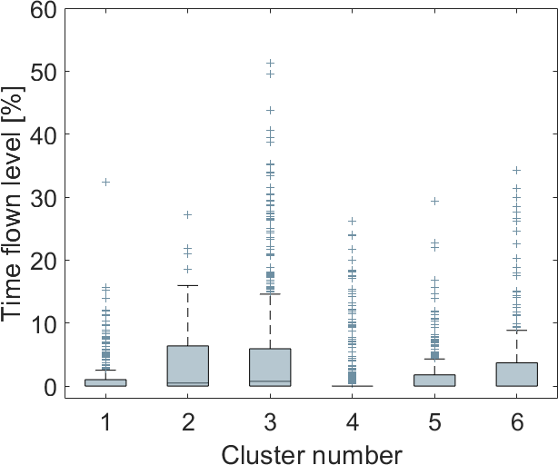
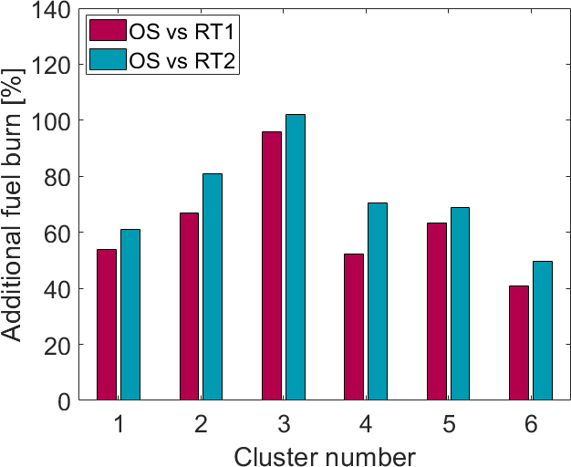
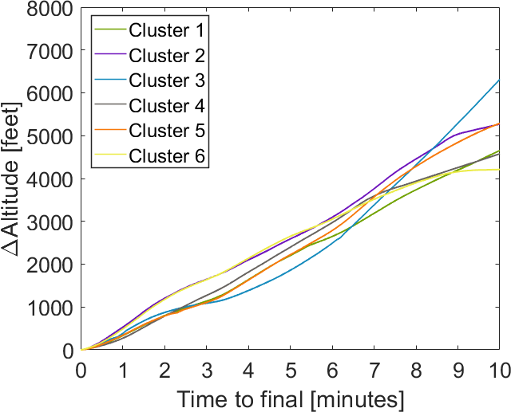
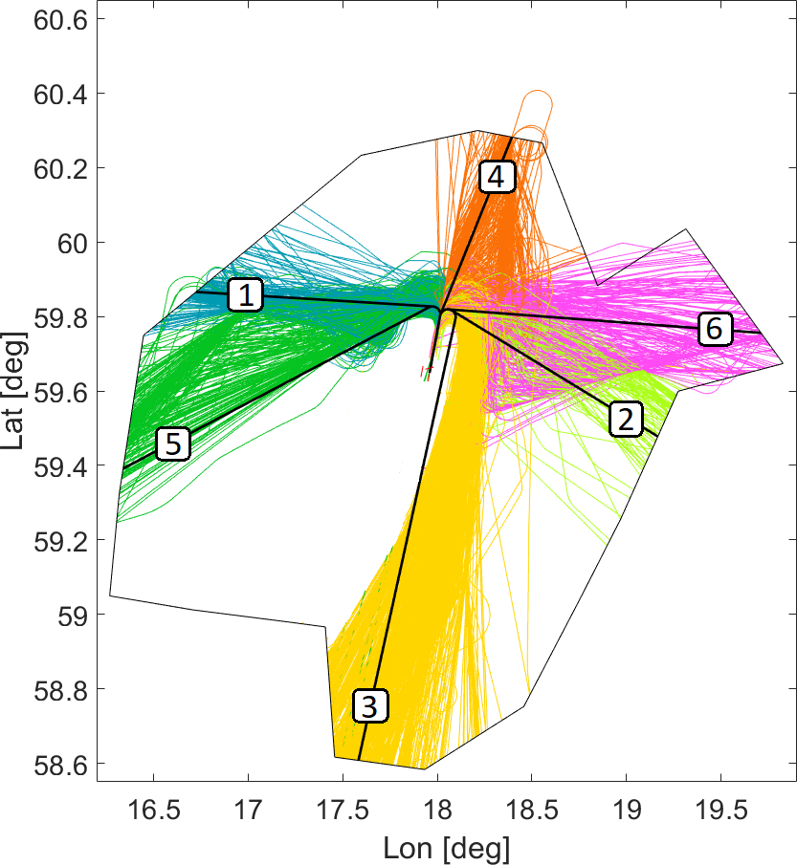
Flight Efficiency – 19L
Cluster 4
High additional distance
Low time flown level
Moderate vertical deviation
Significant difference between RT1 and RT2 additional fuel burn
Cluster 5
Low additional distance
Moderate time flown level
High vertical deviation
Low difference between RT1 and RT2 additional fuel burn

Slide 24
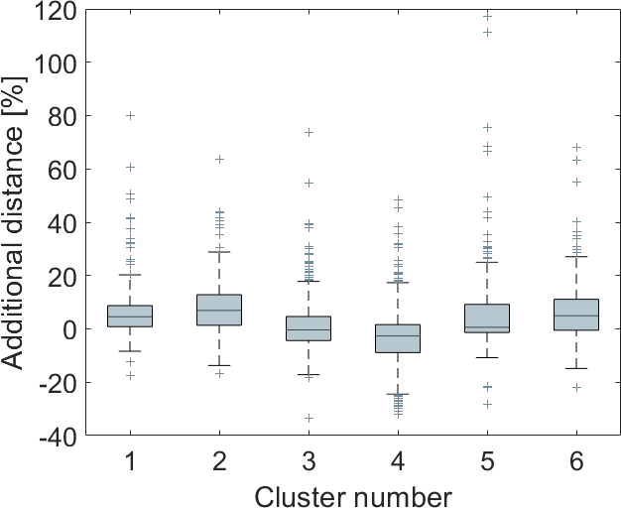
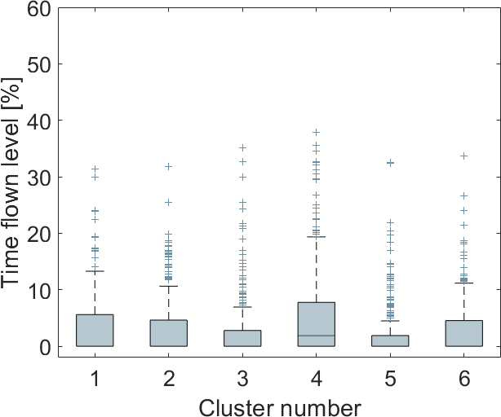
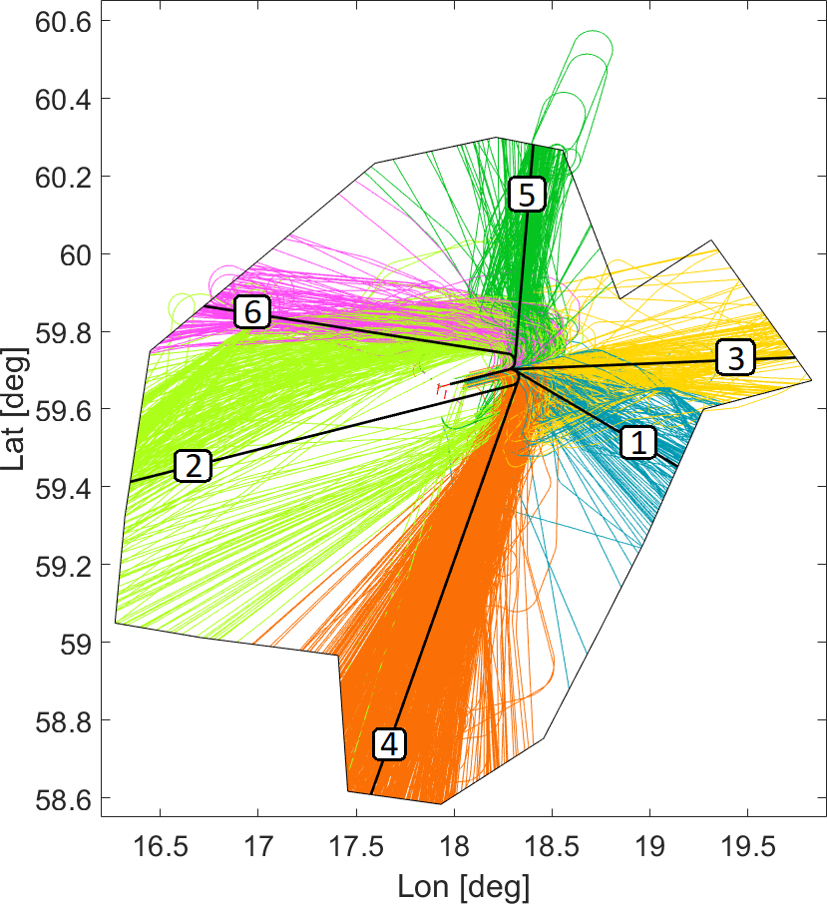
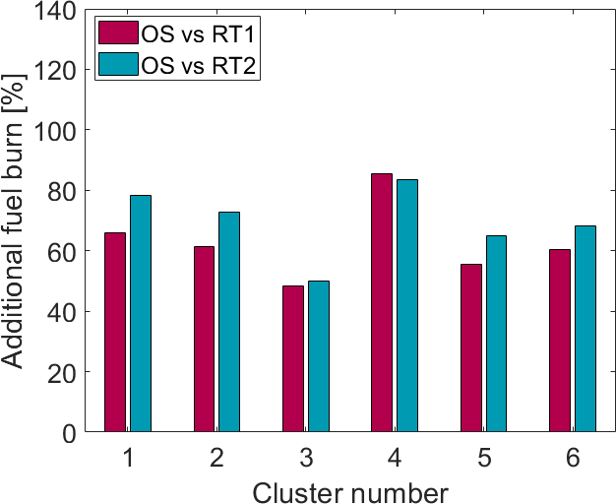
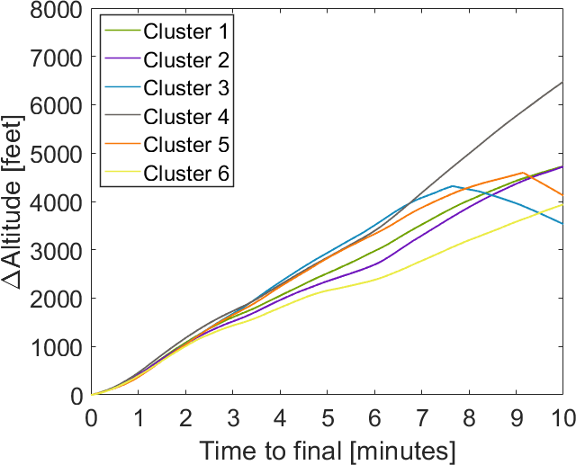
Flight Efficiency – 26
Clusters 3 and 4
Low additional distance
Moderate time flown level
Moderate and high vertical deviation
Low difference between RT1 and RT2 additional fuel burn

Slide 25
Conclusions and Future Work

Slide 26
Conclusions and Future Work
Clustering of the arriving traffic to Stockholm-Arlanda airport
Per-flow analysis of the TMA performance
Weather and traffic impact assessment for whole 2019
Flight efficiency (horizontal, vertical and fuel) assessment for a busy month in 2019
Additional fuel burn ranges from 37.0% to 125%
Traffic intensity has a significant impact on the horizontal flight efficiency for most of the runways and clusters
Plans for future work includes continuous investigation of fuel efficiency in TMA, which is a proxy to aviation’s impact on the environment, and investigate why some clusters are more influenced than others

Slide 27
Thank you for your attention
Questions?

