Slide 1
POLICE AND CRIME IN RURAL AND SMALL
MUNICIPALITIES
Peter Lindström, PhD
Stockholm County Police
Department of Criminology, Malmö University
September 2014

Slide 2
The Government’s standpoint
“A visible and present police across the country is important for people’s feeling of safety…Initially, the government investment in the police focus on the most crime-hit areas which are both in big cities and in rural areas…
… the Government’s goal of 20 000 police officers by 2010 should lead to a locally based police throughout the country” (Budget Bill 2006/07:1, p. 23)

Slide 3
Three research questions:
Has police presence in rural and small municipalities increased during the last decade?
Does it matter whether rural and small areas have more or less police?
How will the new police organisation in 2015 deal with police presence in rural and small municipalities?

Slide 4
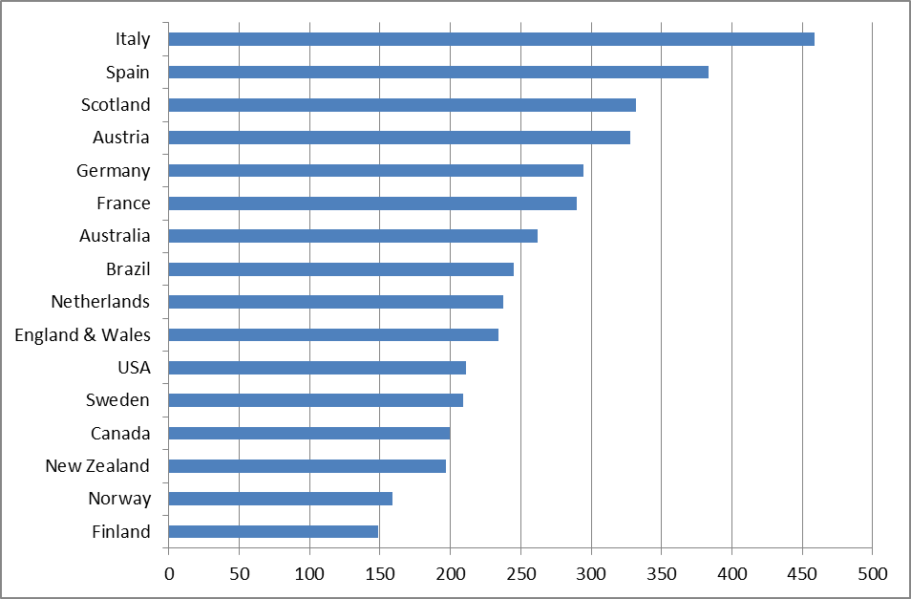
    Number of Police Officers per capita 2012

Slide 5
Police level in Sweden

Slide 6
SWEDEN:
Population: 9 705 005
Area: 449 964 km²
Density: 22 persons/km²
(Australia: 2,7; Brazil: 23; West Virginia US: 29; Scotland: 64; Georgia US: 65; Ohio US: 108; England: 395)
Municipalities: 290
Regional authorities: 21
Police authorities: 21 & National Police Board
One Police Service in 2015 (7 regional police areas)

Slide 7
Defining Rural and Small Municipalities
”The term ’rural’ is a concept that is easily understood… yet difficult if not impossible to define” (Marshall & Johnson, 2005, p. 7)
”Rural is like pornography; I can’t precisely define it but I know it when I see it” (Weisheit et al.,1995)
One method for defining rural and small municipalities is to make use of self-identification…

Slide 9
Type of Municipalities | SALAR (N = 290) | SmåKom (n = 66) | SmåKom Coverage
Sparsely populated | 20 (7%) | 13 (20%) | 65%
Tourism and travel industry | 20 (7%) | 11 (17%) | 55%
Commuter | 51 (18%) | 19 (29%) | 37%
Manufacturing | 54 (19%) | 14 (21%) | 26%
Suburban to large cities | 22 (8%) | 4 (6%) | 18%
In densely populated regions | 35 (12% ) | 4 (6%) | 11%
In sparsely populated regions | 16 (6%) | 1 (1.5%) | 6%
Other | 72 (25%) | -- | --

Slide 10
SmåKom’s opinion on the 2015 Police Reform
”It is important that people living in rural and small areas can feel safe. The most important factor, which should be given higher priority, concerns police presence… SmåKom advocate that the geographical dimension as well as targets for police response time should be taken into account [when allocating resources] ”
(www.smakom.se/pagaende-verksamhet/)

Slide 11
Proportion of Swedish municipalities without a locally based Police

Slide 12
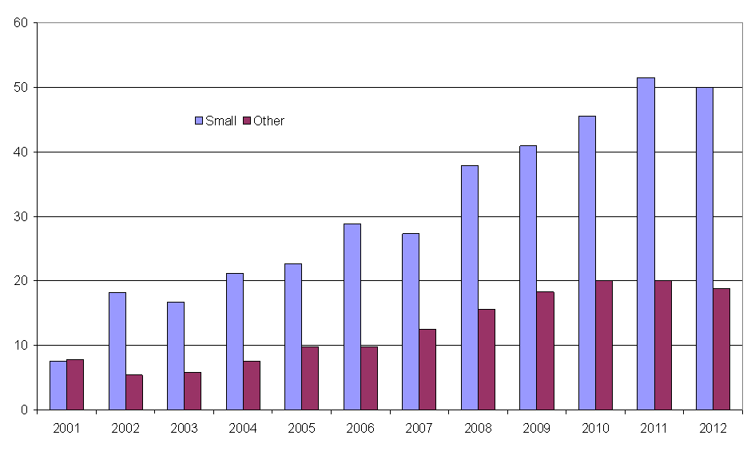
Municipalities without a locally based Police

Slide 13
Trends in Police Presence in three different types of areas

Slide 14
Overall conclusion:
Over the last decade the number of locally based police officers in rural and small municipalities has declined – despite the political intention
”Concern as number of rural police officers sees reduction”(Lancashire Evening Post, Januari 2013)
”The closure of police stations impacts on the number of police officers actually policing the rural areas and results in the loss of core rural policing skills” (Smith and Somerville, 2013, p. 355)

Slide 15
Some potential measures:
- Distance learning programme (since 2002)
- Mobile police stations (since 2005)
- Special task force (since 2011)
- Economic compensation (has been tried in Norway)
- Private policing (security guards)
Renewed police-community cooperation
(the 2015 police reform)

Slide 16
Does it matter?

Slide 17
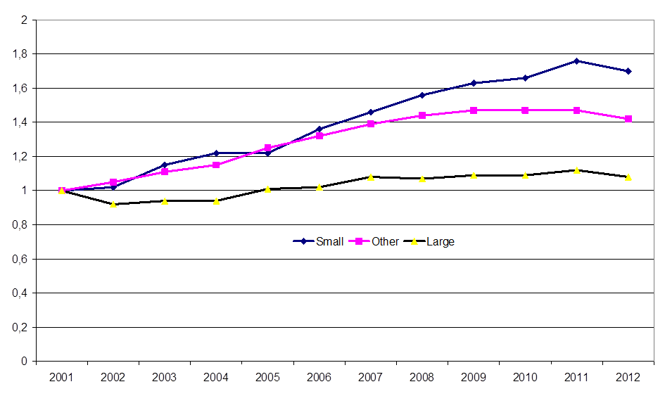
Police-recorded violent crimes

Slide 18
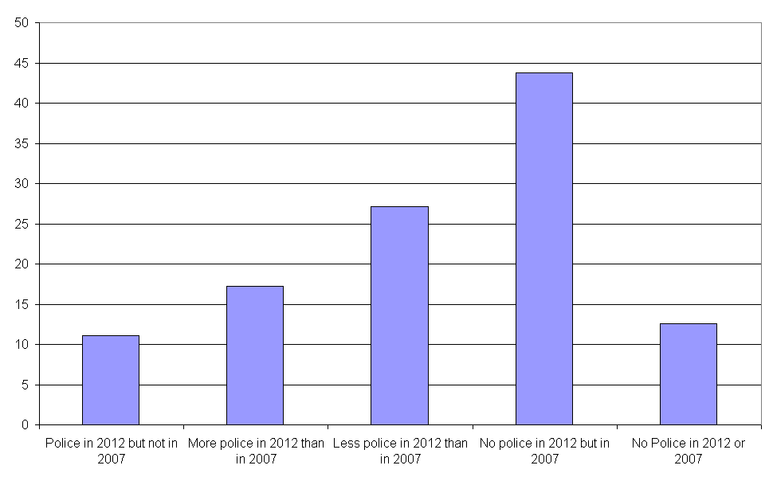
Average change in residential burglary between 2007/08 and 2012/13 in five categories of municipalities

Slide 19
It does matter!
There is a negative message or ”signal” towards the municipalitiy when locally based police is reduced
”Trouble spreads out: Crime, teenage pregnancy, bad schools and other ills are increasingly suburban and rural” (The Economist, May 2014)
Policing in a crime policy perspective – in socially disadvantaged urban neighbourhoods vs. rural and small municipalitites

