Slide 1


Relationships and responses: Policing anti-social behaviour in rural Scotland
Andrew Wooff
PhD Candidate
University of Dundee
a.j.wooff@dundee.ac.uk
@ajwooff
Notes:
Good morning – my name is Andrew Wooff and I am currently a research associate working at the University of Sheffield, but today I am going to talk about some research conducted as part of my very-soon to be completed PhD at the University of Dundee. I would like to start by thanking Vania for organising this and bringing together a group of excellent speakers on what is a fairly momentous day for the country I am going to be speaking about.
This paper seeks to examine notions of rural policing in Scotland. Rural policing is an area that has been largely absent from the literature, although a number of papers and books have recently sought to shed light on the varying dimensions of rural policing including some work by people that are here today.
This paper focuses on the police (rather than the broader plural policing agenda) and argues that understanding the nuance of the rural context is of central importance for understanding the response of the police to ASB in rural Scotland

Slide 2
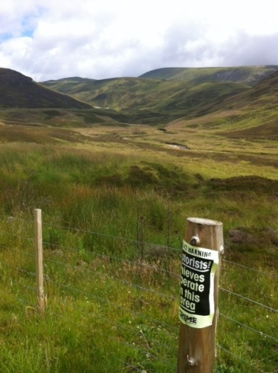
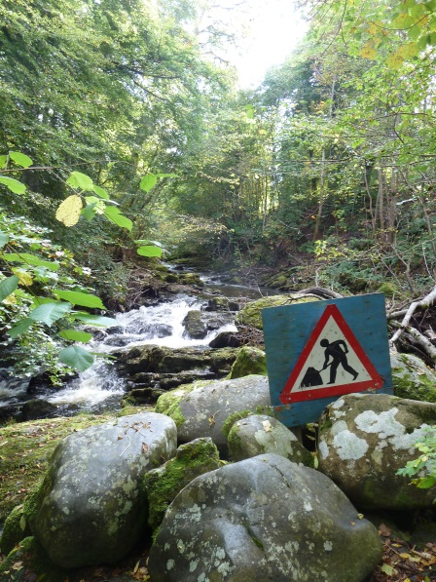
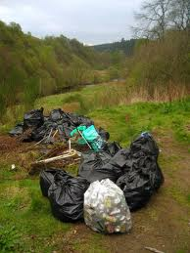
Presentation Overview
Context of study
Conceptualising the rural
Negotiated order and order maintenance
Characterising rural policing – discretion, police-community interaction and situated knowledge
Towards rural policing
Notes:
Using qualitative data, this paper examines the policing response to ASB in rural Scotland – starting by contextualising and conceptualising the study. It applies Halfacree’s (2006) conceptualisation of rural space, which essentially talks about rural space as a triad between the lives of those in rural areas, the rural locality and representations of the rural .
Many existing policies in relation to ASB typically tend to treat ‘the rural’ as a single dimension, where (urban) policy gets enacted with little consideration for the context
Against this backdrop, this paper attempts to understand a set of key practices, which structure the response of the police to ASB in rural Scotland. These practices relate to the use of discretion, police-community interaction and the importance of situated knowledge over two different rural spaces.. Whilst these features are also important to urban police responses to ASB, they acquire heightened importance in the rural, with large rural policing beats being covered by a small number of officers based in police stations which are often geographically removed from the communities for which they are responsible.
This means that there are unique challenges in rural policing which existing policing literature tends to underplay. The final part of the presentation therefore asks whether we need to consider rural policing as something distinct.

Slide 3
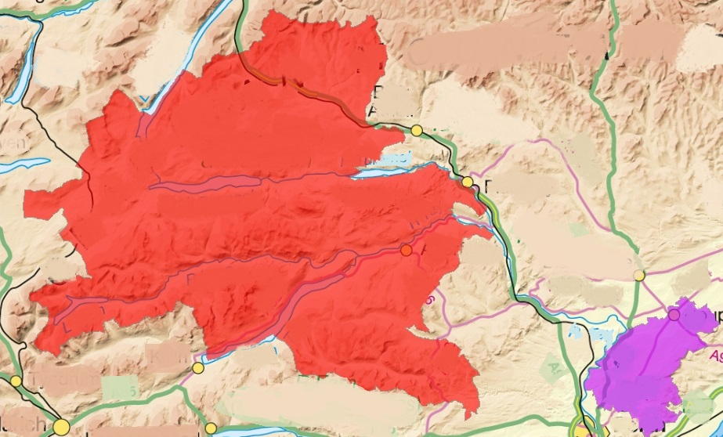

Scotland: Context
Abanoch
Crian
Notes:
The data emerges from: 80 hrs of participant observation conducted with the police and young people across the two communities; 33 interviews conducted with people living in both communities and 8 focus groups conducted with young people and organisations in both locations. The research took place between August 2011 and January 2013 and, because of the temporality of ASB, fieldwork was undertaken at different times and days of the week
Unique geography – 94% of country classed as rural and 18% of population live in rural location
In order to get an understanding of the ways in which ASB differs between types of rural locations. two case studies area were selected by combining the Scottish Government six-fold urban-rural classification and the Scottish Indices of Multiple Deprivation. The village of Abanoch is classed as a remote rural location, located a fifty minute drive from the nearest town of 10,000 people or more. With a population of 1895, it is a small, affluent community with a thriving tourist trade and low levels of reported crime (Scottish Neighbourhood Statistics, 2013).
The second case study setting is the village of Crian. Located a twenty-five minute drive from the nearest town of 10,000 people or more, it is classed as accessibly rural and the local area wards report higher levels of crime than in Abanoch. In order to protect the identities of the participants in this study, Abanoch and Crian are pseudonyms for the two case study locations.
The large rural geography impacts and creates challenges for the way that the police respond to ASB. Before I go onto discuss the dominant ways that the can police respond to ASB, I want to explain quickly the theorisation of the rural that is used.

Slide 4
A three-fold model of rural space (Halfacree, 2006)
Rural Space
Rural Locality
Everyday lives of the rural
Representations of the rural
Notes:
ASB however doesn’t happen in a vacuum, and so Halfacree’s three-fold model of rural space helps provide a platform for beginning to think about how other factors mean that ASB impacts on different members of the community in different ways. Woods (2009) work on the production, reproduction and contestations of rurality continue to be prominent within the discipline of ‘rural geography’, with Rye (2006: 409) stating that ‘rather than asking what the rural ‘is’, the pivotal question has become: how do actors socially construct their rurality?’
The everyday life, combined with the rural locality and representations of the rural, make up what Halfacree (2006) terms ‘the totality of rural space’. This three-fold model is based on Lefebvre’s understanding of spatiality, where spatial practices, representations of space and spaces of representations combine to form a three-part dialectic where space is perceived, conceived and lived (Halfacree, 2006; Lefebvre, 1991). Halfacree (2006) argues that the lives of the rural, representations of the rural and the rural locality triangulate to define rural space. It is important to think about rural space in this manner because it allows for analysis at the local scale and provides a basis for contextualising the response of the police to ASB in rural Scotland.
Indeed, the ‘everyday lives’ part of the model encourages consideration of how ideas about rurality are performed, enacted, embodied and re-produced by different actors.
Today I am going to be focusing on the ways that the rural locality impacts and influences the ways that the police respond to ASB in rural Scotland, something which is tied into specific representations of the rural and the way that the police negotiate order.

Slide 5
Negotiating order: The police response to ASB in rural Scotland
Negotiated order is temporally and spatially specific and require ‘due recognition to the role that social actors have played in their constitution (Henry and McAra, 2012: 344)
Rural context therefore of key importance:
‘In many cases those policing the countryside face a difficult task: one that must balance efficiency against community interaction; local need against national policy; fairness with local sensitivity; and, above all, trying to achieve these over often vast areas with limited resources’ (Yarwood and Mawby, 2011: 218)
Order maintenance rather than enforcement becomes enacted in the remote rural communities because of the socio-legal context
Notes:
The rural context is a key element in understanding the challenges of responding to ASB and negotiating order maintenance, with Henry and McAra (2012) highlighting, negotiated order is temporally and spatially specific – something which as I ve just described is important in rural communities. Negotiated orders require ‘due recognition to the role that social actors have played in their constitution’, something which this paper seeks to do by understanding the way that officers seek to construct rural space as places which can be patrolled and controlled in specific ways according to the way that they (re)produce their responses to ASB.
I guess I try to operationalize negotiated order here by examining the role that the individual, nested in a community, contributes to defining what order is through the relationship they have with the police in the case study locations. Order is therefore negotiated because there is an explicit effort among citizens to engage with the police and advocate for a measured response to ASB in both case study locations.
Order is negotiated at several contextual levels, yet this paper focuses on the local scale of the police responses rather than the broader structural level. Although the broader ‘punitive turn’ and the politicization of crime control is clearly important – I am keen to focus on the importance of the rural context at the local scale in the way that the police shape their response to ASB.
The challenges related to policing the rural are summed up by Yarwood and Mawby (2011: 218)
Just to emphasise, order maintenance in relation to ASB is something which does also occur in the police response to ASB in urban locations. However what I am arguing here is that in rural Scotland, order maintenance is of paramount importance to the way that the police respond to ASB in rural Scotland. And the rural context plays a vital role in creating conditions which mean that order maintenance is the typical way of responding to ASB in rural Scotland. The focus of that order maintenance activity is through the use of discretion and police-community relationships. The following excerpt from my field diary illustrates a typical response I witnessed to ‘youths causing nuisance’ call in Abanoch – the remote rural community

Slide 6
Abanoch – Remote Rural
The officer gets a radio message saying that there has been a complaint about young people causing a disturbance. A group of 10 or 12 young people were running up the street and making a lot of noise. A couple of holidaymakers in a rented cottage heard this and went out to confront them – the group then started shouting and swearing and behaving in threatening manner. When we find the group (the officer knows them all), he gets them to gather round him and listens to them intently. He tells the young people to ‘phone me if you have problems with other people – do not take the law into your own hands’. We go back to the holidaymakers and the officer tells the couple he has spoken to the young people and if there are any more problems to phone him on his mobile [he’s on shift for another couple of hours]. The officer later explains to me ‘if they [the other young people] see me speaking to a young lad in a mature manner and respecting him and him respecting me, then I can gain the respect of the group and not have to deal with ASB in a criminal manner…’ (Fieldnotes, Abanoch, 13/10/11)
Notes:
This is one of a number of interactions I wintnessed when on patrol with the officer in Abanoch.
What struck me about this was the way that he appeased both parties by using very informal policing tactics, where there was no threat of enforcement at any point of the intreraction. By appearing to be fair with the young people and to emphasise the trust and legitimacy, the principles of procedural justice are important, with the fair treatment being seen to provide the ‘we respect you and we see you as a worthwhile member of this community’ type message. For this officer, having this legitimacy was of key importance to the way that he approached the policing of ASB.
His knowledge of the young people, who they are, where they live, their background, their previous records of ASB and of the locations that young people frequent in the village becomes of key importance in the way the course of action the officer
He used what he described as nudge tactics to gain the respect of the young people, where by building trust with young people allowed him to deal with ASB in different ways to incidents of ASB in many inner city locations. One of those ways in through the use of his discretion. What is clear here is that he is negotiating order with the young people, he is non-confrontational and he certainly is not seeking to enforce any form of ASB but appease both sides. In a number of other interactions, the way the officer used his discretion became important. But there are some differences between the responses, between the remote rural and accessibly rural community.

Slide 7
Crian – Accessibly Rural
A call comes in of a neighbourhood disturbance in Crian. I am immediately struck by the sense of urgency when we arrive at the village, there is a fracas going on between two males in neighbouring houses. We are the second police car there, another car from [nearby town] has also turned up…the lads are still shouting and swearing at each other, creating a scene in the street. The mum of one of them comes out and is distressed with what is going on. She starts to become aggressive too, and the officer I have arrived with intervenes and tries to calm her down whilst the other two [male] officers deal with the two lads. The male officers arrest the younger of the two lads, not because of this disturbance, but because he is out on license. I get the sense the officer knows the situation, something I later confirm. Once we are back in the police car, I ask about the situation and the role of discretion…’to be honest, I will use my discretion here more [than neighbouring city]…like you tend to know people more here…see I know his family well, they are trouble, he’s had loads of chances and like I try to build trust with him but look, if he needs the jail, he’ll get it and our hands were kinda [sic] tied there’…I then ask about backup and custody and the officer says ‘that’s no problem, the cells are not far away and the station is only ten minutes up the road’ (Notes from research diary, Crian, 23/01/13)
Notes:
In contrast to previous slide, in this example the officer in Crian is not on their own – partly because of the location and the fact other officers are nearby and partly because of the ASB he is faced with. The officer explains that they have used their discretion before with the family and that at this point they have to arrest one of the individuals. There were differences in how the response of the police played out in both Abaonch and Crian. In Abanoch discretion was used on a very regular basis for dealing with ASB, while in Crian it appeared to be less readily used This in part related to the types of community they are and therefore the dominant forms of ASB that were dealt with in each of the communities, but also the impact of broader resourcing considerations on the police – how far away custody suites were and back up.
Negotiating order in this sense involves the officer using their discretion to arrest the individual. So although knowledge of the community is important, a number of factors make the decision making in Crian less akin to Abanoch.
The rest of the paper is going to explore these nuances focussing on the role that rural localities and the everyday lives of those in the rural interplay with the police (Halfacree, 2006).

Slide 8
The importance of discretion in policing rural ASB
Ericson (2007) definition is particularly helpful because accounts for police culture + organisation:
‘Decisions that do not seem to fit legal rules or are beyond legal rules are posited as discretionary. Discretion is autonomy of decision making independent of legal constraint, although not independent of other constraints embedded in the culture and organisation of policing’
The ways that spaces are defined closely links to the ways that the police use their powers and Importance of situated knowledge of community
‘The community officer discusses discretion in the patrol car, noting it is a skill you pick up over the years…‘I mean, like when you start on a rural beat like this you just follow your training…but you soon learn who are the ones who will cause bother and cause you bother…with the young people it is about…knowing when to come down hard and when to give them guidance…for me it’s about understanding the community…something which is much easier to do in small rural community’ Fieldnotes (Abanoch, 1/10/11)
Notes:
The lack of definitional clarity surrounding ASB means the non-enforcement of ‘the law’ becomes even more of a judgement call than in other more obvious situations of wrong doing. Herbert (1997: 37), who identifies the law as one of the 6 normative orders that structure the way that the police control territory in Los Angeles states, that although there is a clear place for the use of policing discretion, ‘no matter how regularly police officers may escape the control of the formal structures of the law, their basic mission, responsibilities, and powers are principally defined by legal stipulations’. Yet in rural Scotland, the situated knowledge and understanding of the community appeared to be more important in structuring the officers response to ASB than the law itself.
Indeed, with embedded community knowledge, something more readily built up in rural locations - it becomes possible to use discretion and negotiate and use order maintenance rather than enforcement. Discretion in this sense becomes about mediating between those complaining about ASB in particular locations in the village and negotiation, discussing with and speaking to the perpetrators and the complainants. This is reminiscent of Banton's (1964) work, where the rural context necessitates a peace-keeper role (as opposed to law enforcer typology) amongst officers in order to maintain social order.
Thus, whilst the police fundamentally have a responsibility for enforcing the law and the law nationally structures the policing response to ASB in rural Scotland to a point, discretion plays an arguably more important role in how the police respond to and deal with ASB in Crian and Abanoch.

Slide 9
The importance of police-community relationships
Carr (2012: 408) identifies four citizen roles:
Citizen type | Role
Citizen Partner | Takes active role in negotiating order
Citizen Associate | Consulted about crime and safety but has no real means of making inputs
Citizen Bystander | Takes no role beyond being a passive observer of law enforcement
Opponent | Completely alienated from police
Notes:
. Carr’s paper identifies these 4 types of citizen roles in relation to police-citizen interaction. Crian, the accessibly rural field work location, there tended to be a different police – community relationship than in Abanoch. The relationship between the police differed in part because of what Herbert terms the bureacucratic ordering of the police in Crian. The community officer was part time in Crian, meaning he could not attend the youth club and never worked over the times that ASB typically was worse. This was therefore covered by other response officers, meaning that the citizens in crian were typically at the Bystander and occasionally associate levels on carr’s schema. In Abanoch in contrast the police officer lived near the village and was well known in the community. The r’ship therefore was more at the Associate and occasionally partner role.

Slide 10
Police-community relationships
I have what I call ‘the monthly tea spots’, these are people in the community who have the gossip and know whats going on – info that’s very useful to me. So I pop by Miss Harver’s, sit down, have a cuppa…that way she thinks she’s getting good service and I get to hear about all that’s been going on…. (Fieldnotes, Abanoch, 15/11/11)
I am out with [the Officer] and he tells me he has just done a charity walk in aid of his wife’s memory…she died last year…in the hour I am walking with him around Crian 3 different people come up and give him the sponsor money they owe for him completing the walk… (Fieldnotes, Crian, 24/04/12)
I would like to be in Crian more often...thing is, I work Monday, Tuesday and Wednesday day shift... I can’t go to youth clubs because they are on evenings and weekends when I don’t work… (Community officer, Crian, 27/02/12)
Notes:
Police community relationships are a key part of the way that the police control territory and respond to ASB in rural Scotland, something which requires a situated knowledge. The rural context is therefore important, with officers in Abanoch and Crian appearing to have a deeper contextualised knowledge about the community they police and the ASB which is pertinent in each community. As Slade (2013: 120) highlights, many rural police officers are required to ‘think on their feet’ and interact with the community in a different manner than the officers who work in large urban contexts. In Abanoch in particular, the officer was very much a part of the beat with kids going to the local school and a network of what he termed ‘monthly tea spots’.
The officer in Crian, also had been born and brought up in the community. And through a fairly the community police officer were very much part of the respective communities, with both living close to their respective beats. Through a fairly tragic set of circumstances, it becomes apparent that this officer is also well known in the village. Unfortunately those same set of circumstances mean that he cannot be in the community as often as he would like and therefore he cannot be as actively invoved in the community as he would like. [quote 3] Structurally, therefore, there are decisions that can inhibit the police-community interactions, with the police engaging with specific parts of the community, in different ways more readily than the community as a whole
However, in both cases their relationships with the community aid their response to ASB. It does lead to some questions about the legitimacy of the negotiated orders – as Carr correctly identifies, there is the question of when and how individual aspirations and/or roles become a collective response. How many partners or associates are needed for the response to become a collective one? What hjappens if you are not one of the monthly tea spots? Do you receive a different form of rural police response?
Nevertheless, police community relationships are an important factor for responding to ASB in rural Scotland, aiding the use of discretion and allowing for more of a ‘personal service’ than can be achieved in most urban settings

Slide 11
Characterising the rural officer
Importance of managing resources, community expectations and problem solving
Situated community knowledge:
I am out with [the Officer] and he tells me he has just done a charity walk in aid of his wife’s memory…she died last year…in the hour I am walking with him around Crian 3 different people come up and give him the sponsor money they owe for him completing the walk… (Fieldnotes, Crian, 24/04/12)
Response of the police to ASB in Abanoch and Crian is structured by the intimate knowledge, understanding and embedded nature that these officers have of their respective communities
Notes:
Many policing studies over the past five decades have sought to understand what core characteristics make up the police officers working personality (Bittner, 1975; Bowling and Foster, 2002; Chan, 1997; Loftus, 2010; Manning and Van Maanen, 1978; Manning, 1998; Reiner, 2010; Skolnick, 1966). One such characteristic is that of adventure/machismo, described by Herbert (1997: 80) as ‘the courage, power, and aggressiveness of an officer eager to be pitted against the most lethal criminal enemies. Unafraid to face dangerous challenges, capable even of handling themselves strategically in the face of potential death…’ Issues that tend not to be big issues for rural community cops in Scotland.
Far from encountering daily life and death situations, as the police officers in Herbert’s study of Los Angeles Police Department do, rural policing in Scotland is about balancing the challenges of remoteness, isolation and a lack of nearby back-up with community expectation and problem solving (Fenwick et al., 2011; Mawby and Yarwood, 2011).
Situated community knowledge is key. The response of the police to ASB in Abanoch and Crian is structured by intimate knowledge, understanding and embedded nature that these officers have of their respective communities.
Halfacree's (2006) conceptualisation of rural space therefore helps underline the importance of understanding the everyday lives of the rural, the representations of the rural and how these entwine with the rural locality to form rural space. The police engage with all three parts of the dialectic to socially construct their role within the rural community. Again, I am not arguing that these factors are not important for the urban police response to ASB, but rather that in rural communities they form an absolutely fundamental role in the way that the police structure their response to ASB.

Slide 12
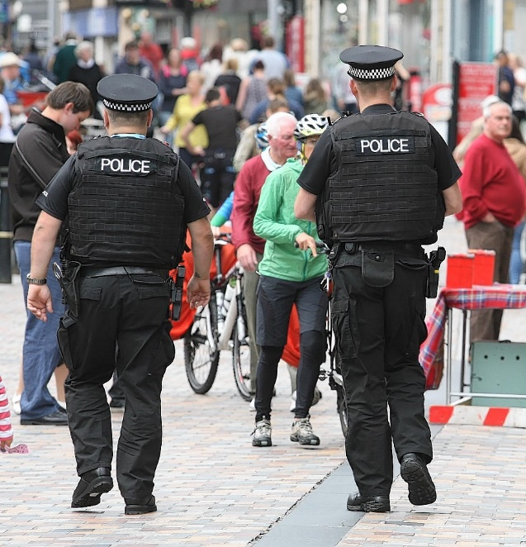
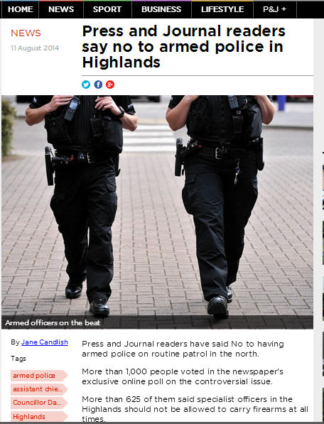
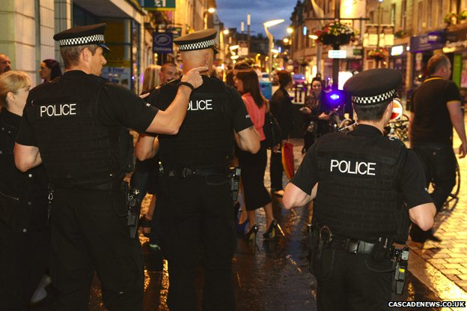
When rural context is not considered…
Notes:
I just wanted to highlight an interesting situation in Scotland, which underlines some of the arguments in this paper. As Scotland has recently introduced a single police force, the chief constable has introduced the routine arming of officers in rural parts of Scotland. This saw armed officers turn up to a routine drunk and disorderly incidents in a mcdonalds in a small rural town which created a media backlash. In many ways, this decision does not take into account the rural context, and a response which may be legitimate and understandable in Glasgow is not the correct response in rural parts in Scotland. Context therefore matters. Thinking this through, I want to draw some conclusions from this paper.

Slide 13
Conclusion: Towards rural policing
The rural is a nuanced landscape in which different locales require different policing responses
Herbert’s (1997) objective orders (law and bureaucratic ordering) helpful for exploring police response to ASB in rural areas, but subjective orders (machismo, competency, morality and safety) less applicable
‘Biased policing exists everywhere, but a growing body of empirical evidence reveals that it may be more prevalent in rural areas’ (Donnermeyer and DeKeseredy, 2014: 9)
Policing the rural or rural policing?
Notes:
Using the policing of ASB as a lens, this paper has argued that the rural is a distinct policing context which requires a better understanding of ‘the spatialities, moralities and powers of policing. This can only be done by understanding the rural as a nuanced landscape in which different locales require different police responses. Negotiated orders, discretionary practices and police-community interactions form the basis for rural policing, in a way that appears to differ from many urban contexts. Indeed, existing, urban typologies of the way that the police operate have been shown to only partially describe the police response to ASB in rural Scotland, suggesting that the rural context impacts on policing responses in a fundamental way. Understanding the interplay between representations of the rural, the rural locality and the everyday lives of those in rural locations becomes of central importance for the police in structuring their response to ASB. This contextualised understanding of policing, where the local setting is important for inferring broader structural actions, has been largely missing from the recent broader policing literature.
I am conscious of not falling into the trap of idyllising notions of the rural and claiming that rural policing is great and urban policing is bad – as Joe and others highlight, the rural is part of an urban-rural continuum, where different types of rural require different responses. Having said that is the police response in rural locations different enough to warrant a distinct rural policing typology or should this kind of policing response be considered as policing the rural?
I would argue based on the evidence of the police response to ASB, there is a case that the police response in rural communities should be considered as ‘rural policing’ rather than simply ‘policing in rural areas’. Rural discourses have remained largely absent from the landscape of rural policing, something this chapter goes someway to addressing. The rural is a unique environment within which to police, something that national policy neglects, with policing in the rural commonly being considered as an appendage of urban policing more generally. Moving towards theorising ‘rural policing’ as something distinct, where there are different challenges, opportunities and ways to respond to ASB and crime would help rescale policy development. Understanding the rural as a nuanced and complex environment which contains unique geographical and resourcing challenges and requires context specific responses to ASB, would help begin to (re)conceptualise the police response to ASB in rural Scotland as rural policing rather than policing in rural area.

Slide 14
Different impacts in different communities
Remote Rural Community: ‘Yes, because you know people here, you can sort stuff out at a one-to-one level. I am always like ‘well if you don’t stop dropping litter, I am going to go home an tell your mum! You don’t feel scared at all because most people know who the young ones are and aren’t afraid to shout at them... [laughter]’ Kate (30s, Abanoch)
Accessibly Rural Community: ‘It is the same families though, you know like we will go through a wave of ASB –fighting, dog dirt and grafitti,- and it is a whole family and we all know who they are and we all know what they have done or what they are doing….And it just seems to go on and nothing seems to get done about it either because people are scared to do anything about it because it is a notorious family so they turn a blind eye because of the consequences.’ Bettie (70s, Crian)
Notes:
And the everyday impact of ASB, you won’t be surprised to hear, varies significantly between my case studies. An interesting difference is related to the fact that in small rural communities many people know one-another. In the remote rural community this was seen as a positive thing, while in the accessibly rural community people were afraid of the perpetrators.
This is linked to a number of different factors, but significantly the impacts and harms caused by ASB tended to fall into the low intensity parochial harms the dog dirts and littering in the remote rural location, while in the accessibly rural location it tended to be the high intensity personal and public harms that were most typical.
The rural representations of each were different to, with the remote rural affluent community being predominantly a tourist village where the rural locality existed around the intertwining of everyday lives . People felt that they know most of the community – they know that the kids hanging about the square are so and so’s grand son or daughter. In many ways the idyllic representation of this community was borne out in some elements of the data, and consequently the harm associated with parochial forms of ASB was lessened.
Participants in the accessibly rural community , by contrast, tended to discuss ASB as being caused by a few notorious families and despite knowing who they were, were frightened to do or say anything because of their reputation. The forms of ASB also tended to be personal rather than parochial. The through flow of people through social housing and the fact that they knew the reputation of individuals meant that ASB impacted on this community in a different way and both the everyday lives of those living in the community and the forms of ASB being commited meant the impact of ASB tended to be more apparent.

Slide 15
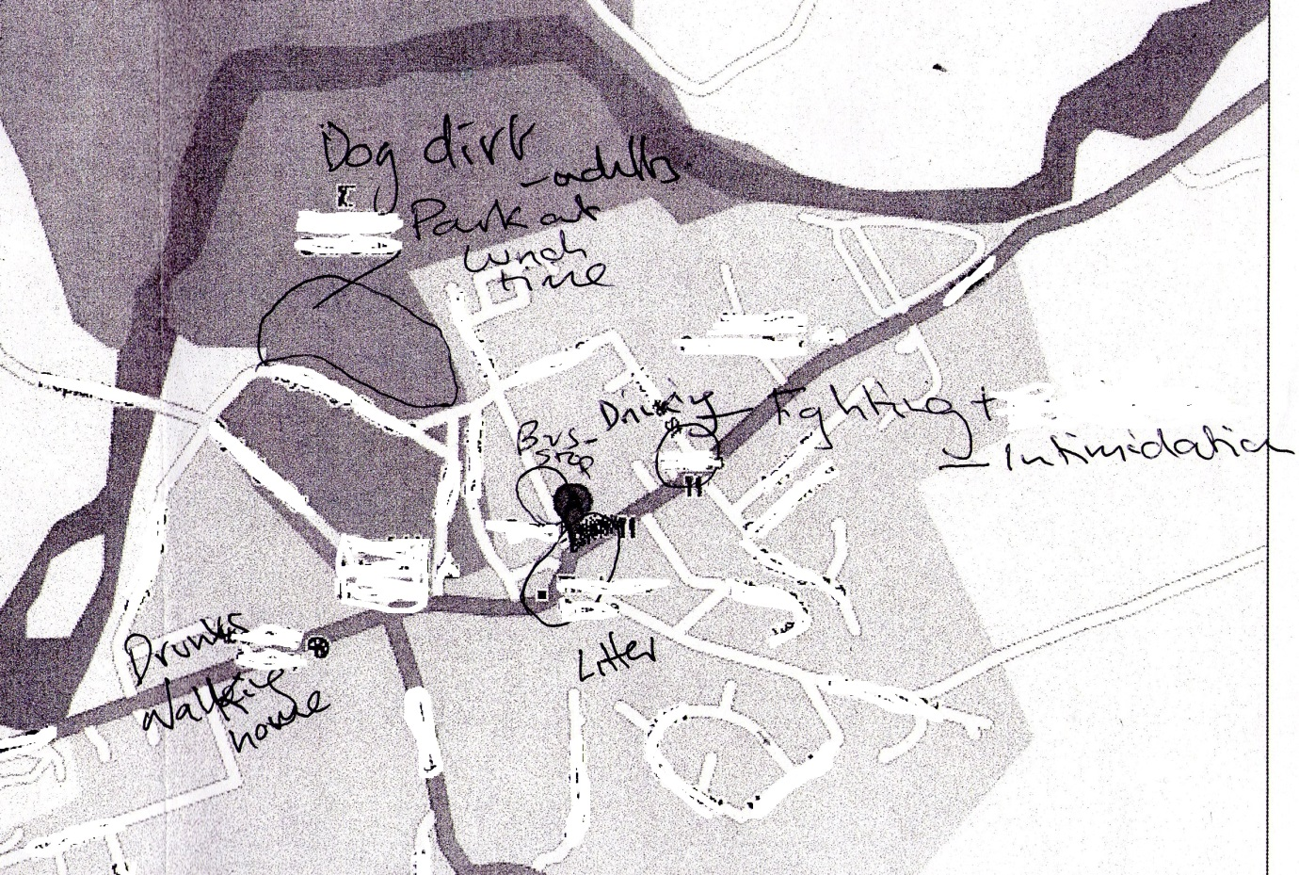
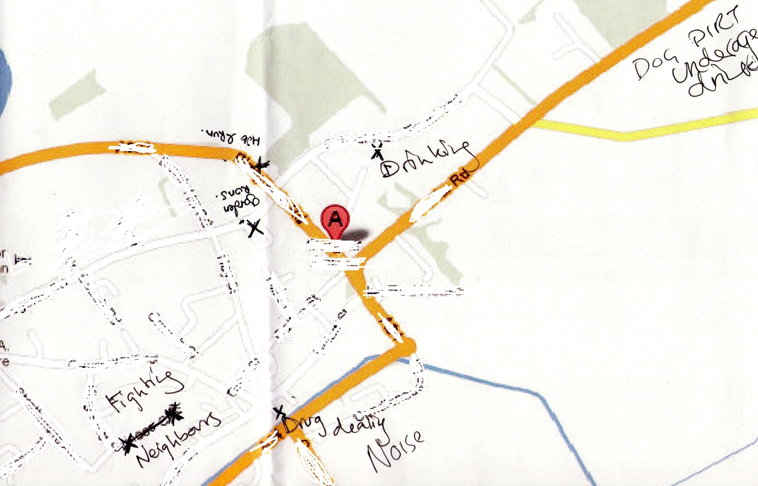
ASB impacting on the everyday lives of individuals
Remote Rural
Accessibly Rural
Notes:
This is played out in these maps which were filled in by young people in focus groups. Distinct geographies to the forms of ASB
The localised impacts of ASB are also spatially defined with the wealthy households around the parks in both locations reporting high levels of ASB.
Parochial harms in parks versus personal harm in certain parts of the town.
Linked to the rural locality is the fact that distinctive spatial activities lead to certain forms of ASB being more impactful in certain locations, with social housing for instance in the accessible rural location located in the centre of the town creating areas which are more actively patrolled, where as in the remote rural location there is much less social housing and it is located on the edge of the village. This impacts on policing response.
The physical spatiality of the location therefore links to the forms of ASB present and the impact that ASB has on the everyday lives of the locals.

Slide 16
The role of age in the lived experience of ASB: Youth as risk or youth at risk?
  Youth as risk:
Mags (70s): We go out once a fortnight and come home about midnight. And down at the [name of pub] they are out in the street drinking and hanging about in the square in gangs. Some of them are only 14. I am totally intimidated to pass them and I always cross the road with my husband…
George (70s): Really? You are intimidated?
Mags (70s): Yes, I mean, they are rowdy and aggressive. I’ve seen them fighting
Notes:
Beyond the physical geography of the location, there are a number of broader social differences that influence the way that ASB impacts on individuals in the community. Age is also a key contextual part of ASB – reflecting different ways that the rural is constructed by people of different ages.
Age is a key factor in the whole ASB debate, with popular media and policy narratives routinely identifying youth and young people as risk. The FG extract above highlights notions of young people being identified as risk –by their presence in public space. Linking this back to the harm matrix, the majority of ASB associated with young people, not surprisingly, related to parochial forms of neighbourghood levels ASB, often involving drinking and general rowdiness. Reflected in quote above
Yet Young people are just as likely as older people to identify ASB as a local problem’ (Innes & Weston, 2010: 22). This goes against the common myth that ASB simply reflects inter-generational tensions.

Slide 17
Thanks for listening…
@ajwooff
a.j.wooff@dundee.ac.uk
Notes:
To conclude then, what I have tried to do today, albeit very briefly, is show the potential in using Halfacree’s three fold model of rural space in conjunction with some of the criminology literature around ‘harm for exploring the spatiality and uneven impacts of ASB on rural communities.
By bringing together these two conceptualisations, more broadly, I hope to show how the impact of ASB does not occur in a vaccus space in rural locations, but rather it is inscribed with meaning by representations of the rural, the rural locality itself and the every lives of those who live in rural communities.
Thanks for listening, I will try and answer any questions you may have.

Slide 18
Context of project: Studying ASB in rural Scotland
2 fieldwork locations:
  Remote rural affluent community; population 1900
  Accessibly rural, less affluent and classed as accessibly rural; population 1800
3 main themes being investigated:
  Nature of ASB in rural communities
  Impact of ASB in rural communities
  Response of the police and community to ASB in rural locations
Methods:
  33 Interviews
  8 Focus Groups
  80 hours participant observation with the police and young people
Notes:
Briefly then, this paper draws on data collected as part of a research project which explores the nature and impact of, and responses to, ASB in rural Scotland.
This paper does not seek to analyse these details, rather use ASB as a lens through which to explore the response of the police in rural locations.
The data emerges from: 80 hrs of participant observation conducted with the police and young people across the two communities; 33 interviews conducted with people living in both communities and 8 focus groups conducted with young people and organisations in both locations. The research took place between August 2011 and January 2013 and, because of the temporality of ASB, fieldwork was undertaken at different times and days of the week.

Slide 19
The role of age in the lived experience of ASB (II)
  Youth at risk:
      Hayley (aged 15, remote rural village): ‘I get the late bus back from [city] sometimes, but I don’t like it at all because it is always like taking the drunk adults home and you know none of them have ever….like…you know….i don’t know how to say this…been abusive or anything. But you don’t feel comfortable...yet we always get the blame for being anti-social, when the most anti-social are in their 20s’
Importance of locality in impact of ASB and in the policing response
Notes:
The is an equally compelling argument to be made that young people should be considered as “at risk” rather than “as risk”. This quote, from the remote rural affluent community and shows that the rural representations of this town as a tourist idyll, does not reflect the lived experiences of many of the young people in this project. And ironically the impact of ASB can contribute to the desire of young people to hang about in groups and therefore contribute to the feeling of insecurity by others in the community
The countryside and its policing often reflect the dominant representations and visions of a rurality, an ideal that young people are often seen to disrupt. It is therefore important to challenge conceptions of the rural idyll, and in locations such as affluent remote rural tourist towns, note that the everyday lives of those in rural locations are impacted as Cloke notes, by a complex interweaving of power relations, social conventions, discursive practices and institutional forces that are constantly combining and re combining.
The rural locality plays an important part in the interactions, however. Being located in a remote rural means that the police are often not called to attend more mundane forms of ASB, with certain members of the community often stepping in. In the accessibly rural community, policing response was much more typical, but forms of ASB also tended to be more serious on the harm scale.

Slide 20
Discretion
Remote rural policing, discretion and a lack of back-up
We have got to have the public onside to police effectively. So whilst there are things we can’t have discretion over – here might be instances where maybe someone in [name of city] doing the same thing will get the jail where here they won’t. You need to box cleverer here. Particularly with disturbances, because the nearest backup might be over half an hour away…by blue light…’ Inspector (Abanoch, 23/06/12)
Accessibly rural policing and discretion
Like with that incident you just seen, well, to a degree we use our discretion, he might have been treated differently in a city centre near a pub on a Saturday night. But we don’t have the same resources here, although we have more [officers] than some of the other villages, we still need to think about our resources. You’re not going to just have 12 officers as back up out here… Community Officer (Crian, 23/01/13)
Notes:
There were differences in how the response of the police played out in both Abaonch and Crian. In Abanoch discretion was used on a very regular basis for dealing with ASB, while in Crian it appeared to be less readily used This in part related to the types of community they are and therefore the dominant forms of ASB that were dealt with in each of the communities, but also the impact of broader resourcing considerations on the police – how far away custody suites were and back up.
In abanoch discretion was used because of the challenge of dealing with a lack of back up and the time it takes to get to custody suites.
The police community relationships also created distinct differences for the police response to ASB in rural Scotland.

Slide 21
What does this mean for rural policing territoriality in Scotland?
Context of rural policing (Yarwood and Mawby, 2011)
  The rural locality
  Representation
  Everyday lives

Slide 22
Harm Matrix (Innes & Weston, 2010)
 | High Scale | Low Scale
High Intensity | Public Harm – impacts on a lot of people quite significantly. Included here: problem teenagers, drunk and rowdy behaviour, vandalism | Personal Harm – impacts upon a few victims but very profoundly. Included here: Race/hate crime, noisy neighbours
Low Intensity | Parochial Harm – moderate level impacts across neighbourhoods. Included here: Litter, dog dirt, drug use in public | Low Harm – has little at all. Included here: Abandoned cars
Notes:
ASB very been loosely defined since its introduction onto the statute books in 1998. it is defined as Acting in a manner that caused or was likely to cause harassment, alarm or distress to one or more persons not of the same household - alarm and distress to one person is different to that of another.
Although having a broad definition was partly a ploy to enable the act to be applied to localised and specific problems, there is a large literature exploring the impact that this has had on the nature and meaning of ASB. I don’t have time to go through these debates in full at the moment, suffice to Innes &Weston developed this harm matrix as a way of getting beyond the increasingly technical definitions of ASB’ to begin to think about ASB in terms of ‘harm’ and ‘impacts’ using signal crimes perspective methodology (Innes & Weston, 2010; Innes, 2004). They argue that people don’t stop and think about whether something is or is not ASB, but rather about whether something has harmed them. In particular, Innes & Weston (2010) differentiate between the number of people harmed by a particular incident and the amount of harm done to each of them. They refer to the former as ‘scale’ and the latter as ‘intensity’ and together this leads to harm matrix.
Explain briefly matrix This is a really useful way of beginning to unpack which forms of ASB impact members of the community in different ways.

