Slide 1
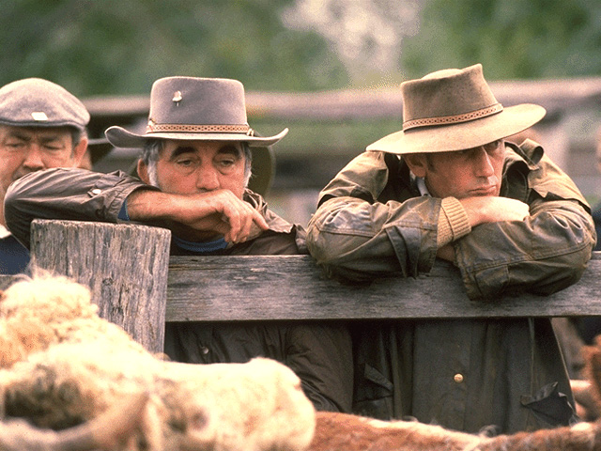
Defining Crime:
The perspective of farmers
Elaine Barclay and Robyn Bartel
University of New England, Armidale, NSW, Australia

Slide 2
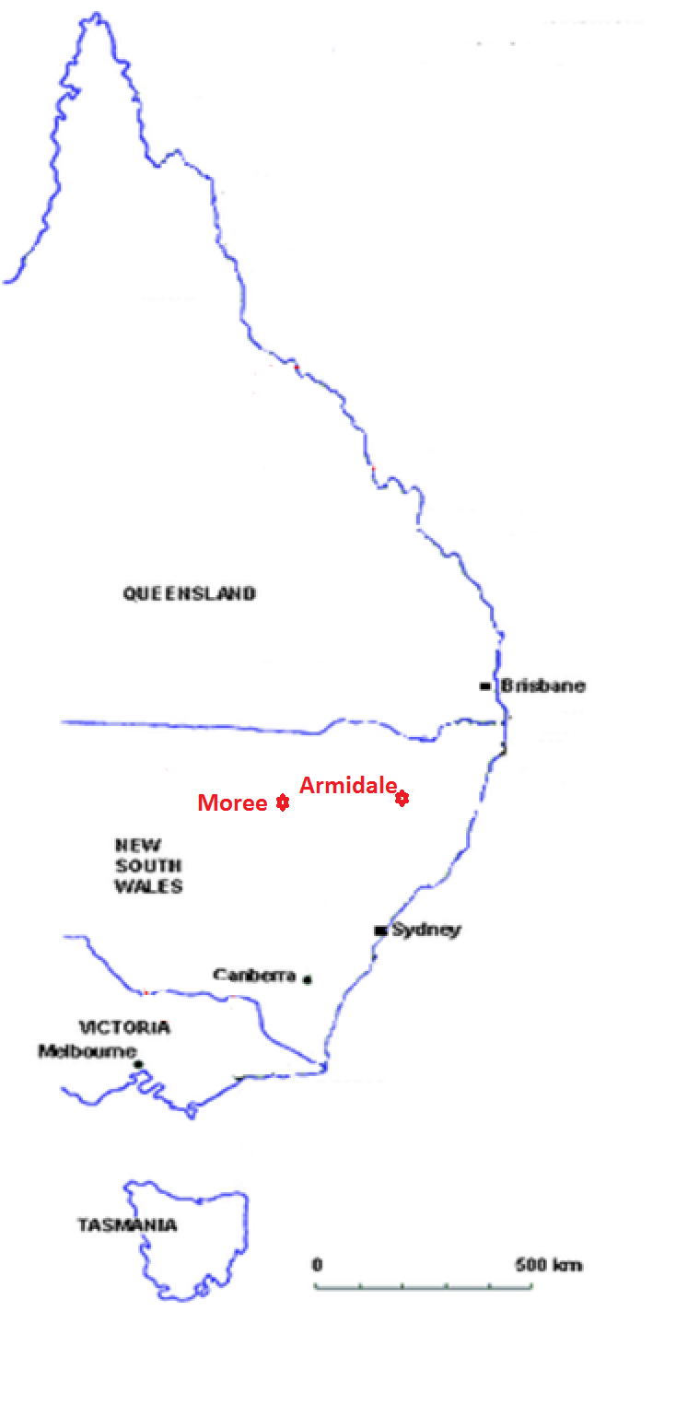
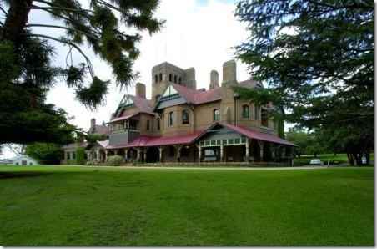
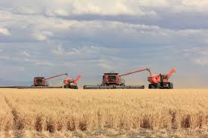

Slide 3
Research Questions:
What is the rate of environmental crime on Australian farms?
Do farmers consider incidents that cause environmental harm on farms as ‘crimes’ or do they qualify such acts in other ways?
Do they see themselves as ‘victims’?
“Rural” refers to areas under agricultural production

Slide 4
Method:
Part 1: Mail survey and follow up phone interviews. 5,235 farmers across Australia surveyed by mail in 2008. Participants stratified by state and industry.
41% response rate
1926 respondents (80.4%) male and (19.6%) female.
Aged between 21 and 91 years (Average age: 58yrs).
40% were livestock operations, 40% were mixed farming, 20% were cropping enterprises.

Slide 5
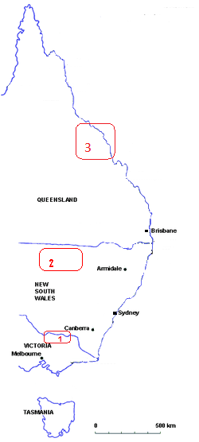
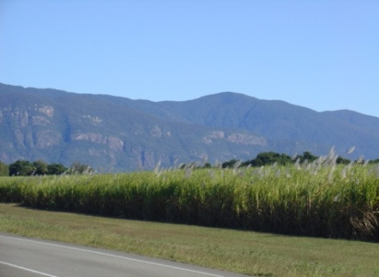
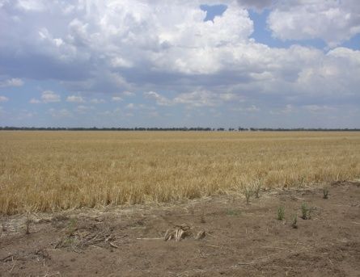
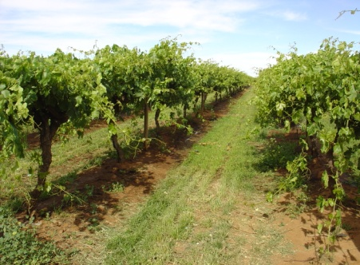
Part 2: Three Case Studies:
3. Whitsunday, Queensland
2. Walgett, New South Wales
1. Moira, Victoria

Slide 6
Environmental Crime on farms (N=1926)

Slide 7
Attitudes to pollution
People who knowingly pollute the countryside are just as criminal as people who steal.

Slide 8
Attitudes to water theft
The high cost of irrigation water and tough times on the land makes the unauthorised taking of water justifiable.

Slide 9
Attitudes to land clearing
Unauthorised land clearing on farms is wrong.

Slide 10
Defining crime
Acts which were accidental were generally not criminal, but wilful or negligent acts were.
Negligence was a factor in defining the mismanagement of weeds and pest animals as a ‘crime’.
Too many grey areas - each case should be judged according to the particular nuances of the event.

Slide 11
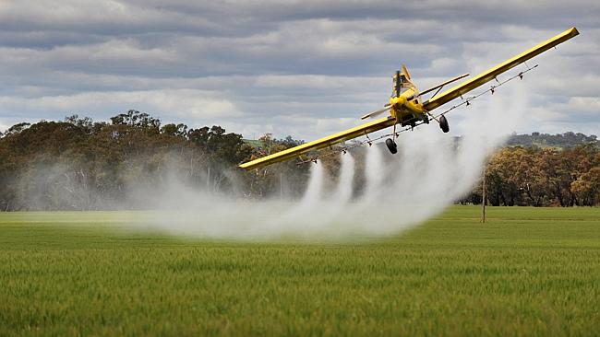
What about chemical spray drift?
Agricultural chemical spray drift from aerial or ground spray rigs, or contaminated run-off from farmland causes contamination of land, animals or plants and waterways.
I don’t know whether spray drift is an environmental crime –it is more of a malpractice or unprofessionalism

Slide 12
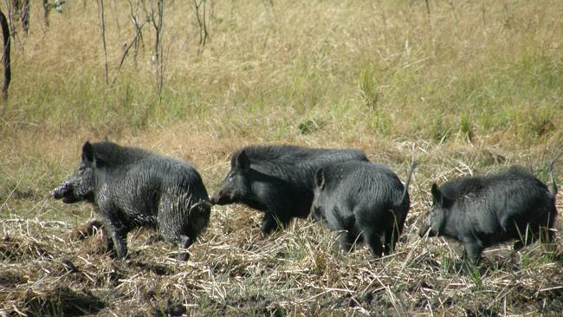
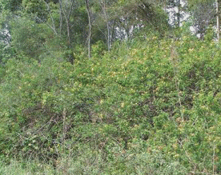
Land mismanagement
People spreading weeds onto your property I would say would be an environmental crime. Knowingly; definitely. Well, the onus is on you to keep your property clean. So the cost becomes yours and the control is your expense.
The dumping of rubbish causes me problems because it blows out in my paddock and for some reason cattle eat plastic. This area is notorious for heavy winds. We continually pick up rubbish.

Slide 13
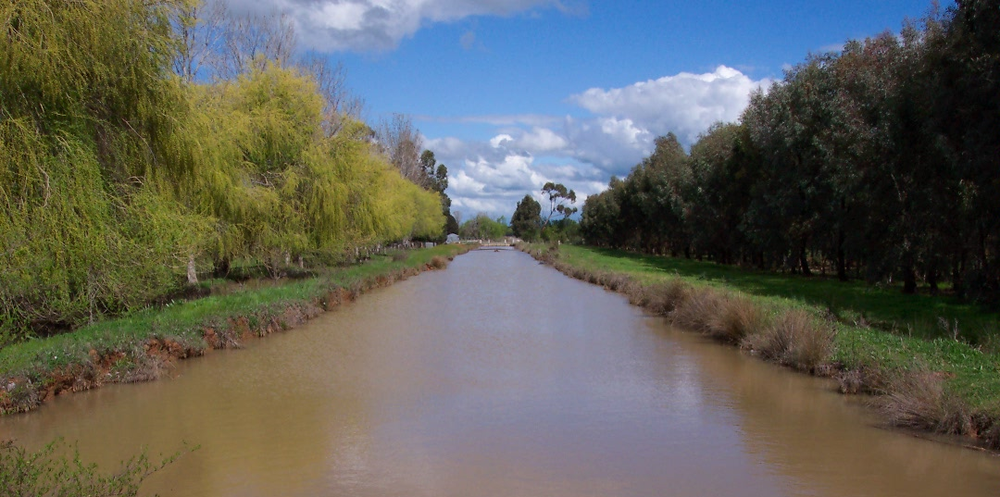
What about water theft?
Includes the pumping, impoundment or diversion of water from irrigation channels, river systems, dams or ground-water bores without a licence that cause changes to flows and reduces water access to neighbouring farms, livestock and riparian zones.
Water becomes like gold when it gets dry and people get a bit cut throat to get water to fill their dams. I don’t say that in a bad way, but if you haven’t got water you can’t have stock - even if you’ve got a bit of feed, well if you’ve got no water, your feed is no good to you. Stock is their livelihood and that’s driving them to do what they have to do.

Slide 14
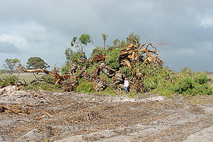
What about land clearing?
Any act that harms native vegetation without permission is an offence. With concerns about high rates of land clearance, regulations limit vegetation clearance for agricultural expansion.
Some of the clearing would be crime, certainly. But in terms of farming in this area, I think it’s absurd to think it’s a crime when you look at real crime like burglary and all the other crimes that we experience. They go on and nothing happens. I think it’s a funny world we live in when we are starting to look at environmental crimes as such - when cutting down a tree is a bigger crime than abusing a woman or breaking into someone’s house.

Slide 15
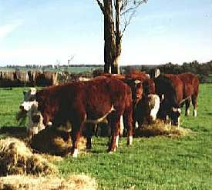
Informal ‘crimes’
There was divergence as well as convergence between farmers’ appreciation of environmental crime and those actions legally recognised as criminal. Sometimes farmers’ appreciations were leading formal law.
Overstocking is an environmental crime because pasture goes back to bare dirt and never gets a chance to recover - even if you get a lot of rain, you don’t get a full array of grasses. We are very aware that we can’t overstock our property. Because we have had so many droughts you have to buy feed for stock or lease grazing land or sell. It’s also an issue of animal welfare with huge fines and consequences.

Slide 16
Victimisation
47% of respondents to the mail survey were victims of some type of environmental crime.
In the case studies: - Farmers, their land and enterprises, as well as the environment, were acknowledged to be the victims of environmental crime
Participants hesitant to label farmers as ‘victims’ - implies powerlessness……
Participants more likely to describe farmers who might offend as victims of ongoing drought or financial stress.
Problems are ‘managed’ within the community by subtle means of persuasion and shaming; including appealing to extension agents to encourage deviant landholders to poor land management.

Slide 17
Key Findings
Research needs to include the perspectives of rural communities in studies of environmental crime.
Further research on environmental victimisation within the social structure of small rural communities is needed to better understand how victimisation is perceived, reported and managed.
As farmers are necessarily managing large areas of the environment, their perspectives are important. We need to listen to them, to find a balance; understand and learn from their working knowledge and develop better ways of working with them toward better environmental management.
Farmers’ perspectives are also important to include in any future determinations future law and policy responses designed to prevent environmental crime. Environmental crimes are a relatively new concept and definitions are unclear. We need more clarity.

Slide 18
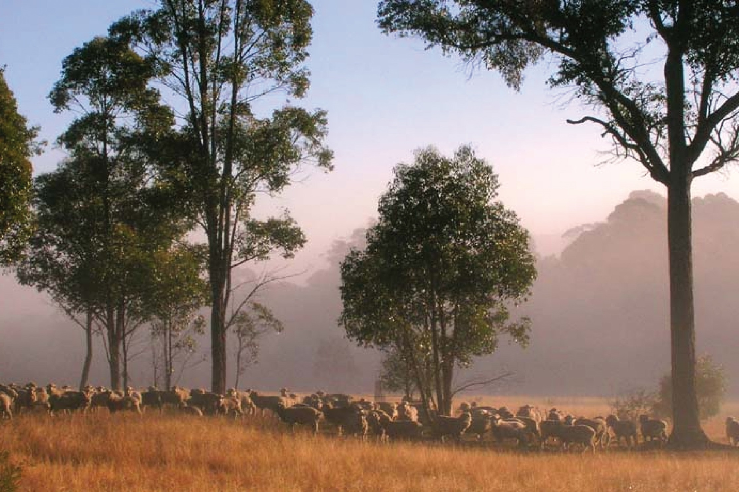

QUESTIONS?
Questions?.....
Acknowledgments:
A CERF significant project funded by

