Slide 1
Lost and Hound
Dr Richard Yarwood
ryarwood@plymouth.ac.uk
http://www5.plymouth.ac.uk/staff/richard-yarwood

Slide 2
Lost and Hound
Introduction
Beyond Community Policing
Hybrid Networks
Search Dogs
Conclusions

Slide 3
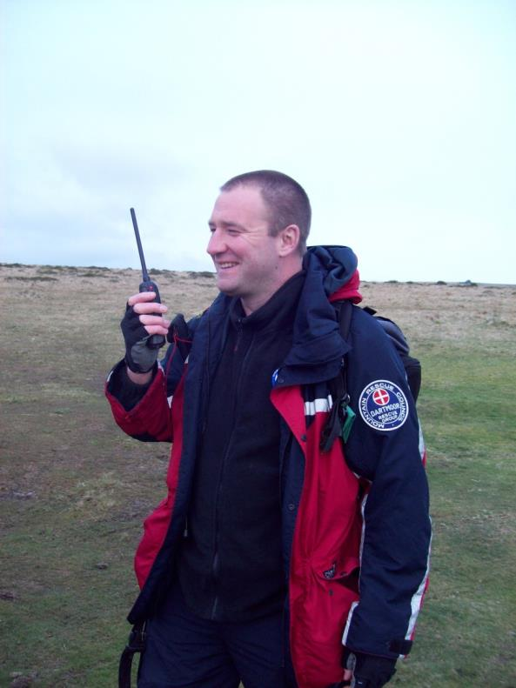
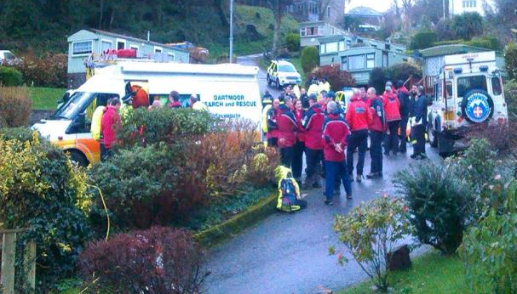
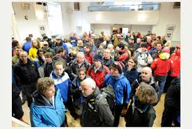
Introduction Noss Mayo Jan 2014

Slide 4
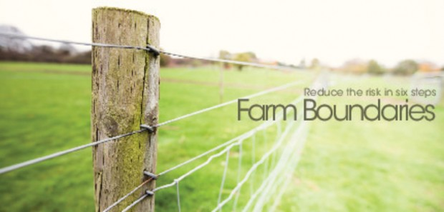
Beyond Community Policing
Community
Widely deployed
Community and Exclusion/Inclusion
Many communities
Community and Governance
Cause and solution of rural problems
Community and Boundaries
Insular view of place

Slide 5
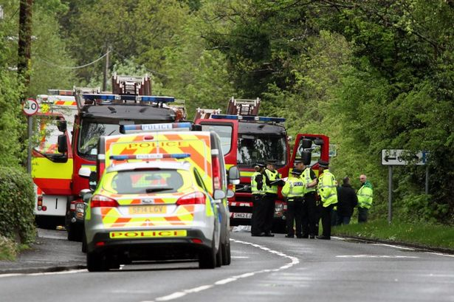
Relational Policing
Networked Approach
Flows of people, resources, ideas, media etc
Murdoch (2003: 274) ‘a focus on networks and fluid spaces will disrupt the notions easily demarcated and fixed rural spaces but will generate contrasting and sometimes contradictory understandings of rural processes.’

Slide 6
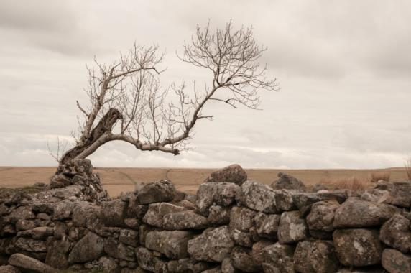
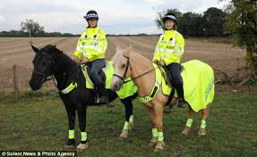
Relational Policing
Murdoch (2003: 264) The countryside is ‘co-constructed by humans and non-humans, bound together in complex inter-relationships.’

Slide 7
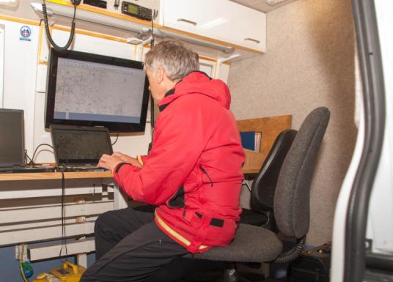
Empirical Focus: Searches for Lost and Missing People
Police responsibility
Range of agencies
Policing
Ad hoc to formal
Different aspect of policing
Non-criminal (Parr and Fyfe, 2013)
Rural aspects
Terrain
‘Dark Ruralities’

Slide 8
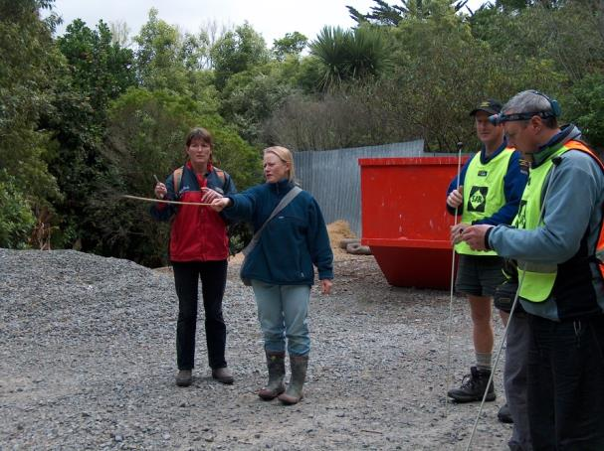
Assets and Resources
Tracking in New Zealand
police service dog teams;
trained volunteer SAR civilian dog teams;
trained volunteer or RCMP Hasty Teams;
RCMP helicopter equipped with Forward Looking Infrared (FLIR);
trained volunteer "specialist" teams (avalanche, white water, ice rescue, etc.);
trained volunteer SAR divers and RCMP Dive Teams;
trained human trackers and other SAR trained persons. (Royal Canadian Mounted Police 2014)

Slide 9
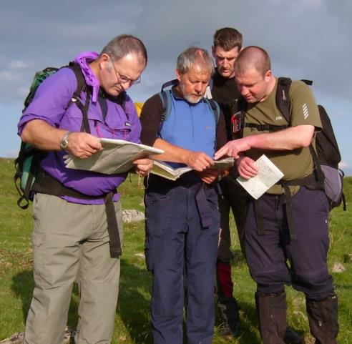
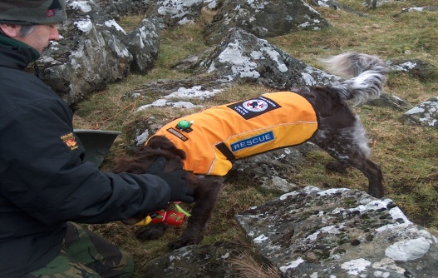
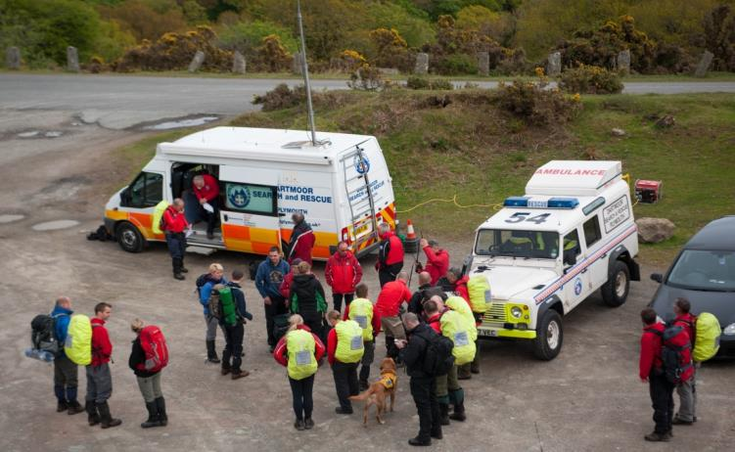
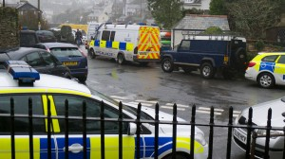
Example: The Relational Networks of a Search
Embodied Performances
‘Eyes on the ground’
Experience
Fitness
Safety
Knowledges
Local knowledge
Navigation (dark and low visibility)
First Aid and evacuation
Rules and procedures (MRC and local)
Tracking
Agencies
MRT Team
MRT Section
Police, military, coastguard
Technologies
Team and personal equipment
Communications
Helicopters
Vehicles
Nature
‘Many moods’
Non-human
Dogs

Slide 10
Search Dogs
Dogs used widely in searches for missing people
Animal and police geographies
Dogs (Brown and Dilly, 2012)
Civilian Trained
Year | Callouts | People | Finds
2013 | 92 | 125 | 5 (5%)
2012 | 118 | 140 | 14 (12%)
2011 | 135 | 153 | 23 (17%)
2010 | 134 | 134 | 16 (12%)
2009 | 168 | 168 | 18 (10%)
2008 | 169 | 169 | 38 (22%)
2007 | 109 | 109 | 11 (10%)

Slide 11
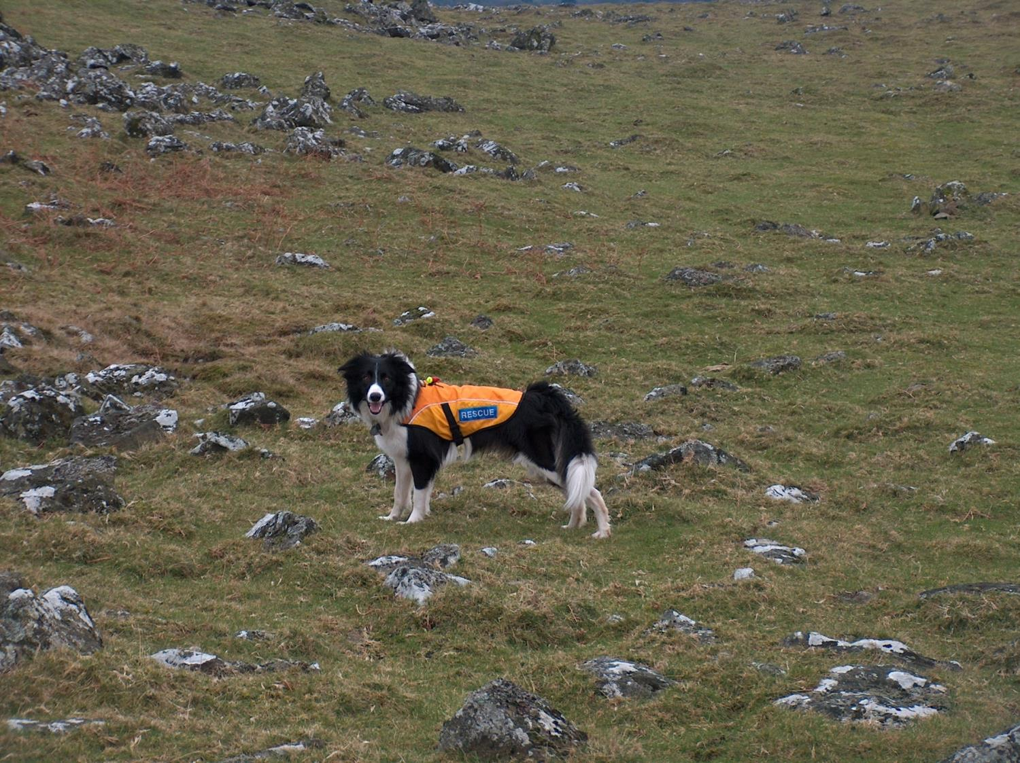
Sunny will learn how to hunt and I must learn how to make the best of the wind and natural features so as to make his job a little easier …. “Just remember, you’re not searching the ground, you’re searching the wind that blows over the ground. So wind direction is absolutely key to us when you are searching”

Slide 12
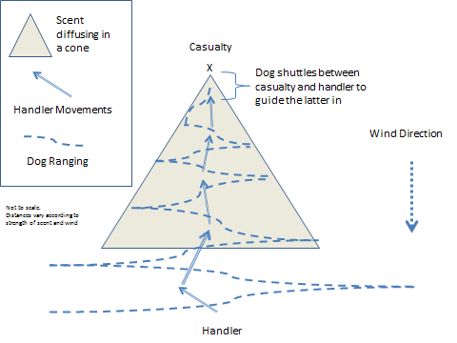

Slide 13
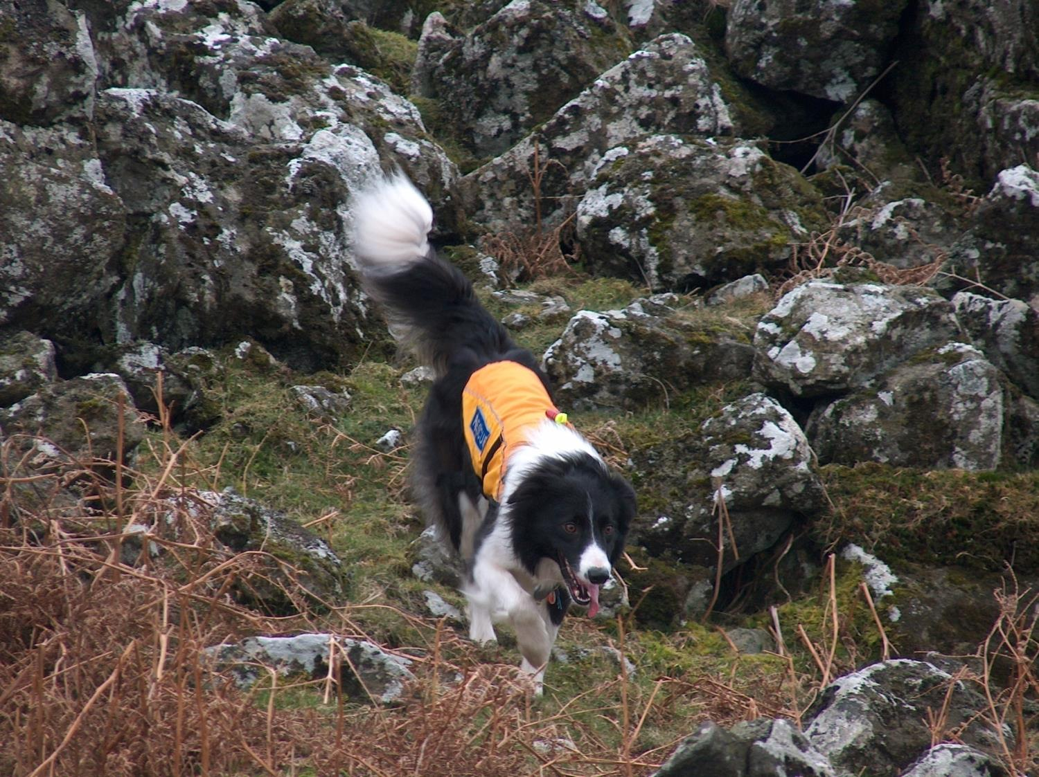

Slide 14
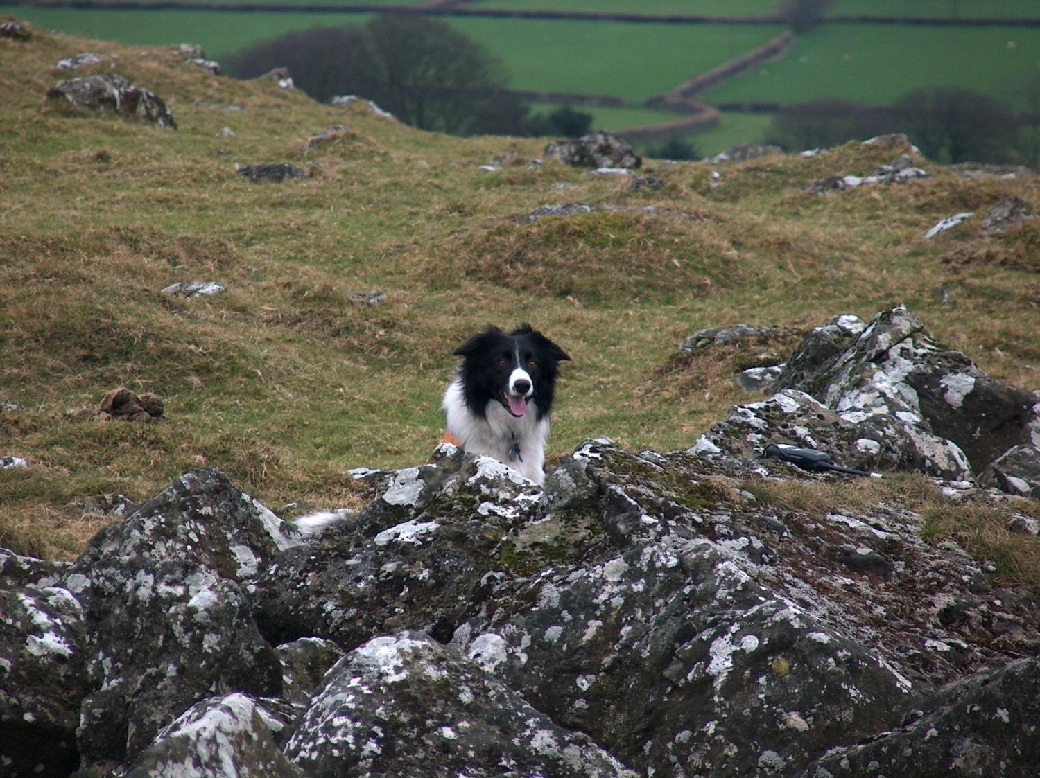

Slide 15
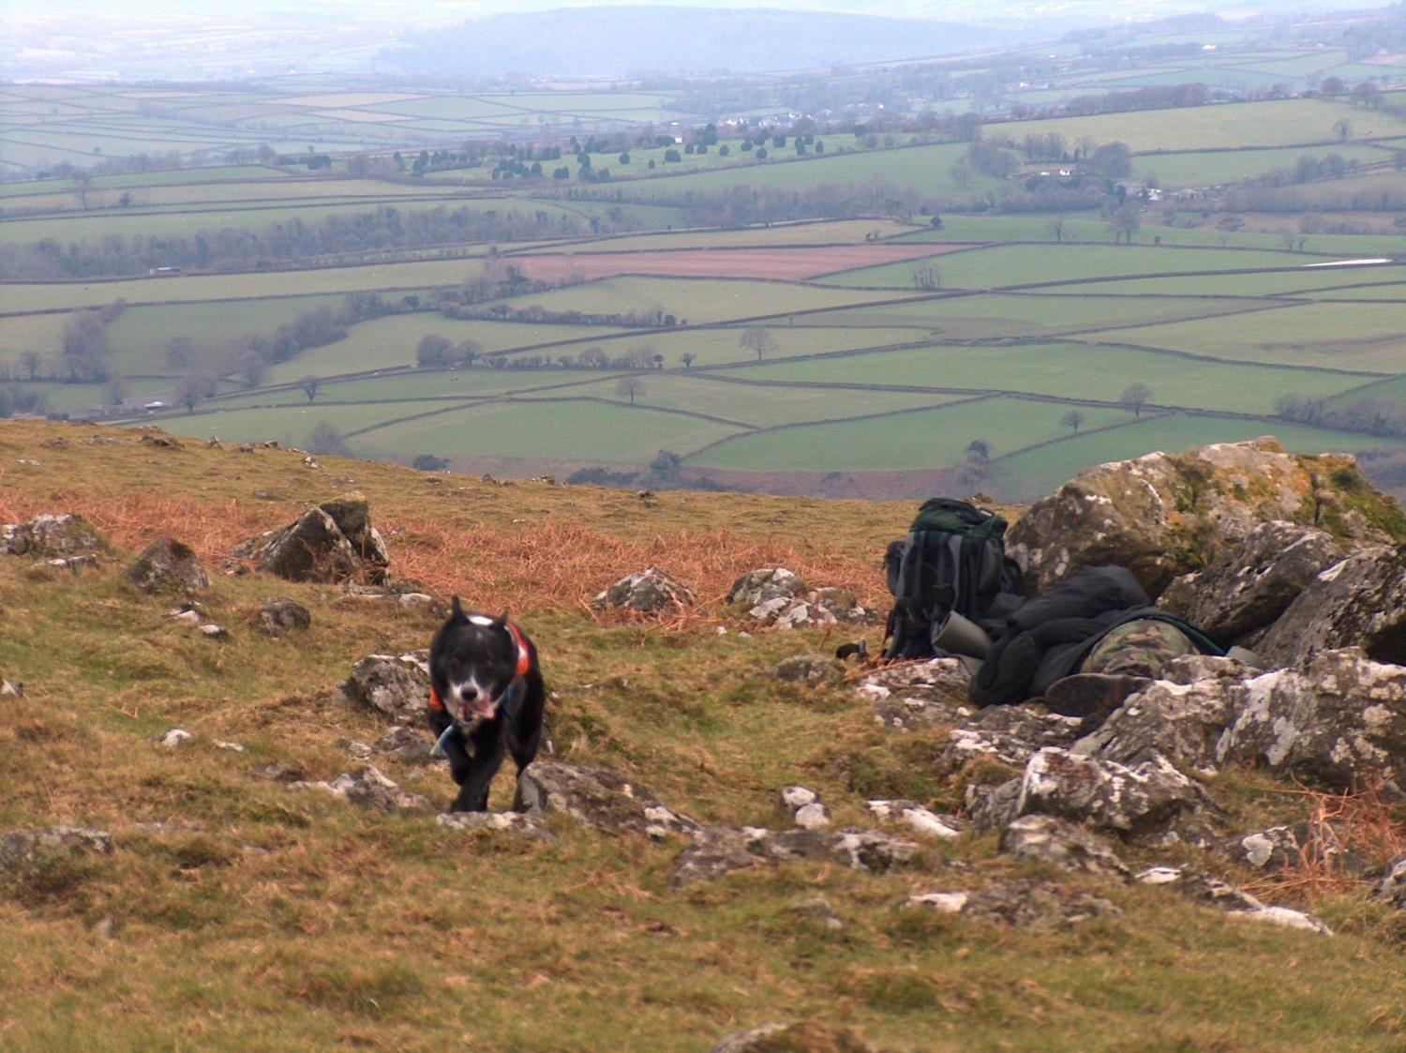

Slide 16
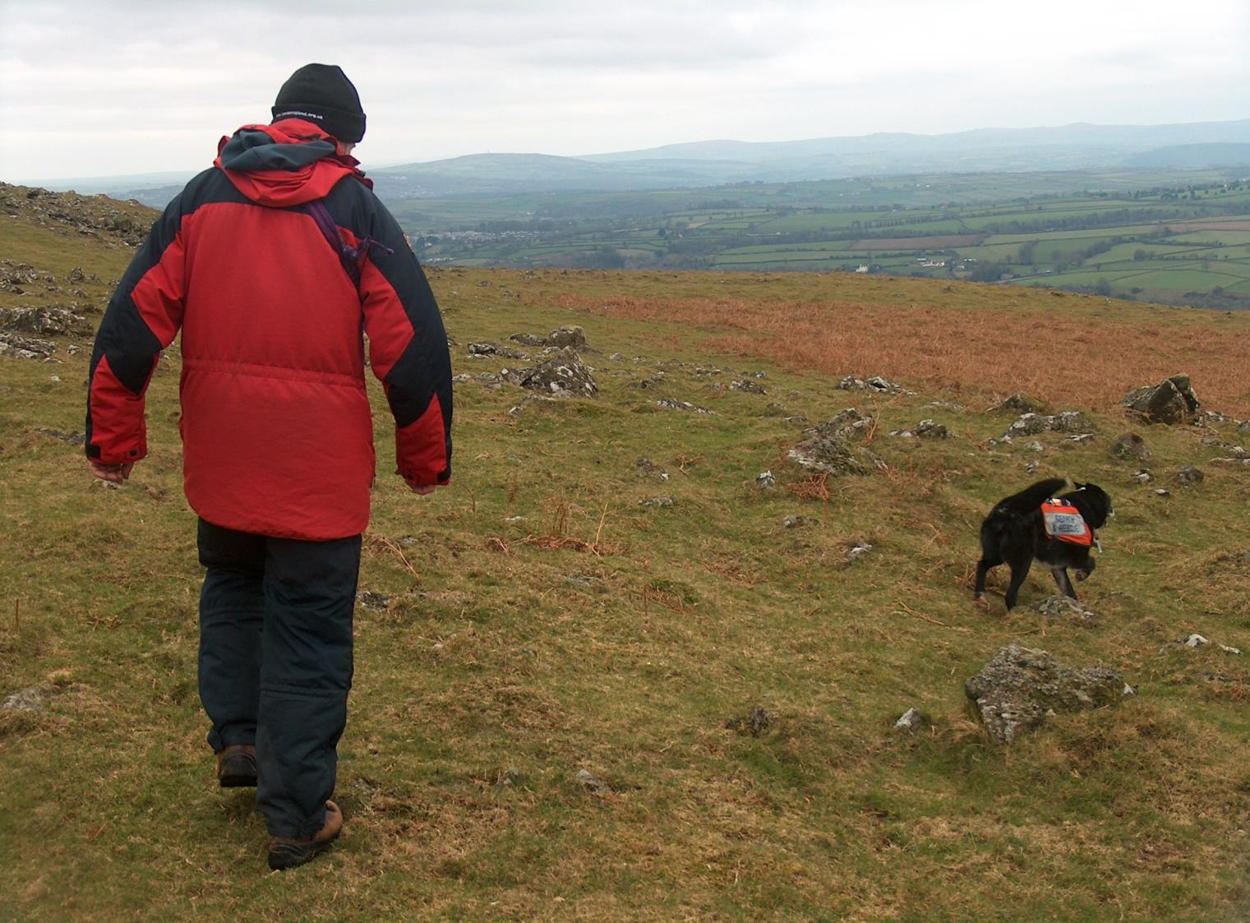
“we had incredible find when the first aid casualty was right at the top of the bank, wasn’t he, he must have been a hundred, two hundred yards away, right at the very top by the fence, and he’d picked up the scent from by the river. But that’s because as it cools down the air temperature then goes down to the river, it’s dragged down to the river level rather than in the summer with the heat in the day, the heat is rising from the river up to the top of the hill”

Slide 17
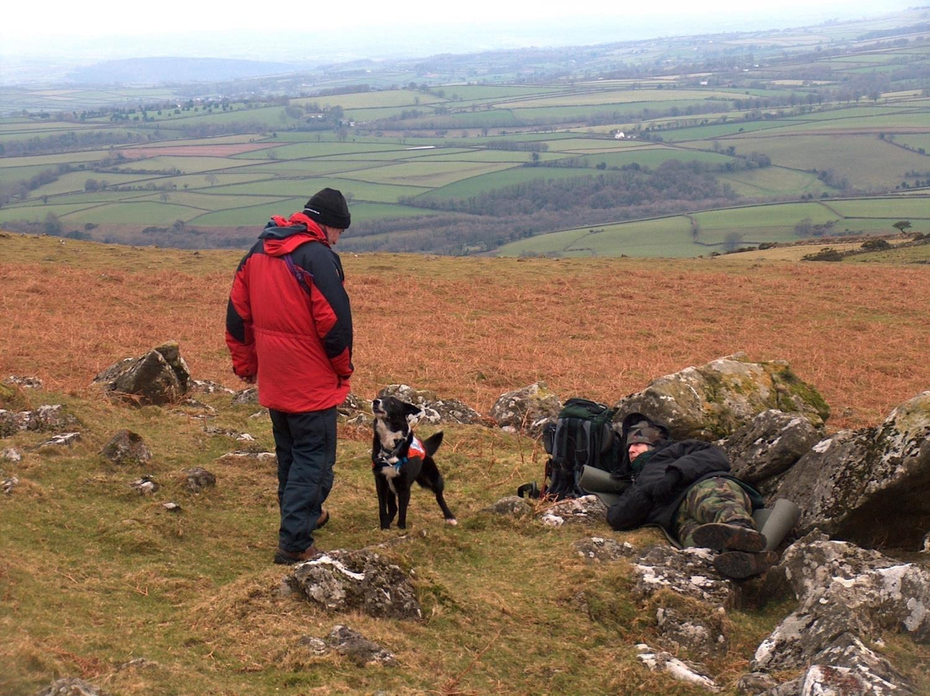
Sunny had to find 3 bodies. As before I had to stay on a forest track and only leave this when Sunny had indicated. The assessor and bodies were in radio contact with each other and therefore knew whether Sunny had found but I did not. I had to rely upon Sunny’s indication only. Each body was well concealed in ditches, holes or hidden under branches in a bivvy bag with only their faces showing. In fact I was amazed he had found any at all for they were not visible to me until I was within a few feet.

Slide 18
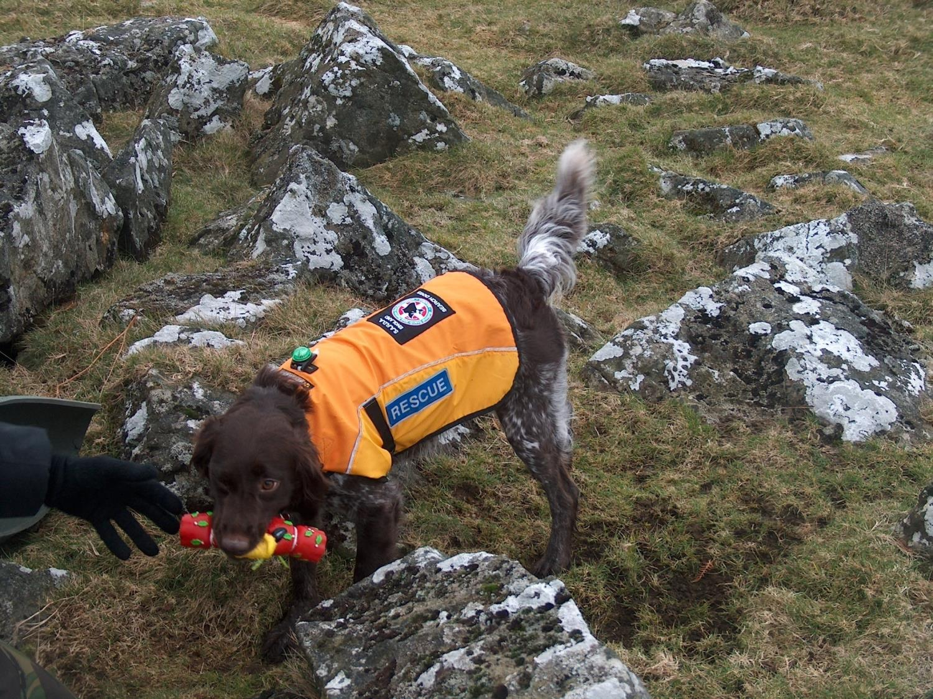
“The dog is rewarded all the time with their favourite toy, it could be a tennis ball, squeaky hammer, whatever you can get from a pet shop, but whatever makes the dog tick, really … it is the desire for the toy … she’s associating human scent with the toy”

Slide 19
Conclusions
Something of a thought piece
Networked approach
‘nuanced understanding of the spatiality of police work.’ Parr and Fyfe’s (2013: 4)
Draws attention to animals in police work
Neglected aspect of policing
Public Safety

Slide 20
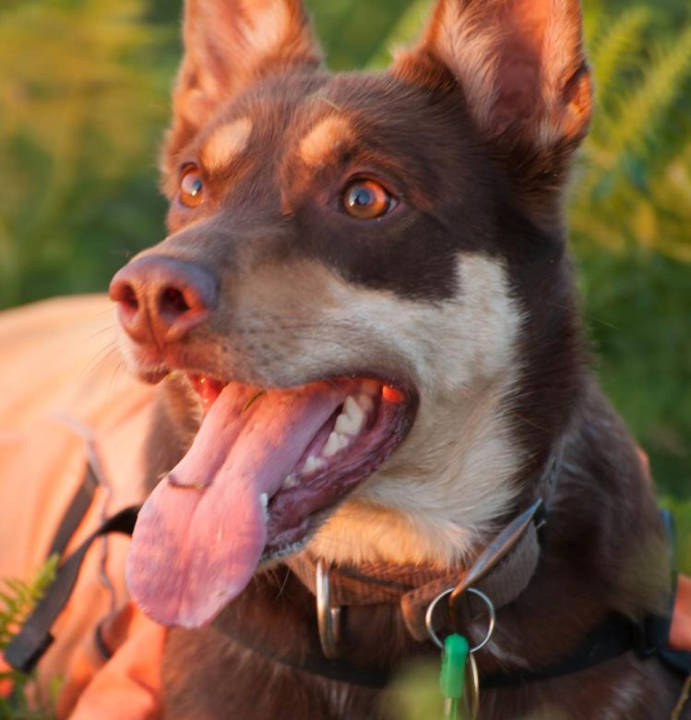
They appear to have a sixth sense when there is nobody in the area and they know if you have strayed back into an area where you have previously searched. This can happen in inclement misty weather especially in the dark” (Dartmoor Search and Rescue Team Plymouth 2014)
‘an approach which focuses on being-in-the-world can draw attention to the mystery, spirituality and ghostliness of rural places’ (Cloke, 2003, p.6).

