Slide 1

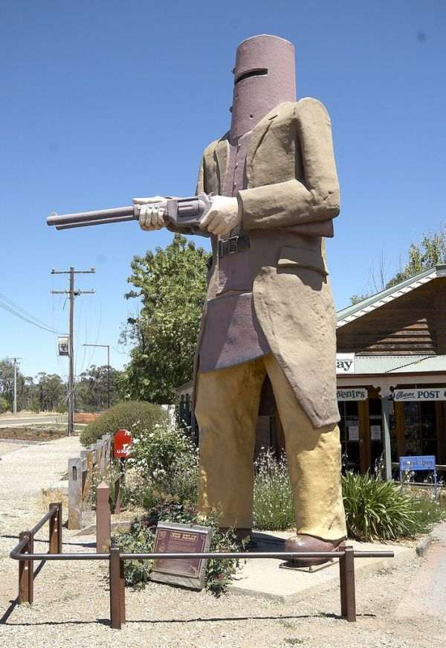
Strange and Stranger Ruralities
Established-outsider Relations and the Social Construction of Rural Crime
Professor John Scott, School of Justice, Faculty of Law,
Queensland University of Technology
Australia

Slide 2
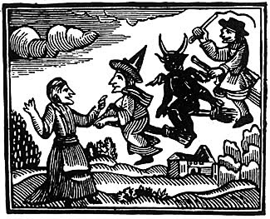
‘Crime brings together upright consciousness and concentrates them. We have only to notice what happens, particularly in a small town, when some moral scandal has been committed. The stop each other on the street, they visit each other, they seek to come together to talk of the event and to wax indignant in common. What emerges is public temper. Mutuality created by supplying a focus on a community. Like a disaster, deviance makes people alert to common interests and values – collective conscience. Deviance makes social organization possible’.
Erikson, K. 1966, Wayward Puritans p. 4.

Slide 3
AIMS
Examine how differentiation occurs in rural places.
Examine how the organizational capacity of social groups in rural places influences interpretations and reactions to crime.

Slide 4
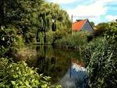
RURALITY AND CRIME
Spatial understandings of crime have drawn on Gemeischaft/Gesellschaft dichotomy
Rural ‘communities’ considered to have dense local networks, strong bonding capital, organic solidarity (social capital)
Bell (2006) examined this as the ‘rural idyll’ (ideological manifestation)
Social disorganisation theory promotes idea of social cohesion and solidarity reducing crime
Need to adopt an understanding of organisation/disorganisation in terms of relations between social groups, especially the relative ‘organisational’ capacity.

Slide 5
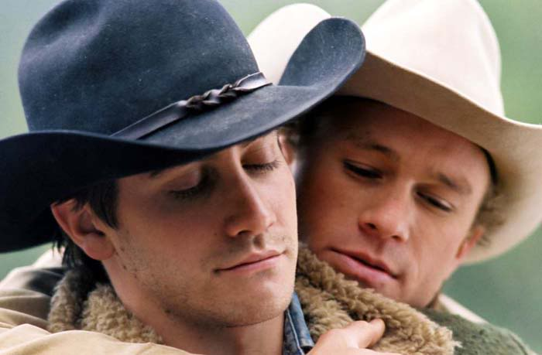
STRANGE RURALITIES
Rural Idyll is symbolic landscape which obscures difference, fragmentation and division, including crime, in the countryside.
Certain aspects of rural life are marginalized or obscured.
Philo (1992) ‘strange ruralities’ or rural ‘others’.
Ideological, but not others merely silenced, also consumed.

Slide 6
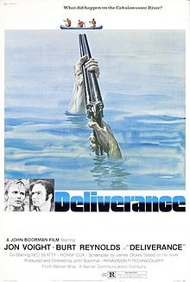
RURAL HORROR
Consumption of strange ruralities by urban audience.
Malignant societies and degenerate individuals.
What I normatively valued in idyll becomes a source of the abject.

Slide 7

SOCIAL CAPITAL
Gemeinschaft vs social disorganization and anomie
Social capital is a source of social control
Social capital linked to relations of power
Not homogenous stable relations
Population instability important in that it relates to ability to organize and engage in claim-making activity

Slide 8
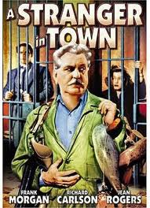
STRANGER RURALITIES
Consumption of strange ruralities by a rural audience
Fear of crime – outsider blamed to maintain internal cohesion
Internal sources of threat – ‘unproductive’ populations
Symbolic order – crime a condensation symbol
Rural crime talk draws attention to ‘unproductive’ populations.

Slide 9
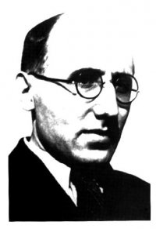
ESTABLISHED-OUTSIDER RELATIONS
Elias and Scotson (1965): figurational sociology
Newer (outsiders) and older residents
(established)
Winston Parva – newer residents lacked civilised standards
Both groups similar socio-economic characteristics. ‘Social oldness’ and cohesion of established group only significant distinction between the groups
Groups ability to organise itself an important power differential

Slide 10
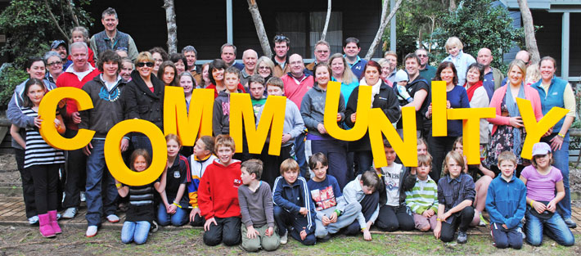
‘COMMUNITY’ AND CRIME
Community is a social and political construct
Meaning of community premised creation of boundaries and outsiders
Look at practices which create community
No such thing as a universal community
‘Crime’ product of community which differentiates people and populations

