Slide 1
The Radicalisation of Rural Resistance
How hunting counterpublics in the Nordic countries contribute to illegal hunting
* * *
Erica von Essen, PhD student at Swedish University of Agricultural Sciences
Division of Environmental Communication
Co-authors: Hans Peter Hansen, Helena Nordström Källström, Nils Peterson & Tarla Peterson

Slide 2
Radicalisation of hunters
Step 1
Hunting as majority culture
For subsistence
Step 2
Hunting as subculture
New functions
Step 3
Hunting as counterpublic
As politics of recognition
Step 4
Beyond counterpublic:
Illegal hunting
Counterpublic (Negt & Kluge, 1972): oppositional public sphere comprised of interests and rationalities excluded from the dominant public sphere; sites of alternative formulations as well as bases for agitational activity

Slide 3
The Radicalisation Trajectory
Superiority, injustice, distrust, vulnerability as mutually reinforcing conditions behind radicalisation.
McCauley, C., Moskalenko, S. 2008. Mechanisms of Political Radicalization: Pathways Toward Terrorism. Terrorism and Political Violence, 20(3), pp. 415-433
’Systematic devastation of the countryside’

Slide 4
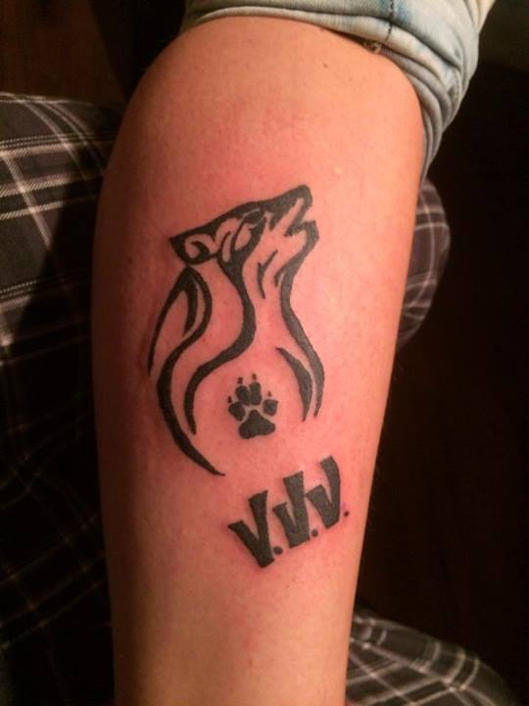
’Våga Vägra Varg’ tattoo
Used with permission

Slide 5

always finds a way”
”Nature
”Communication
email: erica.von.essen@slu.se

