Slide 1

Environmental and wildlife crimes in Sweden
WORKSHOP: Rural crime and community safety
18 September 2014
Vania Ceccato Cornelis Uittenbogaard

Slide 2
Outline
Objective
Data and Methodology
The nature of EWCs in Sweden
Summing up
”How can one release waste water in Hamstasjön? Obviously that is an environmental crime (…) School kids are taught not to dump waste in nature, but what will they think if the municipality directs wastewater into the lake. (…) Wake up and act! Several village residents are protesting against this stupid decision. The environmentally friendly municipality? I doubt it!” (Sundsvalls Tidning, 07 February 2010)
http://st.nu/opinion/ordetfritt/1.1786188-avloppsvatten-gar-ut-i-hamstasjon

Slide 3
The Study
Objectives
1. To investigate the nature of environmental and wildlife crimes (EWC) in Sweden
2. To assess the regional distribution of crimes
3. To evaluate the use of media reports as a data source and police statistics

Slide 4
The Study

Slide 5
Data
11 years of police records &
newspaper articles (Media archives)
Primary Data
Media archives from ”Retriever” (Mediearkivet)
Secondary Data
EWC records (2000-2011) from the Swedish National Council of Crime Prevention (BRÅ)
Notes:
Counts of EWC for the 290 Swedish municipalities were retrieved from the homepage of the Swedish National Council for Crime Prevention (BRÅ) for the time period 2000 to 2011. The database contains all recorded offences by police, customs and prosecutors sorted by the different crime codes.

Slide 6

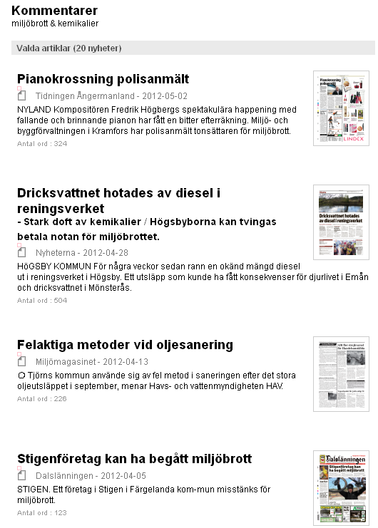

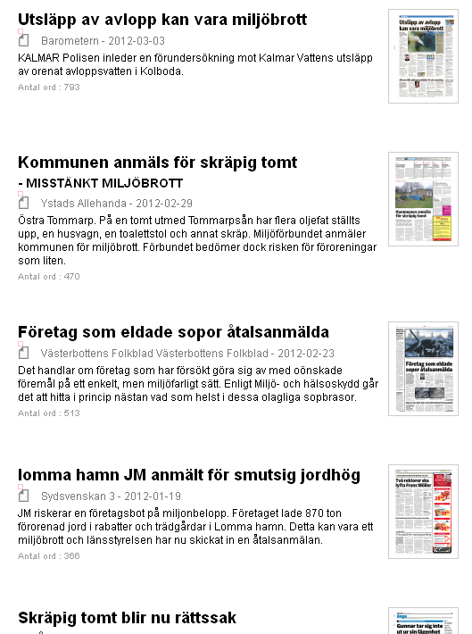

Slide 7
Correlation between Police & media data
Categories of EWCs for police and media data
 | Media Total | Media Air | Media Soil | Media Water | Media Minor | Media Nature | Media Chemicals
Police Total | .330*** | .172*** | .262*** | .213*** | .163*** | .160*** | .247***
Police Serious | .328*** | .130** | .260*** | .226*** | .193*** | .103* | .238***
Police Minor | .234*** | .236*** | .178*** | .139** | .119** | .075 | .245***
Police Nature | .340*** | .096 | .246*** | .252*** | .181*** | .177*** | .154***
Police Chemical | .397*** | .149** | .304*** | .265*** | .186*** | .223*** | .278***
* p-value < 0.100 significant at 10% level, ** p-value < 0.050 significant at 5% level, *** p-value < 0.010 significant at 1% level.
Notes:
crimes in the 8000-series (codes 8001-8019) have been selected as they represent all crimes against the environment and wildlife

Slide 8
Trends - EWC
EWC trends in Sweden
EWC trends in Västernorrland

Slide 9
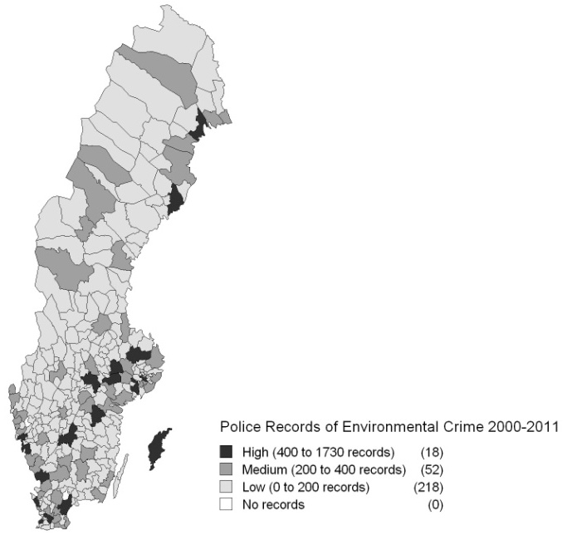
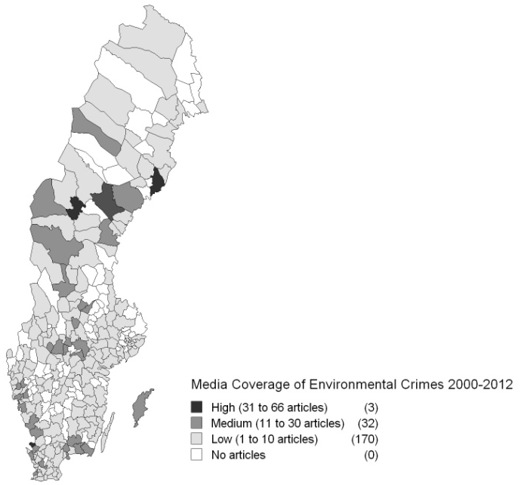
Distribution of EWC

Slide 10
Distribution of EWC
Price of waste collection (SEK) | Number of garbage dump records
 | 0 - 5 | 5 - 10 | 10 - 30 | above 30 | Total
0-1000 | 1 | 1 | 0 | 0 | 2
1000-1500 | 22 | 7 | 3 | 0 | 33
1500-2000 | 58 | 23 | 12 | 3 | 96
2000-2500 | 55 | 17 | 15 | 0 | 87
2500+ | 22 | 4 | 1 | 0 | 27
Total | 158 | 52 | 31 | 3 | 245
Data source: Police records and homeowner association, 2011.
No clear relationship was found between garbage dump and price of waste collection.

Slide 11
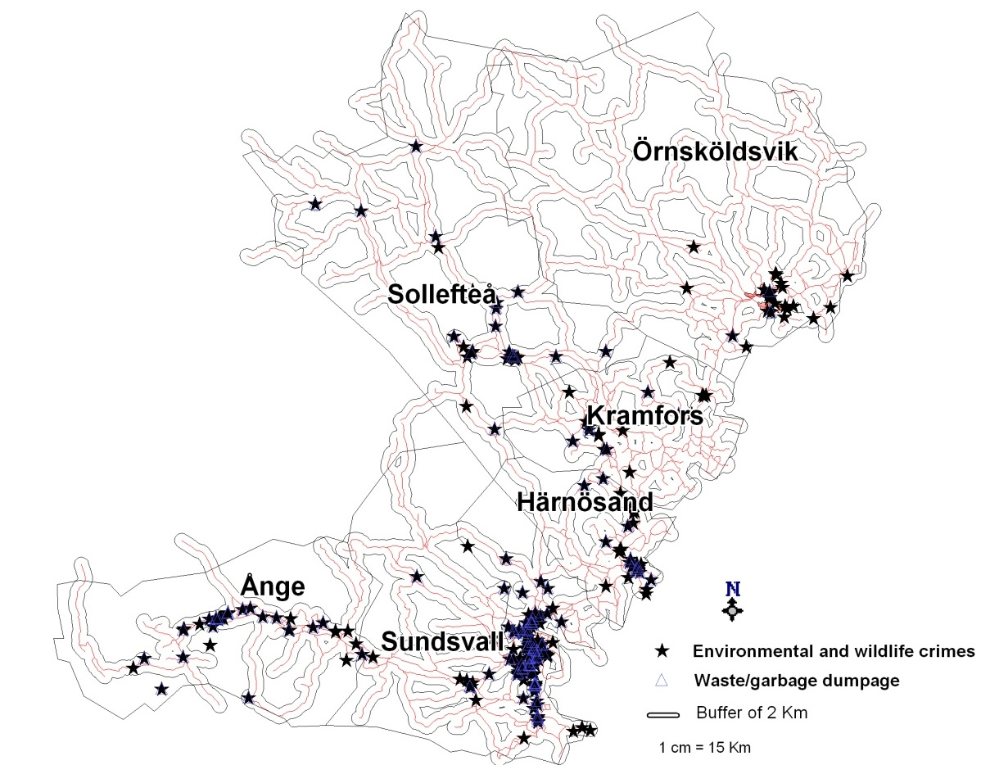
Distribution of EWC
Data source: Police records Västernorrland, 2005-2008.
Police records reflects ”places of detection”- along places where people move around.

Slide 12
Summing up
increase in both police recorded EWCs and media coverage in the last decade.
rural areas: unlawful handling of chemicals and nature and wildlife crimes
urban areas: dumping and other minor EWCs.
police recorded data is limited to detection of EWC.
Which in turn is dependent on people’s movements and accessibility
Most detected cases are close the roads (75 %)
Notes:
Environmental awareness must have played a role in this rise.

Slide 13
Summing up
focus of media coverage has lead to thorough police investigations
media ‘ignores’ minor EWCs: underreported compared to records
media foremost interested in ‘the discovery’: can positively affect detection of EWC and awareness
NEXT STEP – WHY SOME COUNTIES ARE BETTER IN EWC DETECTION?
WHICH ARE THE UNDERLYING FACTORS THAT
EXPLAIN THE GEOGRAPHY OF EWC?
Notes:
Environmental awareness must have played a role in this rise.

Slide 14
Thank you for your attention!
Notes:
Environmental awareness must have played a role in this rise.

