Slide 1



Rural crime & community safety
Housing & Safety Research Group,
CEFIN ABE/KTH
Sponsored by:

Slide 2
WELCOME! Vania Ceccato, chairman Housing & Safety Research Group, CEFIN ABE/KTH

Slide 3
Why care about crime & safety in rural areas?
5 reasons!

Slide 4
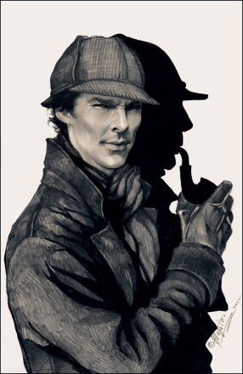
1. Crime is an ‘urban problem’
The Adventure of the Copper Beeches
Sherlock Holmes stories written Arthur Conan Doyle
Lower crime rates in rural areas – ‘a sign’ that there is no problem (Yarwood, 2001: 206)
… this calls for a more nuanced view of crime in rural areas

Slide 5
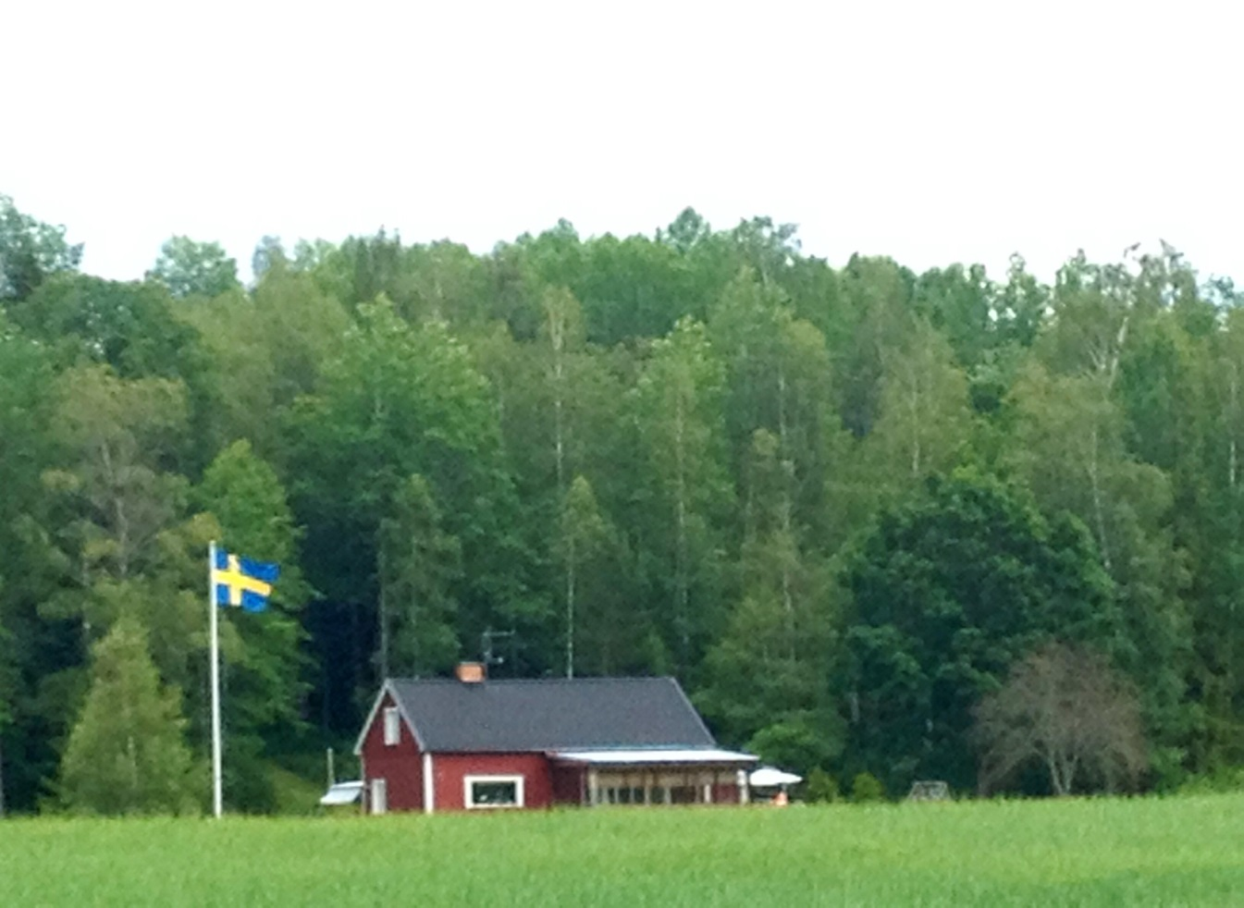
2. Rural areas are not homogenous entities
..but the search for a singular definition of rural is illusory (Halfacree, 1997)
“although crime rates in rural areas are often lower than the rates for large cities, it is a mistake to assume that patterns of crime are homogeneous across rural areas”
(Wells and Weisheit, 2004)
Far from
an homogeneous entity
Complex nature
Dynamic over time and space
Tanglible & imaginary
… this calls for a more plural rural

Slide 6

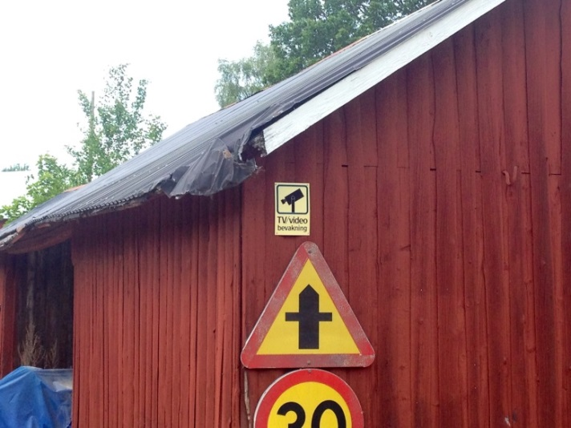
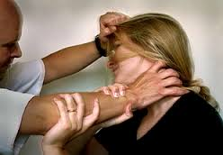
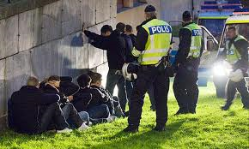
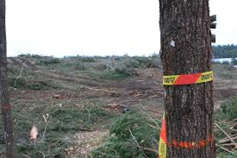
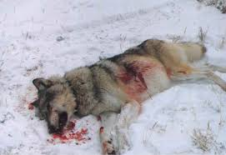
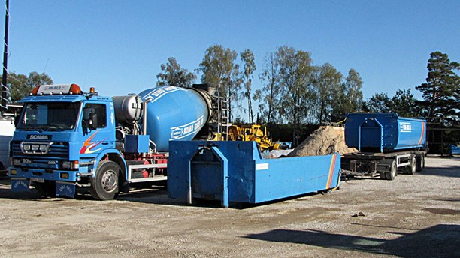
3. The nature of rural areas ’influences’
crime
e.g., Barclay et al. (2007), Mawby and Yarwood (2011),
Ceccato and Dolmen (2011), DeKeseredy and Renninson (2013)
…this calls for better knowledge of the nature of crime in rural areas

Slide 7

4. Rural areas are in constant transformation
e.g. Woods (2004, 2011); Carrington et al (2010); Donnermeyer and DeKeseredy (2013)
These (transformations) happen at different paces and at various scales around the rural world (Donnermeyer, 2013)
Different groups in society are affected by these changes in different ways
ICT have meant new opportunities but also new dangers.
….this calls for the analysis of rural context in a rural globalized world

Slide 8
5. Safety is an individual right
or a commodity?
810
Commodification of safety
in the countryside?
Total number of security enterprises
350
1993 2013
Data Source: Företagsregister, Statistics Sweden, 2013

Slide 9
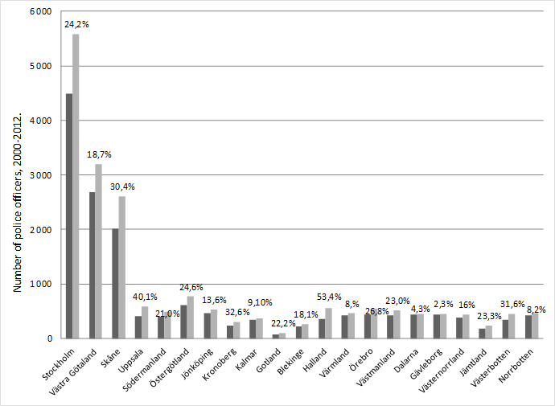
Number of police officers & increase (%), 2000–2012 by county.
Urban
Resources are placed where ”the problem” is!
RURAL

Slide 10
5. Safety is an individual right
or a commodity?
….this calls for a perspective on safety that takes into account the principles of ’distributive justice’ (Rawls, 1971) between urban and rural areas
Safety is a central dimension of social sustainability of areas

Slide 11
Finally, why care about crime in the rural?

Slide 12
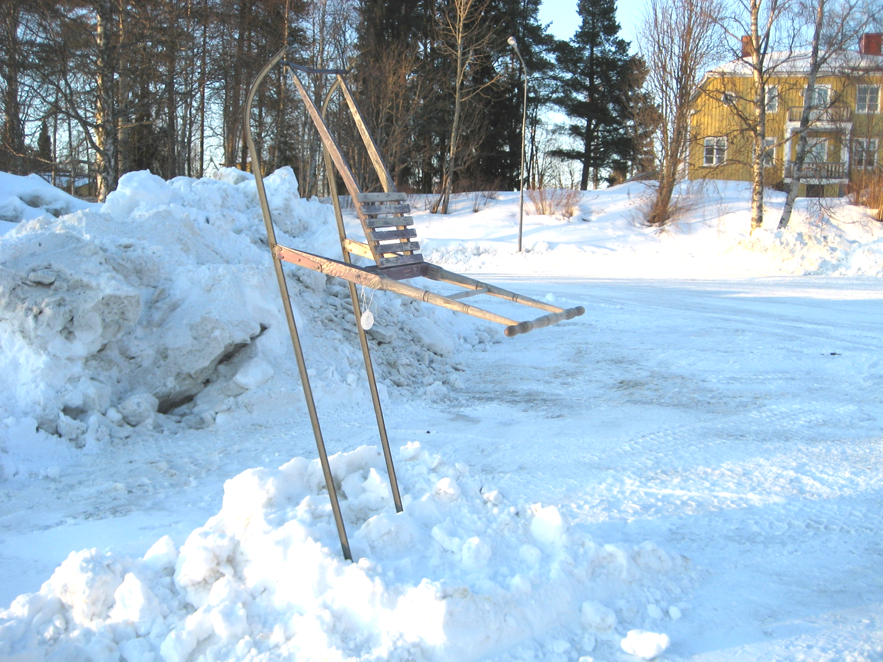
We care about rural areas!
…this calls for a development in research and practice about rural & safety in
rural areas that goes beyond borders of fields, disciplines & theoretical perspectives

Slide 13
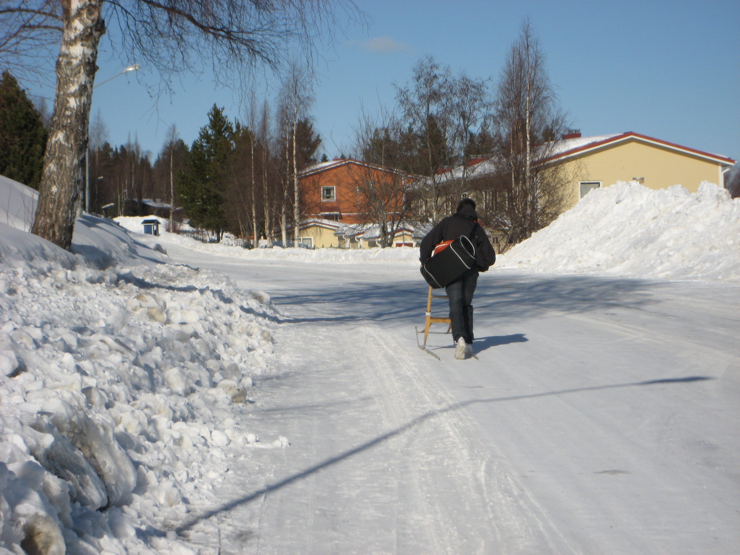
Aim of the workshop
to illustrate the current research on rural communities and safety – an issue
of relevance to scholars and experts working with rural and regional development,
crime and safety, policing, and sustainability.
to encourage a dialogue between participants departing from different disciplinary
traditions to ‘rural’ and ‘crime’ – with different paradigms & methodological approaches –
embracing examples of research that are gender informed
to show examples from different contexts: Scandinavia, the UK, the USA,
Australia and Brazil

Slide 14
Opening
Mike Woods, professor at Aberystwyth University, Wales, moderator
Staffan Nilsson, chairman of the organization The Swedish Village Action Movement a member of European Economic and Social Committee (Sweden)
Charlotta Gustafsson, researcher from The Swedish National Council for Crime Prevention (BRÅ)

Slide 15

PROGRAM

