Slide 1
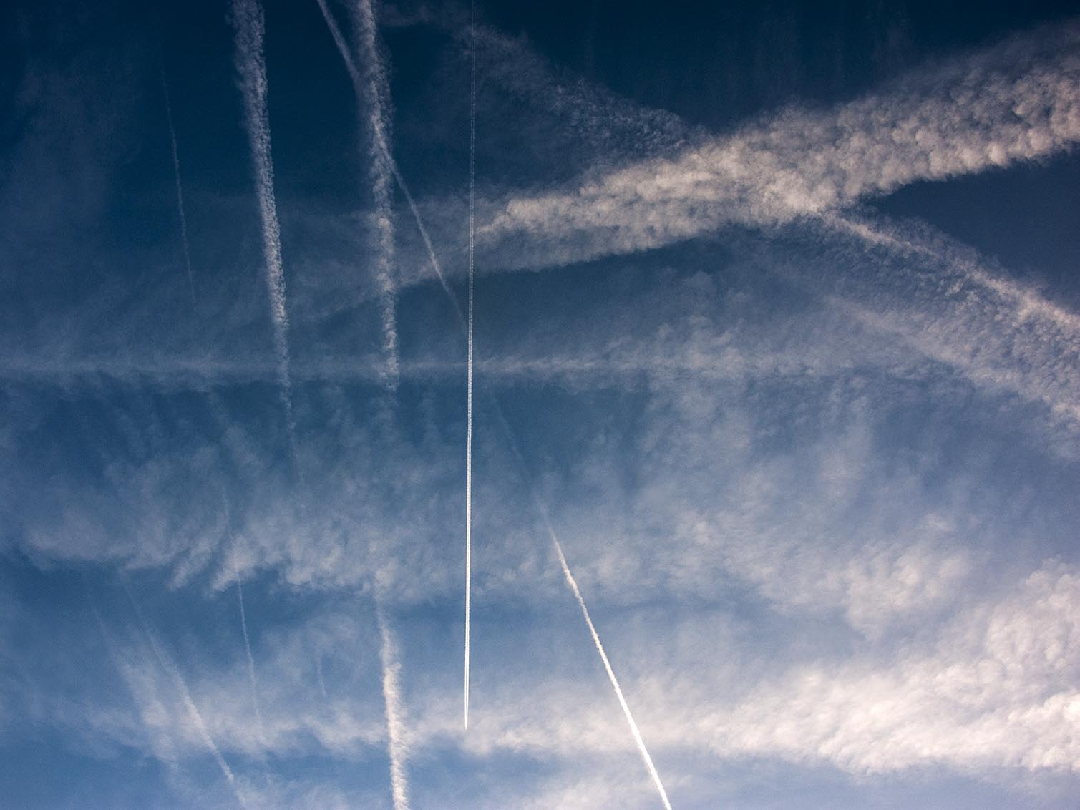
The Travelling Scientist
David Nilsson
History of Science, Technology and Environment, KTH

Slide 2
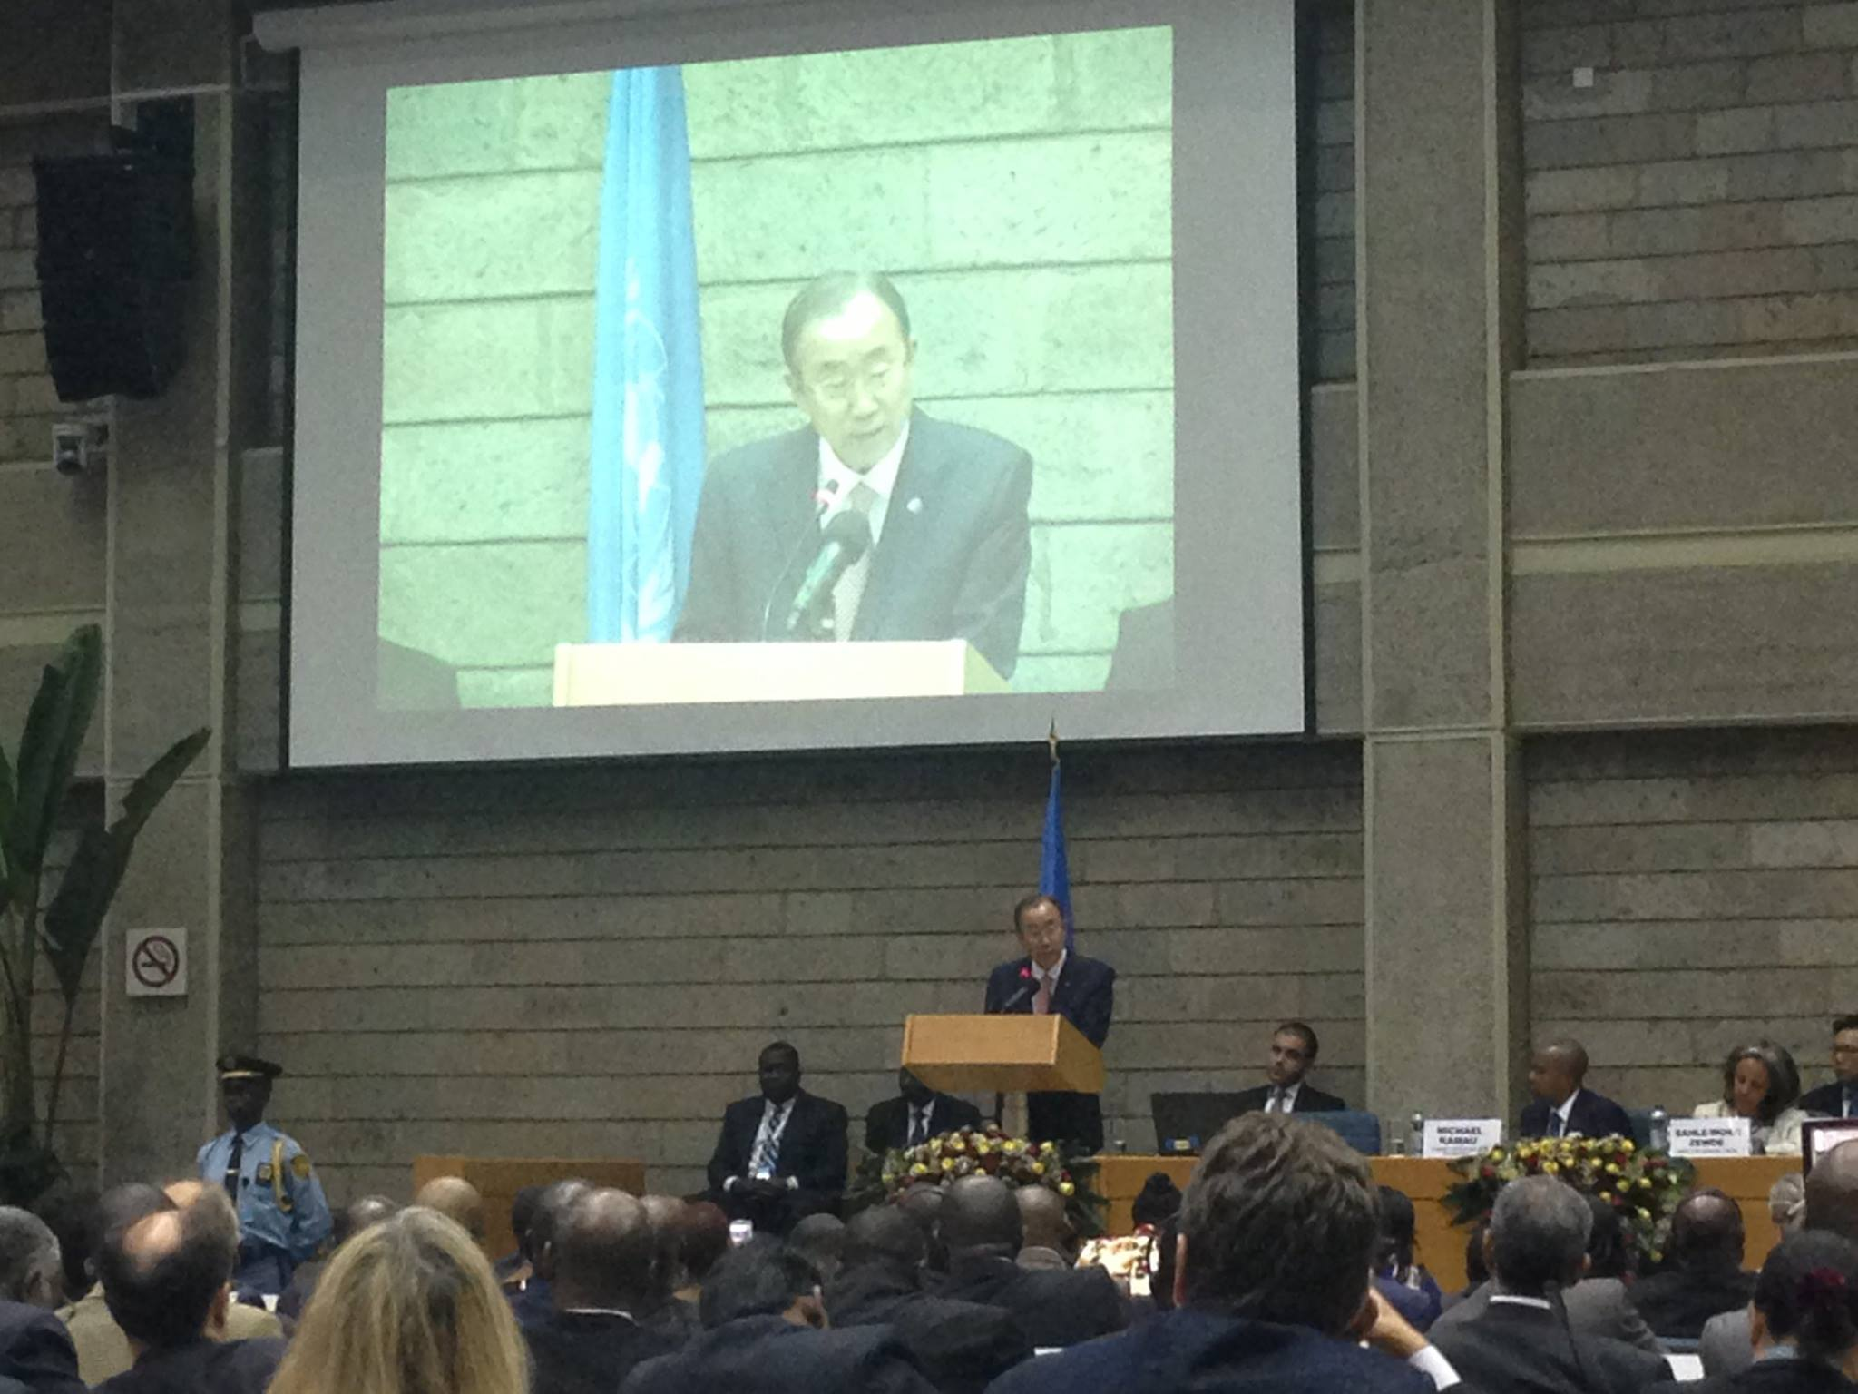
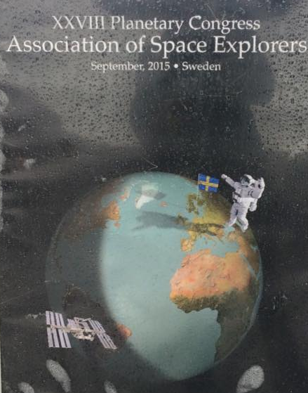

We Are Travellers

Slide 3
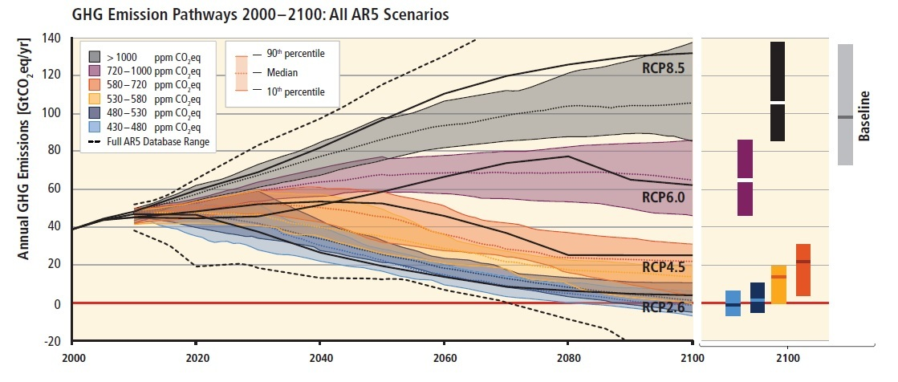
Climate: the Game Changer

Slide 4
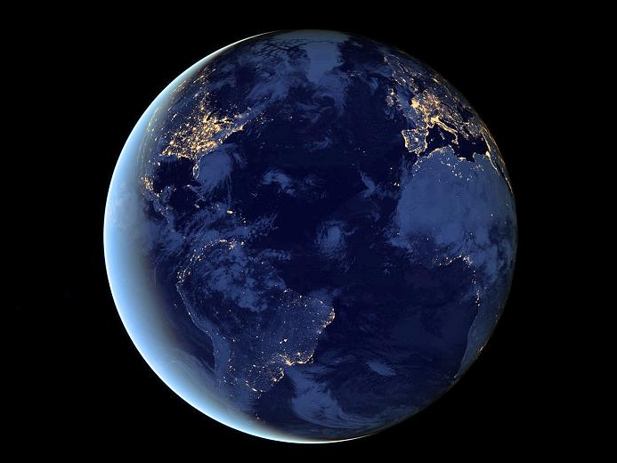
The simple maths:
<2 degrees
=> 20 Gt CO2 eq / year
=> 2 tonnes / cap
KTH research staff emit 2-3 tonnes/year from flying alone

Slide 5
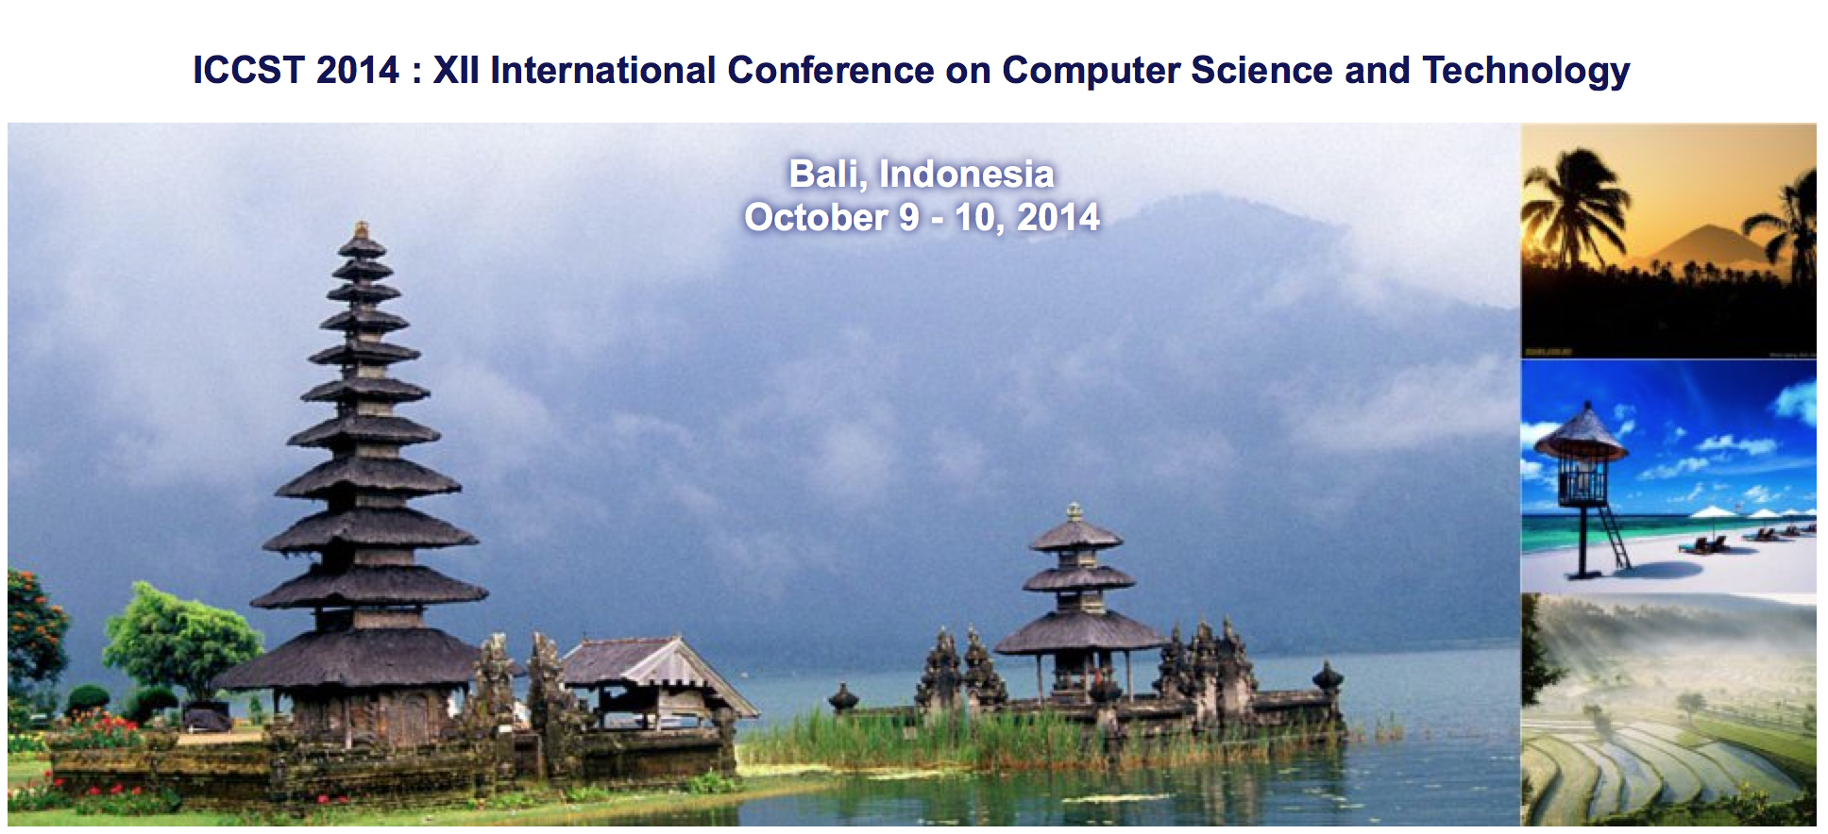
The “Everyday” of Research: dilemmas, incentives and habits

Slide 6
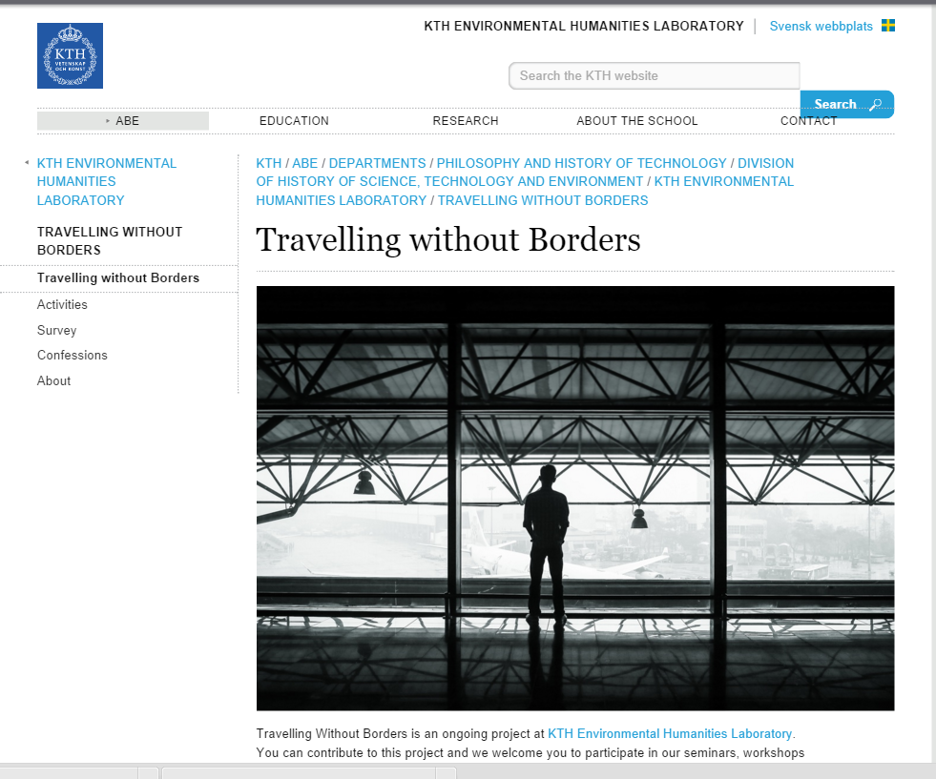
http://www.kth.se/en/abe/inst/philhist/historia/ehl/travelling-without-b

