Slide 1
IT solutions for travelfree meetings at KTH
ITA Catharina Gottberg & Björn Larsson

Slide 2
AGENDA
What different videoconferencing options are there?
What solutions exist on KTH?
How does it work?
How do I get in contact with the support?

Slide 3
Different forms of videoconferencing
Web meeting
Are accessed from your computer, tab, or smart phone. Have functionalities such as chat, upload documents etc.
Well known solutions include: Skype, Google Hangout and Adobe Connect.
Room based conferencing
More advanced HD videoconference system where the emphasis is on personal contact, better picture and sound presentations and security.
Well known solutions include: Cisco Tandberg, Polycom and LifeSize.

Slide 4
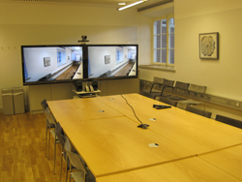
Room based conferencing
KTH central have meeting rooms and lecture theatres with videoconferencing systems which are available to all employees at KTH.
How does it work?
Videoconferencing systems can only connect directly to other videoconferencing systems.
Use IP or SIP addresses.
Can be used to record meeting or lecture.

Slide 5
Room based conferencing
What if a few different locations need to connect and not everyone have a videoconferencing system?
Virtual meeting rooms (PEXIP)
Connect to the room using: web browser (Chrome), Skype for Business, PEXIP client/ app, Cisco Jabber Video, phone.
Book room using your Outlook/ Webmail

Slide 6
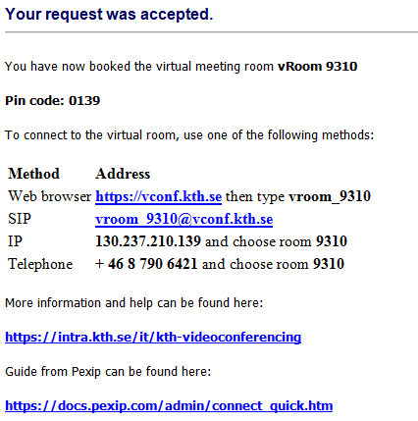

Slide 7
Room based conferencing
How do I book a room?
Send an e-mail to videoconferencing@kth.se for help with sorting out a room or technical support.
We have a room with a videoconferencing system can we also book support?
We are offering workshops on how the systems works to your own local tech support.

Slide 8
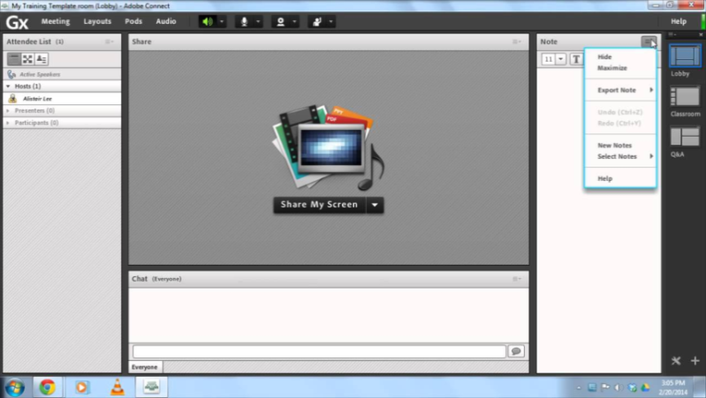
Web meeting - Adobe Connect
For web meetings KTH in cooperation with SUNET supplies Adobe Connect Pro. Recording, polls, chat, screen share, break out rooms.
Who are able to use Adobe Connect?
Both students and staff at KTH, only staff can however create new meetings.
Do I need to book a meeting?
No, you administrate your own web meetings.
Do I need to apply for an account?
No, you login with your KTH.SE account.

Slide 9
Web meeting - Adobe Connect
How do I access Adobe Connect?
Go to connect.sunet.se
Recommendations for web meetings
Use a network cable.
Use headset or mute if not speaking.
Test the connection prior to meeting.

Slide 10
Support
https://intra.kth.se/en/it/kth-videoconferencing
E-mail: videoconferencing@kth.se

