Slide 1

BRANTARE
Project Description, Results and Conclusions
Centre for Sustainable Aviation, 5 October 2018
Bengt Moberg, Johan Rignér, Per Näsman, Pernilla Ulfvengren
Notes:
4 forskare. Jag (Data handling and evaluation), Johan (Human factors), Pernilla, Per (statistics))

Slide 2
Brantare - Steeper – Why?
Reduced noise
  Due to increased distance between the noise source and affected areas on the ground
  Due to reduced thrust
Trials performed in Frankfurt Main and London Heathrow, 3,2°
  Noise reduction by approx. 1dB(A)
Frankfurt Main operates at 3,2°
In studies there have been concerns about changed pilot behaviour that could lead to increased noise on ground.
Increased noise has been shown in one case
Notes:
Used to be B707, DC-8 and similar aircraft.
Also Steeper than 3.5 degrees.
Concerns about increased noise or effects of changed noise footprint

Slide 3
Brantare – Challenges
Well controlled trials can be difficult to perform
  Procedures must be created and approved by local authority
  Approaches must fit in daily operations
  It must be possible to compare data from different types of operations in order to have a meaningful implementation into daily operations
It was necessary to find a method to collect large amounts of data regarding pilot operational behaviour

Slide 4
Brantare – Assumptions
Assumption 1: The pilots’ operational behaviour will change when flying steeper approaches
Assumption 2: The changes in the pilots’ operational behaviour will be similar for tailwind approaches and steeper approaches

Slide 5





Brantare – the Method
$$z_{1}$$
$$y$$
$$x_{1}$$
$$α_{GS}$$

Slide 6





Brantare – the Method
$$z_{1}$$
$$y$$
$$x_{1}$$
$$α_{GS}$$
$$z_{1}$$
$${wind v}_{TW}$$
$$y$$
$$x_{1}$$
$$α_{GS}$$

Slide 7

Brantare – the Method
$$z_{1}$$
$$y$$
$$x_{1}$$
$$α_{GS}$$
$$z_{1}$$
$${wind v}_{TW}$$
$$y$$
$$y$$
$$x_{1}$$
$$α_{GS}$$

Slide 8










Brantare – EZWGS
$$z_{1}$$
$$z_{2}$$
$${wind v}_{TW}$$
$$y$$
$$y$$
$$α_{2}$$
$$x_{1}$$
$$x_{2}$$
$$α_{GS}$$
$\sin{α_{GS}}{= y/z_{1}}$, $\sin{α_{2}}{= y/z_{2}}$ and (for small $α$), ${z_{2}}/{z_{1} = {v_{App}}/{\left(v_{App}+v_{TW}\right)}}$
hence
$$α_{2}= \arcsin^{}\left(\frac{\left(v_{App}+v_{TW}\right)sin{α_{GS}}}{v_{App}}\right)$$
Notes:
x₁=(V_{app}+V_{TW})*t, X₂=V_{app}*t
z₂=x₂/cos α_{2 ,} z₁=x₁/cos α_{GS}
z₂/z₁ =x₂*cos α_{GS}/x_{1*}cos α₂≈{for small α}≈x₂/x₁=V_{app}*t/(V_{app}+V_{TW})*t=V_{app}/(V_{app}+V_{TW})

Slide 9
Brantare – Assumptions
Assumption 1: The pilots’ operational behaviour will change when flying steeper approaches
Assumption 2: The changes in the pilots’ operational behaviour will be similar for tailwind approaches and steeper approaches
Idea: Use wind data in order to approximate a steeper approach. The pilots’ operational behaviour can be estimated for an implementation of steeper approaches. We call the approximation of the steeper glideslope
Equivalent Zero Wind Glide Slope - EZWGS

Slide 10
Brantare – Execution
Verification of assumptions
Creation of a method to derive the EZWGS by help of the collected data
Extraction of flight data from Novair
Analysis of flight data
Follow up on results

Slide 11
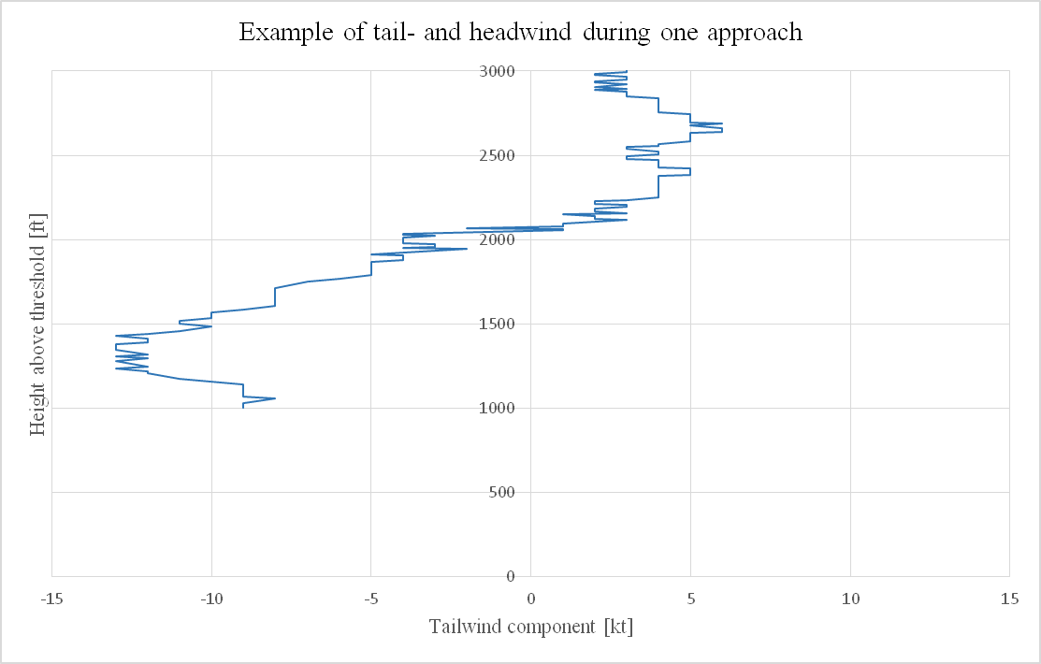
Brantare – Problem #1 (and#2)
Notes:
2 problems. Wind first. Stabilized approach at 1000 ft.

Slide 12
Brantare – EZWGS
Verification of the assumptions and development of a calculation method to calculate an EZWGS from wind data
  Workshop with ten pilots from SAS and Novair
  Interviews with ten other pilots from SAS and Novair
Airbus | Boeing | Generic
1 | 1°, 2° | F1
2 | 5°, 10°, 15° | F2
3 | 25°, 30° | F3
Full | 40° | N/A
Landing gear | Landing gear | LG
Notes:
The table first since we have Airbus and Boeing pilots

Slide 13
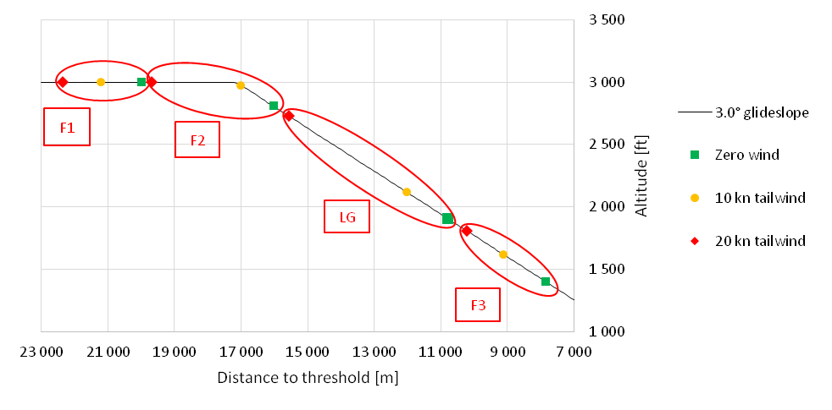
Brantare – Results pilots
Pilots’ responses from workshop and interviews on their extension behavior for flaps and gear, dependent on different tailwinds

Slide 14
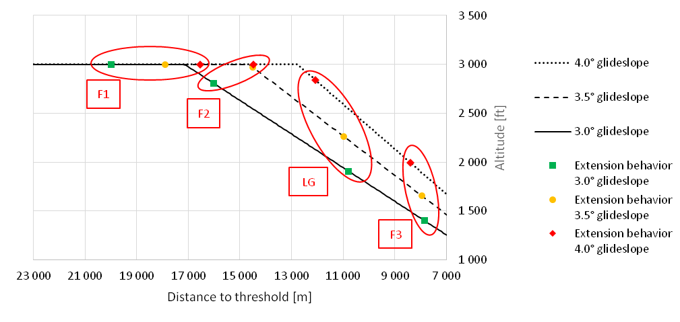
Brantare – Results pilots
Pilots’ responses from workshop and interviews on their extension behavior for flaps and gear, dependent on different glide slope angles
Notes:
Toggle back to previous pic for F1 and F2

Slide 15
Brantare – Execution
Extraction of flight data from Novair
  (1 389 flights)
Analysis of flight data
  (1 159 flights with useful data, 172 tailwind approaches)
Notes:
We need consistent and continous data.
Data loss of 10 - 20% is not strange

Slide 16
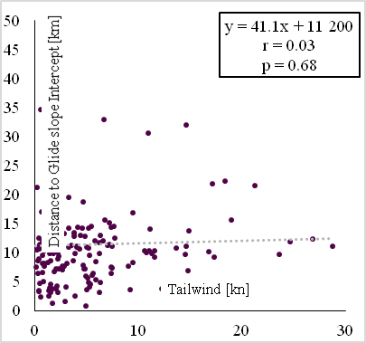
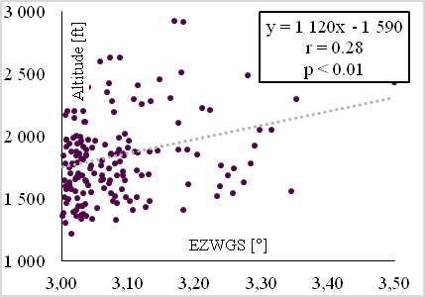
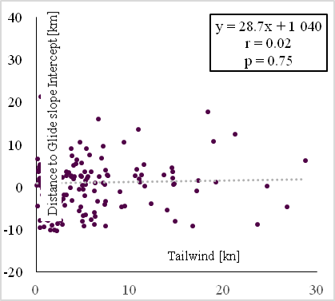
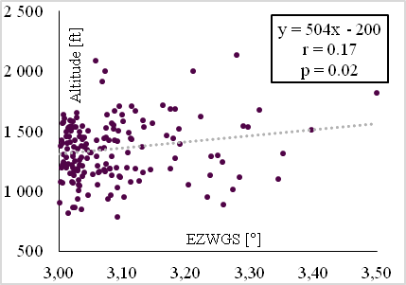
Brantare – Results flight data
Flap 1
Gear
Flap 2
Flap 3
No correlation
Correlation
Notes:
F1 and F2 we don’t look at
LG and F3 are OK

Slide 17
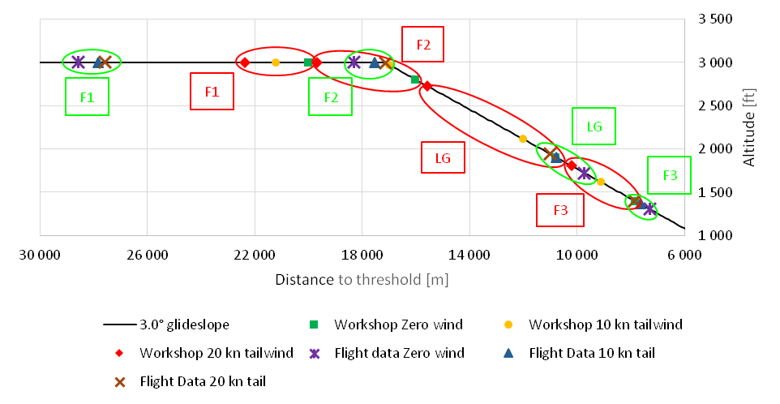
Brantare – Combined results
Notes:
First look at F1 & F2 anyway.
F1 - Slats out due to speed restrictions
F2 – very close to G/S intercept
LG and F3 with are close to the points where you have to do it in order to be stabilized at 1000 ft

Slide 18
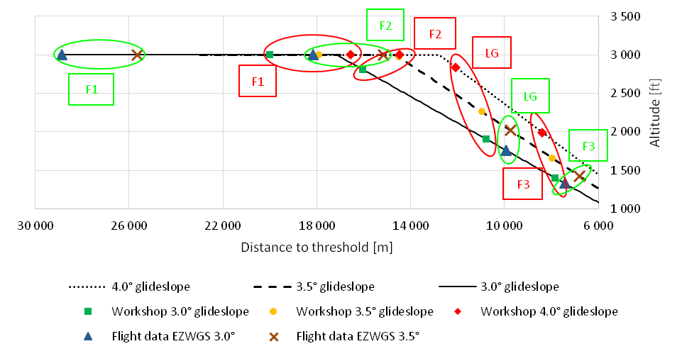
Brantare – Combined result - EZWGS
Notes:
LG and F3 approximately at the same locations
LG and F3 at a greater height.
No measurements and no calculations performed!

Slide 19
Brantare – Results Follow Up Interviews
10 pilots from SAS
7 of 10 were not surprised regarding the discrepancies between results from workshop & interviews versus flight data
”It is for fuel efficiency reasons reasonably to extend gear or flaps as late as possible if the flight is progressing as expected”
”Feedback regarding a given situation is positive and is an opportunity for personal development”

Slide 20
Brantare – Conclusions
Pilot behavior changes for landing gear selection and final flap setting for landing when flying tailwind approaches, but not as much as the pilots themselves believes
By applying the EZWGS method there is an indication that selection of landing gear and final flap setting will take place closer to the airport during steeper approaches
Post flight data can be used for feedback and improved pilot training by:
  Ask the pilot about his/her intention in specific situations
  Extract flight data from such situations
  Give feedback to the pilot about differences between stated perceived behavior and actual performance

Slide 21
Brantare – Dissemination
Paper #1 - Pilot impact on the noise abatement effect of steeper approaches – Initial analysis of wind and flight data
Presentation Internoise 2017
Presentation CSA Workshop 2017
Presentation Swedavia & LFV 2018
Presentation The Swedish Society of Aeronautics and Astronautics 2018
Paper #2 - Pilot operational behaviour during steep approaches – Approximation by a tailwind flight data model
Paper #3 - Pilots’ control strategy - Individual post flight data feedback
Presentation CSA Workshop 2018
Notes:
Dissemination is part of the contract with the Swedish Transport Administration so it must be reported, and here is what we have done when it comes to Dissemination

Slide 22
Brantare – Future research
Actual steeper approaches
Simulator trials, what is operationally feasible?
Noise calculations and measurements connected to real flights
Larger data sets – More flights ↕
Expand to more flight phases for pilot evaluation
Notes:
Get answers to the questions:
Will LG and F3 be approximately at the same locations
Will LG and F3 be extended at a greater height.
We would like to do measurements and calculations!

Slide 23


That’s all!
Questions?
$$α_{GS}$$

