Slide 1


IPD
Integrated Project Delivery

Slide 2
IPD
Bygga teamet
Arbeta integrerat
Dela på vinst
Andra projekt
Specificera
utförandet
Följa upp och ändra
Granska och betala
Idé Design Planering Produktion Drift och Underhåll

Slide 6
AIA

Slide 7
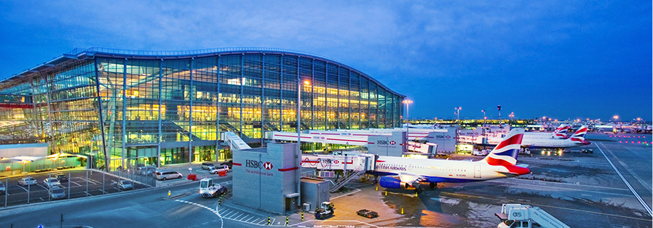
Heathrow Terminal 5

Slide 8
The T5 Agreement
‘The T5 Agreement’. Co-located, integrated teams involved suppliers from the outset, working together.
The Terminal 5 project included the main terminal building and two smaller satellite terminals, an extension to the rail lines for the Heathrow Express and London Underground Piccadilly Line, 60 aircraft stands and associated airfield infrastructure a 4,000-space multi-storey car park a control tower and a 600-bed hotel.
All companies under the T5 agreement came together as an integrated team, with over 1,000 designers working on 16 separate projects.
Design management assisted decision-making by consolidating information and presenting it in a clear and consistent way. An example of this success was the 4D planning tool used at the terminal’s interchange plaza. The tool linked CAD data to one or more schedules, helping to identify potential clashes between contractors, and saved £2.5m in the first nine months of use.

Slide 10
DPR videos on IPD
https://www.dpr.com/media/video
https://www.dpr.com/media/video/p4
https://www.dpr.com/media/video/p5

Slide 11
IPD Modularitet och Specialisering
Moduler skapar specialisering inom modulen
Integration skapar samverkan mellan moduler
Behövs styrmekanismer för att skapa systemnytta!
Identifiera lock-ins
Lösa upp lock-ins genom att:
  Planera arbetsflöde
  Nätverksmanagement
  Eskalera upp i hierarkin

Slide 12
IPD resources
https://www.dpr.com/view/a-guide-to-the-book-integrating-project-delivery
http://www.aiacc.org/wp-content/uploads/2014/07/AIACC_IPD.pdf
https://www.dpr.com/assets/case-studies/IPD-Whitepaper_2018-2.pdf
https://sfuheathrowcase.wordpress.com/

