Slide 1


Privatfinansierad infrastruktur - lärdomar från Finland
Stockholm 29.05.2019
Kim Wikström
Åbo Akademi
PBI Research Institute

Slide 2
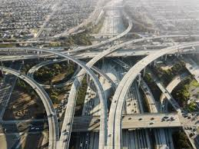
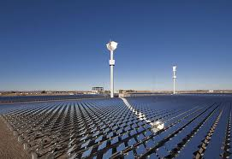
Point of departure
In the coming years infrastructure investments USD 6.3 tn/year¹⁾
Durable impact on countries welfare and companies competitive advantage, also increasingly on environment
Infrastructural investments stalked by cost overruns, time delays and outcomes not meeting expectations and needs (Flyvbjerg 2017)
Increasingly complex, digitalization, system benefits, regulation and new technology
¹⁾ OECD 2017
Notes:
2

Slide 3
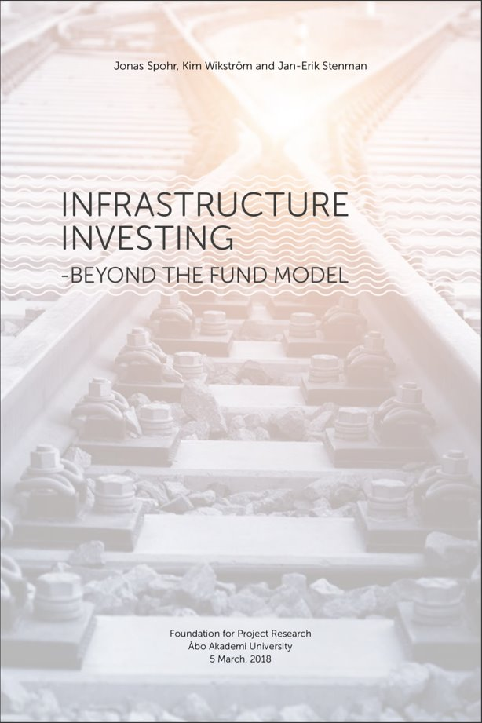
Our requests on infrastructure investments
Larger societal benefits by more sustainable and more innovative investments (long-term roadmaps and incentives)
New competitive offerings for involved companies (testbed for ecosystem development)
Increased efficiency and effectiveness by new delivery models
Faster and more efficient investments, and lowering government debt with new long-term financing where the involved stakeholders have incentives to continuously improve the performance of the investment over its life-cycle
Good investment objects for institutional investors, new directions in regulation (e.g. Swedish government´s initiative 2019)
Sustainable
society
Technology
Economics
Notes:
The parliamentary working group on transport network funding
3

Slide 4
Background
Long history for privately funded infrastructure
PPP not either or but alternative for certain types of investments
Policy and regulation established for SPV, need for rules of the game between SPV and government when introducing PPPs
Emerging international best practices (life-cycle value, Value for Money)
Traditional infrastructure projects had in average cost overrun 35,3 % and PPP 11,6 %
Traditional projects 23,5 % delayed as PPP:s 3,4 % ahead schedule

Slide 5
Governance to ensure the success of PPPs
Agency for nationally important infrastructure investments
Agencies on state, municipality level gives priorities to national level who decides
Market driven initiatives without connection to agency priorities do seldom succeed
Common standards for VfM analysis created in UK, Canada, Australia (based on Ontario Investment)
Contractual maturity for SPV:s, immature for relationship with government, starts to be more mature https://infrastructure.gov.au/infrastructure/ngpd/index.aspx
Contractors should not have a too strong role if involved in SPV ownership
National level agency for long-term planning of strategic infra-structure investments, VfM calculations, procurement processes
State/municipality agency for long-term local planning of infrastructure investments
Permanent collaboratives
Market driven initiatives
SPV
SPV
SPV
SPV

Slide 6
The collaborative model can get things moving
Permanent structure managing several SPVs (10 – 20)
Created by like-minded institutional investors and can grow with new members over time
One of the strong drivers for the collaboratives to outperform the traditional funds is to put emphasis on Environmental, Social and Governance (ESG) performance as a mean to increase the monetary return for its clients
Develop a network
Develop a relationship
Build trust
Informal agreement
Formal agreement
LP-GP
Fund model
Co-investment
with GP
Seed
JV
Syndicate
Alliance
Investment
Opportunity
Investment
Opportunity
Investment
Opportunity
Investment
Opportunity
Investment
Opportunity
Investment
Opportunity
Collaborative institutional investment vehicles
Decreasing relevance of fund manager
Re: Monk et al, 2017

Slide 7
In-sourcing capabilities
Cbus Australia – best practice in greenfield infra investments 11 % in infrastructure (A$4 billion), 30 % of that directly, expects to raise to A$ 60 billion within next five years
Best return 11,8 %
In-house team increased to 8 persons to produce greater returns and reduce costs as well as fees by in-sourcing
Mostly in greenfield (mainly in Australia)
Another example is Dutch pension fund PGGM that has increased internal capabilities to go direct into infra. PGGM is a cooperative consisting of several pension funds.

Slide 8
Asset recycling
Nowacki http://theconversation.com/how-america-can-copy-australias-asset-recycling-scheme-78471

Slide 9
Value for Money (Infrastructure Ontario)
  Govt. “Calculates” and Compares “Value for Money (VfM)”
  of Various Procurement Options

Slide 10
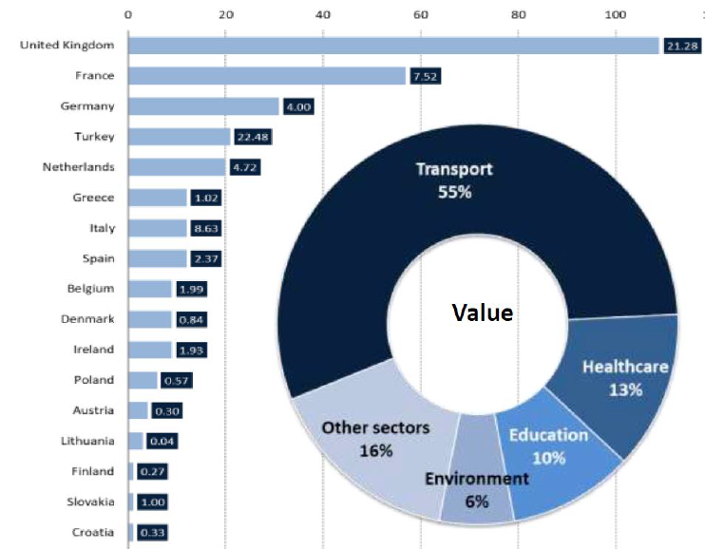
PPP-projects in Europe (2013-17)
Others:
-housing
-safety
-telecom
-energy
-recreation
10

Slide 11
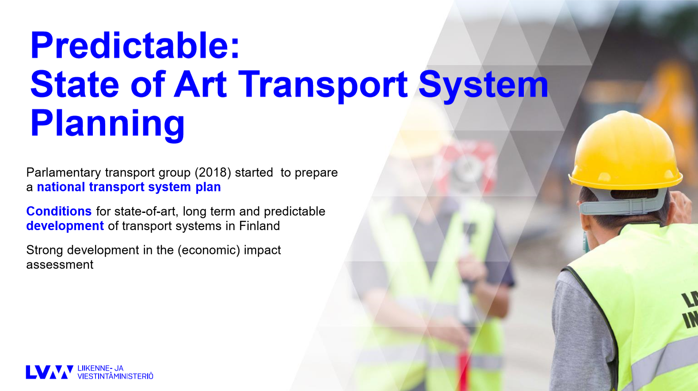

Slide 12
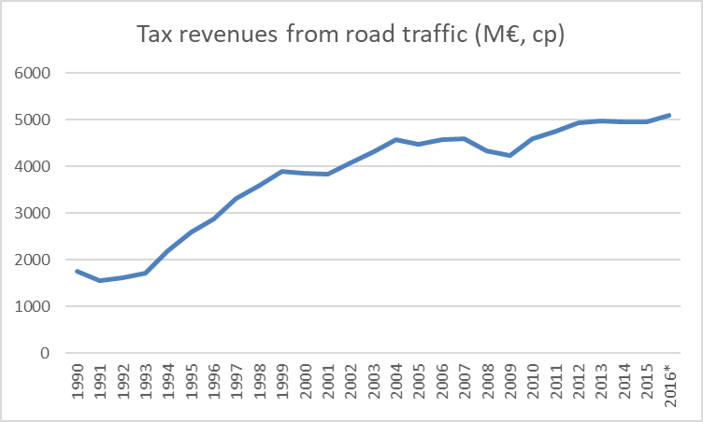
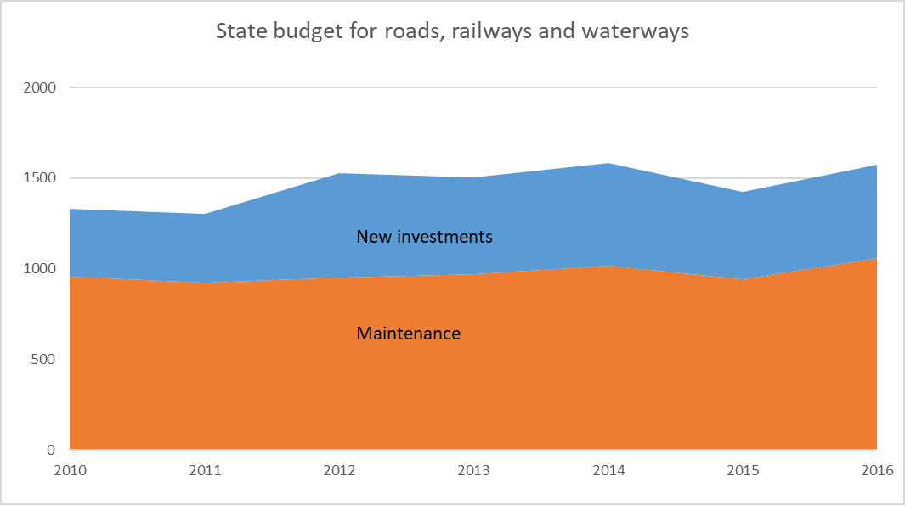
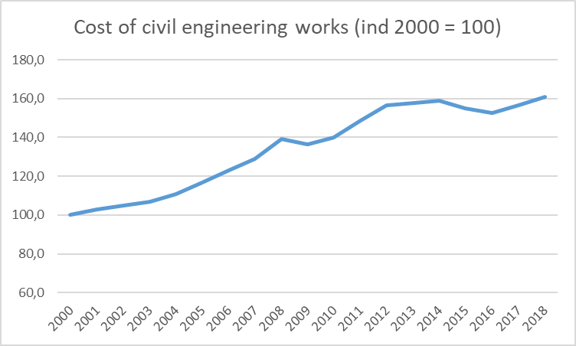
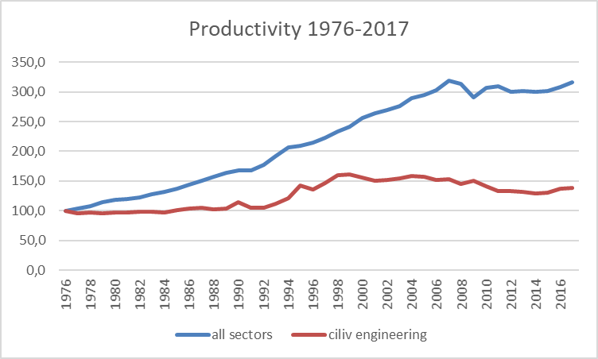
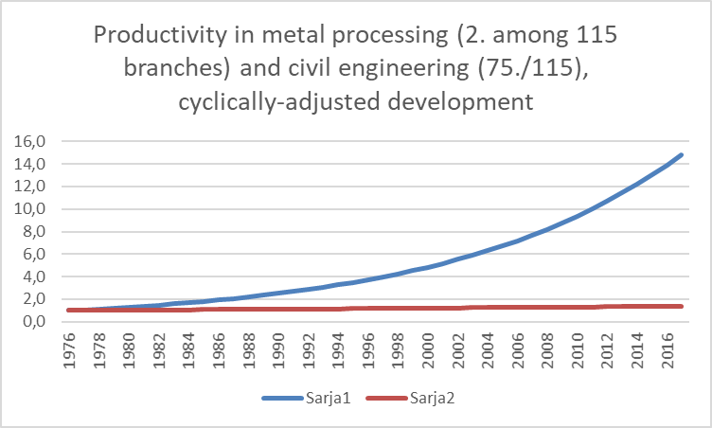
Taxes and budget as a foundation
Common understanding that current level of funds is not sufficient for proper maintenance or big projects
Current additional models (EU subsidies, joint projects and availability based PPP) are needed, but don’t solve the funding problem
Most important and effective solution would be increased level of budget for maintenance as agreed in Parliamentary group
Big investments need separate models and long-term pipelines
Factors that increase funding pressure:
extra wear caused by additional traffic
cost increases
network growth and diversification
Factors and outcomes that reduce financial pressure:
maintenance backlog
quality problems and declines in service level
productivity growth
12
Seppo Toivonen / Väylä

Slide 13
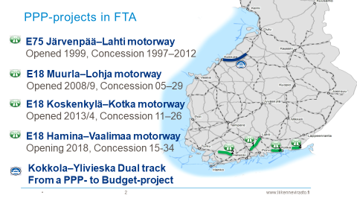
PPP-projects in Finland
Upcoming projects, Hailuoto causeway and 12-year transport plan
Seppo Toivonen / Väylä
13

Slide 14
FTA´s experiences
Positive
Negative
Easier to launch big projects
Fast delivery
Discipline
Systematic risk management
Optimal transfer of life-cycle responsibilities and good management of life-cycle costs
User/benefitter pays
Long term PPP-contracts bind upcoming budgets
High transaction costs
Expensive private money
More market unstabilities (construction markets + finance markets)
Demand risk to private sector
Development ideas
PPP –pipeline
Lighter model with less transaction costs for smaller projects
Change mechanisms
Collaboration
Seppo Toivonen / Väylä
14

Slide 15
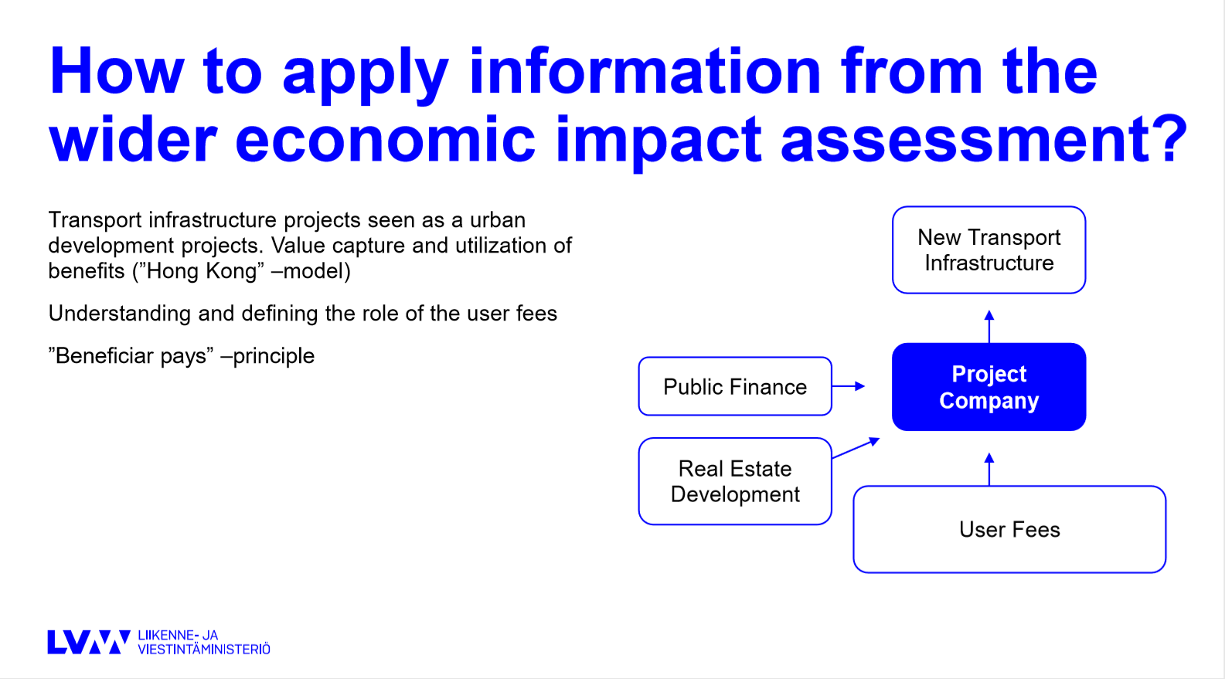

Slide 16
Investeringar i tågtrafik
Finlands Banan Ab
- Tre dotterbolag med städer
som delägare

Slide 17
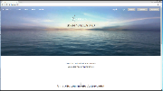






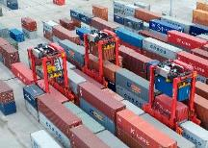
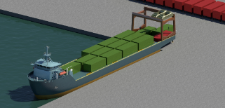
Example: Grand challenge for Finland:
In and outflows of goods and services
Utilization rate low for
assets (35 % for ships)
Environmental burden
Investment opportunities in e.g. roads, ports, rail and especially into digitalization
SMART CITY / EXPORT
COMPANY
LAND
TRANSPORTATION
PORT
SEA
TRANSPORTATION
END
CUSTOMER
TECHNICAL SOLUTIONS
REGULATION
INFRASTRUCTURE INVESTMENTS
DIGITAL SOLUTIONS
Notes:
17

Slide 18
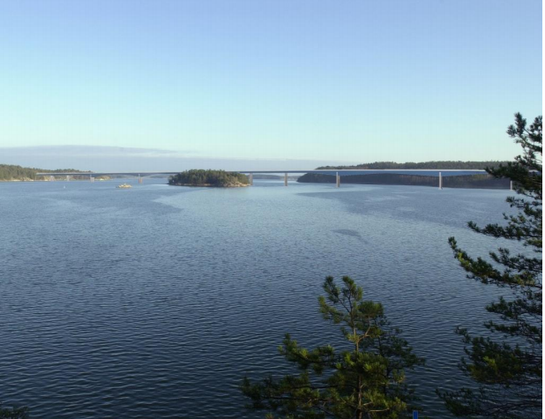
En fast vägförbindelse för att gynna regional utveckling och skapa ny, nationellt viktig kompetens
Ökning av markvärdet
Stort intresse och behov för nya finansierings-modeller på statligt håll
Skärgårdens turism-potential
Bidra till att säkra skärgårdens livskraft
Avsevärt bättre och snabbare förbindelse
Samhälls-ekonomiskt lönsam investering
Pilotprojekt för Finland för broavgift
- Pargas som föregångare
Notes:
18

Slide 19
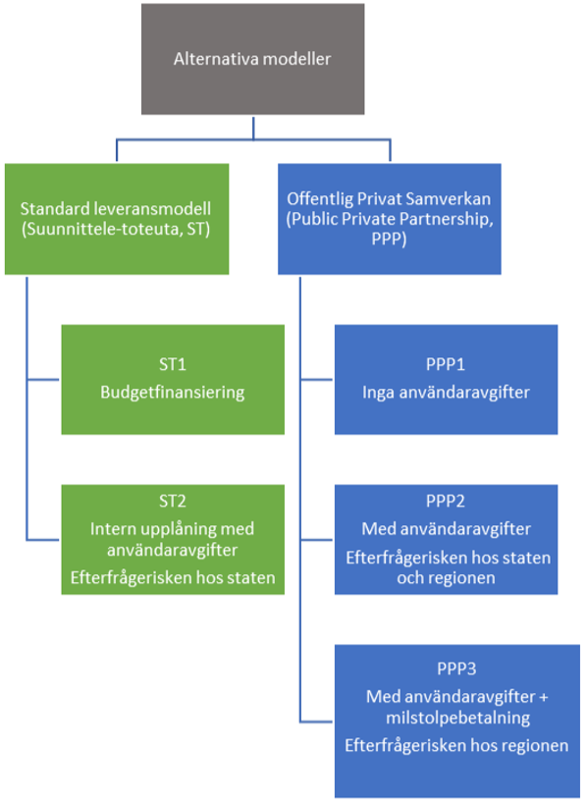
5 alternativa leverans- och finansieringsmodeller granskade

Slide 20
Tack!
Kim.wikstrom@abo.fi

