Slide 1
Network Management Using NFV
IK2200 Midterm Presentation
Group 2 UnnA
Oct.22th.2014

Slide 2
Outline
Introduction
Goal
Approach
Work Splitting
Challenges & Problems
2nd Term Plan
Current results and Video shows

Slide 3
Introduction
Project name:Network Management Using NFV
Team Members:
Epameinondas Kontothanasis: ekon@kth.se
Sikandar Khan: sikkha@kth.se
Maria Haider: mariahai@kth.se
Ganapathy Raman: grma@kth.se
Peiyue Zhao: peiyue@kth.se
Jing Jin: jji@kth.se

Slide 4
Goal
Separate hardware from network functions
Virtualize the Network Functions
Notes:
Setup a Virtual Network Management system that consists mininet topology and implementing functionalities to test and monitor the network. Use various scenarios to see how the topology would respond in different settings.
Set up the frame(Mininet+Opendaylight+Openstack)
Implement 5 basic network functions (Firewall, Load Balancer, Tunneling/Slicing with security flavors, L3 Routing and NAT, Monitoring/Metering)
Run 3 big scenarios that Run 3 big scenarios that showcase and test the functions
Use traffic to stress the Network Fucntions

Slide 5
Approach
Study about SDN
Study about NFV
Define tasks and sub-tasks
We have sub-groups to finish different sub-tasks.
Virtual “physical” topology
OpenDaylight Controller
OpenStack
Integration between components
·
Notes:
To get familiar with the SDN
1)Online tutorial
2)Youtube Videos
3)Follow step by step
We have 3 sub-groups to finish different sub-tasks.
1.Mininet
1)Design a simple mininet topology to explore the mininet function and the OpenFolow features.
2)Work with the Stanford Topology
3)Write a traffic generator
2.OpenStack
3.Connection between Openstack and Opendaylight

Slide 6

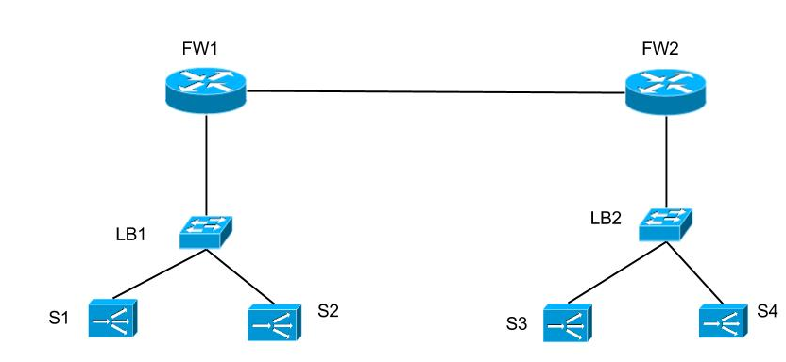
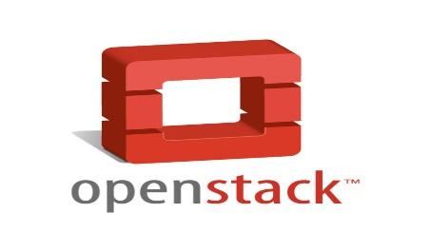



Mininet Topology
Controller Node
OpenVSwitch
Compute Node 1
Compute Node 2
Tenant1
Tenant 2

Slide 7
Division of Responsibilities
Project Integration : Ganapathy Raman, Peiyue Zhao
Connectivity from Mininet to ODL OVSwitch
Connectivity from the instance inside Openstack to Mininet
Project Virtualization : Sikandar Khan, Maria Haider, Jing Jin, Epameinondas Kontothanasis
Generate packet in Mininet
Create a Tenant Network in Openstack
Openstack Functions

Slide 8
Work Splitting-Gantt Chart
Gantt Diagram

Slide 9
Challenges & Problems
Challenges Faced:
Memory issues in physical machines
OpenStack bugs ✓
OpenStack gateway issues ✓
No connection between OpenStack nodes and external world ↻

Slide 10
2nd Term Plan
Finish the integration between Opendaylight and Openstack
Implement Network functions
Design scenarios to test the functions

Slide 11
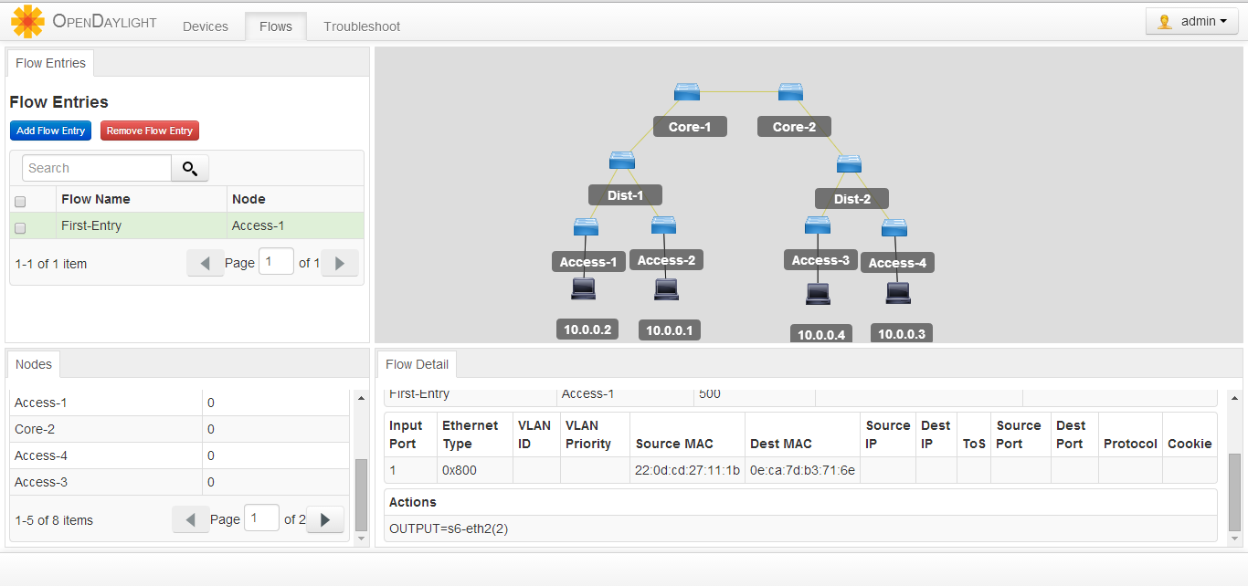
Current Results-Mininet Topology

Slide 12
Current Results - Packet Generator
A packet generator tool has been created in python which can generate following packet types:
ICMP
ARP
UDP
TCP
VLAN

Slide 13
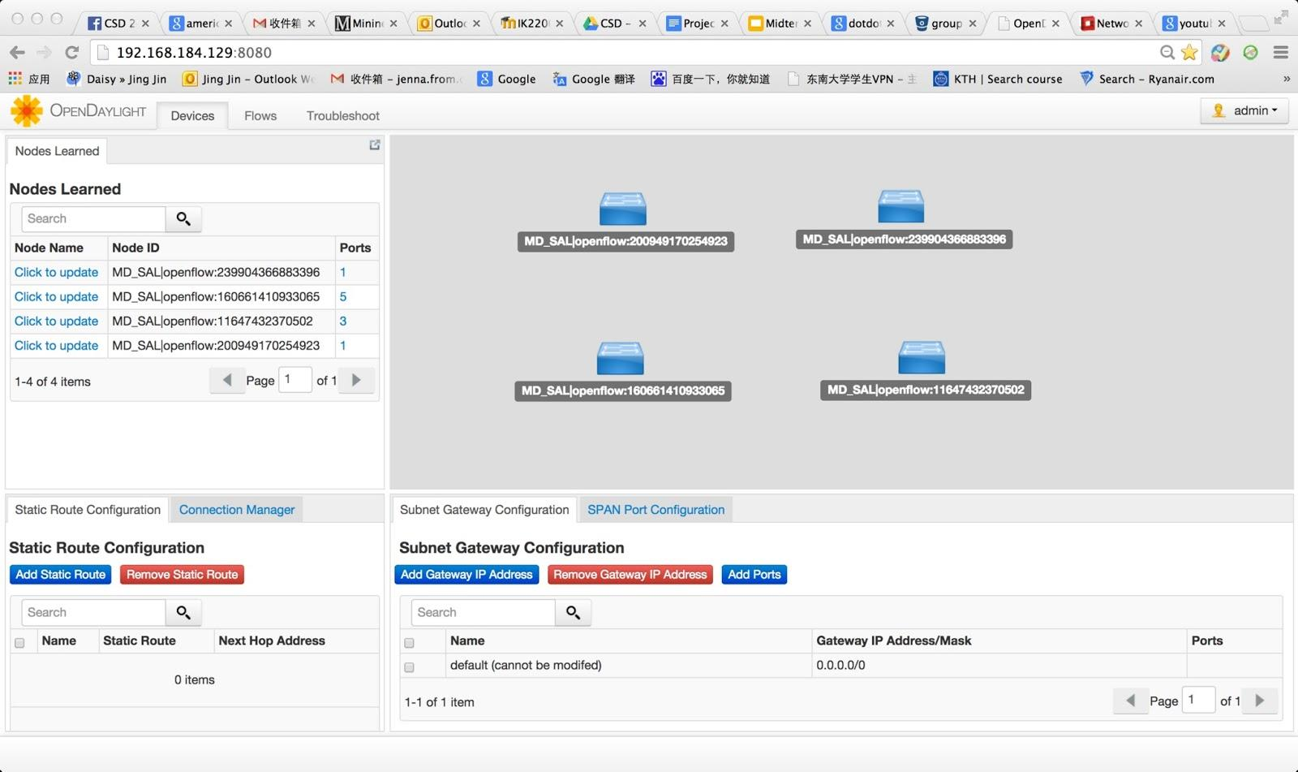
Current Results-Integration of OpenStack and OpenDaylight
Integration of Openstack and OpenDaylight.

Slide 14
Current Result-Video Show
Video1-Ping between OpenStack VMs and Firewall functions.
https://docs.google.com/file/d/0B27BAlA6W2QDLTFpcWpBaXQ1Q1U/edit
Video2-Packet Generator
http://www.youtube.com/watch?v=GkTNknbBJLc&feature=youtu.be

Slide 15

Q&A

