Slide 1
Logistics and Transportation
AH2102
Dr.ir. Sebastiaan Meijer
Associate professor
smeijer@kth.se

Slide 2
This course
Aims to give you an introduction into logistics
Overview of several aspects and dimensions
7 weeks, last lecture December 18th
2 assignments + group project
1 Supply chain game + one choice experiment
Logistics is a very broad topic. Be active, participate and discuss about things that you like. We can steer the contents of the course towards your interests

Slide 3
Examination
You pass the course when:
You handed in the 2 individual assignments and received a ‘Pass’ for each.
You have handed in a report and orally presented the results of the group project successfully. Each member of the group gets the same grade.
You participated in the supply chain game and choice experiment
End result:
  Grade for project.

Slide 4
Teachers
Most lectures + examiner:
  Sebastiaan Meijer
  Associate professor Transport Systems, Head of GaPSlabs
  smeijer@kth.se
Logistics simulation
  Jayanth Raghothama & Maksims Kornevs
  jayanthr@kth.se / kornevs@kth.se
City logistics
  Lara Zomer, zomer@kth.se
Electric transportation
  Qiuchen Wang / Vinutha Shreenath
  qiuchen@kth.se / vinutha@kth.se

Slide 5
Schedule
Every day a different room: check KTH Social
03/11: Introduction (SM)
07/11: Logistics and supply networks (SM)
11/11: Stocks & Packaging (SM)
13/11: City Logistics (LZ, SM)
18/11: Electrification (VS, QW)
20/11: Simulation (JR + MK)
25/11: SimClass (JR + MK) (walk in session)
27/11: Supply chain game (--) (two parts!!!)
1/12: EXTRA: project supervision (SM) (walk-in)
2/12: Cancelled
4/12: SimClass (JR + MK) (walk in session)
12/12: Project supervision (SM) (walk in session)
18/12: Project presentations (all) (two parts)

Slide 6
Schedule assignments / project
11/11: Hand-out of assignment 1
17/11 kl. 17.00: Deadline for handing in assignment 1
18/11: Hand-out of assignment 2
24/11 kl. 17.00: Deadline for handing in assignment 2
Handing in the assignments: by email (smeijer@kth.se) or physical copy at Teknikringen 72, 2tr, room of Sebastiaan Meijer
13/11: Introduction to project (SM)
16/12 kl 24.00: Deadline for sending in report via email to smeijer@kth.se
18/12 Presentations. Not present, no degree….

Slide 7
What is logistics?
A truck delivering pallets
The movement of goods from location A to B
A system to physically leverage the consequences of economic transactions
The process of planning, implementing and controlling the efficient, cost effective flow and storage of raw materials, work-in-process inventory, finished goods or products, and related information from point-of-origin to point of consumption for the purpose of conforming to customer requirements.

Slide 8
Logistics questions in a firm
Strategic level
  What do we make? Which partners to work with?
  Do we have warehouses? And where?
  Have trucks or outsource?
Tactical level
  How to organise the inbound and outbound flows?
  How to exchange data?
Operational level
  Combine packages or not?
  Order new materials or wait?
  Order size

Slide 9
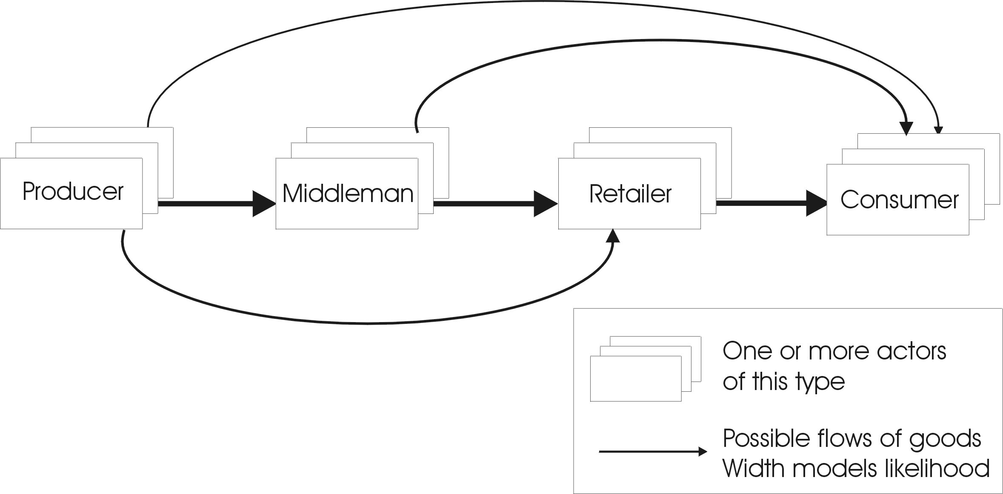
Supply chain management

Slide 10
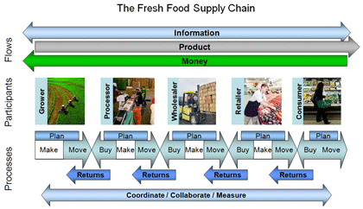

Slide 11
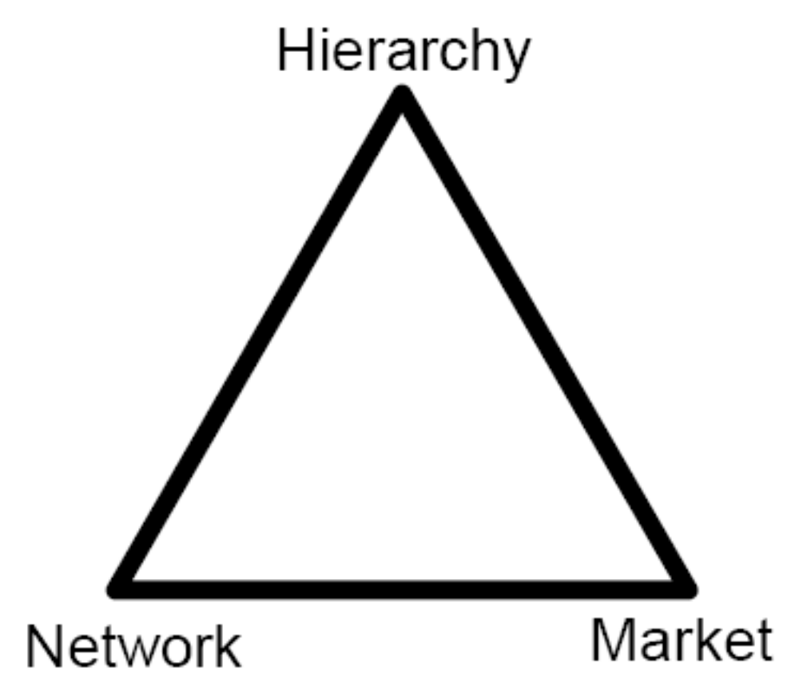
Modes of governance

Slide 12
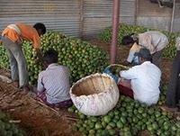
A real-world chain: Indian mango
Largest producer + exporter
10 states produce 95% of supply
National market = 75%
1000 variaties, 20 commercial
Pre-harvest contractors buy most
  ‘Dealers’ provide informal credit
Seasonal market (Mandi), lasts 30 – 45 days
300 – 400 traders per mandi
Waste level = 20%
Due to lack of infra, cooling, credit, information,….

Slide 13
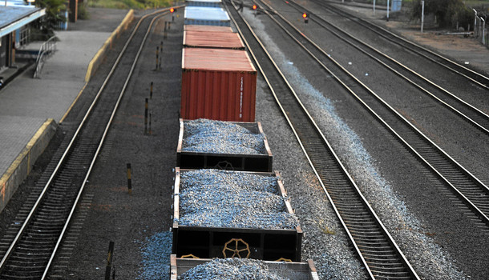
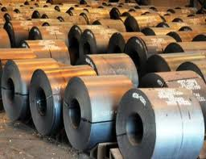
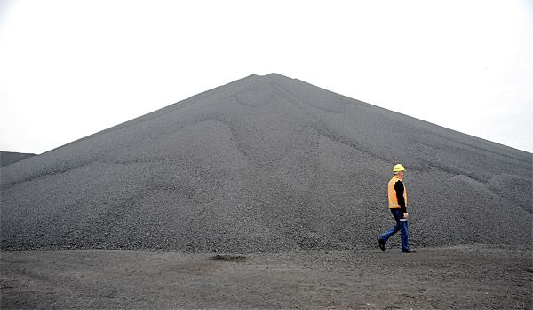
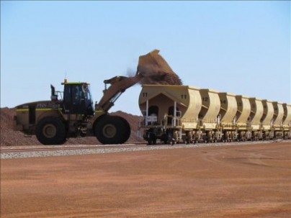
Another real world chain

Slide 14
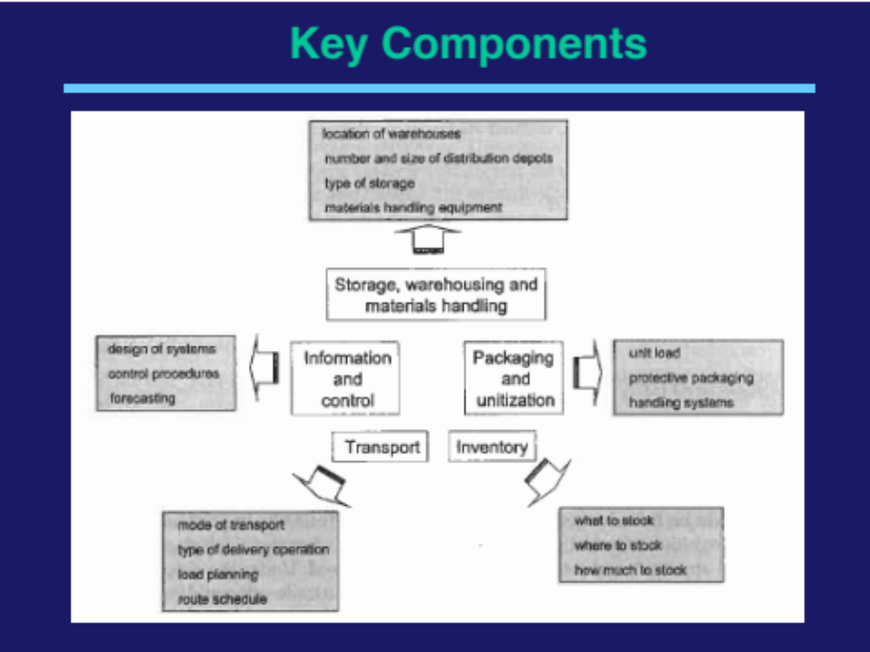

Slide 15
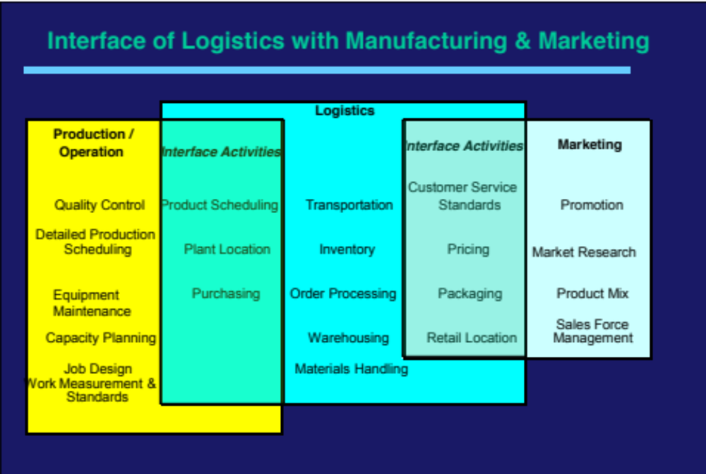

Slide 16
