Slide 1
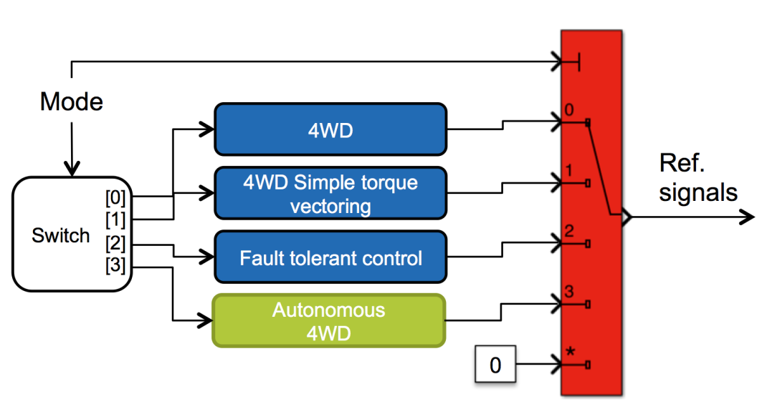
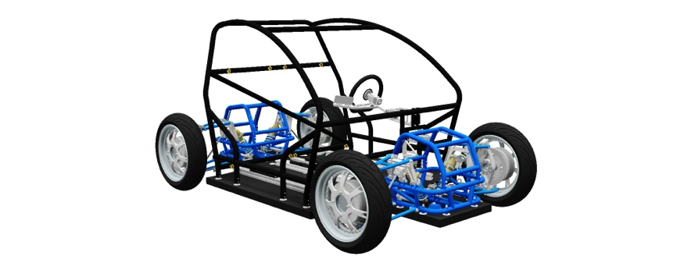
RCV projekt

Slide 2
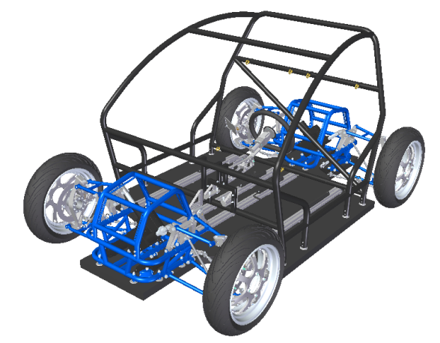
KTH Research Concept Vehicle
Modular design to include research results from several disciplines
Developed to validate and demonstrate current and future research
Versatile in its design and its functions
Full access to and control of all units
Functions:
  Drive-by-wire technology
  4 in-wheel electric motors
  Active electric individual steering, camber and traction/braking on each wheel
    FWS, RWS, 4WS
    FWD, RWD, 4WD
    Torque Vectoring, Adaptive Steering, Active Camber
    Etc.
  Light-weight design with carbon-fiber sandwich
  New battery management technology

Slide 3
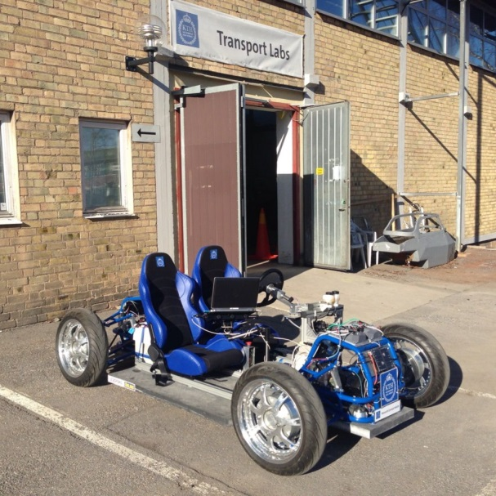
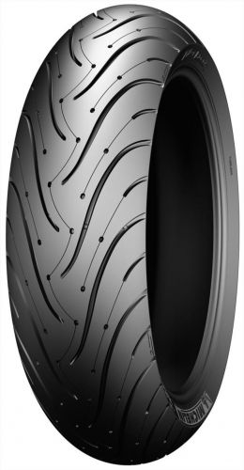
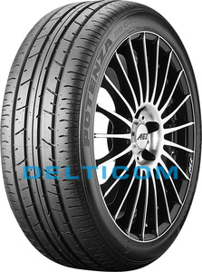
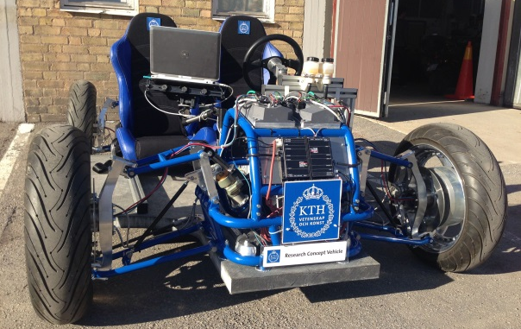
KTH Research Concept Vehicle
Numbers:
  Weight: 400 kg
  Unsprung mass: 25 kg
  Track width: 1.5 m
  Wheel base: 2 m
  Tyres:
    Dual compound Michelin Pilot Sport 3 170/60 R17
    Bridgestone Potenza 175/55 R17 81W
  17 kW drivetrain (peak)
  52 V 42 Ah Lithium-battery for 30 min drive full activity
  Top speed: 70 km/h

Slide 4
Project goal
Create state estimation algorithms to estimate
  Velocity x, y
  Distance x, y
  Tyre forces x, y
  Road banking and slope
  Centre of gravity and mass
  Friction coefficient
  And maybe more…
Create a simplified dynamic Simulink model of the RCV for evaluating autonomous algorithms
Create a path-following autonomous system
  The RCV should be able to drive autonomously on a pre-defined path given by the Managers.
  The autonomous control on the path should be as comfortable as possible for the passenger, i.e. restrictions on accelerations and rotational rates need to be carefully selected.

Slide 5
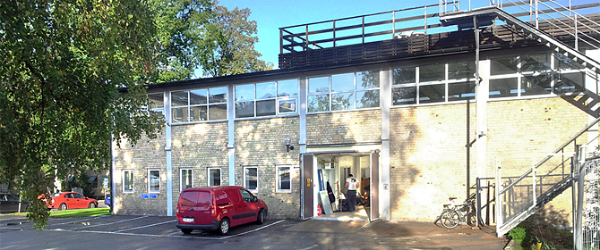
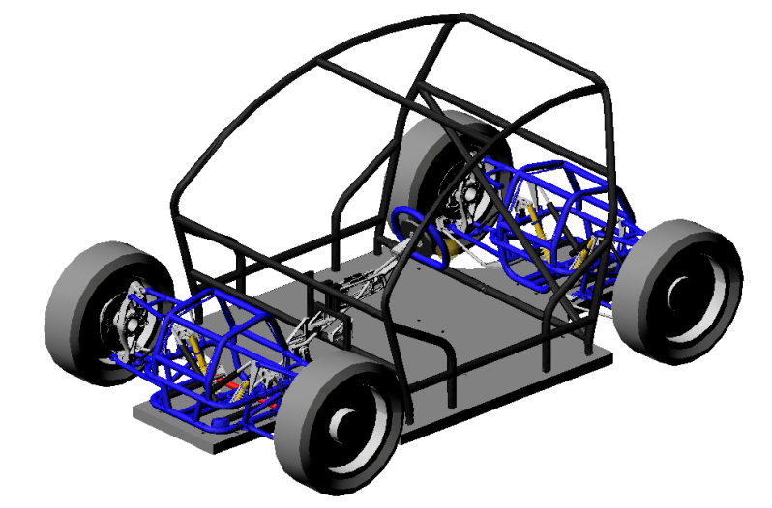
Project resources
Location:
  KTH Transport Labs
Simulation software:
  ADAMS/Car model exists
  Simulink model exists with base functions added
Prototype vehicle:
  RCV vehicle with MicroAutoBox
  Some base Autonomous functions exists

Slide 6
Project collaboration
This project will be done in collaboration between Vehicle Dynamics project students and Automatic Control project students.
Vehicle Dynamics project will run from September – December in half speed, e.g. 20h per week
Automatic Control project will run from end of October to December in full speed, e.g. 40h per week?

Slide 7
Project in detail – vehicle dynamics
Find related work for state estimation, path following, autonomous vehicles.
Make necessary changes to ADAMS/Car model and Simulink model for co-simulation
Create models that should be used for state estimation and autonomous driving
  Vehicle related models
  Tyre models
  Simplified Simulink model for testing and evaluating autonomous functions
Find suitable control strategies with the Automatic Control students
With the Automatic Control students build, test and evaluate the state estimation and autonomous functions in simulation and on the RCV (if weather is suitable)

Slide 8
Project in detail – automatic control
Literature review of path/trajectory following algorithms.
Collaboration with Vehicle dynamics students to develop dynamic simulation model in Simulink.
Requirement specification (in particular, find suitable constraints for comfort and safety in the autonomous RCV).
Design, implementation and evaluation of control algorithms in simulation: Smooth start/stop, comfortable and safe path following.
With Vehicle dynamics students: Integration and evaluation of control and state estimation algorithms in simulation and on the RCV.

Slide 9
System overview
High-level control
Low-level control + state estimation
Real-time controller
CompactRIO/LabView
or
xPC-Target/Simulink
Research Concept Vehicle
dSpace/Simulink
CAN
Real-time simulator
xPC-Target/Simulink
User interface
Windows PC
Data logging
Windows PC

