Slide 1
Career development
Master student
KTH Career: www.kth.se/student/framtid/karriar (English pages!)
Joséphine Häckner Posse, Elin Fellers

Slide 2
Introduction
Purpose
Feel informed and confident in your career development and job search. Your ”own” process, your responsibility. KTH provides guidelines.
Four steps/ seminars plus own work with some exercises in KTH Social
To access the exercises!
Join the career group: Career development for master students on KTH Social:
www.kth.se/social/group/career-development-f/
Log in with your KTH id.

Slide 3
Content seminars
Date | Content | Venue
19/2 | Step 1: Employers - what are they looking for? Who am I, my skills, what do I want? | Main library, lecture hall ”Syd östra galleriet”
26/2 | Step 2: The job hunting in 2015 | Student union house Lecture hall, ”Gröten”
26/3 | Step 3: The professional role in a fast changing working life | Main library, lecture hall ”Syd östra galleriet”
9/4 | Step 4: How to prepare for and handle the job interview | Student union house Lecture hall, ”Gröten”
5/5 | Extra guest seminar on how to make the most out of your profile on Linked in Jörgen Kihlgren from the Swedish union of leaders | Student union house Lecture hall, ”Gröten”

Slide 4
Today
The job hunting in 2015
The wonders of the recruitment process
How to read a job ad

Slide 5
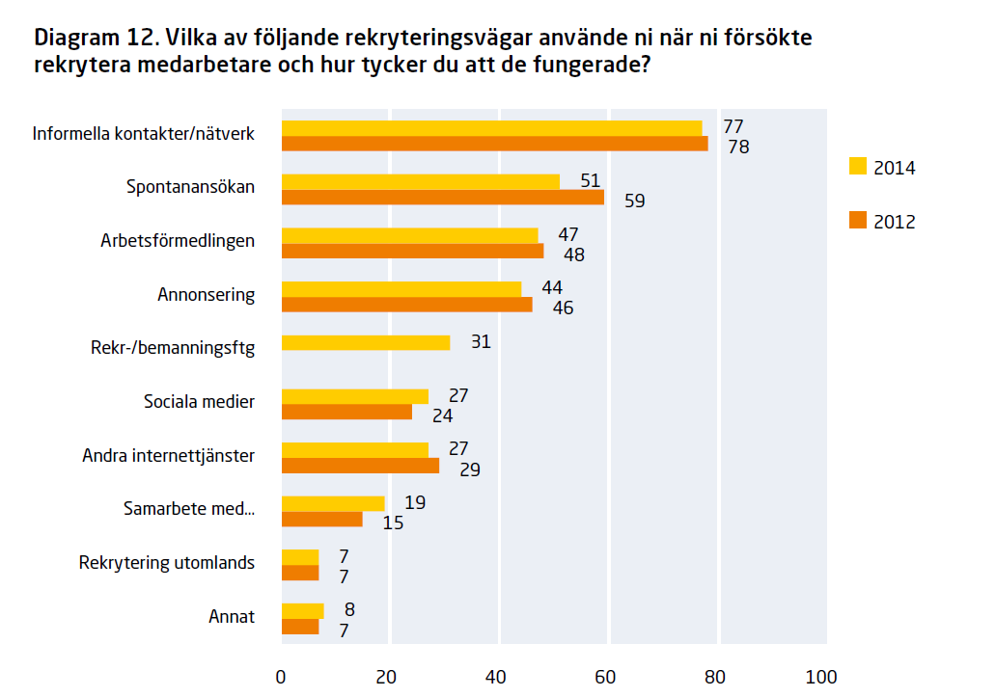
Recruitment channels
Informal contacts and network
Spontaneous application
Swedish public employment service
Job ad
Recruitment companies
Social media
Source; Survey 2014, The Confederation of Swedish Enterprise (Svenskt Näringsliv)
Notes:
The Confederation of Swedish Enterprise (Svenskt Näringsliv) is Sweden’s largest and most influential business federation representing 49 member organizations and 60 000 member companies with over 1.6 million employees. It was founded in 2001 through the merger between the Swedish Employers’ Confederation (SAF, founded in 1902) and the Federation of Swedish Industry (SI, founded in 1910).

Slide 6
Recruitment channels
Swedish union of leaders (Ledarna)
Own web site (63 percent)
Network (42 percent)
Recruitment firms (33 percent)
Social media (13 percent)
Notes:
Note though that Background check of candidates before interview through Social media, 40 percent before and 33 percent before and after the interview.

Slide 7
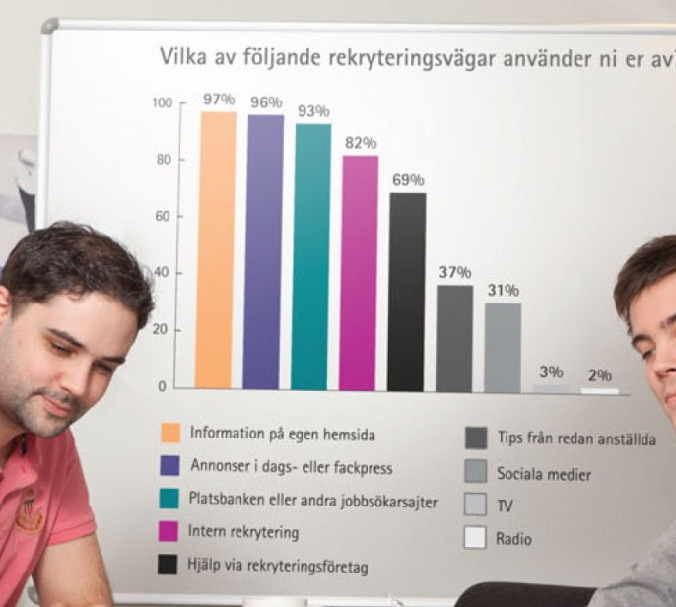
Public sector
Own web site 97 percent
Newspapers and specialized publications 96 percent
Job sites and Arbetsförmedlingen 93 percent
Within the organization 82 percent
Recruitment company 69 percent
Tip from already employed 37 percent
Social media 31 percent
Notes:
Survey by Skill.

Slide 8
The wonders of the recruitment process
Different channels depending on different factors
Type of business, private or public
Small or big company
Type of professional role
Junior Senior
Various channels for one job

Slide 9
The wonders of the recruitment process
Traditional recruitment process
Formal channels
Modern recruitment process
Informal channels
Competence based
Relationbased

Slide 10
Traditional way public service
Requirement analysis
Specification / formulate ad
Channel
1 months
2 months
Handle applications
Interviews, tests etc
3 months
References
Final assessment
Selection Process
Employment: The decision, job offer and salary discussion
Notes:
Prata om HR och rekryterarens roll. När i processen är rekryteraren aktiv.
Chef beslutar om anställning.
HR kan vara med redan från början
Rekryteringsfirma eller HR i urvalsprocessen (och chef)
I huvudet på en rekryterare: Egen BILD??
Systematik
Kriterier
Objektivitet
Lika för alla
Presentera bra kandidater så att kunden (företagsledning) blir nöjd.
Sökandes personlighet och attityd spelar in (längre fram i processen).
Passa in i ett team, företagsklimat.
Rekryteraren också människa svårt bortse helt från eget tycke smak.
Tester bra. Ger en mer objektiv bild.
Inget konstigt med lång rekryteringstid
Ej lag på provanställning

Slide 11
Components in the recruitment process
Spontaneous
application
Company web site
Classic interview
Mobile app
Phone interview
Job ad
Linkedin
CV and cover letter
Tests
Case interview
Recruitment firm webb
Network
Public empl service
Job data base

Slide 12
How does Sandvik recruit?
Register your application documents, linked to an announced vacancy, on the web site.
The recruiter match the applications towards the job vacancy.
The applications of the candidates selected are shown for the accountable manager. Together they decide which candidates will be called for an interview.
The first interview is with the recruiter and the manager.
Next, some kind of personal test. Always feedback on the test.
In case of interest there is a second interview with the head of the manager and some of the employees.
Always bring the certificate of education and current references to the interview.

Slide 13
Job ad, Sandvik (SMT)
Exempel:Product Development Engineers R&D Center Tube
Would you like to take part in creating new possibilities, new business and new concepts? Do you want to achieve results together with an ambitions and focused team? If so, this may be just the job for you!
The Tube product area, within the business area Sandvik Materials Technology (SMT), is specialized in seamless tubes and pipes and associated parts. SMT's new strategy has a strong focus on utilizing our unique competence within materials technology to grow within the energy segment - primarily within oil and gas, but even in other strategic growth areas.
In order to implement SMT's and product area Tube's strategy in the energy segment, Tube R&D will be adding resources and also creating a new unit for product development within oil and gas. The unit will consist of ten people. The existing R&D units for wet corrosion and high temperature applications will be responsible for product development and product-related process development. The unit for process development will focus closely on process development related efforts in the areas of productivity and exchange. The Oil & Gas and Wet Corrosion units are currently looking for three Development Engineers.
Key performance areas
As R&D Engineer you will work with the development of products used in Oil & Gas or Wet corrosion applications. Your main responsibilities will include to:
- Lead and participate in product development projects
- Manage technical problem solving for product and material related issues
- Support the organization in responding to customers' questions about our products
- Conduct materials studies and review results in technical reports and presentations
- Represent SMT in technical contexts, such as meetings with customers and conferences

Slide 14
Job ad, Sandvik (SMT)
Your profile
We are looking for someone with a Master's in Engineering in the areas of materials, machining, chemistry or similar fields, with previous experience working with technical sales and product development. Excellent communication skills in English, both verbal and written, are a prerequisite for the position, and knowledge in Swedish is desirable. Management experience and a background in materials are advantageous, as is knowledge of corrosion and mechanical properties.
As a person you are result oriented, with the ability to challenge the organization and change, as well as improve, the way of working. You have good analytical abilities, combined with a strong will and great enthusiasm, and you can see development opportunities for both yourself and the business. You also have an understanding of the needs of the market and their significance for the business, as well as a genuine interest in technical issues and materials. As you will have a large network of contacts, it is important that you have good ability to establish and maintain relationships, both internally and externally.
A great deal of importance is placed on your personality.
We actively work to create a workplace that is characterized by diversity and inclusion.

Slide 15
Why look at ads when everyone seems to hire through networks?
22% of KTH alumni recieved their first job through their personal network.
22% of KTH Alumni recieved their first job through a job ad.
21% of KTH Alumni recieved their first job through their master thesis, many of those were announced in job ads.
A job ad could be interpreted as the store front of the company: who they are (values), who they are looking for (skills and personal traits). That is always something to focus on when applying for a job.

Slide 16
Exercise (in pairs) Investigating the job ad
General professional skills / General engineering skills / Specific technical skills / Experience / Values / Personal traits and qualities
Read through the ad. Underline key words.
Work in pairs and try to find examples on skills, experiences and personalities that are required in the ad.

Slide 17
Excercises and reflection
Exercise I: Investigating the job ad and myself. Find a relevant ad and do the whole exercise. Remember to go back and look at previous self inventory tasks.
Reflection II

Slide 18
Career development KTH student context
”What should I choose?”
”How do I find the right job for me?
”How do I market myself?”
” Am I good enough?”
Research companies, industries, professional areas, professional role
Who am I?
Which strengths do I have?
What do I want?
How do connect to professionals and employers?
Networking
CV, cover letter, interview
Notes:
“Career Development is the lifelong process of managing learning, work, leisure, and transitions in order to move toward a personally determined and evolving preferred future.”
Source: Canadian Standards and Guidelines for Career Development Practitioners.

Slide 19
Next seminar:
The professional role in a lobour market in transformation
Thu 26 of March
location: Sydöstra galleriet, KTHB

