Slide 1
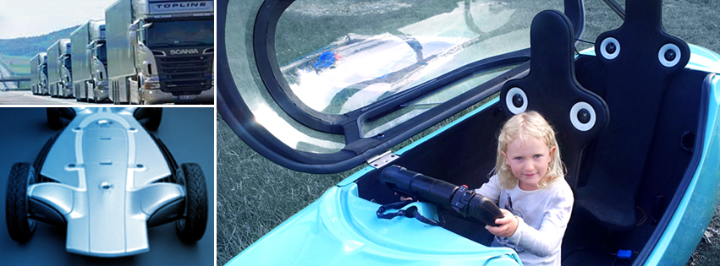
Integrated Transport Research Lab
Future Sustainable Transport Solutions
Peter Georen, Dr., Manager, peterg@kth.se

Slide 2
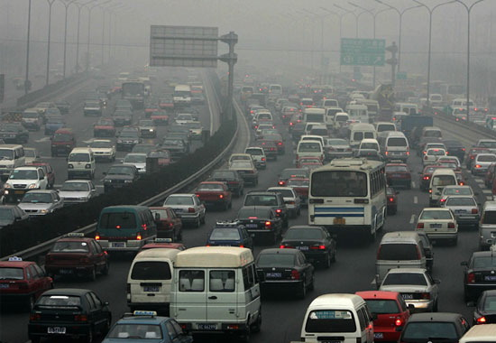
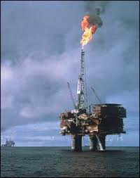
The threat !
4 degrees
27% of CO2
2030 = 3 x
Notes:
En mörk framtid för vår planet
”2 graders” målet
95% red 2050
”Fossil Fri 2030”
Transportlösningar
Specialiserade energieffiktiva fordon
“Modal shift”
Elektricitet och kolfria bränslen

Slide 3
3 factors of transport technology

Slide 4
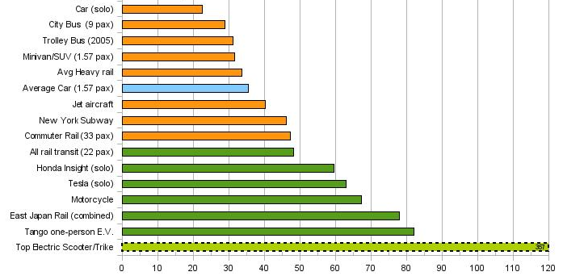
1. Energy efficiency and emissions
1,0 L/mil=900Wh/km
0,2 L/mil=180Wh/km
Miles / Gallon-equivalent [USA 2012]

Slide 5
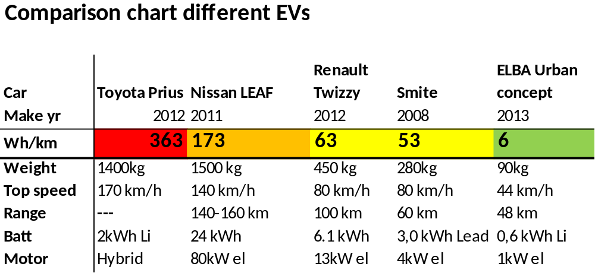
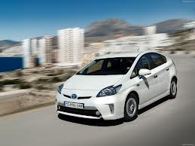
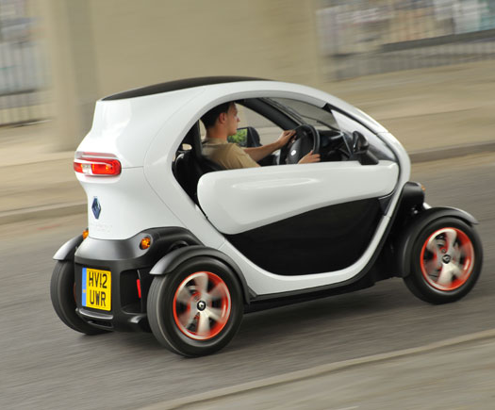
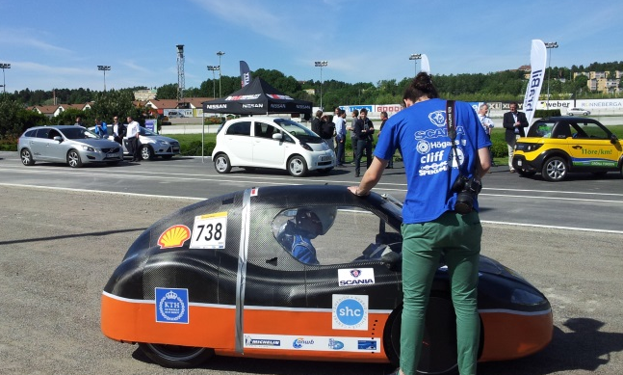
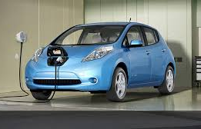

Slide 6
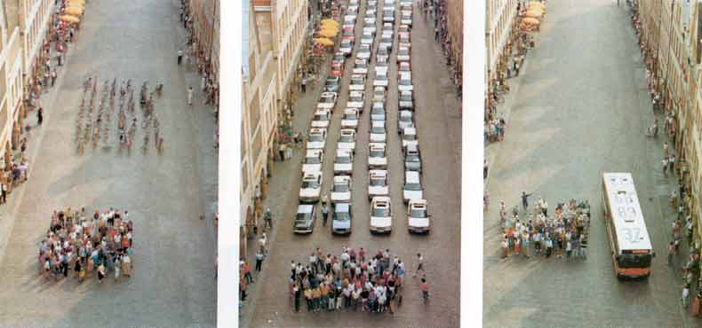
2. Urbanization & City space
-”the 60 people test”

Slide 7
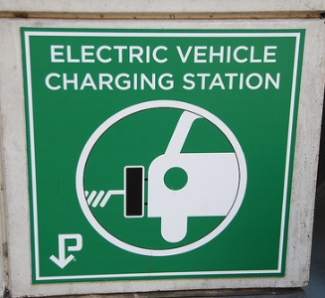
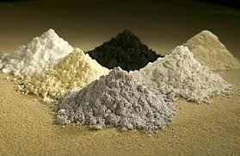

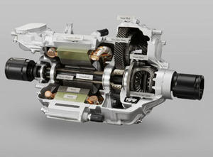
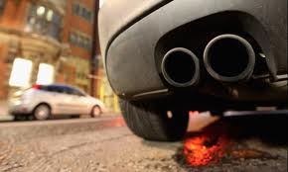
3. Efficiency vs. ”Environmental cost”

Slide 8
What to do about it?

Slide 9
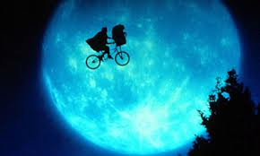
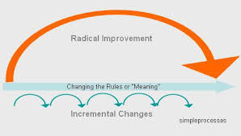
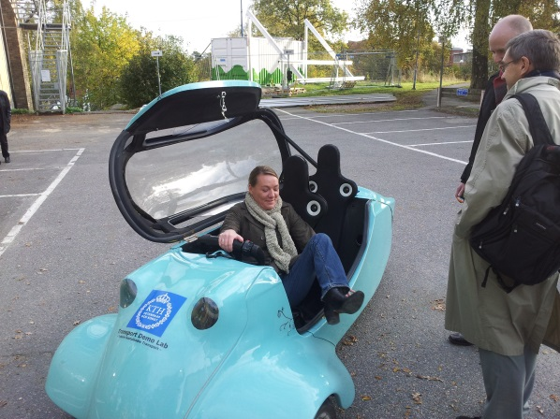
What is needed?
”Empowered” and engaged new engineers
Radical development
”Showcase” examples facilitate change

Slide 10
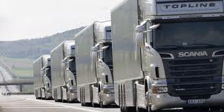


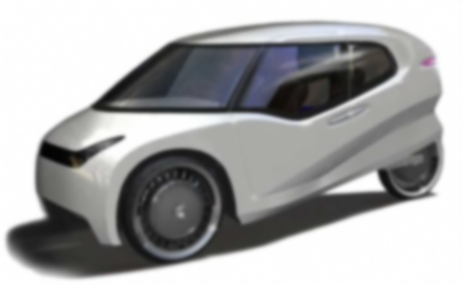
KTH ITRL:
-Demonstrate Sustainable transport
coordinated & electric
10 x efficiency
4 seconds away
seamless transport
Specialized & light
25 x efficiency
Notes:
Smart transport information services
Light Urban Vehicles
Energy efficient goods transport vehicles
Achieve implementation of research results
Engage researchers and students
Create an”prototyping lab” within transport at KTH

Slide 11
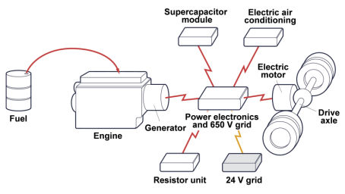
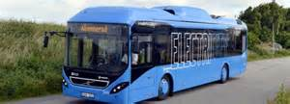
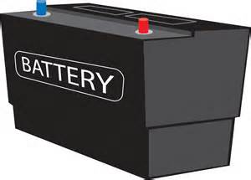
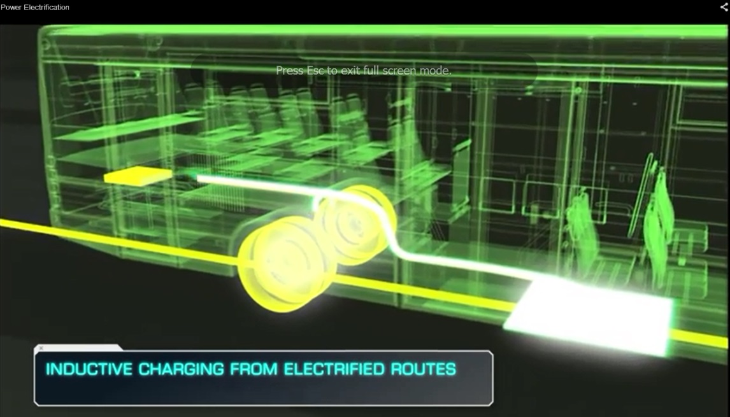
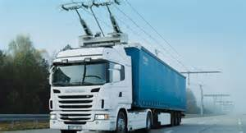
Elektrifiering av tunga fordon
Hybrid vs. Batteri-, Plug-in, Elväg

Slide 12
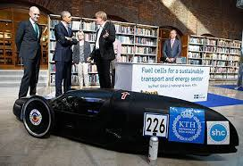

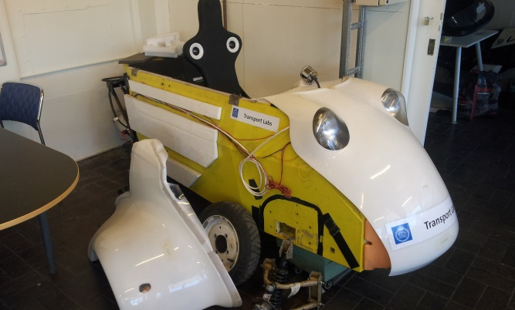
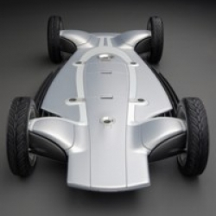
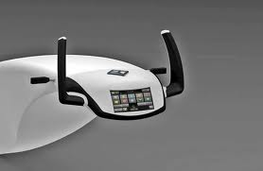
Concept vehicles @ ITRL
100+ students & researchers
”EcoCar”
-Ultra-energyefficient
”Electra”
-Urban Commuter project
”Research Concept Vehicle”
-Test platform for vehicle technology

Slide 13
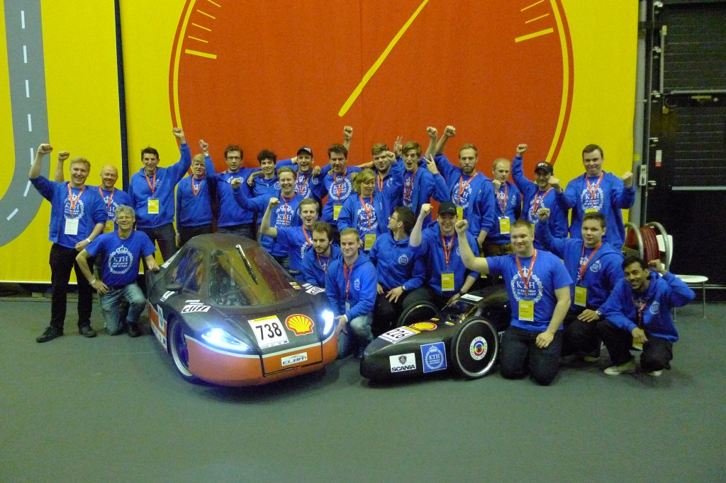
EcoCar 2013
-Swedens most energy efficient vehicles !
1600 km on equivalent of 1L petrol

Slide 14
KTH Transport Labs
Peter Georen, Manager, peterg@kth.se

