Slide 1
Introduction to the main methods for perception measurement
Human Perception for Information Technology,
DT2350, HT 2015
Anna Hjalmarsson, annahj@kth.se
Notes:
Last time – physiology of perception
Questions?
Talking about the basic functionalities of the nervous system
Based on the first chapter in the book

Slide 2
Imagine the following science project…
Assignment
  Design a device that can locate, describe, and identify all objects in the environment, including their distance from the device and their relationships to each other. In addition, make the device capable of traveling from one point to another, avoiding obstacles along the way.
Extra credit
  Make the device capable of having conscious experience, such as what people experience when they look at a scene
Warning
  This project, should you decide to accept it, is extremely difficult. It has not yet been solved by the best computer scientists, even though they have access to the world’s most powerful computers
Notes:
Hypothetical science project
A little silly, the point is to introduce the readers to the area of perception and the complexity of the process involved

Slide 3
Perception
The goal is to understand the processes in the…
  detectors (eye, ear, skin receptors etc.)
  nervous systems (how is the signals forwarded to the brain?)
  brain (how do we sense, interpret, categorize and interact with the environment)
Notes:
The devices responsible for detecting the environment
Forward to the brain in order to do more high level cognitive processing

Slide 4
The perceptual process
Perception
Recognition
Action
EXPERIENCE AND ACTION
1. Environmental stimulus
2. Attended stimulus
3. Stimulus on the receptors
ELECTRICITY
STIMULUS
Transduction
Transmission
Neural processing
Notes:
Is arranged in a circle to emphasize that process is dynamic and continually changing
All the processes that work together to determine our experience of and reaction to stimuli in the environment

Slide 5
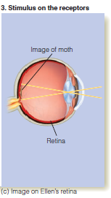
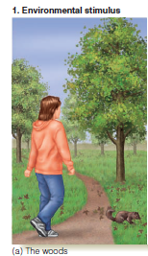
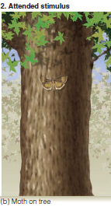
The perceptual process:
1. Stimulus
Environmental stimulus
- all of the things in our environment that we can potentially perceive
Attended stimulus
- Focus of attention
The stimulus on the receptors
- An internal representation of the stimulus
Notes:
Too much to take in – scans the scene and attend to different things that catch her interest
We attend to an environmental stimulus which is registered by our receptors that transform the energy in the environment into electricity in our nervous system

Slide 6
The perceptual process
Perception
Recognition
Action
EXPERIENCE AND ACTION
1. Environmental stimulus
2. Attended stimulus
3. Stimulus on the receptors
ELECTRICITY
STIMULUS
Transduction
Transmission
Neural processing

Slide 7
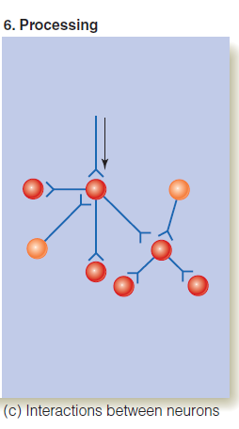
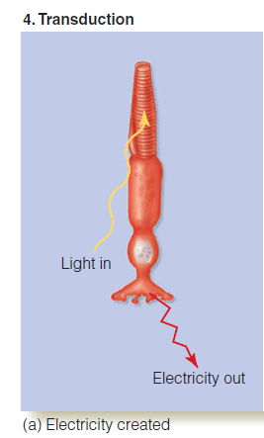
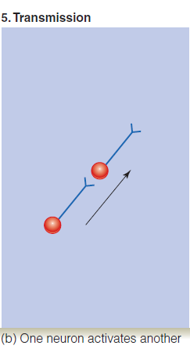
The perceptual process:
2. Electricity
Transduction
- Energy in the environment is transformed into electrical impulses in the neural system.
Transmission
- The transmission of the electrical signals travels from one neuron to another.
Neural processing
- The electrical signals are then transmitted through networks of neurons to the brain
Notes:
Three different sub steps
The way the electrical signal travels through the nervous system depends on the signal.
Action potentials how the signal travels down the axon of the nerve cell and is forwarded to the following neuron through a process called the synapse
(convergence, exhibition and inhibition)
Neurological structures and how the signals is processed along the way in these structures

Slide 8



Processing in cell phones
Copy of stimulus
Stimulus
Hello
Hello
Transmission
Notes:
Get a low resolution copy (maybe some information has been lost on the way because of reduced band with)

Slide 9
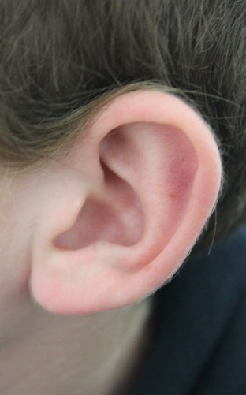

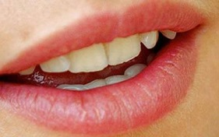
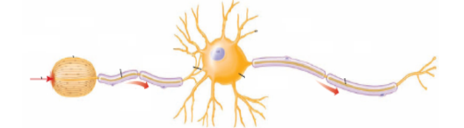
Processing in the nervous system
Hello
Hello
Transmission by nervous system
Stimulus
Perception
Notes:
Processing in the nervous system - not a passive process

Slide 10
The perceptual process
Perception
Recognition
Action
EXPERIENCE AND ACTION
1. Environmental stimulus
2. Attended stimulus
3. Stimulus on the receptors
ELECTRICITY
STIMULUS
Transduction
Transmission
Neural processing

Slide 11
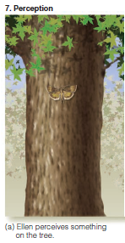
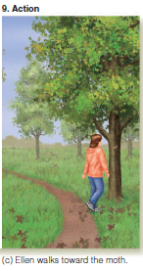
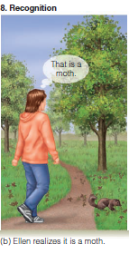
The perceptual process:
3. Experience and action
Perception
- The transformation of the electrical signals into a conscious sensory experience
e.g. Ellen sees the moth
Recognition
- Placing the perceived object into a meaningful category
(e.g. “moth”)
Action
- A motoric action
(e.g. to move towards the moth)
Notes:
Perception – conscious sensory experience.
Could say that the perceptual process stops here -
But, after perceiving the stimulus there are two additional steps that are often included: recognition action.
These are the result of the conscious sensory experience.
Recognition – our ability of placing the object into an for us meaningful category “a butterfly”

Slide 12
Perception and recognition
Perception and recognition are separate processes
  A conscious sensory experience
  A meaning is attached to the representation and the object is identified
Notes:
Tempted to group perception – to consciously experience something - and recognition – to identify an object –
there is evidence which suggests that these are two separate processes

Slide 13
Visual form agnosia
  Subjects that are able to describe parts of objects but have inability to recognize and categories objects as a whole
  The man who mistook his wife for a hat (Sacks, 1985)
    Dr P. describing his perception of a glove:
      “A continuous surface unfolded on itself. It appears to have five outpouchings, if this is the word
    Dr P. trying to recognize a glove:
      “A container of some sort. It could be a change purse, for example, for coins of five sizes.”
Notes:
Agnosia – inability to process sensory information
Patients with Neurological impairments
neurologist Oliver Sacks case studies

Slide 14
How do we recognize a stimuli?
Notes:
What do we actually know about how we recognize objects in our environment?
How can we categorize the mental representation of the moth as a moth?

Slide 15
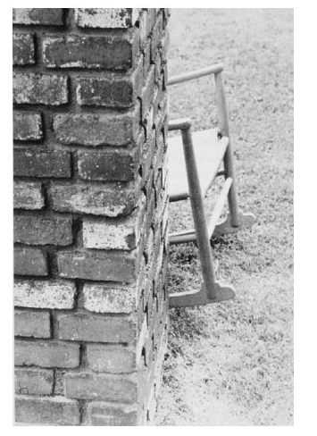
Stimulus can recognized when only a part of an object is visible:
Notes:
Our perceptual system are good at identifying objects from different angles and objects that are partly hidden

Slide 16
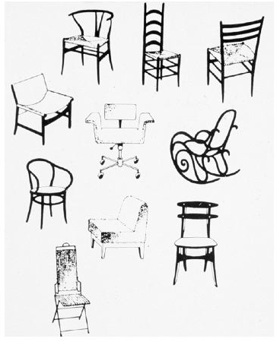
Novel example can be recognized:
…even if we have never seen them before
Notes:
How can the template theory deal with new novel examples of a category?

Slide 17
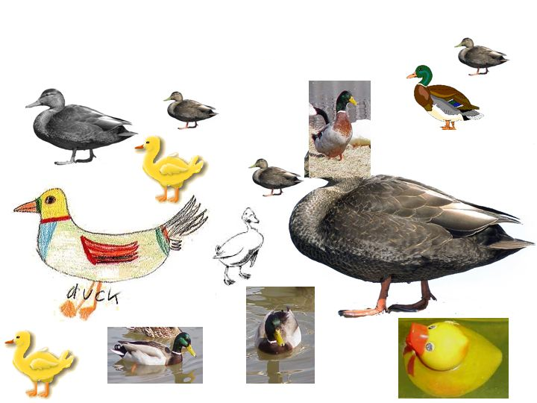
Invariance of recognition
Notes:
impressive accomplishments of visual recognition is that we can recognize an object from many different viewpoints, even though the images of that object are very different from one another. We can also very rapidly categorize an object (e.g., as a duck) even though there are many different kinds of ducks including drawings of ducks and rubber ducks.

Slide 18
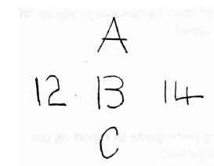
Context influence what we perceive:
Notes:
Another example – number sequence
Categorize objects differently based on the surrounding visual context

Slide 19
Pattern recognition
1. Template matching theory
Temple matching theory
  Representations of external stimuli matches an internally stored template (copy)
  Templates are created by experience
Problems with the template matching theory:
  How can we identify objects from different viewpoints?
  How can we identify new objects which we have never seen before?
  How do we explain the influence of context?
  How can we store and access all these templates in an efficient way?
Notes:
Different theories of pattern recognition – that is how we recognize faces, objects, melodies etc.
This is done through a match between our

Slide 20

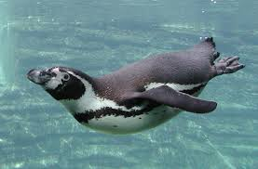
Pattern recognition
2. Prototype theory
The visual representation is compared to a stored prototype
  The central core instance of a category
  The “average” characteristics of a particular subject
Notes:
An other influential theory of recognition
An average of many objects
Explain why we can categorize new objects
Do not emphasize the need for a perfect match

Slide 21
Pattern recognition
2. Prototype theory
No need for a perfect match
Experiment by Rips (1975)
  Prototypical bird species (e.g. sparrows) were expected to infect a larger % of other bird species than atypical bird species (e.g. geese)
Notes:
Explain why we can categorize new objects
Do not emphasize the need for a perfect match

Slide 22
Pattern recognition
3. Feature analysis
Rather than matching an entire pattern to a template or a prototype stored in memory, the sensory system breaks the incoming stimulus down into features that are matched to feature representations stored in memory
Four stages
  Detection
  Pattern dissection
  Feature comparison in memory
  Recognition
Notes:
A smaller set of generalized feature templates
Explain why we can categorize new objects
Do not emphasize the need for a perfect match
Attractive today - Used in computers for pattern recognition
Supported by research on our receptors that which appear to be sensitive to different patterns

Slide 23
The perceptual process
Perception
Recognition
Action
EXPERIENCE AND ACTION
1. Environmental stimulus
2. Attended stimulus
3. Stimulus on the receptors
ELECTRICITY
STIMULUS
Transduction
Transmission
Neural processing

Slide 24
Action
Motor activities in order to interact with our environment
  E.g. Ellen takes a step towards the moth
The end goal of perception is not to create a “conscious” perception of the environment, but to interact with it
  E.g. control navigation, catch prey, avoid obstacles etc.
Perception – a dynamic process
  Perception changes as the individual interact with the environment and the perceptual process starts again
Notes:
Not always included as a part of the perceptual process
Action: Important step as it is important for our survival.
Perception from an evaluation perspective, not important to create an “image” but to interact with the environment navigate, catch prey, avoid danger and obstacles

Slide 25
KNOWLEDGE
Perception
Recognition
Action
EXPERIENCE AND ACTION
1. Environmental stimulus
2. Attended stimulus
3. Stimulus on the receptors
ELECTRICITY
STIMULUS
Transduction
Transmission
Neural processing
Notes:
Going back to the perceptual process
Important aspect missing
Knowledge - Any information that the perceiver brings to the situation
Placed outside and above because it affects different steps in the perceptual process

Slide 26
Perceptual experiment!
Notes:
Everyone close their eyes.

Slide 27

Notes:
Everyone sitting in the window half of the lecture room open their eyes

Slide 28

Notes:
demonstrated the importance of expectations

Slide 29

Notes:
demonstrated the importance of expectations

Slide 30
How does knowledge impact perception?
Bottom-up processing
Top-down processing
Notes:
That the perceptual process is not only the processing of environmental stimuli
One way to look at how the perceiver identifies an object is to distinguishing between

Slide 31
Bottom-up processing
  Data driven processing
Use features and clues obtained from the external stimulus
Rely on information provided by the environmental stimuli rather than your excising knowledge to identify a pattern
Notes:
Use information to use that is provided to us in the environment

Slide 32

Example
Notes:
If you never seen this photograph before, trying to figure out what is depicted is a good example of bottom-up processing
Just white and black dots
Because I show you this example and ask you that question – you probably expect it to illustrate something
Eventually you probably see a Dalmatian
Listen to someone speak a foreign language is another example
Rare that data is so lacking in context to help us perceive

Slide 33
Top-down processing
  Conceptually driven processing
  When your perceptual processes are guided by means of the “top” level of knowledge stored in memory
  Only little information in the environment is needed to trigger the relevant information
  Today, most psychologists agree that perceptual processes include both top-down and bottom-up processes
Notes:
If you have seen the image before, realized that it is that strange Dalmatian picture after a short glance
Once aware of what the image depicts, it is difficult to avoid seeing the Dalmatian
During normal circumstances, perceptual processes include both top-down and bottom-up processes
The perceptual process is often triggered by stimulation of our receptors, once the bottom-up processes
Has triggered the sequence of steps in the perceptual process – top-down processing comes into play as well

Slide 34
Cognitive influences on perception
How does our knowledge, memories and expectations influence our perception?
Perceptual sets
  A perceptual bias or predisposition or readiness to perceive particular features of a stimulus
  (An example of top-down processing)
  E.g. needs, beliefs, emotions, expectations

Slide 35
Perceptual sets: Needs
Participants were more likely to interpret ambiguous pictures as food if they had been deprived of food for a longer period of time (Sanford, 1936)
Participants who had gone without food for the longest periods were more likely to rate pictures of food as brighter than non-food pictures
(Gilchrist & Nesberg, 1952)

Slide 36

Perceptual sets: Expectations
Notes:
The visual context or previous visual experiences provides you with expectations

Slide 37
How can we study perception?
Goal
  To understand the steps in the perceptual process
Approach:
  Psychophysical approach
  Physiological approach

Slide 38
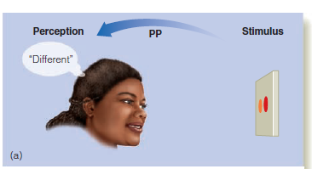
Psychophysical approach
Elements of Psychophysics (Fechner, 1860)
Quantitative methods to measure the relationships between stimuli (physics) and perception (psycho)
Notes:
a German philosopher and experimental psychologist Fechner
Coined the term psychophysics
The relationship between stimulus and perception
In this example – ask the subject whether the two colors on the screen are different or same

Slide 39
Psychophysical approach
EXPERIENCE AND ACTION
PP
PHYSIOLOGICAL
PROCESSES
STIMULI

Slide 40
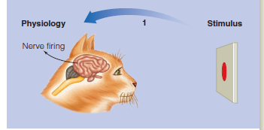
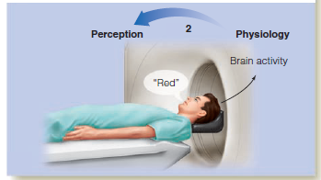
Physiological approach
Measuring the relationship between stimuli and physiological processes and between physiological processes and perception
Notes:
Example 1: measure how the cortex of a cat’s brain respond to different coloured lights – no measurement of high level processing
Example 2: Measurement of brain activity when the subject is reporting what it is perceiving

Slide 41
Physiological approach
The relationship between biological makeup and behavior and experience
The relationship between stimuli
and physiological processes
The relationship between
physiological processes and
perception
Assumption: our behavior and experience can be explained by physiological changes
Notes:
Also known as the biological approach
The main assumption of the physiological approach is therefore that behavior and experience can be explained by physiological changes. This approach investigates the brain, the nervous system and other biological factors such as hormones.

Slide 42
Physiological approach
EXPERIENCE AND ACTION
PH2
PH1
PHYSIOLOGICAL
PROCESSES
STIMULI

Slide 43
Measuring perception
How can we explore the higher level cognitive processes of perception?
(perception, recognition and action)
We can ask subjects to:
  describe
  recognize
  detect
  estimate the magnitude of
  search for
…a particular stimulus
Notes:
Used in both the psychophysical and physiological approach

Slide 44
Description
The researcher ask the subject to describe the characteristics of a stimulus
  E.g. “All of the people in student section are wearing read”
Phenomenological method
Explores personal experiences of a stimulus
  E.g. sweet, bitter, dark, light, high, low…
Notes:
Introduce the example of studying the visual perception of the scene of a football field
Phenomenological method - identify phenomena through how they are perceived by the actors in a situation
study of experience from the perspective of the individual

Slide 45
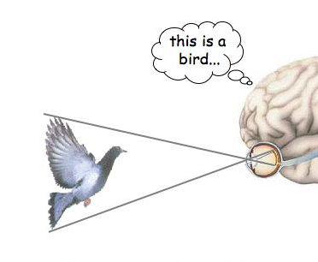
Recognition
A match between a stimulus and a “mental representation” of that stimulus
Showing pictures of an object and asking subjects to name it
Notes:
Another way to study perception is to study recognition:
Make subjects place objects into a certain category

Slide 46
Recognition
Placing a stimulus in a specific category (“naming”)
  E.g. “Number 12 is the other team’s quarter back”
Individual identification:
  E.g. “Number 12 is James Smith”
Recognition memory:
  E.g. “I saw number 12 play last year”
Matching:
  E.g. “Number 12 has the same shoes as player number 5”
Notes:
What is the position of player number 12

Slide 47
Detecting
Becoming aware of a barely detectable aspect of a stimulus
  E.g. “The lineman moved slightly just before the ball was snapped”
Thresholds
  The absolute threshold
  The difference threshold
Notes:
Measuring detection is often done through exploring two different types of thresholds

Slide 48
The Absolute Threshold
The level of intensity of a stimulus at which the subject is able to detect its presence
  at some proportion p (typically 50%) of the time
  Intensities below absolute threshold: undetectable
  Intensities above absolute threshold: detectable
Example: The smallest amount of light needed that enables a person to detect it
Notes:
The smallest amount of stimulus energy necessary to detect a stimulus
Repeated many times (50% of the time)

Slide 49
The Difference threshold
Just-noticeable difference (JND)
The smallest difference in magnitude that a person can detect
  At some proportion p (typically 50%) of the time
Point of subjective equality (PSE)
  The subject perceives the two stimuli to be the same
Notes:
the smallest detectable difference between two sensory stimulus

Slide 50
Weber’s law
As the magnitude of the stimulus increases, so does the size of the difference threshold
Research on several senses has shown that the ratio of the Difference Threshold to the standard stimulus is constant
Notes:
Some interesting properties of the difference threshold has been identified
If something if you look at difference in loudness – if something is really loud
It has to change quite a bit before the difference is perceived, whereas if the sound is soft, only a small changes is necessary

Slide 51
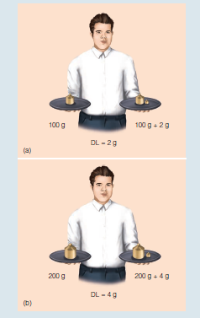
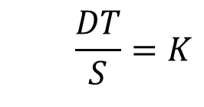
Weber’s law
  2g / 100g = 0.02
  4g / 200g = 0.02
$$\frac{DT}{S}=K$$
  DT = Difference Threshold
  S = The value of the stimulus
  K = A constant (Weber fraction)
Notes:
Weber’s law:
So for example in order to sense the difference in weight for 2 stimulus that weigh approximatly 100 g – the difference needs to be at least 2g
200 g – difference in 4 g
the ratio of the Difference Threshold to the standard stimulus is a constant
This constant called weber fraction

Slide 52
Weber Fractions for different sensory dimensions
Sensory dimension | Weber fraction
Electric shock | 0.01
Lifted weight | 0.02
Sound intensity | 0.04
Light intensity | 0.08
Taste (salty) | 0.08
Notes:
Imagine that someone asks us to turn down the sound on the TV:
JND = 0.04 * 100 = 4
JND = 0.04 * 50 = 2
Has also been criticized since cannot be verified for all senses

Slide 53
Classical psychophysical methods
Methods to explore subjects’ absolute and difference thresholds:
  The method of limits
  The method of adjustment
  The method of constant stimuli
Notes:
So how can we find out the different threshold for different sensory stimulus?
Psychophysical experiments have traditionally used three methods for testing subjects' absolute and difference thresholds
Called the classical psychophysical methods

Slide 54
The method of limits
The stimulus is presented in either
  ascending (increasing intensity) order
  descending (decreasing intensity) order
The level is then gradually increased/decreased until the participant reports that they are aware of the stimulus
The ascending and descending methods are used alternately and the absolute thresholds are averaged

Slide 55
Click to start
Notes:
Example of how the absolute threshold of light can be explored using an ascending order
Imagine that you are the subjects

Slide 56
Notes:
randperm(7) = 1 2 4 7 3 6 5

Slide 57
Could you see the spot of light?

Slide 59
Could you see the spot of light?

Slide 61
Could you see the spot of light?

Slide 63
Could you see the spot of light?

Slide 64
Method of limits
Threshold = Mean of crossovers = 60.94
1
2
3
4
5
6
7
8
9
10
N |  | N |  | N |  | N |  | N
N |  | N |  | N | N | N |  | N | N
Y | N | Y | N | N | Y | Y | N | N | Y
 | Y |  | Y | Y | Y |  | Y | Y | Y
 | Y |  | Y |  | Y |  | Y |  | Y
 | Y |  | Y |  | Y |  | Y |  | Y
65.8 | 70.1 | 65.8 | 70.1 | 70.1 | 65.8 | 65.8 | 70.1 | 70.1 | 65.8
Crossover value:
Notes:
Based on the responses to these, we can identify the absolute threshold for different subjects
And put them in a table
The dashed line indicate cross over value for different subjects

Slide 65

Method of adjustment
The subject adjusts the intensity of the stimulus continuously until they report that they can (ascending) or cannot (descending) detect the stimulus
The procedure is repeated several times
At the end mean is calculated giving the average error which can be taken as the measure of sensitivity

Slide 66
Method of constant stimuli
The levels of a certain property of the stimulus are presented randomly instead of in order of intensity
Test each stimulus many times in random order
Prevents the subject from being able to predict the level of the next stimulus, and therefore reduces errors of habituation and expectation

Slide 67
Method of constant stimuli
Calculate the proportion of “yes” responses at each light level
0% 5% 20% 50% 80% 95% 100%
+ - + + + - - - + + + - - - - +

Slide 68
Psychometric function
Plot the percentages against stimulus intensity
100%
75%
50%
Percentage “seen”
25%
0%
Stimulus intensity
Notes:
The data can also be use to produce psychometric function
describes the relationship between a parameter of a physical stimulus and the subjective responses of the subject
Illustrates the subject’s sensitivity to the parameter, a steeper slope would indicate a higher sensitivity

Slide 69
Problems of the classical psychophysical methods
Classical psychophysical methods are inefficient since much data is collected at points on the psychometric function that provide little information about the threshold
100%
50%
Percentage “seen”
0%
Stimulus intensity

Slide 70
Adaptive psychophysical methods
Adaptive psychophysical methods have been developed so that the points sampled are clustered around the psychometric threshold
These methods, however, provide less information regarding the psychometric function's shape
(the sensitivity)

Slide 71
Staircase procedure
Start with a high intensity stimulus that is easy to detect
The intensity of the stimulus is decreased until the person cannot detect it
At this point the staircase 'reverses' and intensity is increased until the observer responds correctly, triggering another reversal
Threshold is considered the average of several of these reversal points
Notes:
Many different types of staircase algorithms with different step sizes etc.

Slide 72
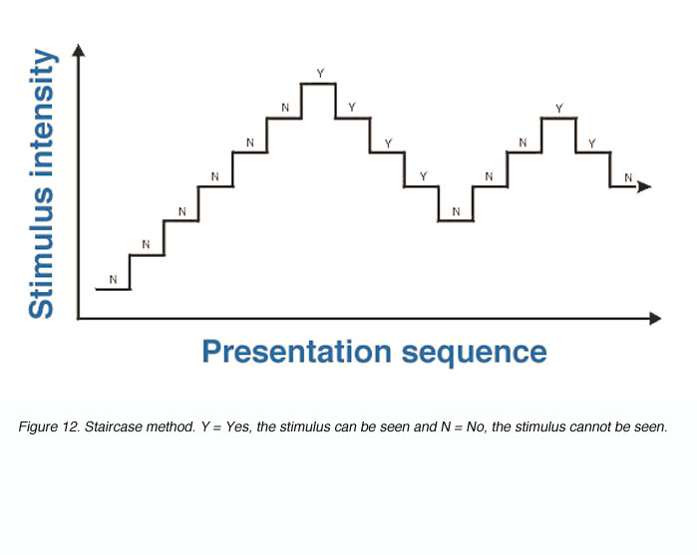
Staircase procedure
average
Notes:
Here start with a stimulus that is clearly undetectable
Incrementally increase the intensity of the stimulus – until the subject is able to perceive it
In this way we get more data points around the psychometric threshold

Slide 73
Magnitude estimation
Asking subjects to estimating the size or intensity of a stimulus
  “The lineman is smaller than the quarterback”
Example: If we double the intensity of tone, does it sound twice as large?
Ask subjects to assign numbers that is proportional to their perception of the stimulus’ intensity

Slide 74
Response compression
The perceived magnitude increase less than the level of intensity
Magnitude estimate
Stimulus level of intensity
Notes:
As the intensity increases, the perceived magnitude increases but not at as much as the intensity

Slide 75
Response expansion
The perceived magnitude increase more than the level of intensity
Magnitude estimate
Stimulus level of intensity
Notes:
As the intensity increases, the perceived magnitude increases more than the intensity

Slide 76
Search
Looking for a specific stimulus among a number of stimuli
  “I am looking for Susan in the student section”
Measures the reaction time
  The time it takes to find the stimulus
Discussed more thoroughly in Chapter 6: Visual attention

Slide 77
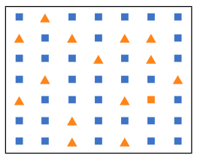
Example: Find the yellow square

Slide 78
Threshold measurement can be influenced by how a person chooses to respond
Is it meaningful to measure an “absolute threshold”?
The thresholds are affected by our physiological features but also by our experiences and context
Do no discriminate between the real sensitivity of subjects and their (potential) response biases
Notes:
If we measure one subject’s threshold in a particular context or average over many subjects this is not a problem – compare different thresholds in different situations or between different subjects

Slide 79
TED Talk:
Beau Lotto: Optical illusions show how we see
http://www.ted.com/talks/beau_lotto_optical_illusions_show_how_we_see.html
Notes:
Illustrates that not only the perception of high level stimulus that are semantically meaningful to us that are influenced by previous knowledge
Also processing of low level stimulus is highly affected by our previous experience
Lottolab, a hybrid art studio and science lab.

Slide 80
Signal detection theory
Signal detection theory:
  Quantifies our ability to distinguish between information-bearing patterns (stimulus/signals) and random patterns that distract from the information (noise)
  Was originally developed for communication where the goal was to detect the signal against background noise
  Provides a precise language and graphic notation for analyzing decision making in the presence of uncertainty
Notes:
The probability of detecting the signal depends on the level of background noise
Depends not only on the magnitude of the signal – but also on the level of noise
http://ucalgary.ca/pip369/mod1/differencethresholds/signal
http://www.cis.rit.edu/people/faculty/montag/vandplite/pages/chap_5/ch5p1.html
http://www-psych.stanford.edu/~lera/psych115s/notes/signal/
http://www.skidmore.edu/~hfoley/Perc2.htm#ch2demo1

Slide 81
Signal detection theory
SIGNAL
PRESENT
ABSENT
HIT
FALSE
ALARM
YES
RESPONSE
MISS
CORRECT
REJECTION
NO
Notes:
Imagine a doctor trying to find a tumour in a CT-scan
Quantify the four different outcomes
Look at two different parameters –
The subjects’ response and the presence or absence of a signal

Slide 82
How much can be explained by biology?

Slide 83
The Mind-Body Problem
How do physical processes (the body) become transformed into the richness of perceptual experience (the mind)?
Neural correlates of consciousness (NCC)
  Studying the relationship between stimuli in the environment an how neurons fire
  The correlation between physiological responses and experience
  “The easy problem of consciousness“
How does physiological responses cause experience?
  “The hard problem of consciousness”
  Studying the relationship between stimuli in the environment an how neurons fire

Slide 84
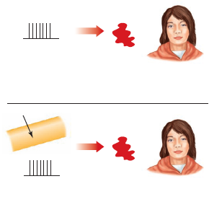
The Mind-Body Problem
Experience
Correlation
“red”
(a) “Easy” problem
Na⁺
Experience
Cause
“red”
(a) “Hard” problem
Notes:
Solving the “easy” problem of consciousness involves looking for connections between
physiological responding and experiences such as perceiving “red”.
Solving the “hard” problem of consciousness involves determining how
physiological processes such as ions flowing across the nerve membrane cause us to have experiences.
The majority of research on perception focus on the “easy” problem, which after all isn’t that easy…
And maybe studying the “easy” problem will eventually lead to knowledge about the hard problem?

Slide 85
Finally….
How can we apply the information presented today in the design of information technology?
  Metaphors
    Triggers top-down processing
  Affordances
    Making the functionalities visible

Slide 86
Metaphors
Metaphors have a fundamental role in human perception
(Lakoff & Johnson, 1980)
  Shape how we think an act
To perceive something through a conceptual metaphor is to understand an idea or domain in terms something else
Notes:
How can we guide users to use top-down processing, that is to bring previous experiences to the interaction with the interface and thereby avoiding the need for them to learn how to interact with something completely new
L & J challenged the traditional view of metaphors as something poetic by proposing that

Slide 87
Interface metaphors
Triggers knowledge that users already have of other domains
The use of interface metaphors:
  Triggers top-down processing
  Make the capabilities as well as the limitations of the system visible to the user
  Creates expectations from the users
Norman (1988):
  A good conceptual model is a model that allows us to predict the effects of our actions
Notes:
The choice of metaphor should not be taken lightly – created expectations from the users

Slide 88
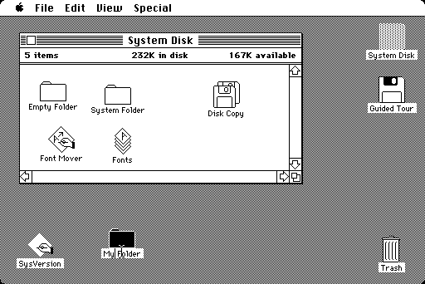
Metaphors example: The desktop metaphor
Xerox PARC in 1970
Notes:
We can use metaphor to highlight certain features & suppress others
Alan Kay at Xerox PARC in 1970

Slide 89
Metaphors
Metaphors can make user interaction more:
  Intuitive
  Usable
  Quick to learn
  Easy to understand

Slide 90
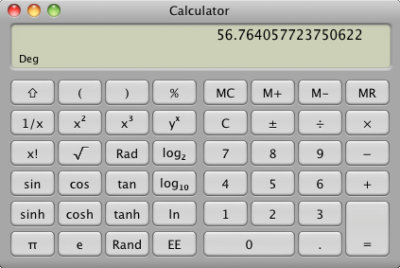
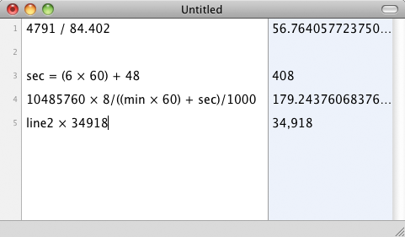
Overdoing the interface metaphor
Notes:
Using an already exciting artifact as a metaphor for a new interface also introduces limitations
There are examples of when designers overuse metaphors
A calculator comes with all the limitations of an real calculator – but with few benefits
No history of the calcualations that you have done or how you got there
Multipart calculations including paranthesis etc
http://www.marco.org/2010/03/11/overdoing-the-interface-metaphor

Slide 91
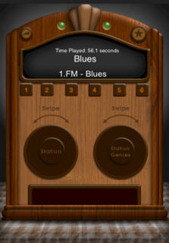
Overuse of metaphors can
Limit functionality
Make things harder to operate
Take up more screen space
Sacrifice accuracy by avoiding numerical input
Notes:
Using knobs for volume control and frequency – if we know the exact frequency of a radio station it would be easier to type with numercial input

Slide 92
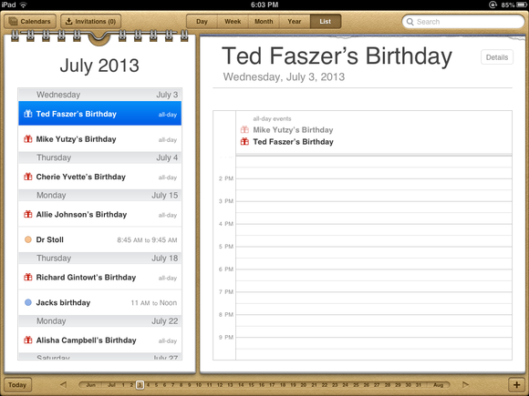

Skeuomorphism
Notes:
A design feature that is no longer functionally necessary
References original functionality – triggers top-down processing
The iphone operative systems
Iphone one of the first commercially successful touch screens telephones
Textures invited touch
The new IOS 7 – has Today flat design

Slide 93

Notes:
Good time to make to connect this lecture to the design of information technology
For each lecture we have picked a specific item in this book

Slide 94



7. People see cues that tell them what to do with an object
Notes:
A good conceptual model is a model that allows us to predict the effects of our actions
Some examples of objects that are well designed and it is pretty obvious what you can do with them

Slide 95
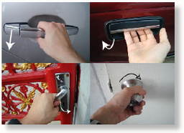
Affordance theory
Action possibilities latent in the environment (Gibson)
  E.g. knob affords twisting
Notes:
Psychologist James J. Gibson
World is not only percieved in terms of shapes and spatial relationships but also in terms of object’s possibilities for actions

Slide 96
Affordances in the field of human-machine interaction
Perceived affordances
Norman (1988) The Design of Everyday Things
Refers to the property of an object or system's action possibilities being easily discoverable
A designer needs to make sure that functionalities of an object or an graphical user interface are clearly visible and have clear affordances
Notes:
Donald norman

Slide 97

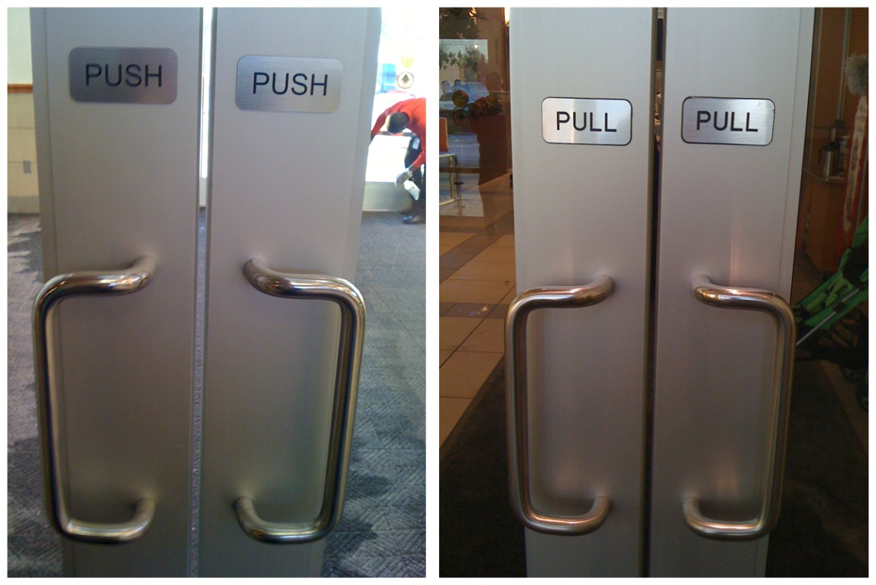
Affordance – door design
Mixed messages
Notes:
Classical example -
These Doors give mixed messages -
When you walk up to a door- how do you know how to open it
Handles affords pulling, not pushing
Flat plate - push

Slide 98
Takeaways (Weinschenk, 2011)
Think about affordance cues when you design. By giving people cues about whet they can do with a particular object, you make it more likely that they will take that action
Use shading to show when an object is chosen or active
Avoid providing incorrect affordance cues
Rethink hover cues if you’re designing for a device that uses touch rather than a pointing device
Notes:
Cannot hover with your finger on an ipad

Slide 99
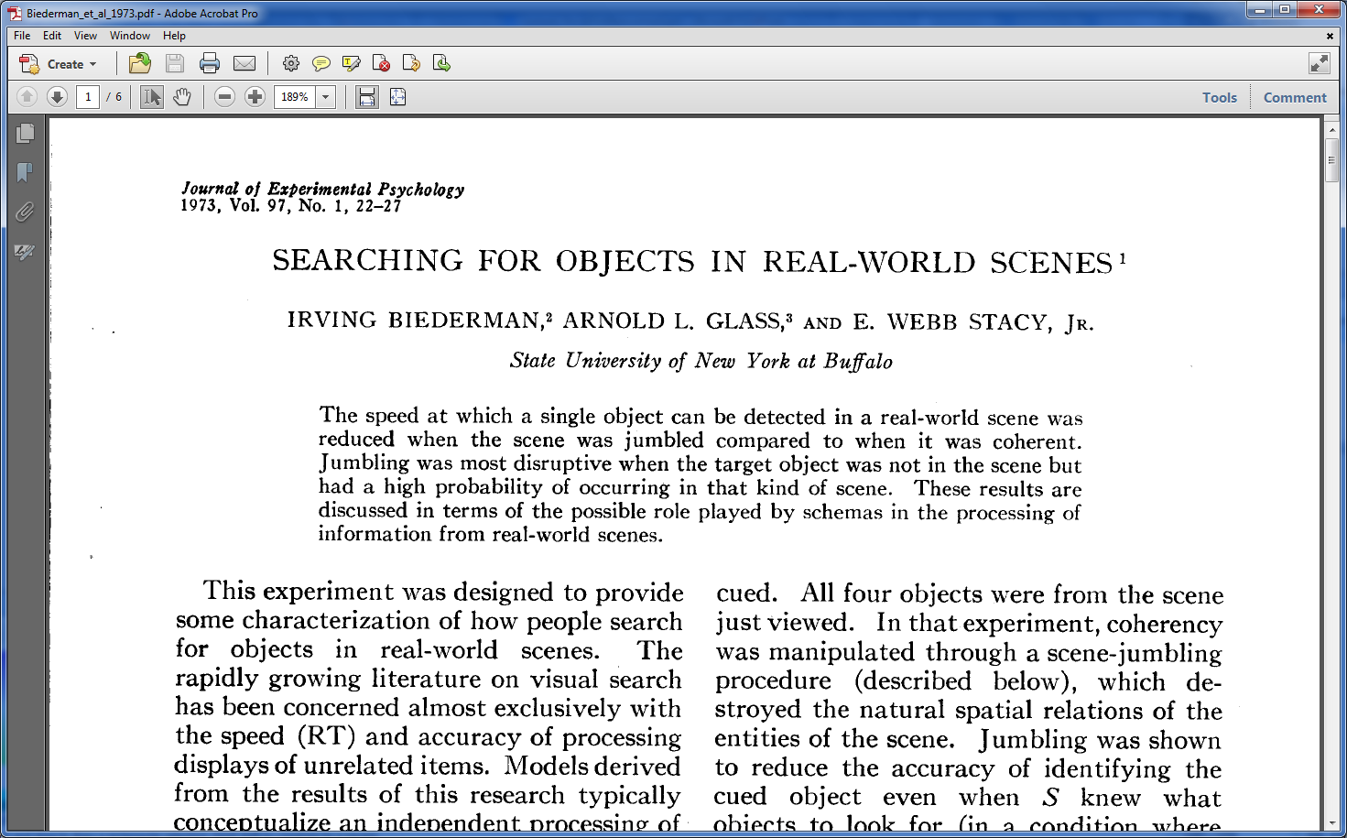
Assignment 1: Lecture 2
Notes:
Write a critical review of one of the papers included in the course literature for Lectures 1 to 3.
Old paper – 1973 – a good example of a classical perception experiment that explores how our previous experiences affect our perception

