Slide 1

Sound, the Auditory System, and Pitch Perception
DT2350 Human Perception for Information Technology
Roberto Bresin
Copyright (c) 2015 Roberto Bresin
This work is licensed under the Creative Commons Attribution-Noncommercial-Share Alike 3.0 Unported License. To view a copy of this license, visit http://creativecommons.org/licenses/by-nc-sa/3.0/ or send a letter to Creative Commons, 559 Nathan Abbott Way, Stanford, California 94305, USA.

Slide 2
Outlook
The nature of sound
How we experience sounds
Physiology behind the perception of pitch
Hearing loss
How different parts of the brain respond to sound
Sound localization
Sound design: getting attention with sound

Slide 3
Literature
Goldstein, E. (2009/2014). Sensation and Perception.
Chapter 11 (2009 edition): Sound, the Auditory System, and Pitch Perception
Chapter 11 (2014 edition): Hearing
Weinschenk, S.M. (2011). 100 Things Every Designer Needs to Know About People.
Chapters #48: Loud noises startle and get attention

Slide 4
Test
Which sense would you choose to keep if you had to pick between hearing and vision?
Why?

Slide 5
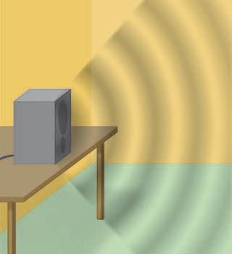
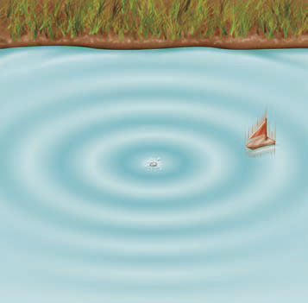
What is sound?
Physical vs perceptual definition
Sound wave speed: 340 m/s (air), 1500 m/s (water)

Slide 6
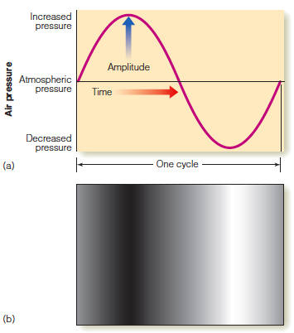
Air pressure changes
Frequency [Hz]
Number of times/second
that the pressure changes repeat.
Humans can perceive frequencies in the range from 20 Hz to 20,000 Hz.
Decibel [dB]
dB = 20 x log (p/p_{o})
p = stimulus sound pressure
p_{o} = standard sound pressure
(20 micropascals = hearing threshold)

Slide 7
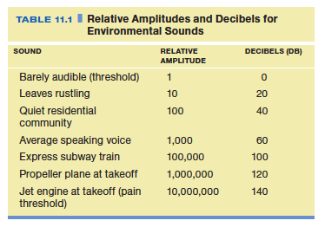
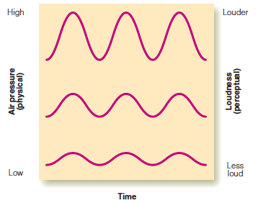
Sound level [dB]
Higher amplitude (physical) ➔ Higher sound level (perceptual)

Slide 8
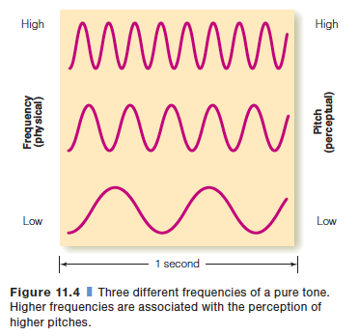
Frequency [Hz]

Slide 9
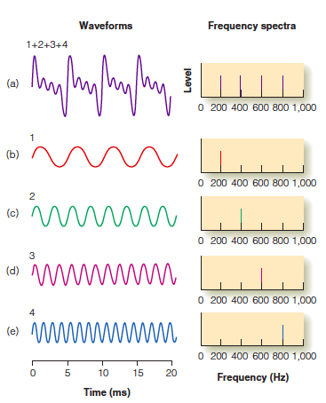
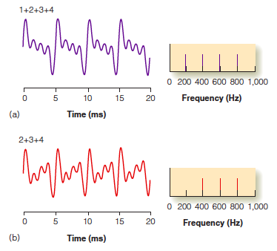
Complex wave forms / Frequency Spectra

Slide 10
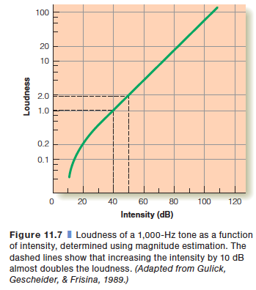
Loudness
Loudness was judged relative to a standard of a 1000 Hz tone at 40 dB, which was assigned a value of 1.
Thus, a tone that sounds 10 times louder than this standard would be judged to have a loudness of 10.

Slide 11
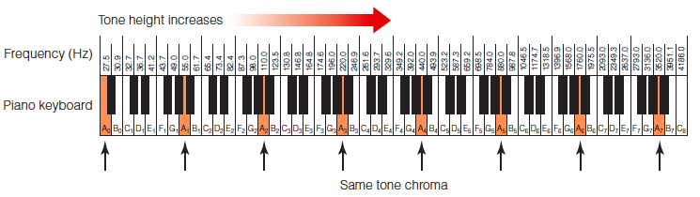
Pitch
Pitch, the perceptual quality we describe as “high” or “low” is defined as the attribute of auditory sensation in terms of which sounds may be ordered on a musical scale.
(Bendor & Wang, 2005)

Slide 12
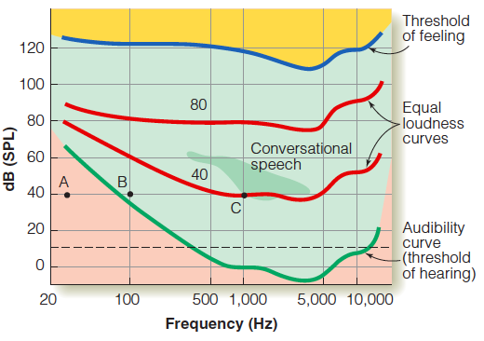
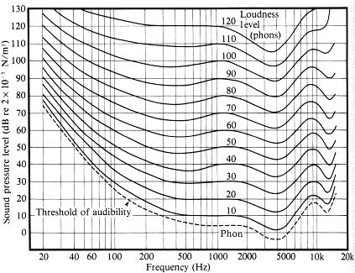
Audibility curve and auditory response area
Equal loudness curves
unit (phons)
Phon = the level in dB of a 1kHz tone judged to be of the same loudness as the test stimulus

Slide 13
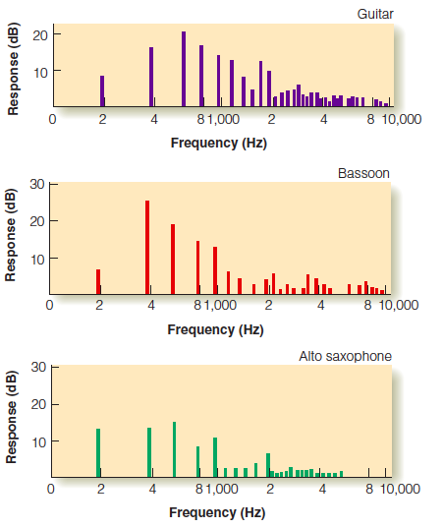

Timbre

Slide 14
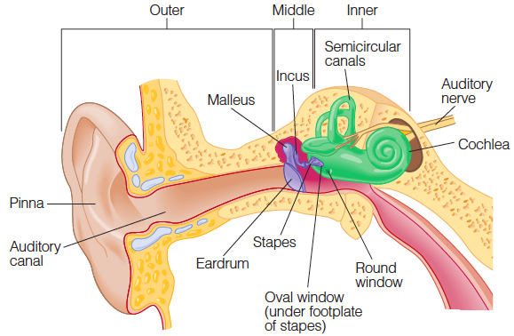
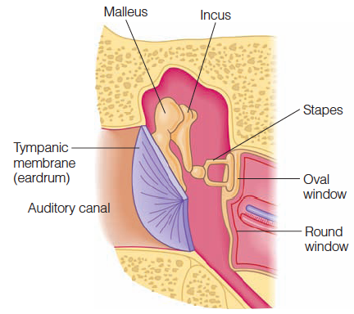
The ear
http://www.youtube.com/watch?v=dCyz8-eAs1I&feature=related
http://www.youtube.com/watch?NR=1&v=0jyxhozq89g&feature=fvwp

Slide 15
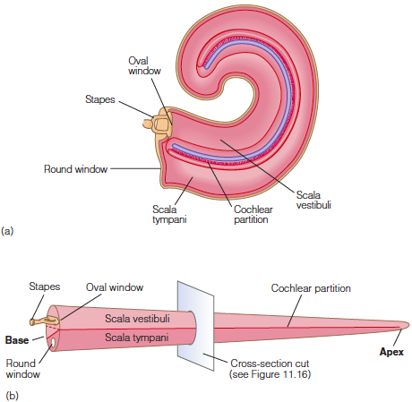
The cochlea
The cochlea is a spiral tapered tube, 2¾ turn.
The cochlea is divided into three parts along its length.
Helicotrema is the part of the cochlear labyrinth where the scala tympani and the scala vestibuli meet.
The basilar membrane is a vital part of the hearing process.
As the cochlea becomes narrower, basilar membrane becomes wider. 0.1 mm at the oval window, 0.5 mm at helicotrema.

Slide 16
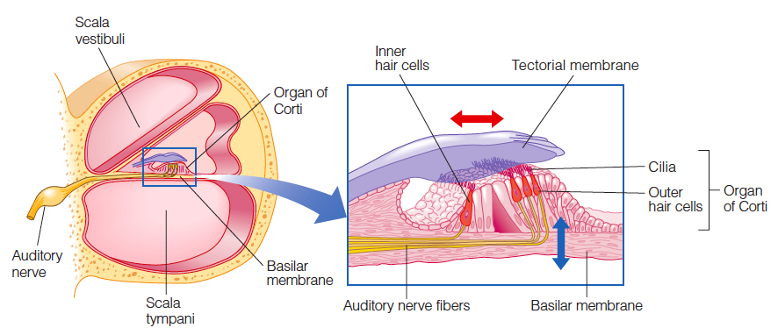
Basilar membrane

Slide 17
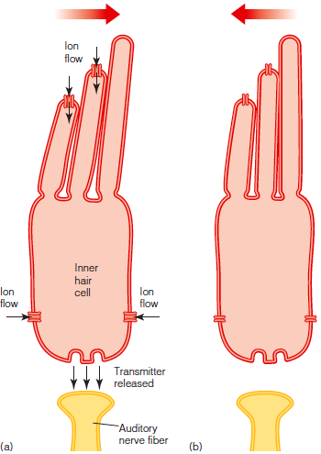
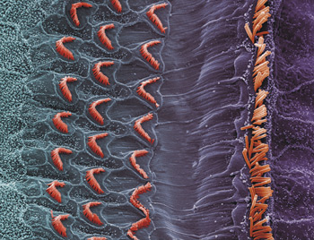
Inner and outer hairs cells

Slide 18
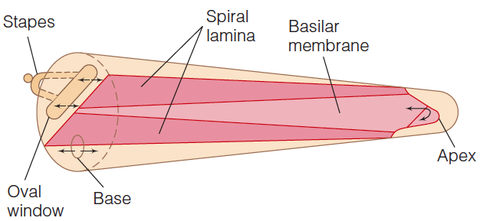
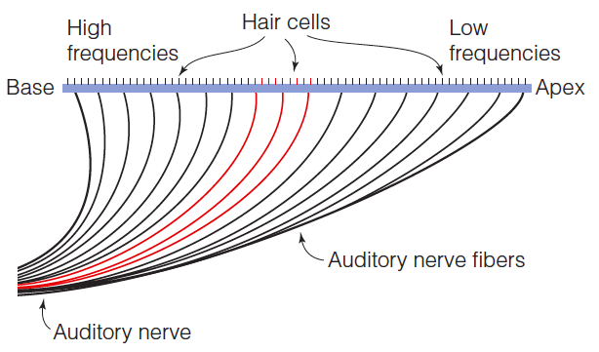
Frequencies

Slide 19
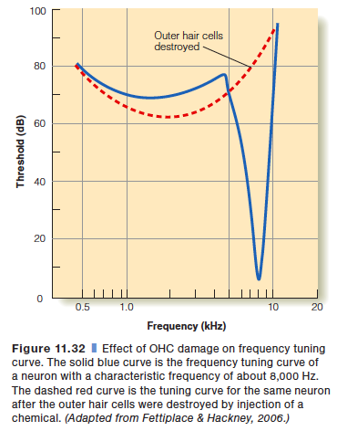
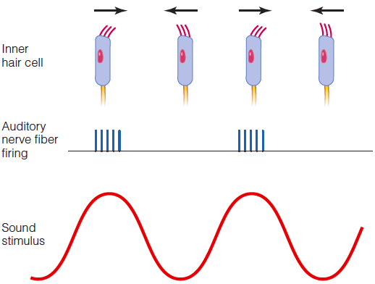
Sound frequency ➔ timing of firing

Slide 20
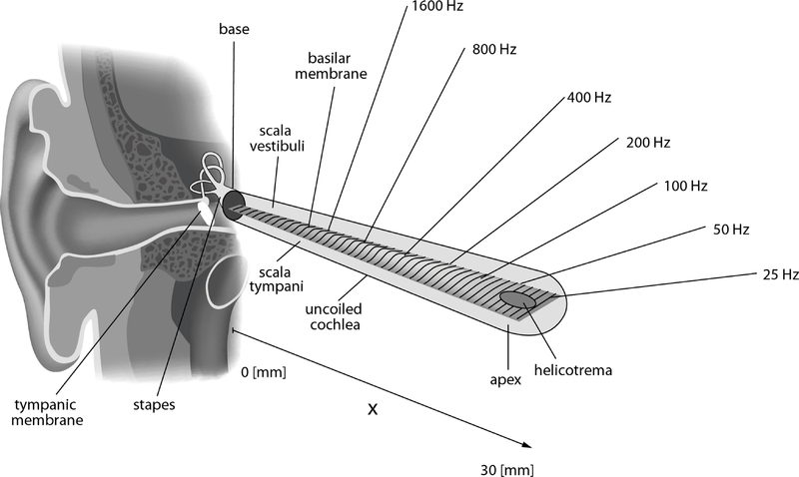
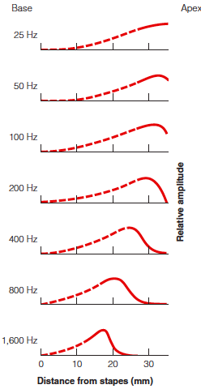
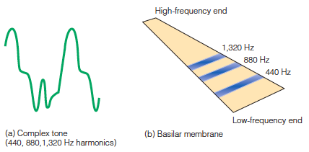
Basilar membrane: Vibration

Slide 21
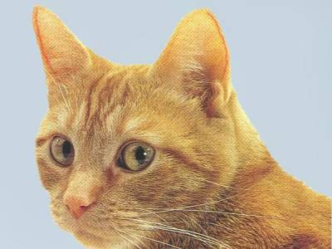
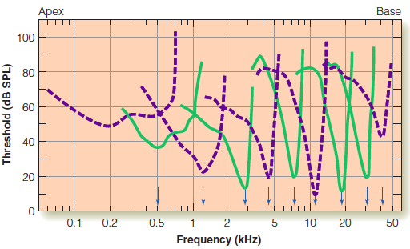
Tuning curves (cat auditory nerve fibers)

Slide 22
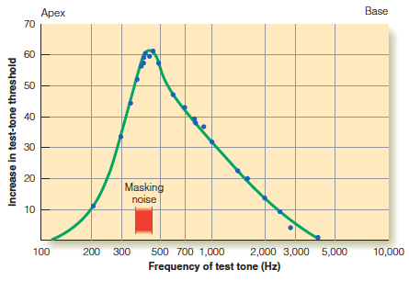
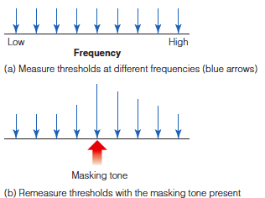
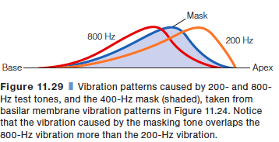
Masking
Low frequencies mask higher frequencies more than high frequencies mask lower frequencies
➔ The human auditory system is not sensitive to a detailed spectral structure, e.g. mp3.

Slide 23
Hearing loss
Conductive
  Deteriorated impedance conversion between the eardrum and the oval window
  Abnormalities at the eardrum, wax in the ear canal, injuries to the ossicles, inflammation in the middle ear
  ➔Sometimes possible to recover with surgery
Sensorineural
  Damage to the inner and outer hair cells
  Acoustic trauma, drugs, infection, congenital
  ➔Usually permanent

Slide 24
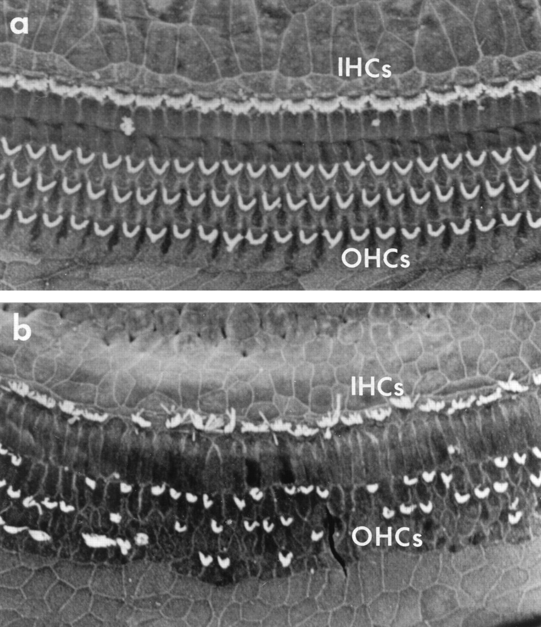
Sensorineural Hearing Loss

Slide 25
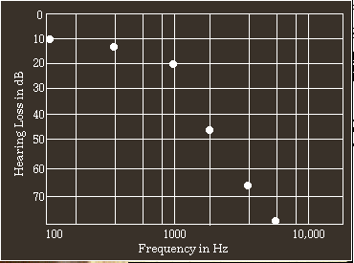
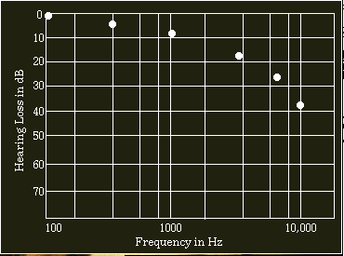
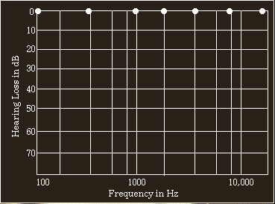
Hearing loss simulations
Severe
Moderate
Normal

Slide 26
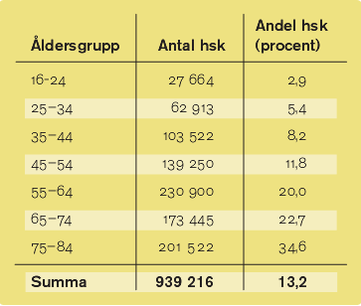
Hearing loss (Sweden)

Slide 27
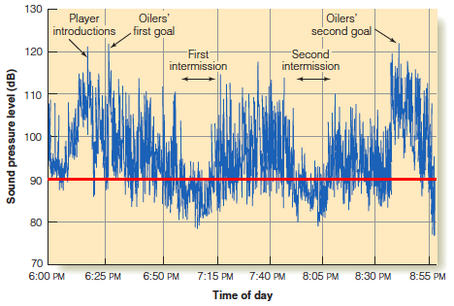
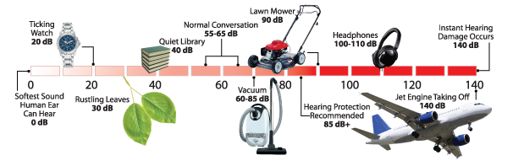
Safe sound level
Ishockey match

Slide 28
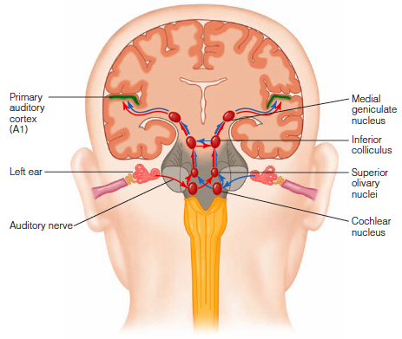
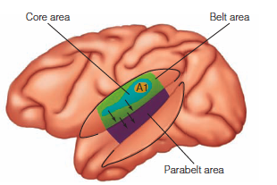
Auditory pathways

Slide 29
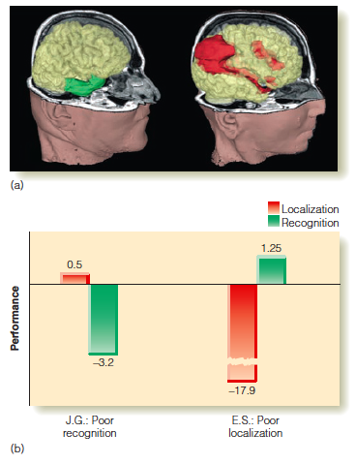
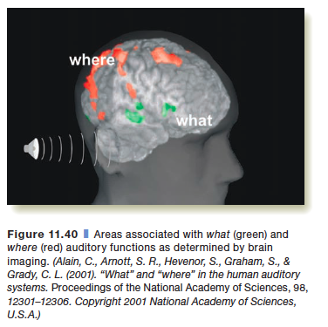
What and where streams
Areas with brain damage

Slide 30
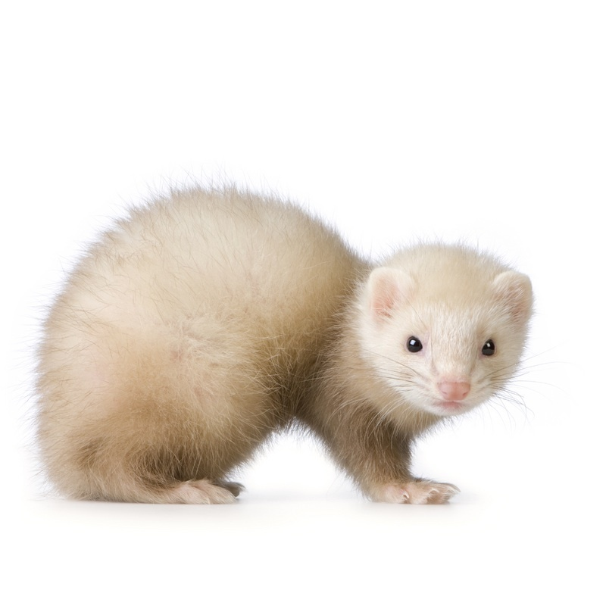
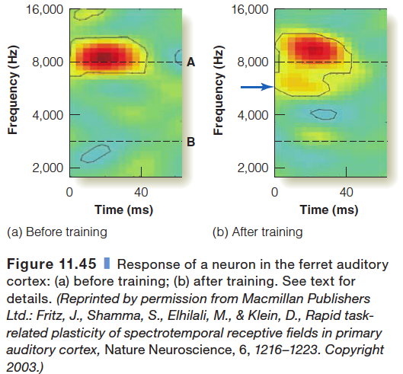
Auditory cortex is shaped by experience 1/2

Slide 31
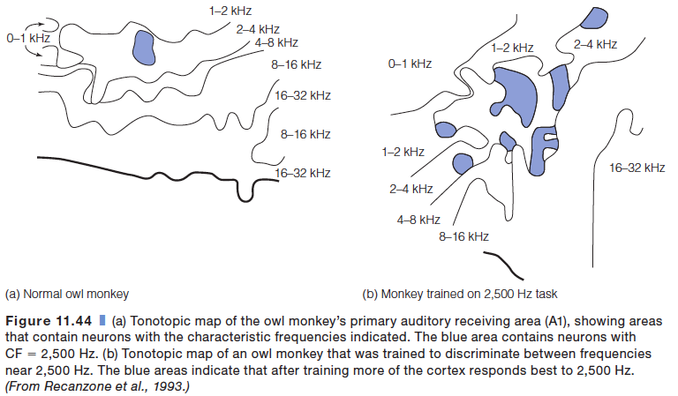
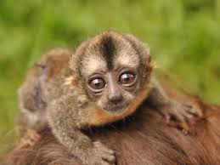
Auditory cortex is shaped by experience 2/2

Slide 32
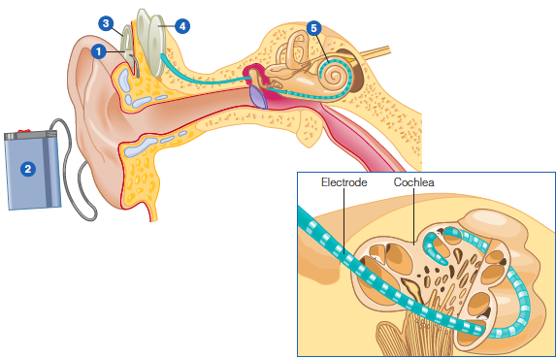
Cochlear implant (CI)
Microphone
Processor
Transmitter
Receiver
Electrodes

Slide 33
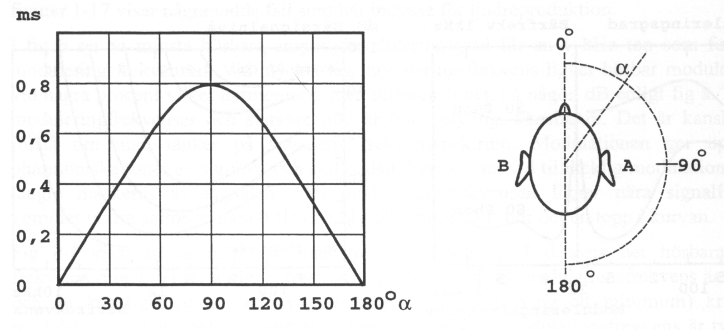
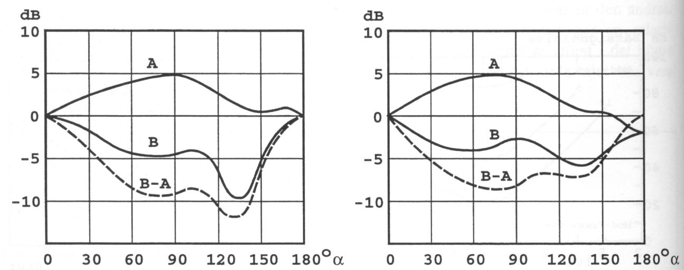
Sound localization – Horizontal plane
Time differences
Level differences
Time differences as function of angle
Level differences as function of angle
2 kHz tone
Speech

Slide 34
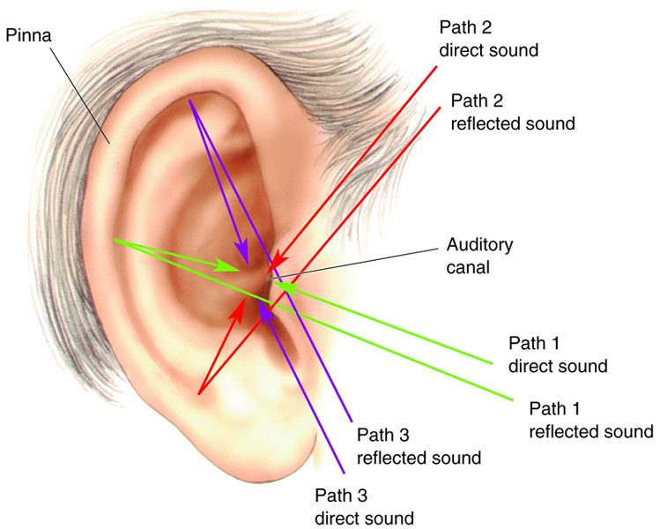
Sound localization – Vertical plane

Slide 35

Loud noises startle and get attention
Weinschenk, S.M. (2011). 100 Things Every Designer Needs to Know About People. Chapter #48

Slide 36

Loud noises startle and get attention
Weinschenk, S.M. (2011). 100 Things Every Designer Needs to Know About People. Chapter #48
People habituate to stimuli
Examples: computer fan, church bells, clock

