Slide 1
DT2350, Lecture 4: Introduction to vision, including perception of objects and scenes
Dr. Ginevra Castellano
Department of Information Technology
Uppsala University
Email: ginevra.castellano@it.uu.se

Slide 2
Textbooks
Goldstein, E. (2009). Sensation and Perception.
Weinschenk, S.M. (2011). 100 Things Every Designer Needs to Know About People.

Slide 3
Overview
Introduction to vision
  What happens at the very beginning of the visual system
The visual cortex and beyond
  Processes that occur in the visual areas of the brain
Perceiving objects and scenes
  How do we distinguish objects from their background?

Slide 4
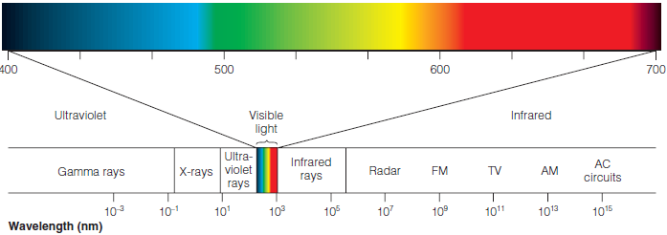
Introduction to vision - Focusing light onto the retina
Vision begins when visible light is reflected from objects into the eye
  Wavelength
  Photons
Electromagnetic spectrum

Slide 5
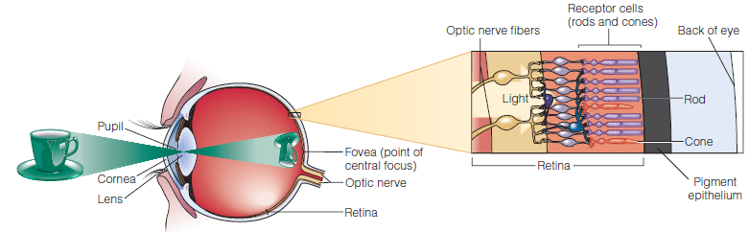
Introduction to vision - Focusing light onto the retina
Light entering through the pupil is focused by the cornea and lens to form images on the retina
  The lens can change its shape to adjust the eye’s focus for stimuli located at different distances (accomodation)

Slide 6
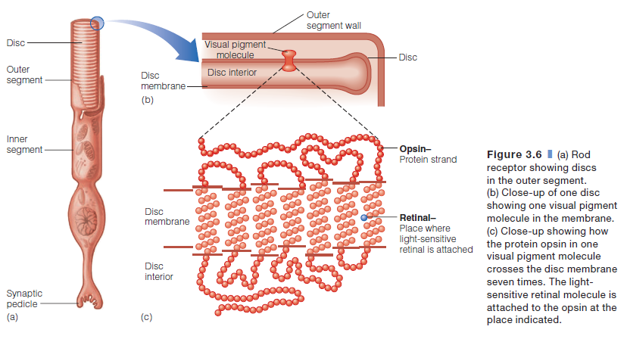
Introduction to vision - Transforming light onto electricity
Transduction is carried out by receptors (rods and cones) via visual pigments molecules

Slide 7
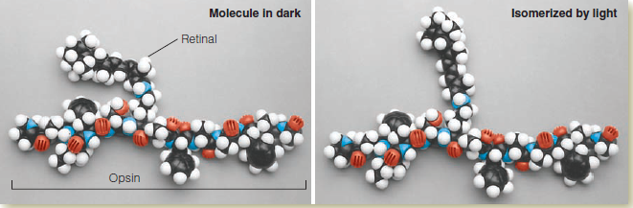
Introduction to vision - Transforming light onto electricity
Retinal is the part of the visual pigment that is sensitive to light
Isomerization -> activation of the entire receptor

Slide 8
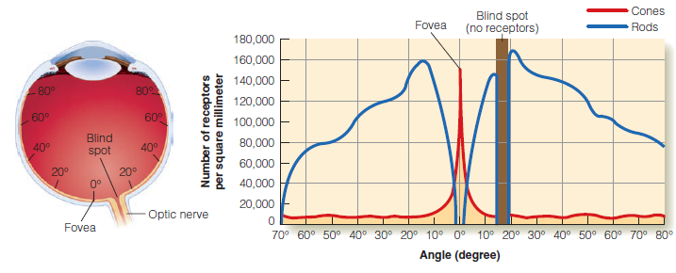
Introduction to vision - Pigments and perception
Distribution of rods and cones (120 vs. 6 million)
  Fovea contains only cones
  When we look directly at an object, its image falls on the fovea
  Blind spot: no receptors where the optic nerve leaves the eye

Slide 9
Introduction to vision - Pigments and perception
Dark adaptation of the rods and cones
  Increase eye sensitivity in the dark
Two different stages
  Initial rapid stage
    Cone receptors
  Second slower stage
    Rod receptors

Slide 10
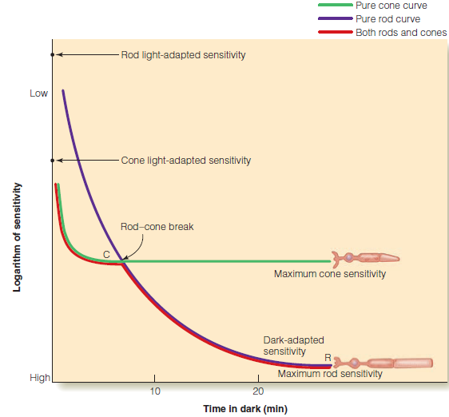
Introduction to vision - Pigments and perception

Slide 11
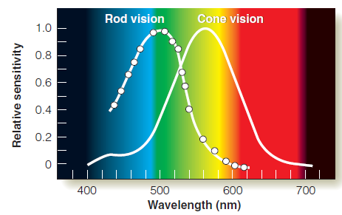
Introduction to vision - Pigments and perception
Spectral sensitivity curves for rods and cones
  Rods are more sensitive to short wavelength light than are the cones
  The cones are more sensitive in the light, and the rods are more sensitive in the dark

Slide 12
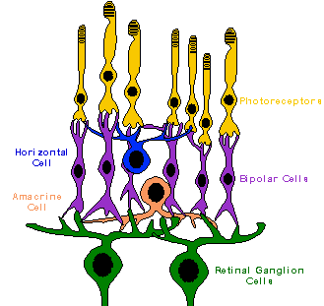
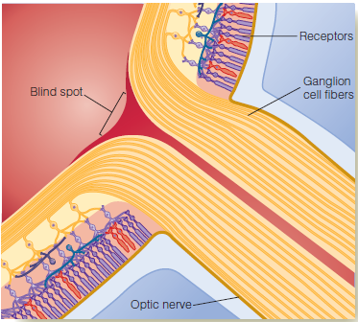
Introduction to vision - Neural convergence and perception
Neural convergence
  From receptors to ganglion cells

Slide 13
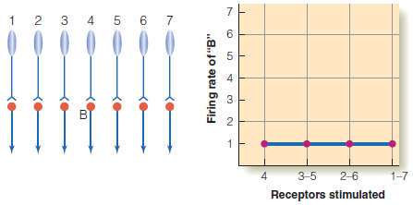
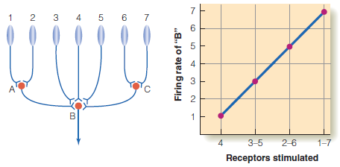
Introduction to vision - Neural convergence and perception
Neural convergence
  When one neuron receives signals from many other neurons
Circuit with no convergence
Circuit with convergence

Slide 14
Introduction to vision - Neural convergence and perception
Signals from the rods converge more than do the signals from the cones
  120 rods to one ganglion cell vs 6 cones to a ganglion cell
  The rods result in better sensitivity than the cones
Signals from the cones converge less than do the signals from the rods
  The cones result in better detail vision (visual acuity) than the rods
  Visual acuity is highest in the fovea (rich in cones); objects that are imaged on the peripheral retina are not seen as clearly

Slide 15
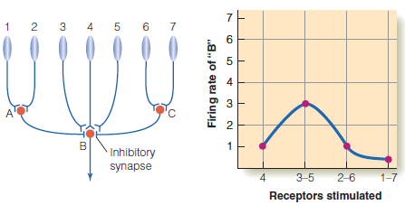
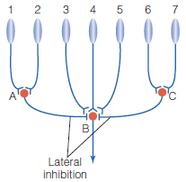
Introduction to vision - Lateral inhibition and perception
Lateral inhibition
Lateral inhibition arrives at neuron B from A and from C;
neuron B responds best when just the center receptors (3–5) are stimulated

Slide 16

Introduction to vision - Lateral inhibition and perception
Perceptual effects of lateral inhibition
  Perception of lightness
    Perception of shades ranging from white to grey to black
The Hermann Grid: seeing spots at intersections

Slide 17
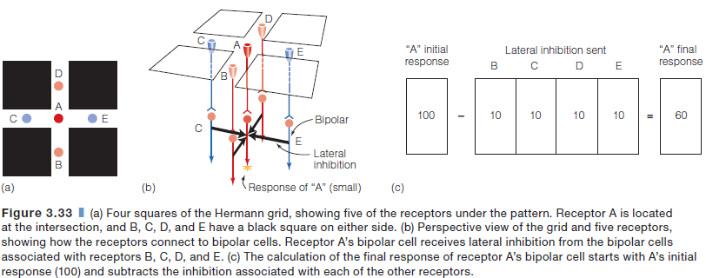
Introduction to vision - Lateral inhibition and perception
How the dark spots at the intersections can be explained by lateral inhibition
Assumption: The lateral inhibition sent by each receptor’s bipolar cell is one-tenth of each receptor’s response

Slide 18
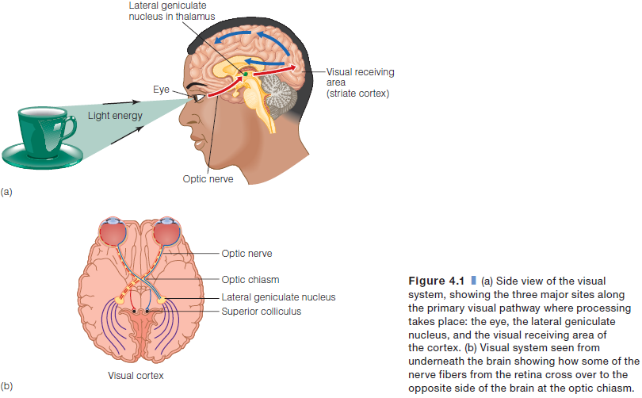
The visual cortex and beyond -
Following the signal from retina to cortex
Overview of the visual system

Slide 19
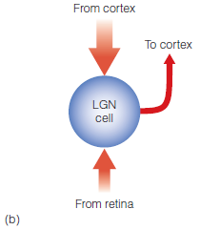
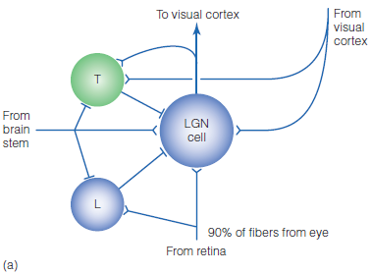
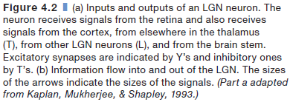
The visual cortex and beyond -
Following the signal from retina to cortex
Processing in the lateral geniculate nucleus (LGN)

Slide 20
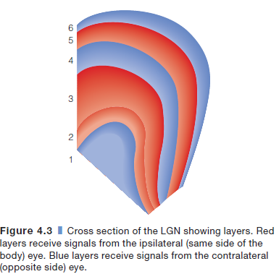
The visual cortex and beyond -
Following the signal from retina to cortex
Signals arriving at the LGN are sorted and organized based on
  the eye they came from
  the receptors that generated them
  the type of environmental information that is represented in them
LGN is a bilateral structure
  one LGN in the left hemisphere and one in the right hemisphere

Slide 21
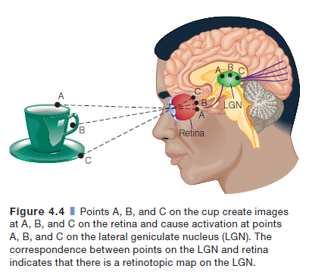
The visual cortex and beyond -
Following the signal from retina to cortex
Organisation as a spatial map
  Retinotopic map
  A map in which each point on the LGN corresponds to a point on the retina

Slide 22
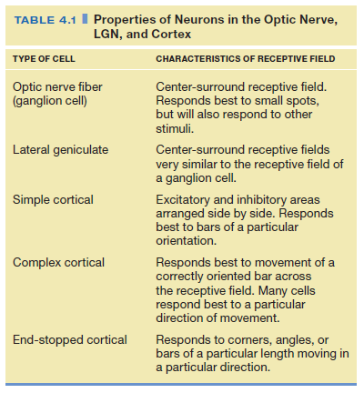
The visual cortex and beyond -
Following the signal from retina to cortex
Receptive Fields of Neurons in the Striate Cortex
  Simple, complex and end-stopped cells
    Fire in response to specific features of the stimulus
    E.g., orientation or direction of movement
    Feature detectors

Slide 23
The visual cortex and beyond - Do feature detectors play a role in perception?
When we view a stimulus with a specific property, neurons tuned to that property fire
Selective adaptation
  if the neurons fire for long enough, they become fatigued, or adapt
    the neuron’s firing rate decreases
    the neuron fires less when that stimulus is immediately presented again

Slide 24
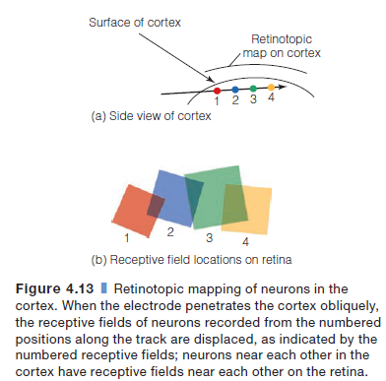
The visual cortex and beyond - Maps and columns in the striate cortex
Retinotopic mapping indicates that information about objects near each other in the environment is processed by neurons near each other in the cortex
Maps in the striate cortex

Slide 25
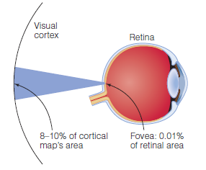
The visual cortex and beyond - Maps and columns in the striate cortex
Cortical magnification factor
The area representing the cone-rich fovea is much larger than one would expect from the fovea’s small size
Even though the fovea accounts for only 0.01 percent of the retina’s area, signals from the fovea account for 8 to 10 percent of the retinotopic map on the cortex

Slide 26
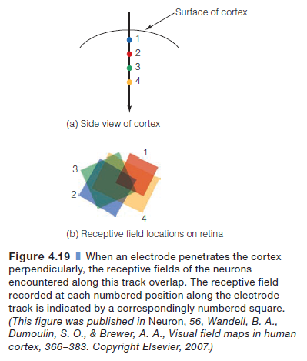
The visual cortex and beyond - Maps and columns in the striate cortex
The cortex is organized into a number of different kinds of columns

Slide 27
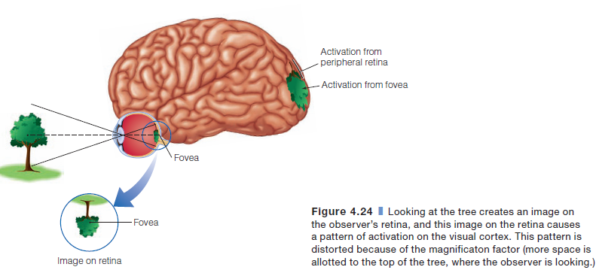
The visual cortex and beyond - Maps and columns in the striate cortex
How is an object represented in the striate cortex?

Slide 28
The visual cortex and beyond - Streams: pathways for what, where and how
Streams that transmit information from the striate cortex to other areas in the brain
  The what pathway (the ventral pathway)
    From the striate cortex to the temporal lobe
    Identifying objects
  The where (how) pathway (the dorsal pathway)
    From the striate cortex to the parietal lobe
    Locating objects
    Taking action

Slide 29
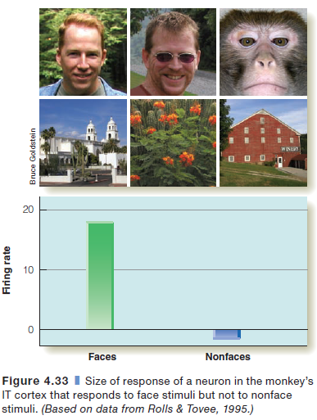
The visual cortex and beyond - Modularity: structures for faces, places and bodies
Fusiform face area (FFA)
  Activated by faces
  Located in the Fusiform Gyrus

Slide 30
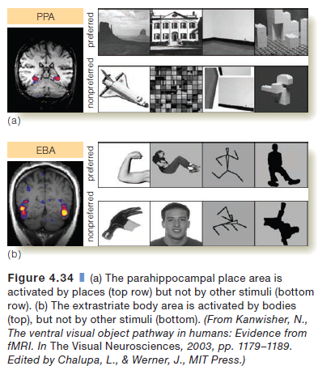
The visual cortex and beyond - Modularity: structures for faces, places and bodies
Parahippocampal place area (PPA)
  Sensitivity to indoor and outdoor scenes
Extrastriate body area (EBA)
  Activated by pictures of bodies and parts of bodies (but not by faces)
Located in the temporal cortex

Slide 31
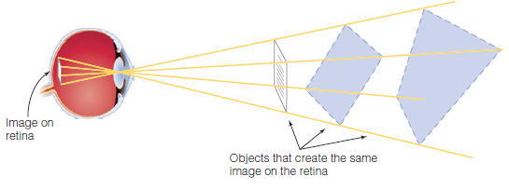
Perceiving objects and scenes - Why is it so difficult to design a perceiving machine?
The stimulus on the receptors is ambiguous

Slide 32
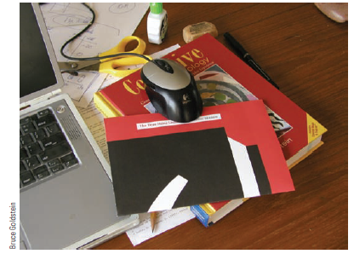
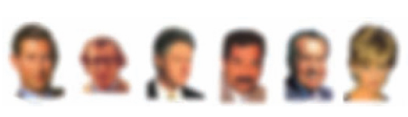
Perceiving objects and scenes - Why is it so difficult to design a perceiving machine?
Objects can be hidden or blurred

Slide 33
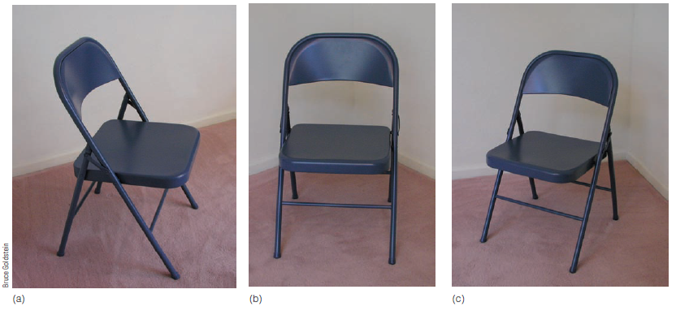
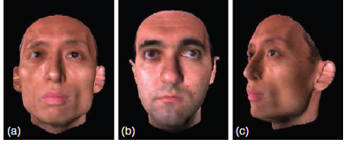
Perceiving objects and scenes - Why is it so difficult to design a perceiving machine?
Objects look different from different viewpoints

Slide 34
Perceiving objects and scenes - The Gesthalt approach to object perception
Rejecting the idea that perception is built up of sensations
Perceptual organisation
  Grouping elements in an image to create larger objects
  Six laws to explain how perceptual grouping occurs

Slide 35
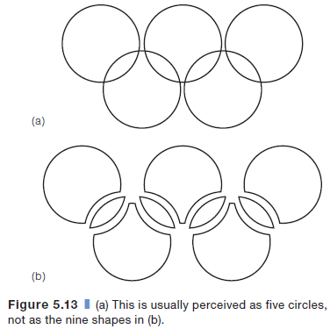
Perceiving objects and scenes - The Gesthalt approach to object perception
Law of pragnanz
  Every stimulus pattern is seen in such a way that the resulting structure is as simple as possible

Slide 36
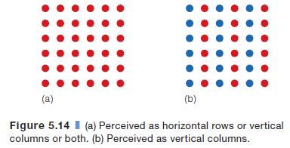
Perceiving objects and scenes - The Gesthalt approach to object perception
Law of similarity
  Similar things appear to be grouped together

Slide 37
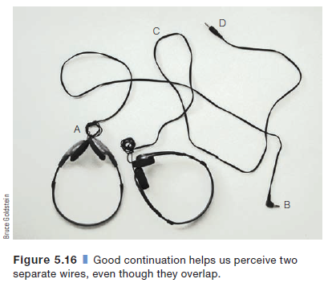
Perceiving objects and scenes - The Gesthalt approach to object perception
Law of good continuation
  Points that, when connected, result in straight or smoothly curving lines are seen as belonging together, and the lines tend to be seen in such a way as to follow the smoothest path

Slide 38

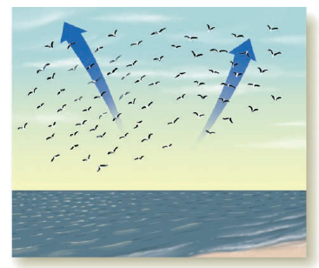
Perceiving objects and scenes - The Gesthalt approach to object perception
Law of proximity
  Things that are near each other appear to be grouped together
Law of common fate
  Things that are moving in the same direction appear to be grouped together

Slide 39
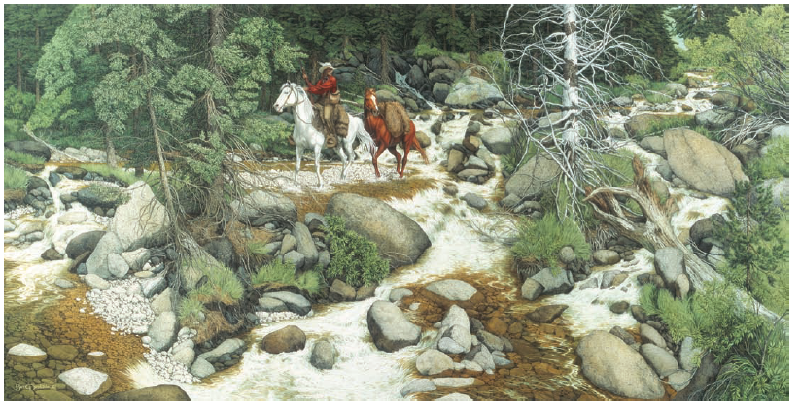
Perceiving objects and scenes - The Gesthalt approach to object perception
Law of familiarity
  Things that form patterns that are familiar or meaningful are likely to become grouped together

Slide 40
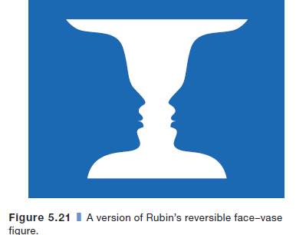
Perceiving objects and scenes - The Gesthalt approach to object perception
Perceptual segregation: how objects are separated from the background

Slide 41
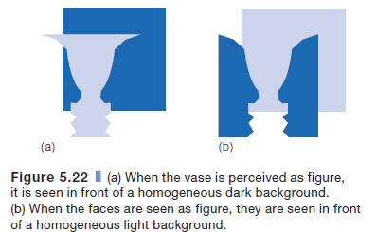
Perceiving objects and scenes - The Gesthalt approach to object perception
What are the properties of figure and ground?
The figure is more “thinglike” and more memorable than the ground
The figure is seen as being in front of the ground
The ground is seen as unformed material and seems to extend behind the figure
The contour separating the figure from the ground appears to belong to the figure

Slide 42
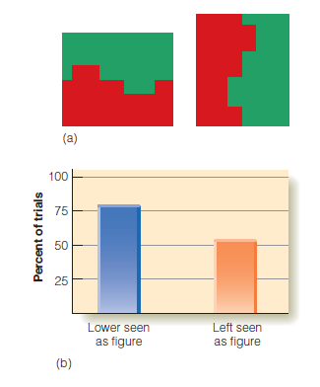
Perceiving objects and scenes - The Gesthalt approach to object perception
What factors determine which area is figure?
  Regions in the lower part of a display are more likely to be perceived as figure than regions in the upper part

Slide 43
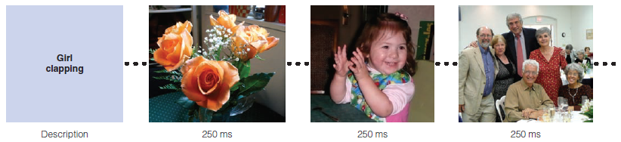
Perceiving objects and scenes - Perceiving scenes and objects in scenes
A scene is a view of a real-world environment that contains (1) background elements and (2) multiple objects that are organized in a meaningful way relative to each other and the background
Perceiving the gist of a scene is possible within a fraction of a second

Slide 44
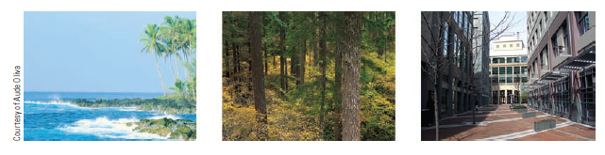
Perceiving objects and scenes - Perceiving scenes and objects in scenes
What enables observers to perceive the gist of a scene so rapidly?
  Global image features (Oliva and Torralba, 2006)
    Degree of naturalness; degree of openness; degree of roughness; degree of expansion; colour

Slide 45
Perceiving objects and scenes - Perceiving scenes and objects in scenes
We easily use our knowledge of regularities in the environment to help us perceive, even though we may not be able to identify the specific information we are using
  Physical regularities
    Regularly occurring physical properties of the environment people can perceive horizontals and verticals more easily than other orientations
  Semantic regularities
    Meaning of a scene

Slide 46
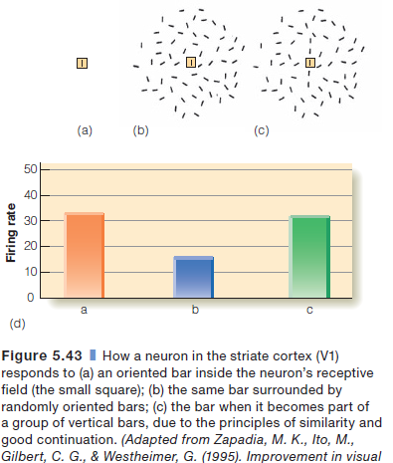
Perceiving objects and scenes - The physiology of object and scene perception
Neurons that respond to perceptual grouping

Slide 47
Perceiving objects and scenes - The physiology of object and scene perception
How does the brain respond to objects?
Distributed activity across the brain
Fusiform face area (FFA)
  A face might cause a large amount of activity in the FFA, but also cause activity in other areas as well
  Firing is, therefore, distributed in two ways:
    across groups of neurons within a specific area
    across different areas in the brain

Slide 48
“Design” case study: There’s a special part of the brain just for recognising faces
There’s a special part of the brain just for recognising faces
People are born for a preference for faces
Fusiform face area (FFA) (Kanwisher, 1997; 2000)
    Outside visual cortex
    Recognise faces
    Helps us identify faces more quickly than objects
    People with autism do not use FFA to identify faces (Pierce, 2001)
Kanwisher, N. (2000). Domain specificity in face perception. Nature, 3, 759–763.

Slide 49

We look where the face looks
Eye tracking research shows that if a picture of a face looks away from us and toward a product on a web page, we tend to also look at the product
Establish emotional connection vs directing attention
Weinschenk, S.M. (2011). 100 Things Every Designer Needs to Know About People.

Slide 50

People decide who and what is alive by looking at the eyes
Looser and Wheatley (2010) took pictures of people and then morphed them in stages into inanimate mannequin faces
Subjects say the pictures no longer show someone who is alive at about the 75 percent mark
People primarily use the eyes to decide if a picture shows someone who is human and alive
Video 1; video 2
Weinschenk, S.M. (2011). 100 Things Every Designer Needs to Know About People.

Slide 51
Take away messages
People recognize and react to faces on Web pages faster than anything else on the page (at least by those who are not autistic)
Faces looking right at people will have the greatest emotional impact on a Web page, probably because the eyes are the most important part of the face
If a face on a Web page looks at another spot or product on the page, people will also tend to look at that product. This doesn’t necessarily mean that they paid attention to it, just that they physically looked at it.
Weinschenk, S.M. (2011). 100 Things Every Designer Needs to Know About People.

Slide 52
References
Goldstein, E. (2009). Sensation and Perception.
Weinschenk, S.M. (2011). 100 Things Every Designer Needs to Know About People.

Slide 53
Contact
Dr. Ginevra Castellano
Department of Information Technology
Uppsala University
Email: ginevra.castellano@it.uu.se

