Slide 1
Telecom regulation and spectrum
Prepared for IK 2514 Wireless Infrastructure Deployment & Economics
4 November 2015, 13-15
Bengt G Mölleryd
Swedish Post and Telecom Agency (PTS)
Guest researcher: wireless@KTH
Email: bengt.molleryd@pts.se

Slide 2
Agenda
Why regulation
The role of the regulator
Regulation of electronic communication
European Commission: Telecoms Single Market
Conclusions

Slide 3
If regulation is the answer what is then the question?

Slide 4


How to organize road traffic?

Slide 5


How to organize air traffic?

Slide 6
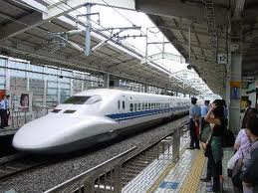

How to organize rail traffic?

Slide 7


How to control the financial market?

Slide 8

How to maintain a natural monopoly?

Slide 9
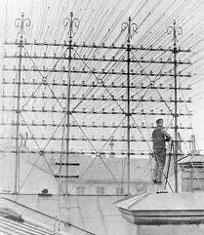
Interconnection with other networks?

Slide 10
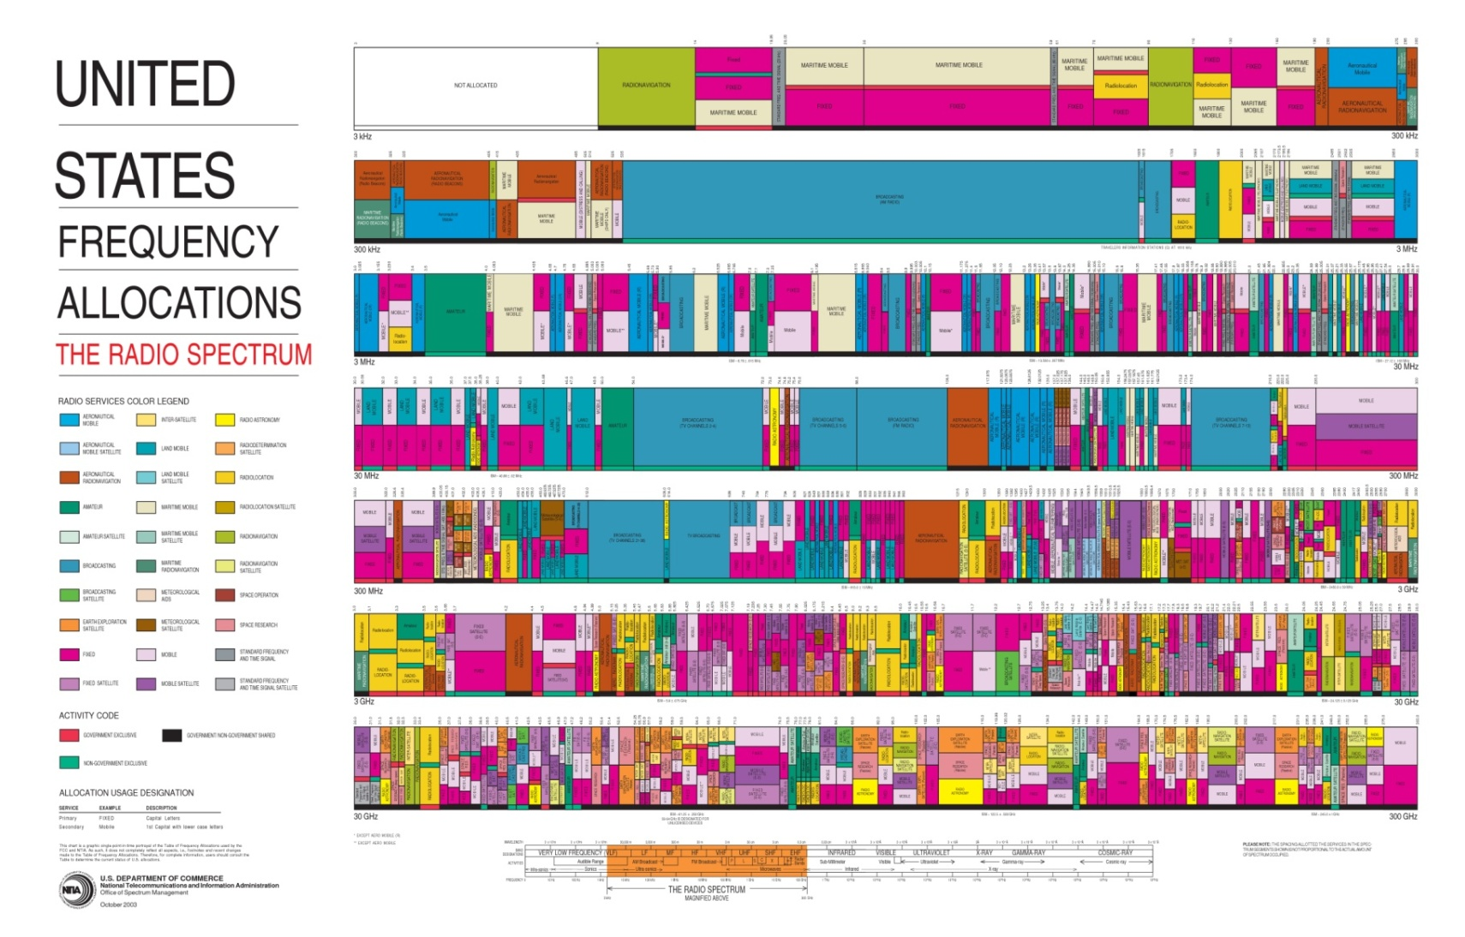
How to allocate spectrum?

Slide 11












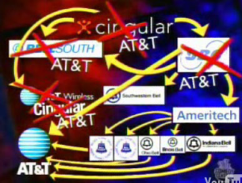





Development of telecommunications
High fixed cost – low marginal cost
Economy of scale
Price deflation
Telecom 3.0
Monopoly
Liberalization - competition
Regulation 3.0
1880 1920 1980 2010 2020

Slide 12
Key words
Essential facility
Ex ante
Ex post
SMP (Significant Market Power)
Three criteria (entry barriers, no movement towards competition, competition law)
EU regulatory framework - National laws and regulation

Slide 13
# 1 – About regulation
Table | Perspective | Question | Issues
A | Denmark: challenger | View on regulation? How does it impact the business and the ability to provide services. | Interconnection, termination, network sharing, backhaul, spectrum
B | Sweden: incumbent | See above | SMP-obligations, unbundling, obligations, spectrum
C | Spain: new entrant | See above | Termination, interconnection, MVNO, backhaul, spectrum
D | Kazakhstan: dominating operator | See above | Interconnection, termination, backhaul, spectrum
E | Nigera: possible entry | See above | MVNO, interconnection, VoIP, termination, spectrum,
Examine the view and priorities on regulation for each perspective

Slide 14
The role of the regulator
Sector specific – ex ante (decide on obligations for operators with significant market power (SMP))
Safeguard price worthy services to end customers
Implement directives/national regulation
Allocate spectrum
What is the aim with telecommunication regulation?

Slide 15
Competition Authority
General purpose Ex-post (violation towards the rule of law) gives the competitive authority a mandate to intervene
Other regulatory bodies, issuing building permits
Telecom and competition authorities are commonly
separate agencies, but Ofcom in the UK combine the two roles

Slide 16
Ex ante vs ex post regulation
Ex ante regulation is anticipatory intervention
  concerned with market structure,
  number of firms and level of market concentration
  entry conditions and
  the degree of product differentiation
Ex post regulation addresses specific allegations of anti-competitive behavior or market abuse.
  It aims to redress proven misconduct through a range of enforcement options including fines, injunctions, or bans.

Slide 17
Essential facility
Doctrine
Bottle-neck (railroads, monopolist refusal to deal…)
Not replicable (like the copper access network)
Investment ladder
Access

Slide 18
SMP criteria
Dominant position
Market power (market shares) >25%
Control of infrastructure not easily duplicated
Technological advantages or superiority
Absence of or low countervailing buying power
Economies of scale and scope
Vertical integration
Highly developed distribution and sales network

Slide 19
Three criteria test
The presence of high and non-transitory barriers to entry
A market structure which does not tend towards effective competition within the relevant time horizon
The insufficiency of competition law alone to adequately address the market failures
The EU Commission identifies markets that should be subject to regulation (can veto market definition but not obligations)
The National Regulatory Authorities pursue SMP-analysis

Slide 20
Relevant markets defined by the Commission
1) Wholesale fixed call termination
2) Wholesale mobile call termination
3a) Wholesale local access at a fixed location WLA
3b) Wholesale central access for mass market products WCA
4) Wholesale high quality access at a fixed location

Slide 21
Interconnection
Communication between different networks
Fixed to mobile termination
Mobile to mobile termination
Mobile to fixed termination
Cost recovery
Origination
What would a network be without interconnection?

Slide 22
Mobile termination
Monopoly on terminating calls (voice calls)
Regulated price to terminate calls
LRIC (Long run incremental cost)
EU directive on mobile termination
No termination on mobile data (but transit or peering are needed)
What is the link between termination prices on wholesale and prices that operators charge end-customers?
Explore pricing strategies with on-net and off-net prices?

Slide 23
The regulatory tool box
Remedy | Example
Obligations to provide access, or other obligations | Origination, termination, unbundling, wholesale access,
Access to facilities | Place equipment, backhaul, support systems
Non-discrimination | Treat wholesale customers the same way as the internal retail operation
Cost oriented prices | Price regulation, LLUB, termination charges

Slide 24
#2 - Regulation
Table | Role | Area | Issues
A | Regulator/EU Commission | Spectrum | Allocation methods, reserve price, single authorization
B | Regulator/EU Commission | Termination charges, pure LRIC, roaming | Termination, interconnect, MVNO,
C | Incumbent/challenger | Fixed infrastructure, LLUB, dark fiber, VULA | SMP, unbundling, obligations, price regulation
D | Regulator/EU Commission | Fixed infrastructure, LLUB, dark fiber, VULA | SMP, unbundling, obligations,
E | Incumbent/challenger | Termination charges, pure LRIC, roaming | Termination, interconnect, MVNO, spectrum
F | Incumbent/challenger | Spectrum | Allocation methods, reserve price, single authorization
Elaborate your view on regulation, and how the different issues should be handled by the regulator

Slide 25
Conclusions
Competition problems varies depending upon perspective
Operators have to cope with regulation
Essential facility
Ex ante
Ex post
SMP (Significant Market Power)
Three criteria (entry barriers, no movement towards competition, competition law)
Mobile termination is declining in importance
Competition is key to develop the market

Slide 26
Regulatory authorities/interest groups
US – FCC
UK – Ofcom
Sweden – PTS
Regulatory bodies
ERG (http://www.berec.europa.eu)
ECTA (http://www.ectaportal.com/en)
NRAs decisions has to be in line with the Commission’s practice and the relevant jurisprudence of the European Courts

Slide 27
Spectrum

Slide 28
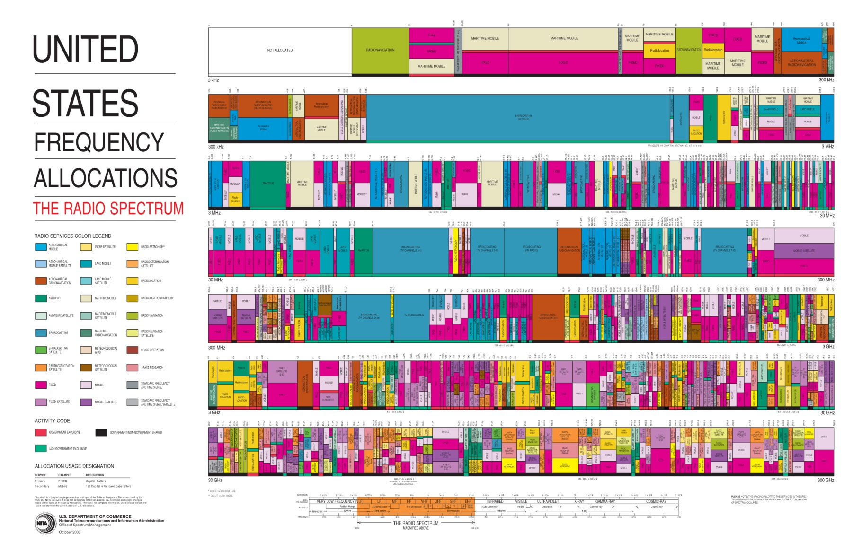

Slide 29
Spectrum management
Frequency planning
Spectrum allocation
  Administrative allocation
  Auctions
  Beauty contest

Slide 30
Spectrum Sweden
PTS spectrum policy
IMT bands have been allocated: 800, 900, 1800, 2100, 2600 MHz
Future spectrum releases, like 700 MHz

Slide 31
The PTS spectrum policy
Aim to provides the greatest possible level of use and social benefit, promote innovation, development of technology and a broader range of wireless-based services.
Licences to use radio transmitters shall be as technology and service neutral as possible
Auctions is the preferred selection mechanism for spectrum
Second-hand trading (transfer of licences) shall be promoted
Licence exemption should be introduced where there is little risk of harmful interference and there are no other impediments

Slide 32
The 800 award in Sweden 2011
Auction format similar to the Swedish 2.6 GHz auction (SMRA with switching)
Started bid at SEK 150 million per license
Coverage obligations for one of the licenses:
  License holder shall cover households and working places that do not today have basic possibilities for broadband (less than 1000)
  License holder promises to invest in coverage up to SEK 300 million

Slide 33
The 800 award in Sweden
The auction closed after 31 rounds and five days
For Net4Mobility SEK 300 million comprise bids for coverage for those households and fixed places of business that lack broadband
Com Hem AB and Netett Sverige AB also participated in the auction but did not win any licenses.
Bidder | Bandwidth, MHz | Auction proceeds, SEK | Amount for coverage, SEK
HI3G Access AB | 2x10 | 431 000 000
Net4Mobility HB | 2x10 | 469 000 000 | 300 000 000
TeliaSonera Mobile Networks AB | 2x10 | 854 000 000

Slide 34
900 MHz
PTS decided in 2009 that the license holders in 900 should have their licenses renewed with new frequency arrangements and technical conditions
However, the issue was under legal challenge, resolved by February 2011
Current licenses have according to the decision been renewed with no changes when it comes to frequency arrangements and technical conditions
New frequency arrangement and technical conditions entered into force in May 2011

Slide 35
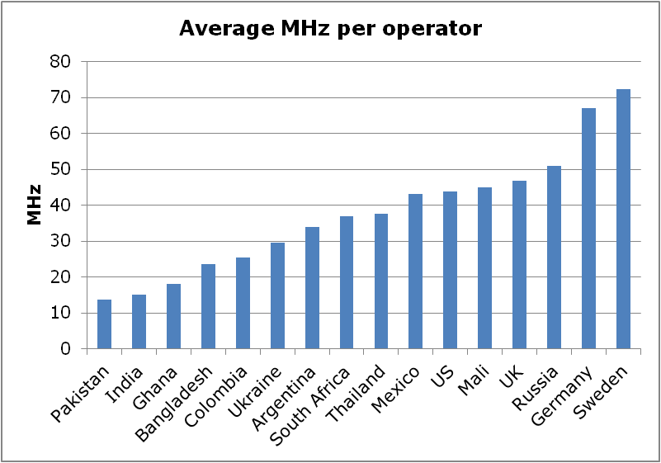
Average holding for an operator on these markets. Market share weighted. Shows only downlink and FDD spectrum.
Source: Cullen-International, NRA,
Operator reports, author’s calculation

Slide 36
Spectrum Allocation in Sweden today
 | 450 | 800 | 900 | 1800 | 2100 | 2600 | Σ
Net1 | 5 |  |  |  |  |  | 5
Hi3G |  | 10 | 5 | 0 | 20 5 TDD | 10 50 TDD | 45 55 TDD
TeliaSonera |  | 10 | 10 | 35 | 0 | 20 | 75
Net4Mobility(T2+TN) |  | 10 | 6 | 35 | 0 | 40 | 71
Tele2 |  | 0 | 9 | 0 | 0 | 0 | 9
Telenor |  | 0 | 5 | 0 | 20 5 TDD | 0 | 25 5 TDD
Sulab (TS+T2) |  | 0 | 0 | 0 | 20 5 TDD | 0 | 20 5 TDD
Spectrum FDD 2x

Slide 37

Questions
How is the production cost affected by different levels of spectrum?
How does the use of spectrum aggregation influence the evaluation of spectrum?
Base station density for “low“ (left) and “higher” (right) depends on amount of spectrum and the carrier frequencies

Slide 38
Estimate the value of spectrum
Economic value of spectrum can be assessed by estimating the value of the economic activities through the contribution to the GDP
Marginal value of spectrum
  Engineering value is determined by cost savings in infrastructure of the operator’s network obtained when additional spectrum is used.
  Strategic value reflects the expected position and competitive advantage an operator would hold in the market as a result of the assigned spectrum

Slide 39
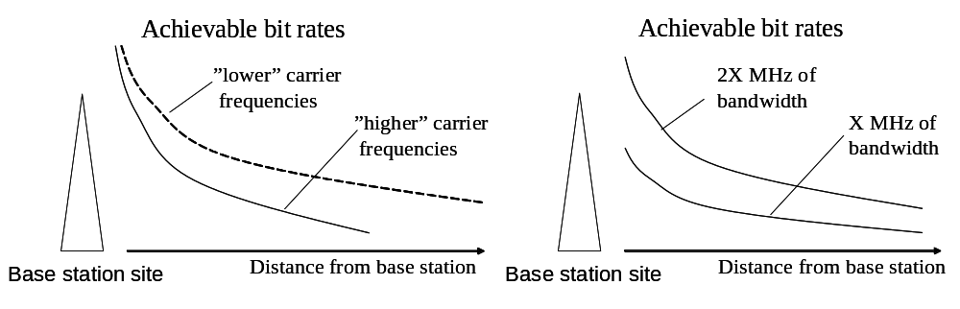
Approach - technical
Coverage = π * cell range²
Capacity = Bandwidths (MHz) * number of sites * sectors * spectrum
Bit rate = MHz * spectrum efficiency
Busy hour = 12.5%

Slide 40
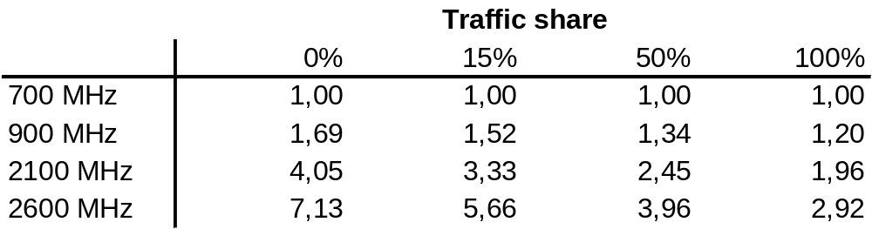
Capex comparison - 700 MHz vs higher bands
Capex for each band is normalized to cost of deployment in 700 MHz
Source: Azcoitia et al (2010)

Slide 41
License exempt - unlicensed
PTS Regulation on license exempt (PTSFS:2007.4) on the 2.4 GHz and 5.3 GHz band for ‘short-range device’ (ISM), radio transmitters which provide either unidirectional or bidirectional communication and which transmit over a short distance at low power (WiFi)
2400-2483.5 MHz, maximum 100 mW e.i.r.p
5150-5250, 5250-5350 MHz, maximum 200 mW e.i.r.p
1875.0-1880.0 MHz, maximum transmission power from base station 20 dBm (100 mW e.i.r.p)
Source: 2006/771/EG – Commission decision of 9 November 2006 on harmonization of the radio spectrum for use by short-range devices (source: http://eur-lex.europa.eu/LexUriServ/LexUriServ.do?uri=OJ:L:2006:312:0066:0070:EN:PDF

Slide 42
Conclusions
Spectrum is a vital and scarce resource making allocation decisions to key events
Market mechanism in allocation but yet no spectrum trading
The license exempt for WiFi underscores that allocation mechanism should be combined
Exclusively allocated harmonized spectrum is set to be the main principle to allocation…

