Slide 1
Career development
Master student
KTH Career: www.kth.se/student/framtid/karriar (English pages!)
Joséphine Häckner Posse, Elin Fellers

Slide 2
Content seminars fall 2015
Date | Content | Venue
3/11 | Step 1: Career development – Who am I? What are my strenghts? What do I want for my future?” | KTH Gröten, THS student union house
5/11 | Step 2: Employers serach for suitable candidates | Main library, lecture hall ”Syd östra galleriet”
10/11 | Step 3: My professional identity and how to link to other professionals | Main library, lecture hall ”Syd västra galleriet”
12/11 | Step 4: The job application. What should I write in my CV and cover letter. | Main library, lecture hall ”Syd östra galleriet”
24/11 | Step 5: How to prepare and handle the job interview | Main library, lecture hall ”Syd östra galleriet”

Slide 3
Social
To access the exercises!
Join the career group: Career development for master students on KTH Social:
www.kth.se/social/group/career-development-f/
Log in with your KTH id.

Slide 4
Today
My professional identity and how to link to other professionals.
The role of an engineer now and then
The networking of today

Slide 5
The professional role
Then… Industrial society The engineer as an heroe Specialist and Expert
Now… Knowledge-based economy Teamwork Specialist and/or generalist

Slide 6
What is employability today?
The individual’s ability to get employment
The responsibility of the organization (i.e. KTH) to make this possible
Notes:
”Anställningsbarhet” har skiftat innebörd över tid i takt med samhällets strukturomvandling.
I vårt individcentrerade samhälle ser vi anställningsbarhet som individens ansvar, det är dennes ansvar att göra sig anställningsbar – genom att skaffa utbildning, vara beredd att flytta, ta ett tillfälligt jobb etc. Men det är också organisationers ansvar att se till att individen görs anställningsbar. Som ex kan mas se KTH som när man planerar och genomför utbildning har ansvar att erbjuda en utbildning som i viss utsträckning ska motsvara arbetsgivares krav och behov av kompetens.
Begreppet myntades i början av 1900-talet då man endast pratade om människors förmåga, inte deras kompetens. Antingen var man anställningsbar, inte inte!
Under 50- och 60-talet blev anställningsbarhet ett policybegrepp. Man började se på anställningsbarhet utifrån ett sysselsättningsperspektiv och vidtog åtgärder för att öka sysselsättningen.
Nuförtiden, i ett samhälle som präglas av livslångt lärande ser vi på individens kompetens och sociala färdigheter. I detta individualistiska samhälle har anställningsbarhet kommit att bli något som du själv har ansvar för, större än tidigare. Du förväntas själv vara medveten om din anställningsbarhet och se till att följa kraven som ställs (flexibilitet AMS). Samtidigt ska sägas att vi också har ett system som ska bidra/underlätta, ex förväntas utbildningen erbjuda kurser som du kan använda vid din asntällning…

Slide 7
How can I make myself more employable?
Education Work experiences
Develop myself
Good cover letter Prepare for the interview
Networking
Update my LinkedIn …………

Slide 8
How employable are alumni from KTH?
94% employment
The difference between Swedish citizens and non-Swedish citizens are 9%.
More than half of the alumni found work before they finalized their degrees, and more than one in four did so within three months of graduation.
Almost one third have changed jobs once, 17% twice, and 9% three times or more.
KTH Career report 2015 - Östling
Notes:
Hur anställningsbara är KTH alumnerna? Mycket…
Utbildningens relevans i arbetet (s24)?

Slide 9

What is networking?
Get to know people who can help you to develop your prospects for your career.

Slide 10
Some rules of thumb…
First impression lasts!
Networking as a way to gather information
Give and take
Research
Act wide
Patience…

Slide 11
My network today?
MYSELF
Family/Relatives
Friends
Families of my friends
People I meet on the gym…
Former colleagues
Classmates
Teachers / Supervisors
Present colleauges
Industry related contacts

Slide 12
ARMADA
How can I get the most out of it?
Study the catalogue or web site www.armada.nu
Pick out five favourite companies
Register for extra events
Prepare questions, try to make contact
Collect a couple of names
Go to LinkedIn, join the company group
Search for and make contact to the persons you talked to
Ask more questions
Make a post about your participation at the fair

Slide 13

Branding
Employer branding
Personal branding
Notes:
Employer branding is the process of promoting a company, or an organization, as the employer of choice to a desired target group, one which a company needs and wants to recruit and retain. The process facilitates the company’s ability in attracting, recruiting and retaining ideal employees – referred to as Top Talent in recruitment – and helps secure the achievement of the company’s business plan.

Slide 14
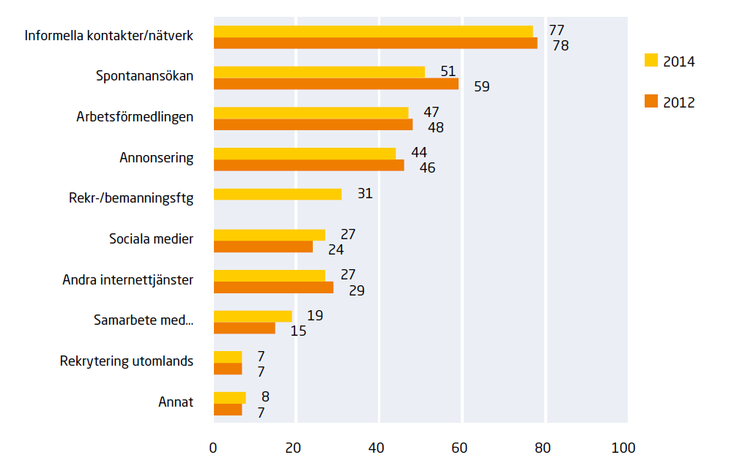
The Confederation of Swedish Enterprises:
Informal contacts and network
Spontaneous application
Swedish public employment service
Job ad
Recruitment companies
Social media
Other internet services
Collaborations
Recruitment abroad
Other
Notes:
The Confederation of Swedish Enterprise (Svenskt Näringsliv) is Sweden’s largest and most influential business federation representing 49 member organizations and 60 000 member companies with over 1.6 million employees. It was founded in 2001 through the merger between the Swedish Employers’ Confederation (SAF, founded in 1902) and the Federation of Swedish Industry (SI, founded in 1910).
Which recruitment ways have you been using
and regard as being the most effective ones?

Slide 15

Employability skills
Communication
Teamwork
Problem Solving
Initiative & Enterprise
Planning & Organising
Learning
Technology
Self Management and career management skills

Slide 16
LinkedIn
Employability perspective
Career smart
Social media ”hygiene”
Digital ”business suit”
Net smart
Keep updated
Business intelligence
Personal branding
networking
Part of the Social economy

Slide 17
LinkedIn
Student and job seeker?
What’s in it for me?
Reputation
Be found by recruiters
Get tips and recommendations about jobs
Follow companies/ dream employers
Connect to alumnis
Build network with fellow students
Look for job ads posted only on Linkedin

Slide 18
How to begin?
KTH Alumni: Become a member as a student! www.kth.se/alumni
Attend seminars about Linkedin: Jörgen Kihlgren, Ledarna Feb 12, 2016
Buy a book and build your profile step by step:
Hågård, C. (2014): Stick ut! Bygg ditt personliga varumärke, gör en vinnande LinkedIn-profil
  Serdula, D. (2015): LinkedIn Makeover: Professional Secrets to a powerful LinkedIn Profile

Slide 19
Career development KTH student context
”What should I choose?”
”How do I find the right job for me?
”How do I market myself?”
” Am I good enough?”
Research companies, industries, professional areas, professional role
Who am I?
Which strengths do I have?
What do I want?
How do connect to professionals and employers?
Networking
CV, cover letter, interview
Notes:
“Career Development is the lifelong process of managing learning, work, leisure, and transitions in order to move toward a personally determined and evolving preferred future.”
Source: Canadian Standards and Guidelines for Career Development Practitioners.

Slide 20
ARMADA
How can I get the most out of it?
Study the catalogue or web site www.armada.nu
Pick out five favourite companies
Register for extra events
Prepare questions, try to make contact
Collect a couple of names
Go to LinkedIn, join the company group
Search for and make contact to the persons you talked to
Ask more questions
Make a post about your participation at the fair

Slide 21
Next seminar:
Career development for master students step IV:
What should I write in my CV and how do I present myself in the cover letter?
Thursday, Nov 12 2015, 12:15-13:00
Location: Sydöstra galleriet, KTH Main Library

