Slide 1
Career development
Master student
KTH Career: www.kth.se/student/framtid/karriar (English pages!)
Joséphine Häckner Posse, Elin Fellers

Slide 2
Content seminars fall 2015
Date | Content | Venue
3/11 | Step 1: Career development – Who am I? What are my strenghts? What do I want for my future?” | KTH Gröten, THS student union house
5/11 | Step 2: Employers serach for suitable candidates | Main library, lecture hall ”Syd östra galleriet”
10/11 | Step 3: My professional identity and how to link to other professionals | Main library, lecture hall ”Syd östra galleriet”
12/11 | Step 4: The job application. What should I write in my CV and cover letter. | Main library, lecture hall ”Syd östra galleriet”
24/11 | Step 5: How to prepare and handle the job interview | Main library, lecture hall ”Syd östra galleriet”

Slide 3
Social
To access the exercises!
Join the career group: Career development for master students on KTH Social:
www.kth.se/social/group/career-development-f/
Log in with your KTH id.

Slide 4
Today
Career development for master students step IV:
What should I write in my CV and How do I present myself in the cover letter?
The format of a job application
What should I include in my CV?
What is a clever way to write a cover letter?
Elevator pitch

Slide 5
The job application: CV and Cover Letter
Why could it be difficult to write about myself?
What is the purpose of these documents?
Difference between CV and Cover letter?

Slide 6
How does the employer read a job application?
”Objective glasses” ”Personal preference glasses”
HR-manager Manager, boss
Recruiter

Slide 7

Curriculum vitae
Chronologial
Biography
Life description
A bit more general
”Cold facts”

Slide 8

Cover Letter
Personality
Specific
Customized
”Warm facts”

Slide 9
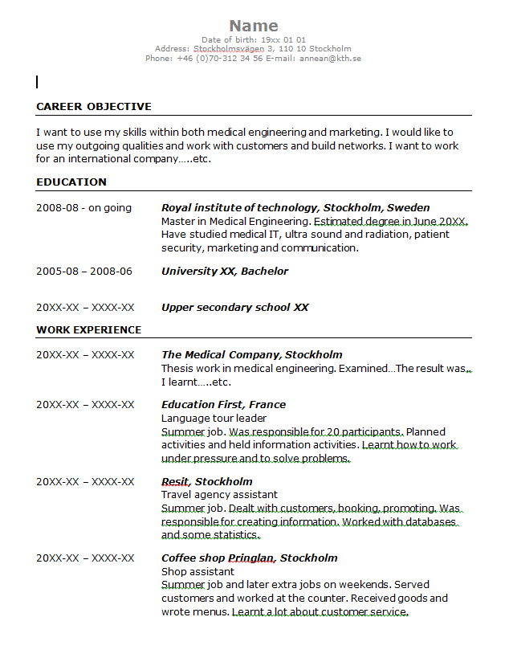
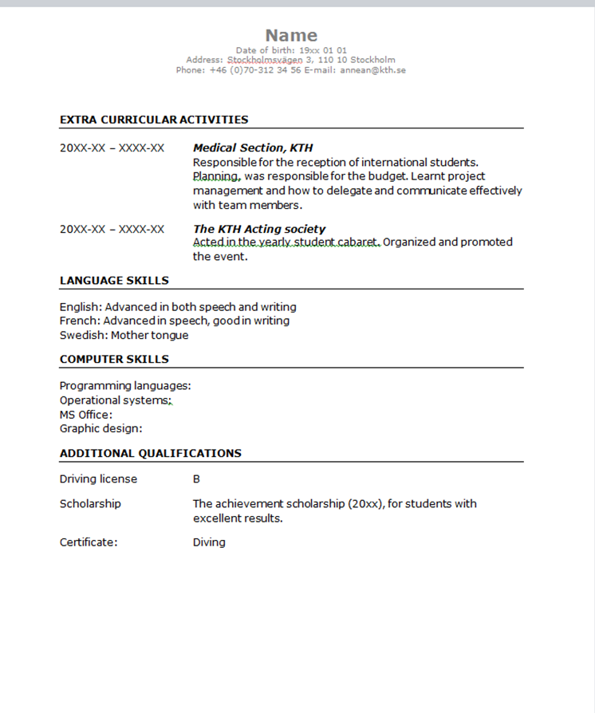
Page 1

Slide 10
Page 2

Slide 11
Sections…
Education
  Reversed chronological order, year and month.
  Translate into the standards of the new country
  Describe what you have learnt and what is specific about your education. What are your qualifications as an engineer?
Work Experience
  Employability skills
  Active verbs, ”I described, developed, managed…”

Slide 12
Employability skills
Communication skills
Teamwork skills
Self-management and Career skills
Problem solving skills
Initiative and Enterprise skills
Planning and Organizing skills
Learning skills
sydney.edu.au/careers

Slide 13
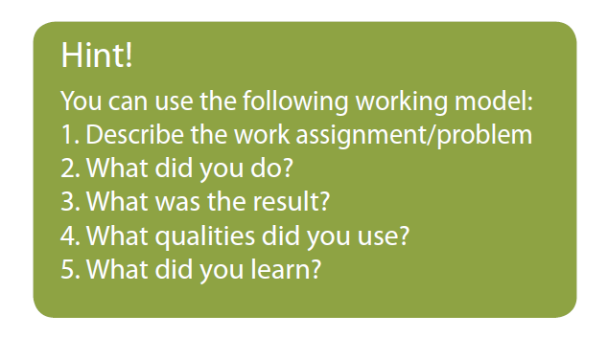
How do I describe an experience?

Slide 14
Design, Spelling and Grammar
Maximum two pages
Use a text size and font that is easy to read
A consequent format
Distinguish between headers and body text.
Avoid abbreviations
Proof read

Slide 15

Rules of Thumb
Tailor your CV to meet the requirements of the position
Use a reversed chronological order
Two pages maximum
No lengthy detail – keep it precise
Active/ action verbs, past tense
Write for the reader – Human Resources

Slide 16
Common mistakes
Unfocused
You present all your study projects and make them look like actual work experience
You don’t mention what you have achieved, what the role was and what you’ve learnt.
Difficult technical language (Write for the reader)
A flashy layout (unless you’re an artist)
You are lying or exaggerating
You are under evaluing things, (I helped a little, )
Spelling errors

Slide 17
Extra workshop: CV café
Thursday Nov 26
12.00-13.30 – flexible time
Location: KTH Entré, Drottning Kristinas väg 4
Bring a copy of your CV

Slide 18
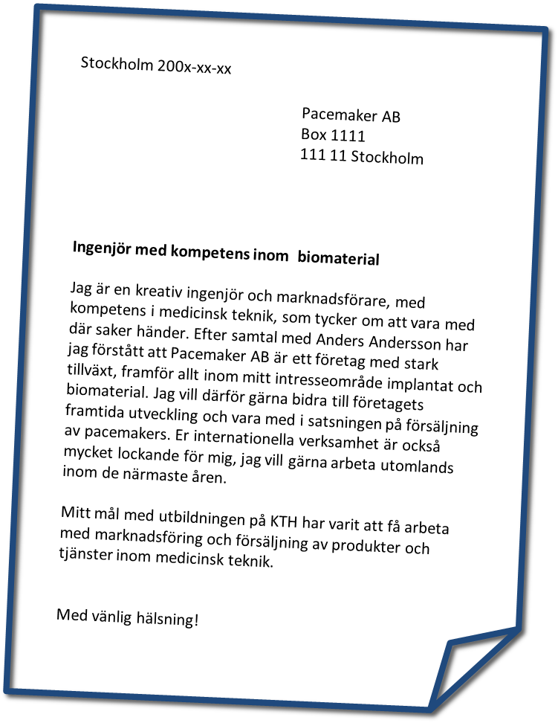
Purpose of a Cover Letter
promote yourself to an employer
Show your knowledge about the company
Tell that you match
- what is requested in the advertisement
- what the company needs now
Notes:
1. The purpose of a letter is to get you to the interview – so you need to promote yourself and make them interested in you.
2. You need to be specific about which skills, abilities and experiences that make you suitable for the job. You need to be very clear!
If you answer an ad.
No lenghty detail. What are they requesting now? Do not include information that is irrelevant or that you think the employer might benefit from in a few years. Think about the reader. At the same time Personality. Balance….
3. Personality is important - since you will be part of a team of different kinds of people.
They might even look for a certain personality type - so show them who you are.

Slide 19

Always write a new Cover Letter
Tailor your Cover Letter to meet the essential
requirements of the job
Always customize each Cover Letter for
each job that you apply for
Never mass mail the same version to different companies
Notes:
Focus on the job – respond to the requirements in the ad - do not write the story of your life.
Each cover letter need to respond to the requirements – but you also need to put your personality in to the letter and show them who you are.
Sending the same letter to several employers will probably not get you to the interview.

Slide 20
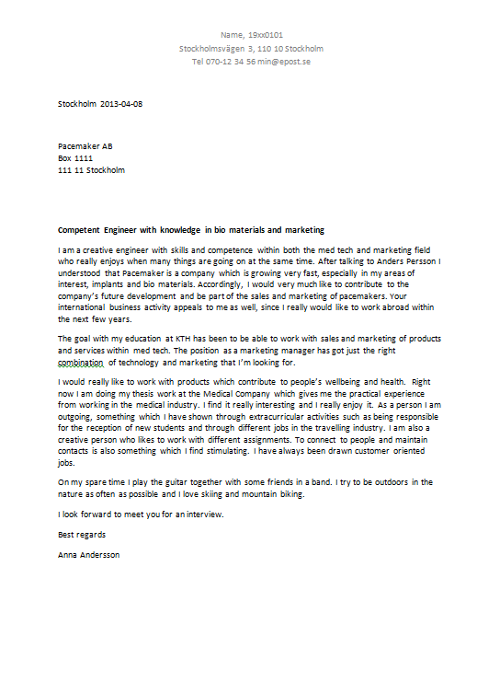

Slide 21
Investigating the job ad and myself
Pick out the three most important factors under each area, use key words.
 | Skills |  |  | Experience | Personality
 | General professional skills | General Engineering skills | Specific technical skills |  | Values | Personal Traits and Qualities
The Company/ The job ad | 1. 2. 3. | 1. 2. 3. | 1. 2. 3. | 1. 2. 3. | 1. 2. 3. | 1. 2. 3.
My self | 1. 2. 3. | 1. 2. 3.. | 1. 2. 3. | 1. 2. 3. | 1. 2. 3. | 1. 2. 3.
Notes:
Koppling till CV-skrivande och söka jobb – att visa arbetsgivaren att man är anställningsbar…
Sätta ord på vem man är, vad man har med sig, vad man vill åstadkomma

Slide 22
Answer three questions
Why the company - show you have done your “home work”
Why the position - show why you are particularly suitable
Why you - let them know your advantages
Notes:
Be clear about why you are interested in working for this company – not for just any company
Be clear about why you are interested in this position – and how you match the position
Be clear about all your advantages – skills, personality, experiences etc
Focus on what your contribution might be, not on what you want in terms of salary and future network

Slide 23
Rules of Thumb Cover letter
One page
Keep it precise
Contact information
Which position are you applying for
Proof read
Notes:
1. One page – the reader does not have a lot of time to read long letters.
2. So no lengthy detail – keep it precise.
3. Contact information – your own – send it to an individual at the company.
4. Start the letter by telling which position you are applying for – not by ”Dear Mr… or Mrs...” or ”To whom it may concern”
5. Ask some one to proof read your application – spelling and grammatical errors distroys a good impression

Slide 24
Next seminar
How to prepare for and handle the job interview
Tuesday Nov 24, at 12:15-13:00
Location: Syd östra galleriet, KTH Main Library

Slide 25
Exercises
Visit the career group in KTH Social:
.
https://www.kth.se/social/group/career-development-f/page/seminar-iii/
Exercise 1: Skills
Exercise 2: Work experience
Examples of CV and cover letter from students

