Slide 1
IH2655 Seminar
January 26, 2016
Electrical Characterization,B. Gunnar Malm
gunta@kth.se

Slide 2
Outline
Background (material from IH2652 in particular review by Deen)
Process flow & measurements (suggested reading)
In-line (on-wafer) measurements and test-structures (process-control monitors)
Measurement types examples of IV and CV and process stability

Slide 3
Process flow & measurements
Monitor starting wafer resistivity
Monitor ion-implantations in patterned regions (wells and contacts), requires monitor wafer plus physical methods
Monitor gate dielectric stack through IV, CV and reliability measurements
Monitor back-end through specific contact resistivity and sheet resistance (interconnects). Also electromigration issues
Monitor CD-control, particle contamination
Front-end to back-end

Slide 4
Process flow & measurements
Most of the Chapters in Plummer have a subsection called:
Mesurement Methods
  Electrical measurements
3.4.1.2 Sheet resistance on page 113
4.4.1 Particle control on pages 171-172
5.4.3 Etched features on pages 244-246
6.4.3 The MOS Capacitor on page 301
7.4.3-4 Sheet resistance & Capacitance-Voltage on page 398- (also 2D methods)
11.4.2 Contact resistance/transfer length/oxide breakdown/accel. testing p.726
Front-end to back-end

Slide 5
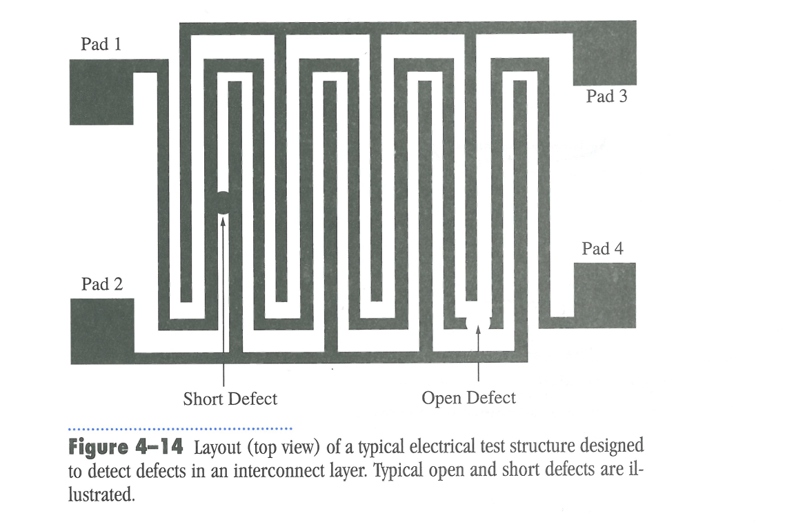
Examples from Plummer

Slide 6
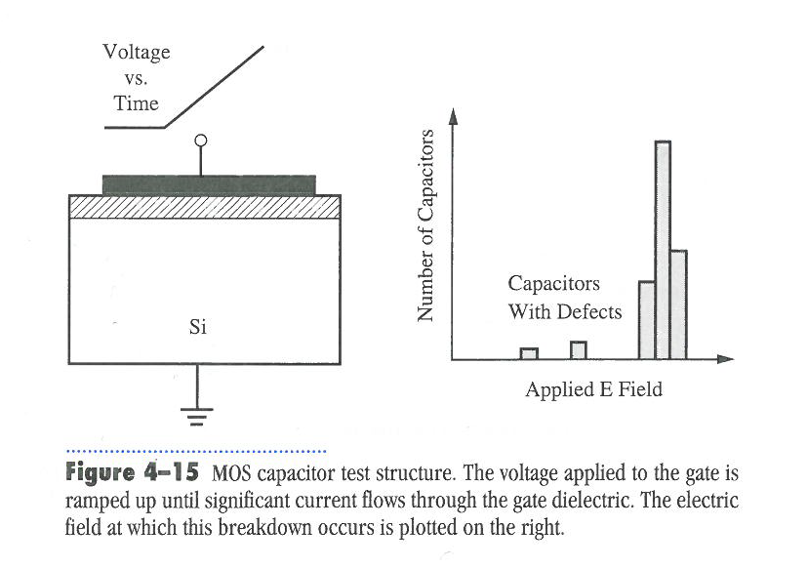
Examples from Plummer

Slide 7
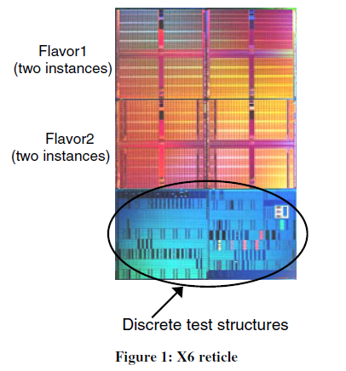
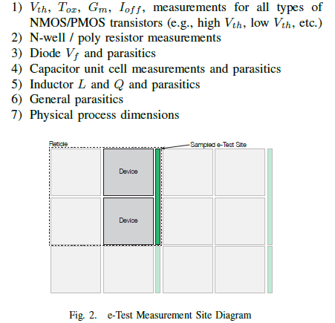
Test structures
All measurements are typically on a 200-300 mm inch wafer. Map statistics at selected locations
Process control monitors located at edge of die (pads in line/row)
Special test dies
of structures for in-line probe-card measurement (PCM)

Slide 8
Device under test (DUT)
MOS capacitances for dielectrics 4-terminal resistance structures
    Van der Pauw for sheet resistance of metals, silicides, implanted/activated dopants
    Cross Bridge Kelvin for contact resistance (metal-to-semiconductor)
Different MOSFET transistors (gate length and width)rays

Slide 9
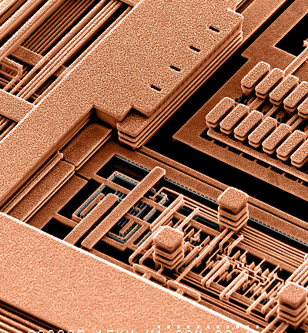
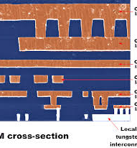
Interconnects needed for electrical probing!
http://www.eetimes.com/document.asp?doc_id=1324343

Slide 10
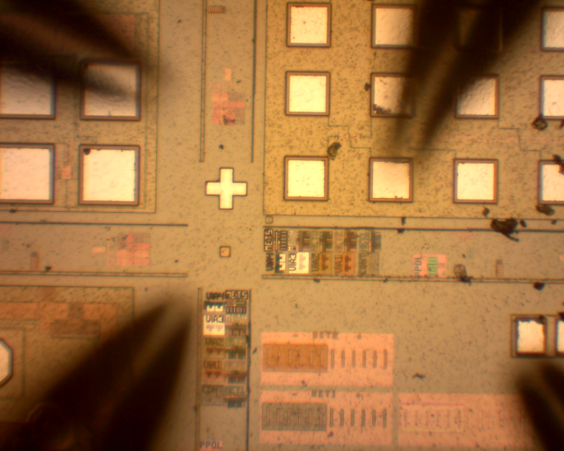
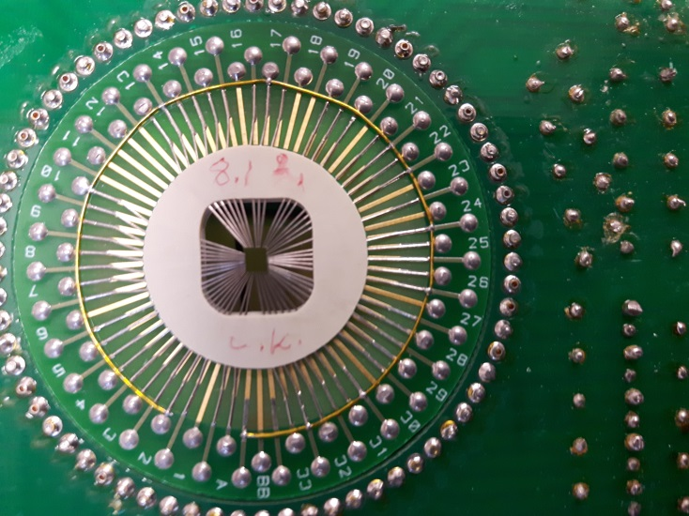
Measurement setup
Automatic wafer prober http://www.kth.se/ict/forskning/ickretsar/kiselbaserade-kompontenter
micromanipulators with needle probes
or probe cards

Slide 11
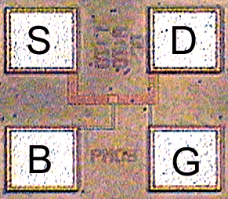
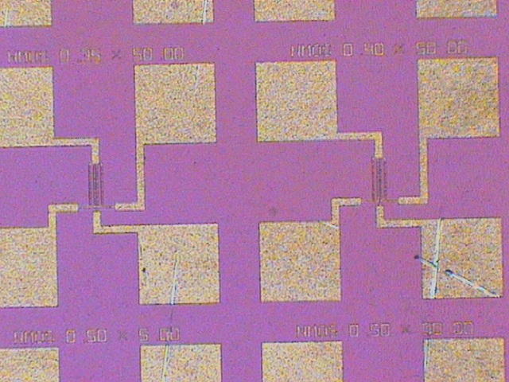
Test-structure PADS
B
D
S
G
4-15 metal layers for interconnects. Top layer thick and soft metal (Al or Au few microns)
First metal layer for in-line testing in cleanroom=fab
area 80x80 μm, pitch μm 100

Slide 12
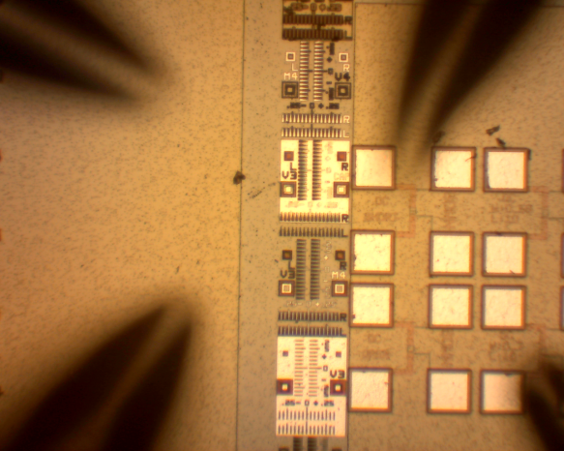
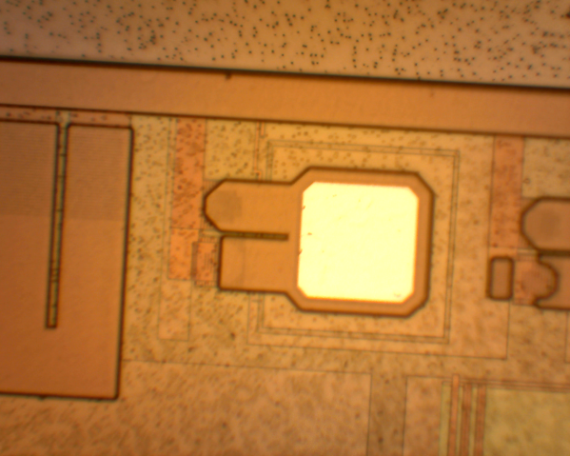
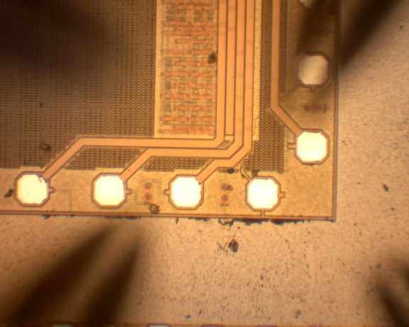
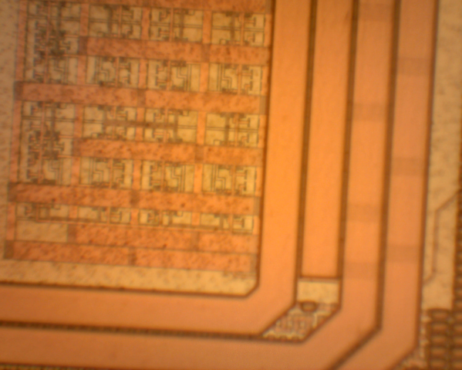
Array of DUTs vs bonding pads

Slide 13
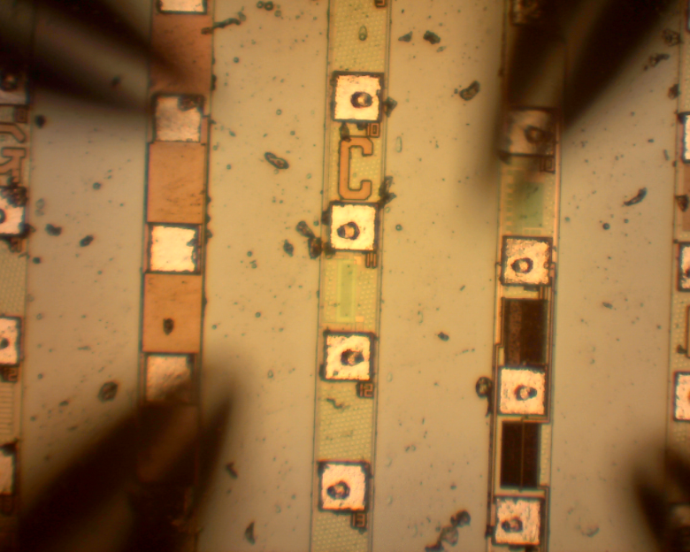
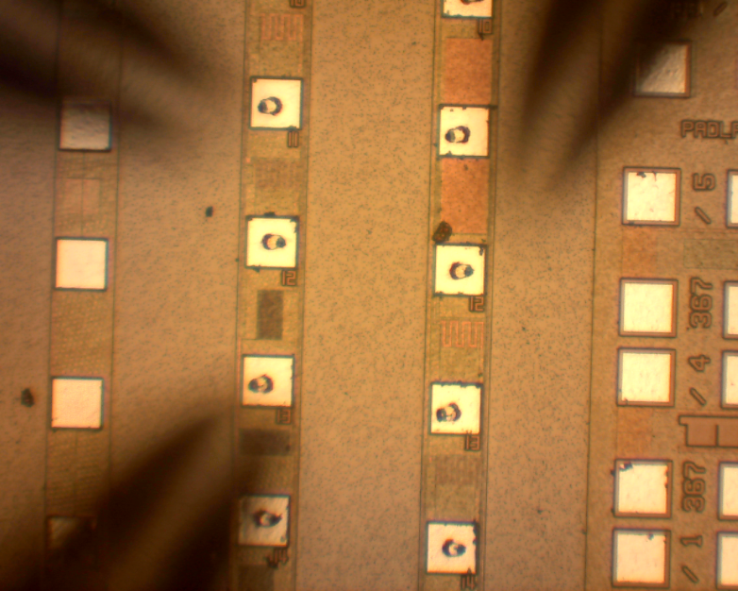
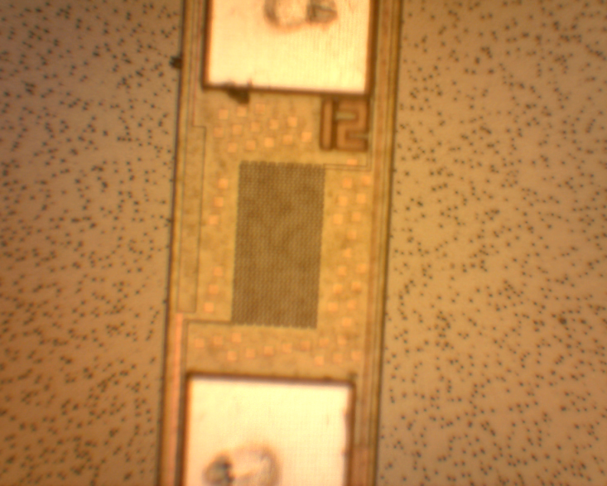
In-line process control monitors
Process control monitors located at edge of die (pads in line/row)
Common layout serpentine/folded lines

Slide 14
Characterization types
IV/DC with source/measure units (SMUs), possibly preamplifiers below 1pA
  High current (example small resistance of metal/silicide line or contact)
  Low current (gate and junction leakage, charge pumping)
  Pulsed to get information about defects and avoid self-heating
AC: Impedance and C-V mainly for MOS gate oxide but also channel mobility

Slide 15
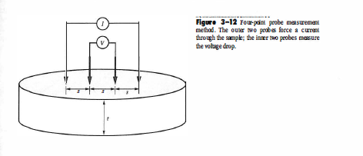
The 4-point principle (Kelvin)
Separate voltage and current

Slide 16
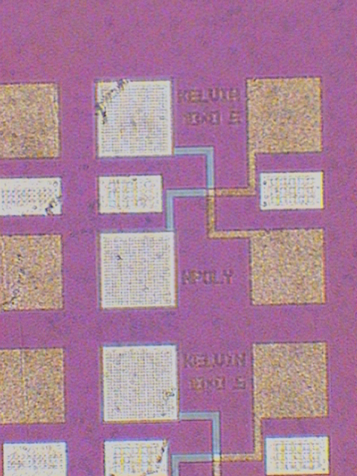
Test-structure layout for resistance
Cross-bridge Kelvin
Contact resistance, metal to highly doped silicon or
Metal to silicide

Slide 17
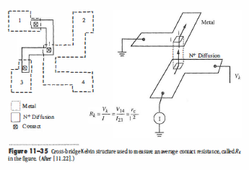
Test-structure layout for resistance
Cross-bridge Kelvin

Slide 18
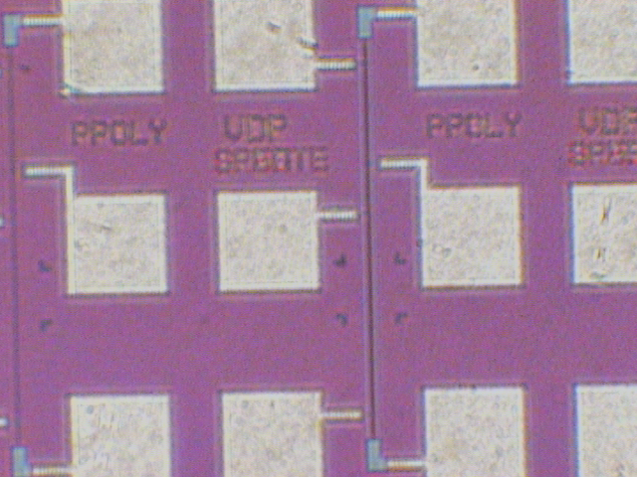
Test-structure layout for resistance
Van der Pauw: 2 current terminals + 2 voltage sense terminals, different length of resistor lines
Metal or metal
silicide lines,
approx 10 – 1000 Ω

Slide 19
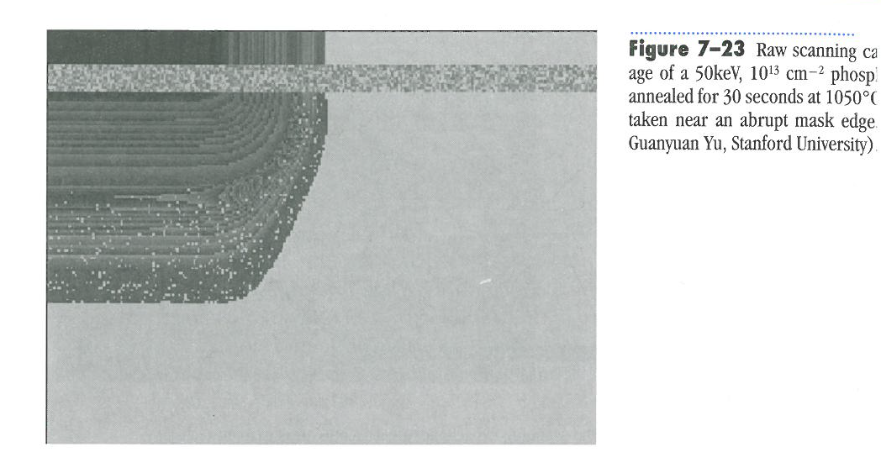
Examples from Plummer

Slide 20
MOS gate oxide process stability
IV - oxide integrity, leakage current, breakdown field, charge-to-breakdown (QDB, TDDB) , hot-carrier injection (HCI), stress (NBTI)
CV - thickness (TOX), trapped charge, interface states

Slide 21
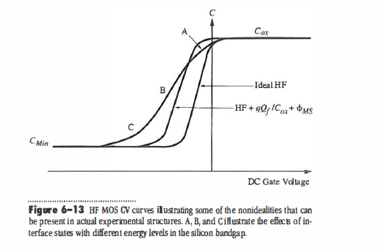
Interpretation of real life MOS CV data
The set of CV curves from a wafer contains information about the charge in traps and interface states. Shift with respect to ideal curve shows the type of effect present.

Slide 22
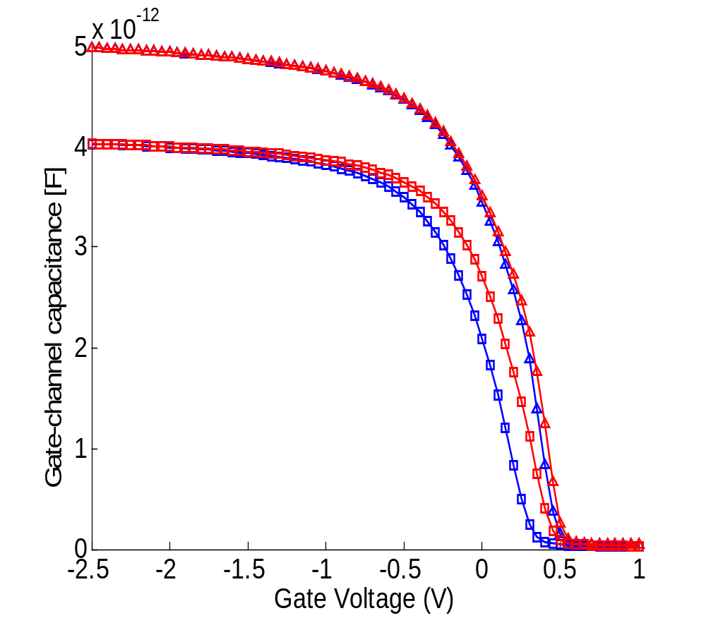
MOS CV-curves
The set of CV curves from a wafer contains information about the charge in traps and interface states and TOX
Shift with respect to ideal curve shows the type of effect present
Sweep direction
Shift in Vfb
Delta ’Vfb’ hysteresis

Slide 23
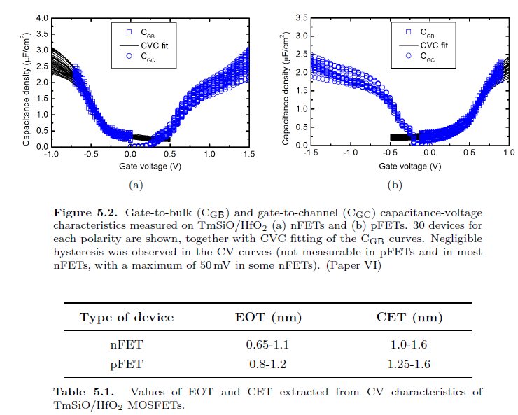
How to interpret CV-data

Slide 24
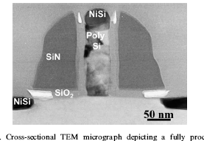
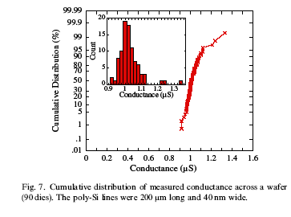
Monitoring of process stability
Gate length variation - critical dimension (CD) control
Monitor gate electrode in 4-point resistor configuration across wafer, plot in Weibull graph

Slide 25
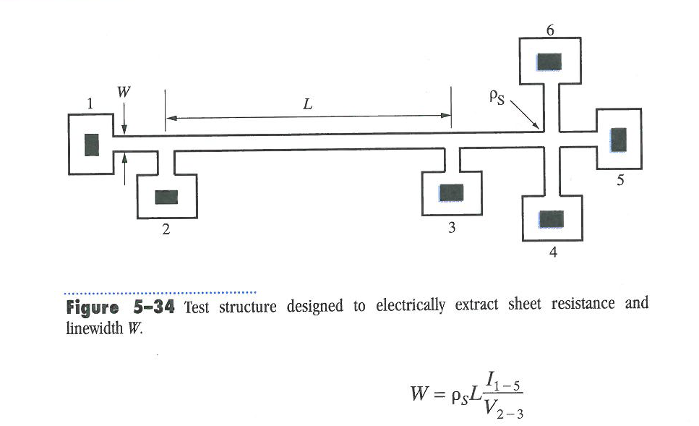
Examples from Plummer

Slide 26
Summary
We have followed the process flow and identified need for measurements for starting wafer, front-end and back-end
Placement of process control monitors and layout of pads introduced

Slide 27
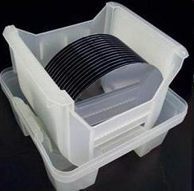
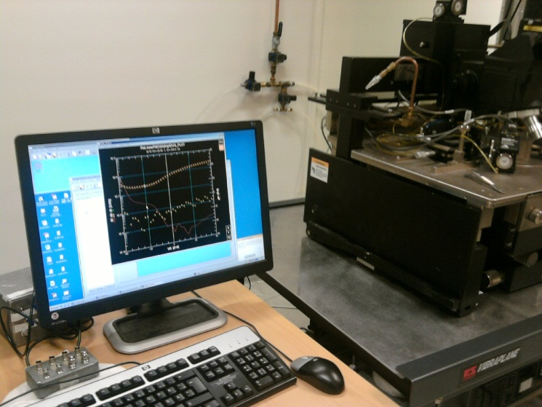
L4: Seminar - Concept Test 4.2
Electrical characterization is used to evaluate new materials: Which statements are true?
(One or more answers may be correct)
Capacitance-Voltage (CV) is the best technique to probe defects and thickness of thin oxides
Current-Voltage (IV) is the best technique to probe defects and thickness of thin oxides
Both IV and CV are needed to probe defects in thin oxides
Both IV and CV are needed to probe thickness of thin oxide
None of the above.

Slide 28
Seminar: Electrical Characterization - Concept Test 3.1
3.1 Electrical characterization is an important step in the wafer fabrication flow: Which statements are true?
(One or more answers may be correct)
Measurements are usually done on completed wafers
Measurements are usually done during the process flow
Measurements are usually done on special test structures
Measurements are usually done on transistors
None of the above.

