Slide 1
Information Integration using a Linked Data approach
OSLC Tool-chain architecture for data-intensive computations
Jawad Munir
KTH, Royal Institute of Technology
Scania AB

Slide 2
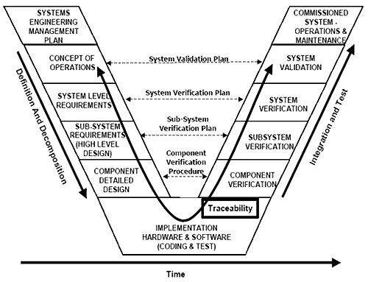


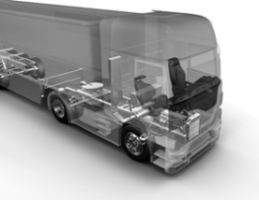
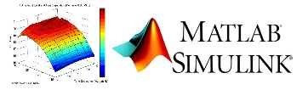
Models-based Systems Engineering Development
ISO/IEC 15288 SE Process V-Model
System Architecture
Requirements
Computer Aided Design (CAD)
(e.g. 3D models, 2D drawings)
And Many
More ...
Many Relationships & Overlaps between these Models
Management
Simulation Enviroment

Slide 3
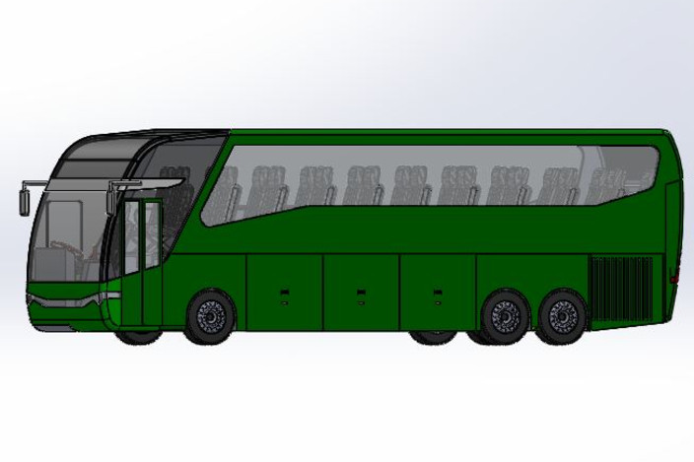
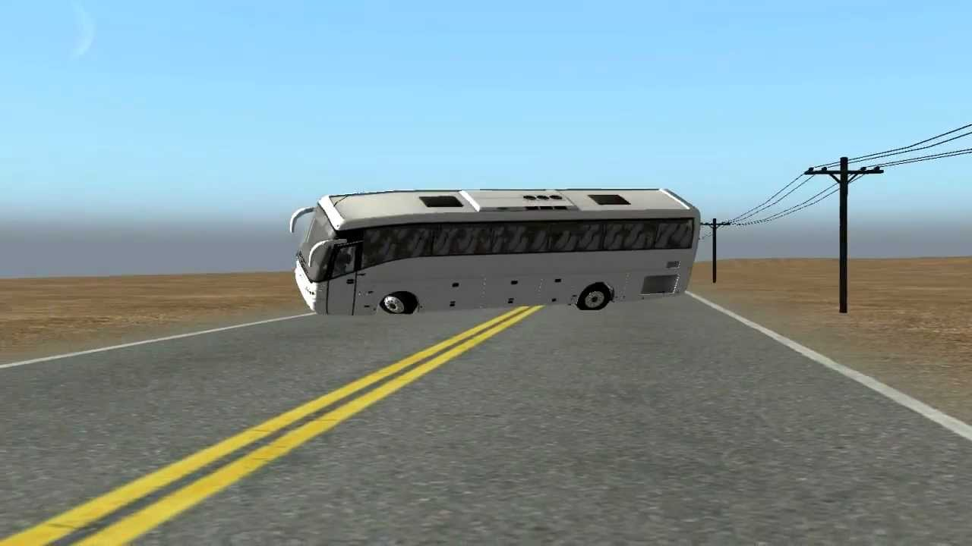
Problem: Rollover Risk of Buses
ECE R66.02 Valid from 2017, regulates the strength of the assembley in buses and the requirement of the roll-over test.

Slide 4
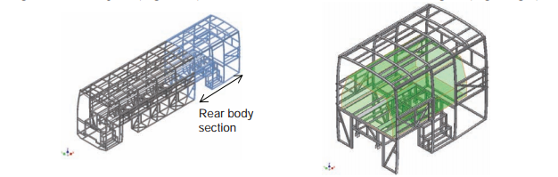
The strength of bus Superstructure
<<Requirement>>
Roof Crush Resistance
Bus superstructure section consist of four bays including rear entrance door, emergency door and rear end. Residual Space envelope requirement, in case of structural deformation in rollover test: residual space need to be 38.0 mm
System Egineer define the test
The bus superstructure (left) & CAD model of rear bus body section with 3D residual space envelop (right). The Models developed using CATIA software
<<verify>>
<<Test Case>>
Accuracy test for bus superstructure model, quasi static load test
Mechanical Engineer designs the bus geometrical model

Slide 5
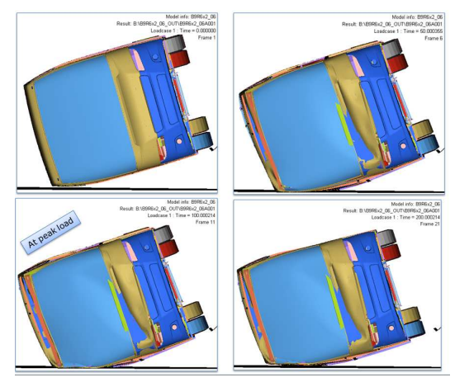
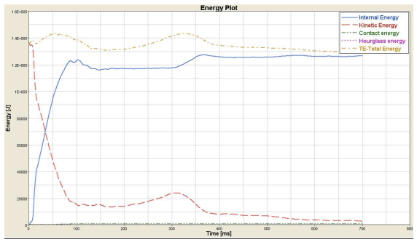
Dynamic complete computer rollover simulation test for bus body
<<requirement>>
Vehicle in motion rollover test
---------------------------
The superstructure of the vehicle shall be of sufficient Strong so that in the event of rollover it doesn’t intrude inside the Residual space, for it, dynamic simulation should verify it at speed of 40km/h
System engineer defines simulation testCase
<<verify>>
Mechanical Engineer performs simulation with dynamic system model
<<testCase>>
Vehicle in motion rollover simulation

Slide 6
Link between Residual Space parameter of Geometric Model and Simulation Model
Residual Space
Computer simulation: inertia
Residual Space in Geometric Model
Residual Space in simulation model

Slide 7
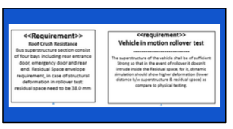

Relationships between Engineering Data
Requirements
Simulation Model
testCases
Geometric Model
Notes:
This is just a simple example of Relaionships that exists for this specific use case

Slide 8

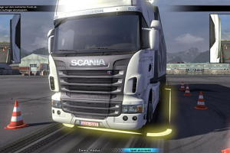
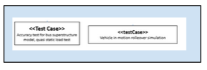
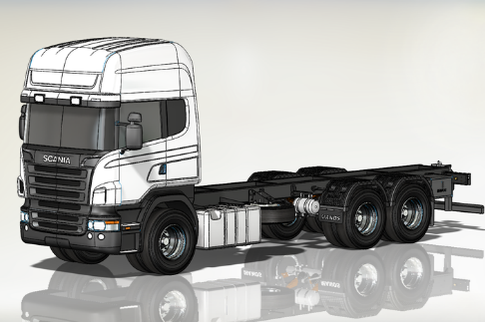

Reality in Complex System Design: (Too Many) Relationships between Engineering Data
Software
Requirements
Simulation Model
testCases
Geometric Model
System
Architecture

Slide 9
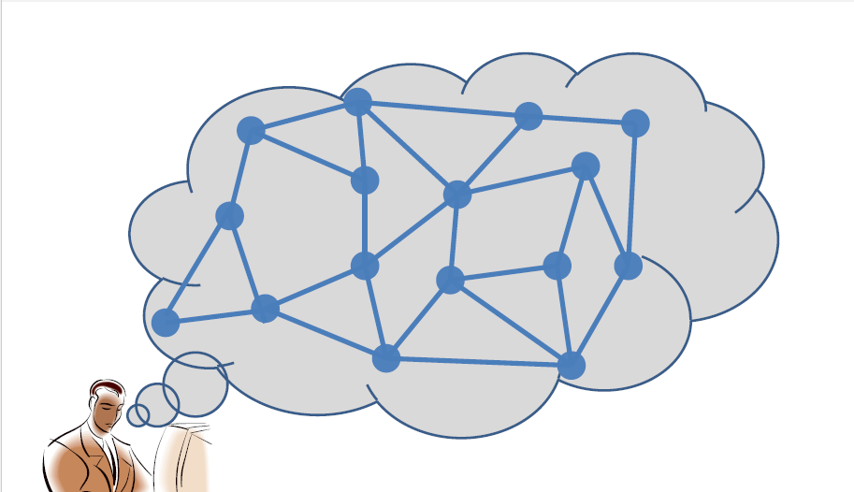
Network of Relationships

Slide 10
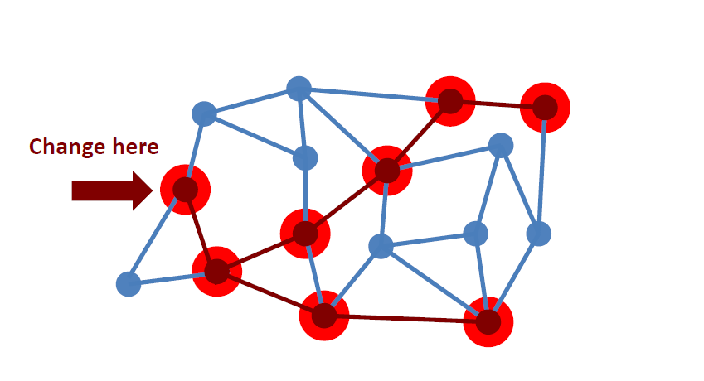
Impact Analysis
Notes:
So if we can capture these relationships we can perform impact analysis

Slide 11
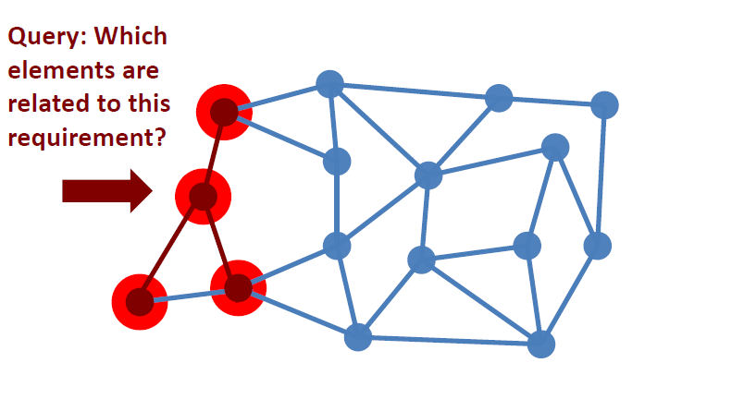
Queries
Notes:
We can perform smart queries. Such as What is connected to what else? Or what is the context of a specific engineering decesion?

Slide 12
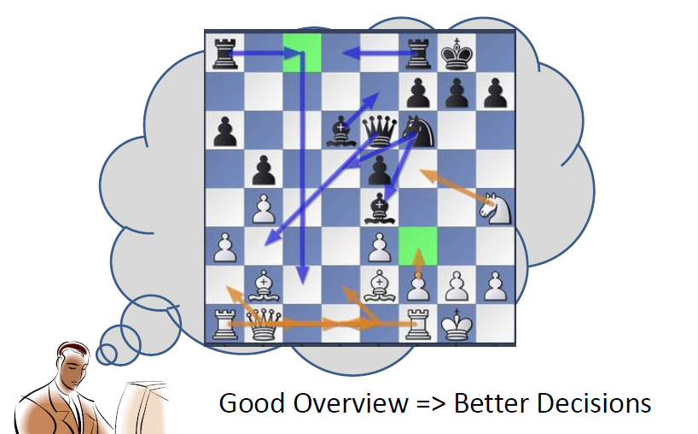
Overview of Development Process

Slide 13
Scania – A case study
40000 employee
Company in VM Group (Heavy Vehicles)
In-house development
Number of tools (in-house + commercial): 1000+
The product: a truck in many versions and configurations
Continous Development and integration

Slide 14
Tradional Tool and Data Integration
Point-to-Point connections
  Don’t scale
  limited coverage
Tight Coupling
  Dependence on internal structures and meanings
  Inability to identify crucial entities (components, locations etc.)
Monocultures
  Vendor lock-in
  Processes and methods needs to follow the tool
  Incomplete w.r.t domains
  What to do with in-house tools? – results in Data duplication
There is no (can not be a) single Enterprise Information Model
Notes:
- In tight coupling discuss about data warehousing, master data management etc.
In Monocultres – discuss about Monolithic off-the-shelf PLM/ALM system
Replication of data (if the tool contains own database) if we ALM/PLM is made of combination of Inhouse + off-the-shelf tools

Slide 15
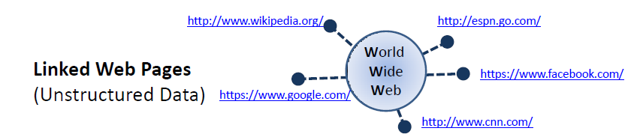
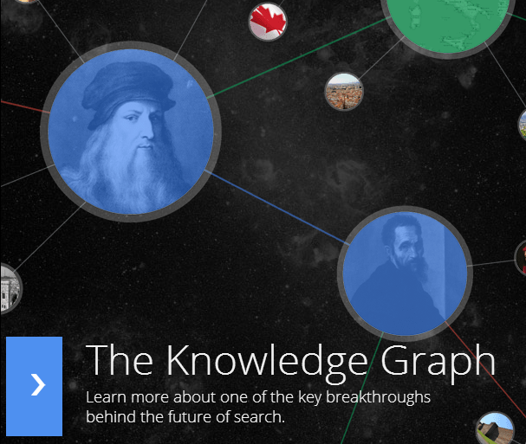
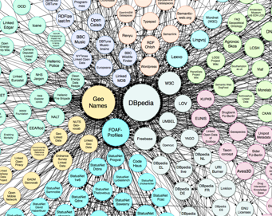

Relationships on the Web
Linked Data
(Structured Data)
Facebook
Open Graph

Slide 16
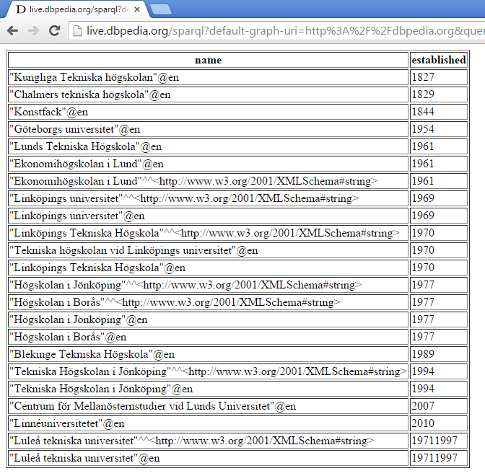
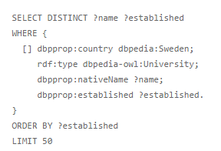
Example Linked Data: Dbpedia Query
Dbpedia Query: Give me name and date of establishment of universities in sweden?

Slide 17
Tim Berners-Lee, Linked Data principles
Tim berners-lee, Linked Data Principles
Use URIs to identify the “things” in your data
Use http:// URIs so people (and machines) can look them up on the web
When a URI is looked up, return a description of the thing (in RDF format)
Include links to related things

Slide 18
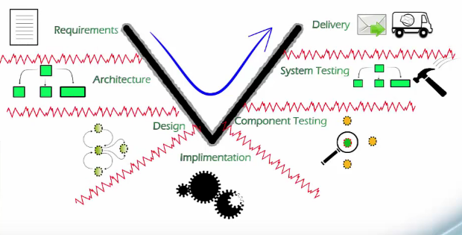
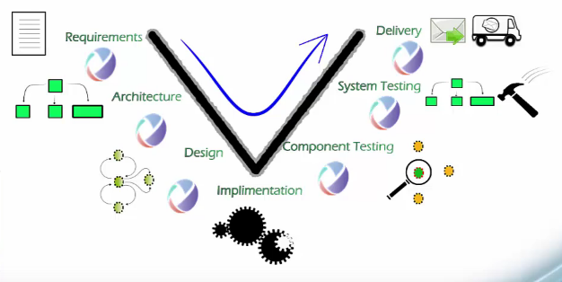
Open Services for Lifecycle Collaboration
ISO SE V-Model
OSLC = Reusing the Web for tool integration
Based on Web standards (Linked Data and
RESTful Web Services)
Initiated by IBM, It is OPEN-initiative
Adopted by many tool vendors like Ericsson,
IBM, Airbus etc ...
Many tools have OSLC support like Jira,
Jenkins, IBM rational tools etc ...
Managed by OASIS
OSLC Tool Integration
Notes:
So why I am talking about web and linked data? Well it has already been used to a certian degree to capture relationships between engineering data. These linked data principles has been adopted by IBM, to integrate there rational tools. They did it already few years ago, at the time when IBM has acquired many new new sotware tools and custimers were requesting better integration between these tools and IBM than thought linked data would be great approach, and they even realeased their approach under the name: OSLC. Linked data by itself is just set of principles but you need more defintions and specifications to capture relationshsips. So in OSLC standard, data is exchanged between tools following OSLC specifications.

Slide 19
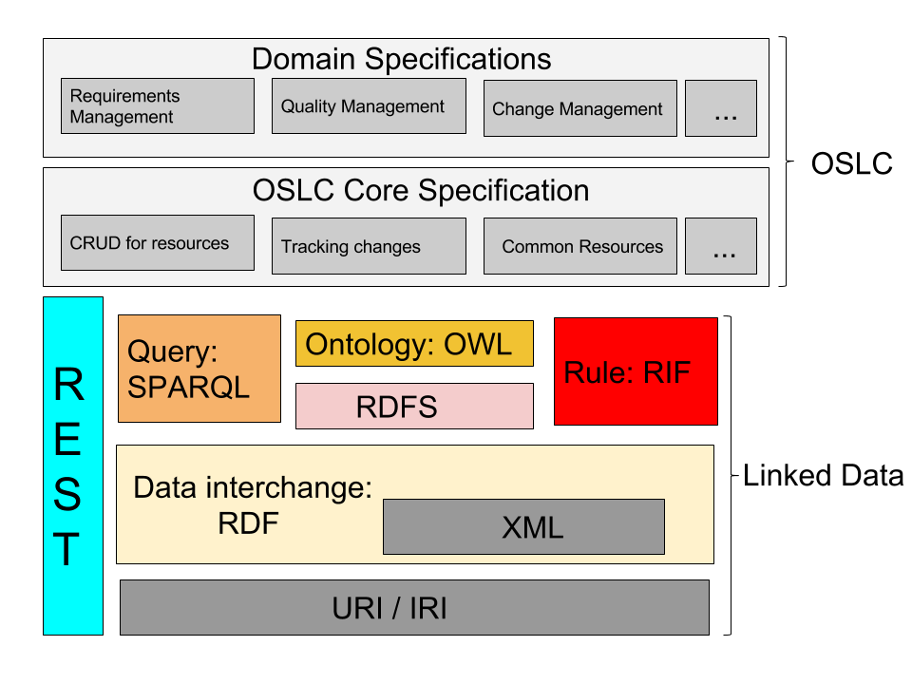
The OSLC Technology Stack

Slide 20
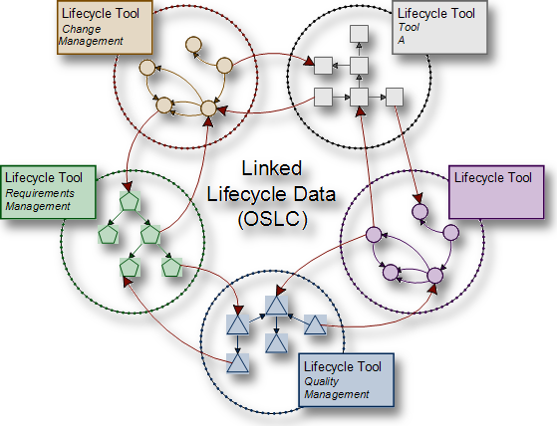
How OSLC works?
OSLC defines set of Specifications and best practises for using linked data approach for tool integration and interoperability.
Publishing OSLC resources
Retrieving OSLC resources
Linking OSLC resources across tools
Tracking changes to OSLC resources
Operations on OSLC Resources

Slide 21
Thesis Project
Assumption – Building an OSLC Tool-chain data integration architecture for performing complicated cross domain queries.
Goal
  Identify Integration Scenario for tool integration
  Develop a prototype to support that Integration Scenario (Proof of Concept)
  Test the prototype with cross domain queries
Notes:
Validate the use of such an approach for data integration at Scania.

Slide 22
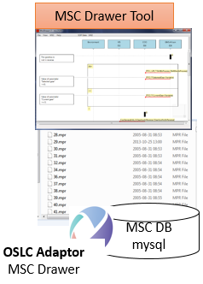
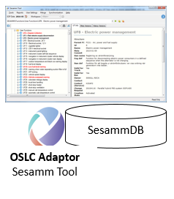
Integration Scenario – Scope + Tools involved
We want to link MSC Drawer with Sesamm Tool
Both tools have been developed by RESA

Slide 23
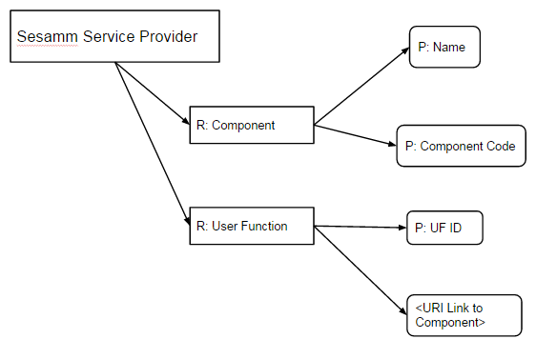
OSLC Adaptor for Sesamm Tool
Sesamm OSLC adaptor publish two resources to the web
  Components – ECU´s
  UF
Sesamm OSLC Provider adaptor Model

Slide 24
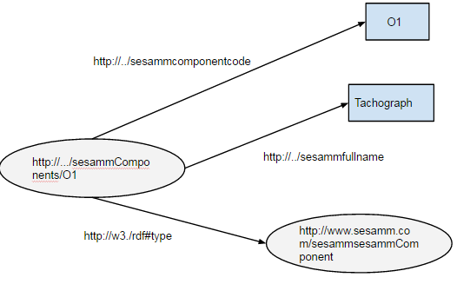
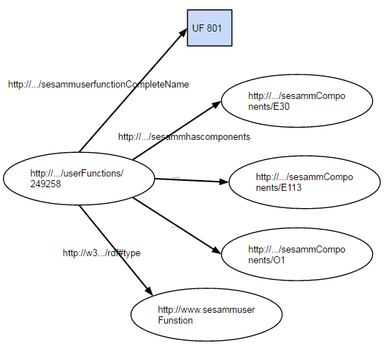
Sesamm Tool OSLC Adaptor
Example: Showing Sesamm Tool Adaptor Resources
R: Component
R: UF
OSLC LINK
Intra Tool

Slide 25
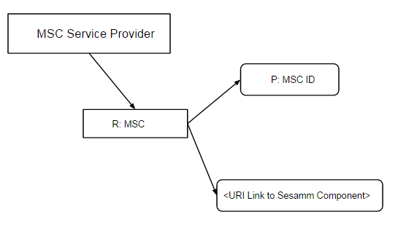
OSLC Adaptor for MSC Drawer
MSC OSLC adaptor publish one resource to web
  MSC – SCN of an UF
MSC Drawer OSLC Provider adaptor Model

Slide 26
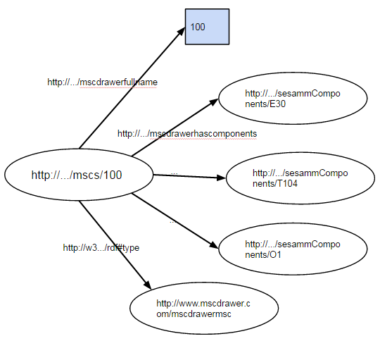
Linking Resources between MSC Drawer and Sesamm Tool – Detail
OSLC Adaptor for MSC- Drawer
Resource: MSC
OSLC Link Tool
OSLC Adaptor for Sesamm Tool
Resource: Component

Slide 27
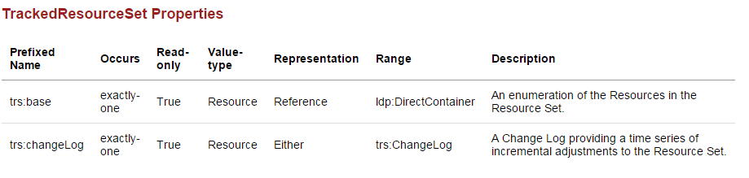
Tracking changes to OSLC Resources
Tracked Resource Set (TRS) Sepecification is used to track changes.
Part of OSLC core Specifcation.
The specification allows a OSLC server to expose an exact set of resources (TRS), track additions to and removals from the set, and track changes to the resources in the set.

Slide 28



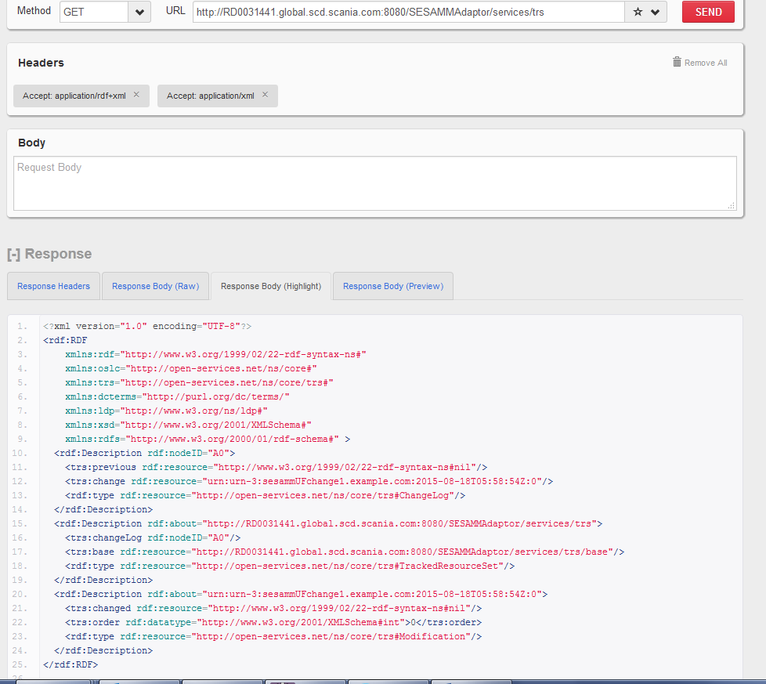
Retrieving Base and ChangeLog
IBM Rational Engineering Lifecycle Manager (RELM)
Only ChangeLog
Client
HTTP
Sesamm Tool TRS Adaptor
--------------
Support for tracked resource set protocol

Slide 29
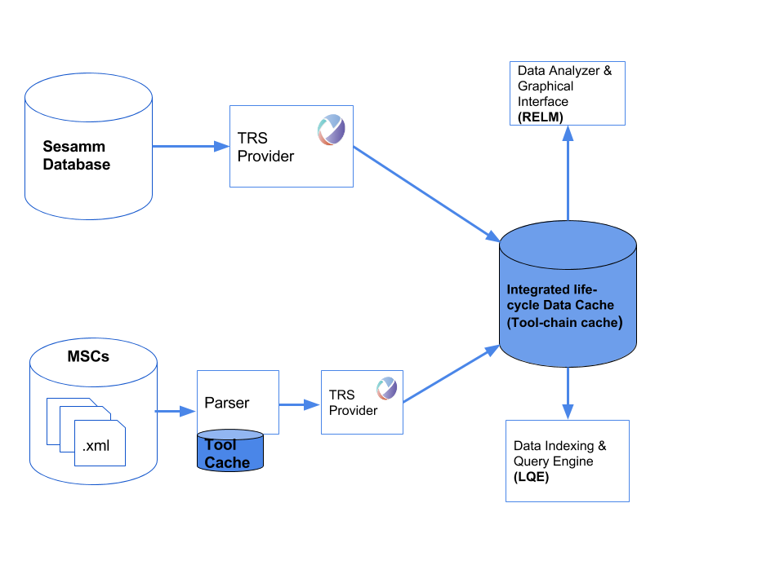
OSLC Tool-Chain Architecture for data integration

Slide 30
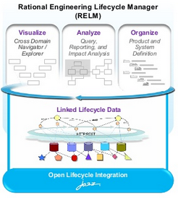
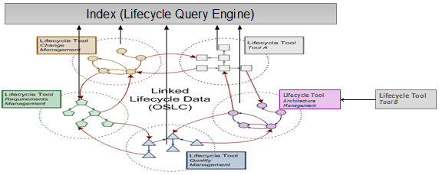
IBM Rational Engineering LifeCycle Manager (RELM)
RELM is analysis tool, which help engineering teams to visualize, analyze and organize engineering data and their relationships.
Analysis Tool
Client Application LQE indexes TRS
Tracked Resource Set

Slide 31
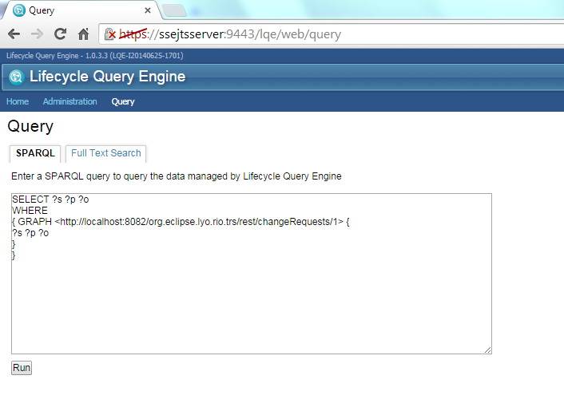
LifeCycle Query Engine
Indexes reources from TRS providers (TRS Client)
Indexed resources are represented as RDF
Exposes an ´Endpoint´ for running queries on that data
  Endpoint: A server that exposes its data via the SPARQL protocol
LifeCycle Query Engine
SPARQL Endpoint

Slide 32
Test Queries: Cross Domain
Query 1:
“for all the components in one UF, give me all the MSCs where the components exists?”
Query 2:
“for all components in one MSC, give me all the UFs where the components exists?”
Query3:
“for all components in UFs starting with UF1** give me all the MSCs where the components exists?”

Slide 33
DEMO – OSLC Tool-chain prototype

Slide 34
Results
Sr No. | Queries | Time of Execution (In seconds)
1 | “for all the components in one UF, give me all the MSCs where the components exists?” | <1
2 | “for all components in one MSC give me all the UFs where the components exists?” | <1
3 | “for all components in UFs starting with UF1** give me all the MSCs where the components exists?” | <10
Table: Query Processing Time for each cross domain query

Slide 35
Results
Sr No. | Data Source | Indexing time (hh:mm:ss)
1 | TRS Provider for Sesamm Tool | 2:30
2 | TRS Provider for MSC Drawer | 1:10
Table: Data indexing time for each tool

Slide 36
Conclusions
Data Consistency and Tracebility across the tool-chain.
Capability of computation intensive, cross domain queries.
Caching at individual Tool level and at Tool-Chain level.
A federated approach to SPARQL query processing: Federated over multiple single repositories.
LQE is dead-end of the Tool-Chain
FO, SA or ST were not interested in RELM as an analysis tool.

Slide 37
Conclusions
Key advantages
  Open Technologies (Using Open Web Standards XML, RDF, SPARQL etc...)
  Dramatically reduce data integration costs, increase enterprise flexibility.
  Scalability
Cons
  No open implementation for TRS Client exists.
  Patent for TRS Client specification.
  Installation of IBM RELM can be frustrating
  No Interface for machines (APIs etc.)
  SPARQL is still an expensive skill

Slide 38
Future Work
HTTP PUSH capability in TRS Protocol
  Tool data don’t change so often
  Safety critical systems – instant update necesary
Implentation of TRS Client
  Interface for humans
  Interface for machines (APIs etc.)
  Analysis tool (Graphical tool) – Customizable for Specific needs.
Further Development of prototype: further develop existing Adaptors + Including other tools

Slide 39




Q & A
ends with
says
Master Thesis
presentation
Thankyou for your Attention!
gets
did
want

Slide 40
Appendix

Slide 41
Alternatives
SDshare – A Specification used for publishing and consuming resource descriptions
A protocol for tracking changes in semantic data store
Based of Linked Data principles
Defines how an RDF system can maintain a synchronized local copy of master data contained in another RDF system
Not an active community behind the standard
Mature Product:
  Hafslund Sesam

Slide 42
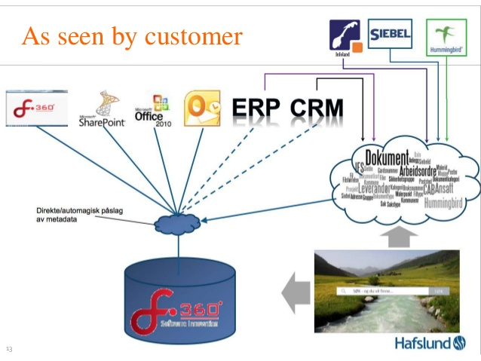
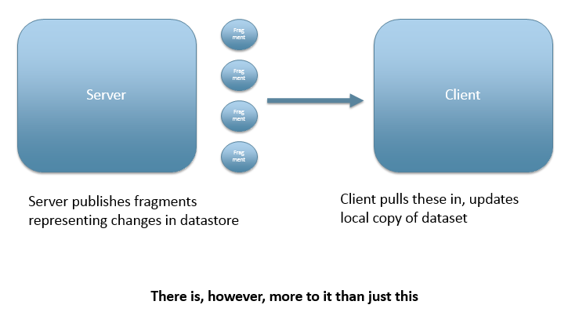
Sesam Approach – SDshare implementation
SESAM is an architectural approach and set of components for integrating, querying, reusing and repurposing enterprise data. SESAM enables the data from many sources to be seamlessly merged together in a schema-less, and scalable data store, that we call the DataHub.

Slide 43
Sdshare – More Details
SDshare spec
  http://www.egovpt.org/fg/CWA_Part_1b
SDshare issue tracker
  http://projects.topicmapslab.de/projects/sdshare
SDshare use cases
  http://www.garshol.priv.no/blog/215.html

Slide 44
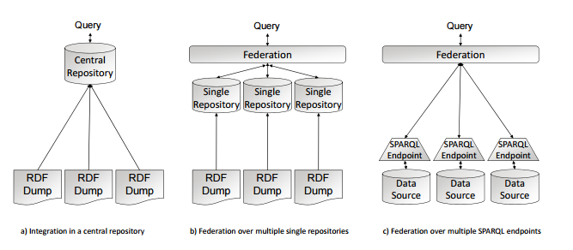
Approaches to Federation

