Slide 1
Wireless Based Positioning
Project in Wireless Communication

Slide 2
Wireless Based Positioning
Adrien Anxionnat
Baptiste Cavarec
Irlon Santos
Navneet Agrawal
Raees Kizhakkumkara Muhamad
Yuqi Zhang

Slide 3
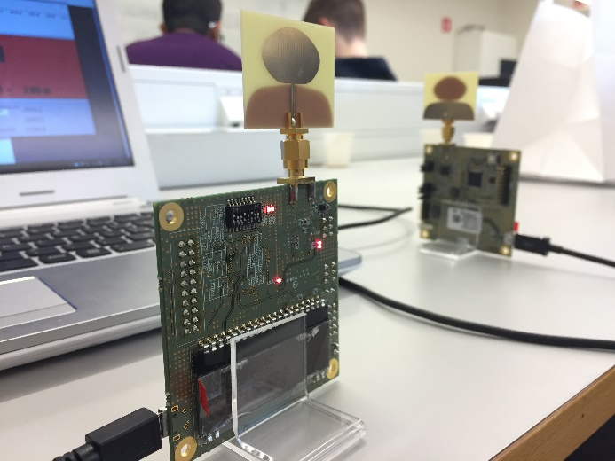
Positioning Systems
Growing interest in positioning systems
Ultra Wide Band
DecaWave EVB1000

Slide 4
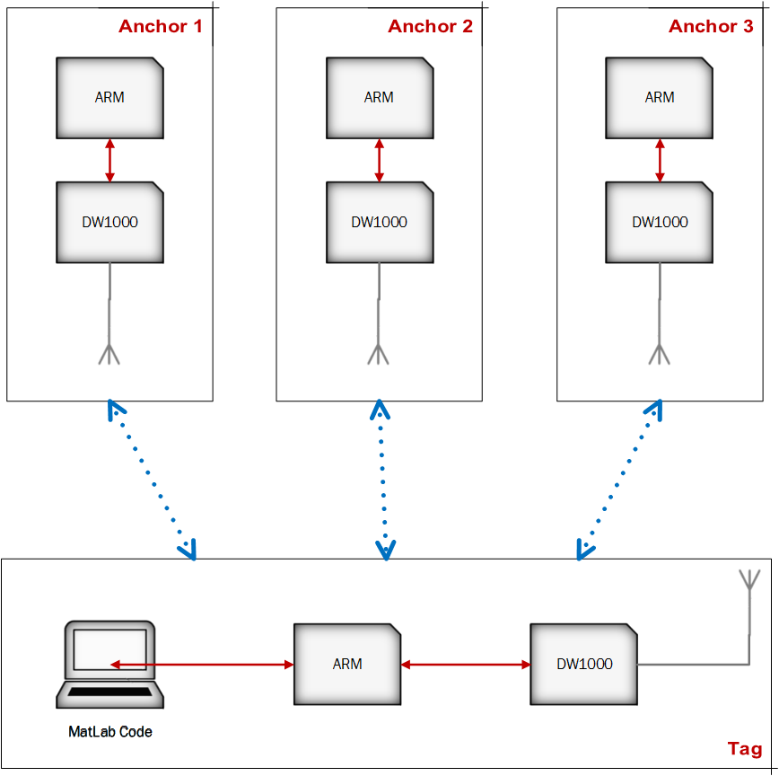
Setup

Slide 5
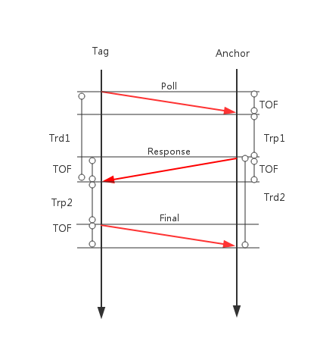
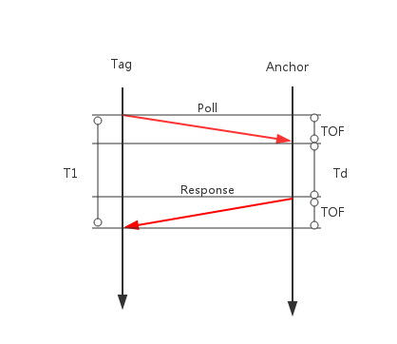
Ranging
Time of Flight
Two-way Ranging
Symmetric Two-way Ranging
Protocol

Slide 6
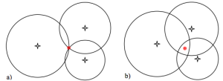
Positioning
Trilateration
Static vs Dynamic Positioning
We assume the error in the measurement as Additive White Gaussian Noise

Slide 7
Static Positioning
The algorithm is derived from a quadratic cost function basis defined over the measurements and using a non-linear least squares estimation to estimate the position
We have to use all measurements till the time to estimate our position.
We avoid using a batch method for computational reasons
Implemented algorithm is recursive and involves a two step approach

Slide 8
Static Positioning –Two Stage Approach
The two stage approach works by splitting the cost function minimization problem into two steps
The first step is a linear step wherein we estimate a non-linear combination of the parameter such that the measurement is linear with respect to the combination
The linear first step is solved recursively and optimally using a Kalman filter
The first step estimate is fed into an iterative Gauss Newton algorithm to perform a non-linear least squares fit

Slide 9
Dynamic Positioning
We implemented dynamic positioning using an Extended Kalman Filter
In Extended Kalman Filter we have a state-space model and a measurement model
We model the state(position and velocity) of the tag and includes its position and velocities in the three co-ordinates axes in the state space model
We model the distance equations of the tag from the anchors in the measurement model

Slide 10
Dynamic Positioning – Extended Kalman Filter
The extended Kalman filter can accept both non-linear state transformations and measurement models unlike the linear Kalman filter
It works by linearizing the model about a working point.
Extended Kalman filter is the ‘defacto’ standard in navigation and GPS systems.

Slide 11
Results
Parameter estimation
Results before correction
Results after correction

Slide 12
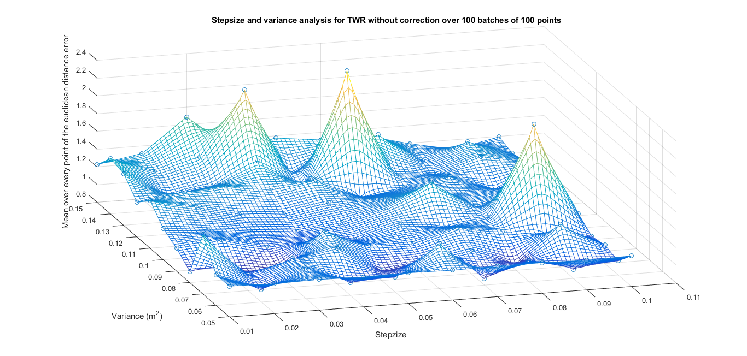
Results- Parameter estimation

Slide 13
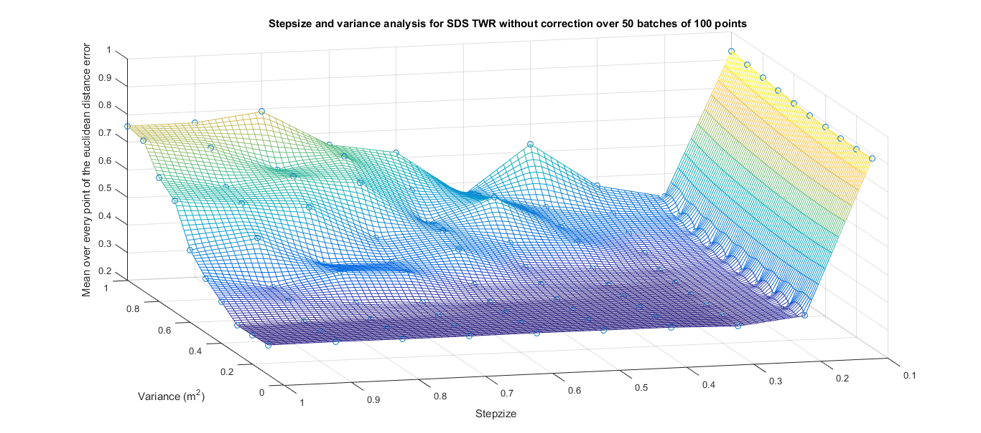
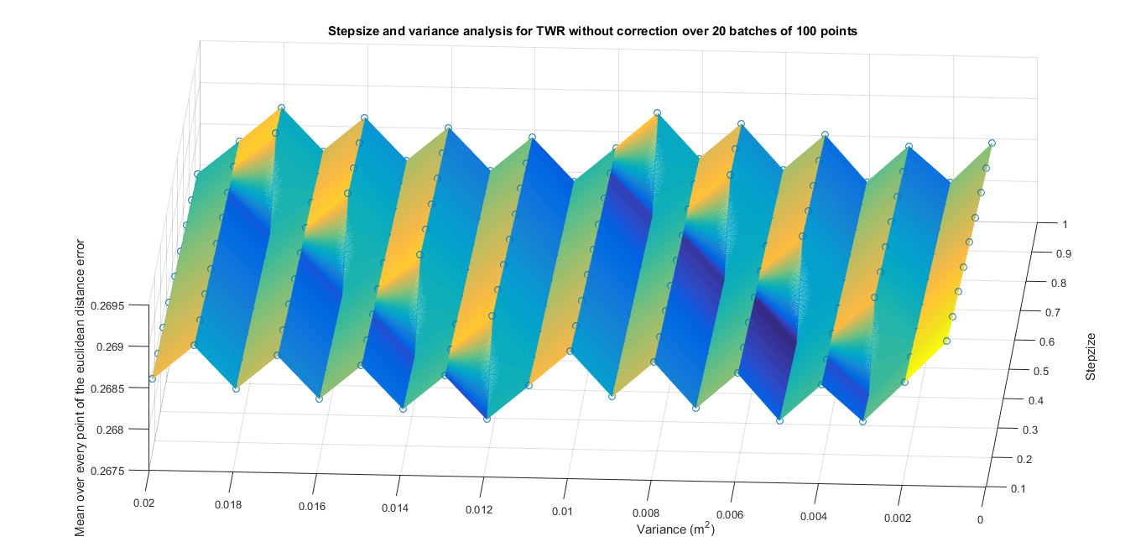
Results- Parameter estimation

Slide 14
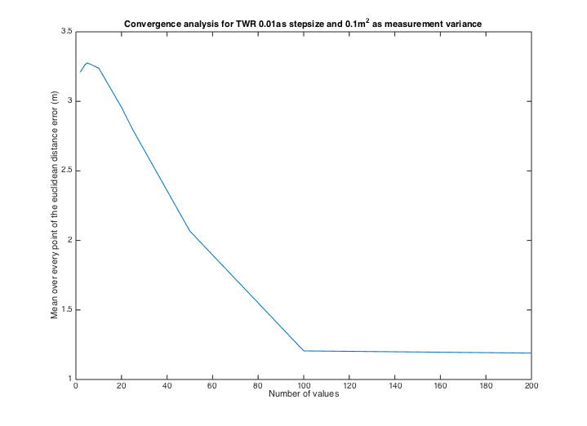
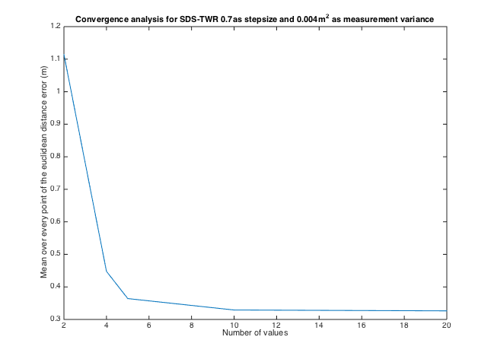
Results- Parameter estimation

Slide 15
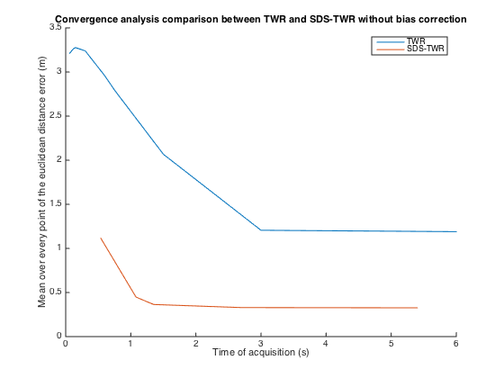
Results- Parameter estimation

Slide 16
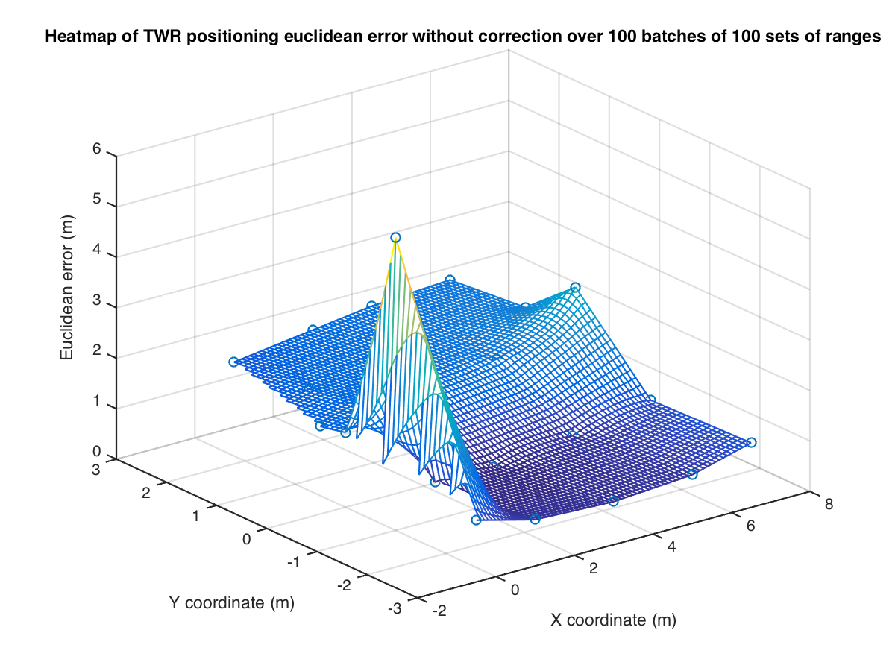
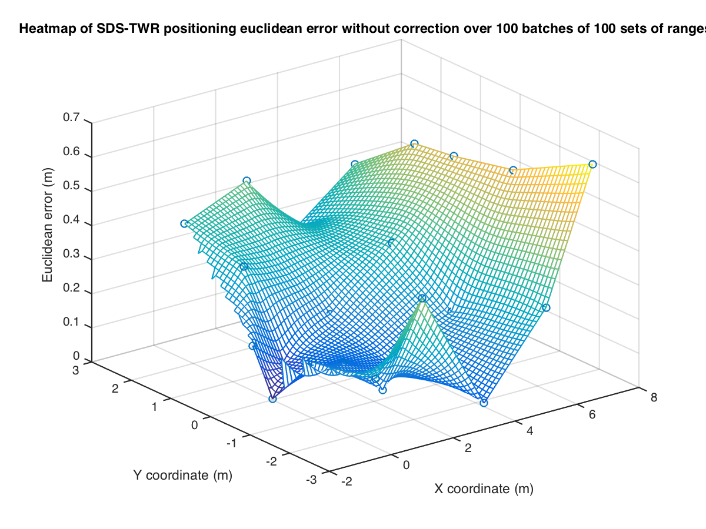
Results-Results before correction

Slide 17
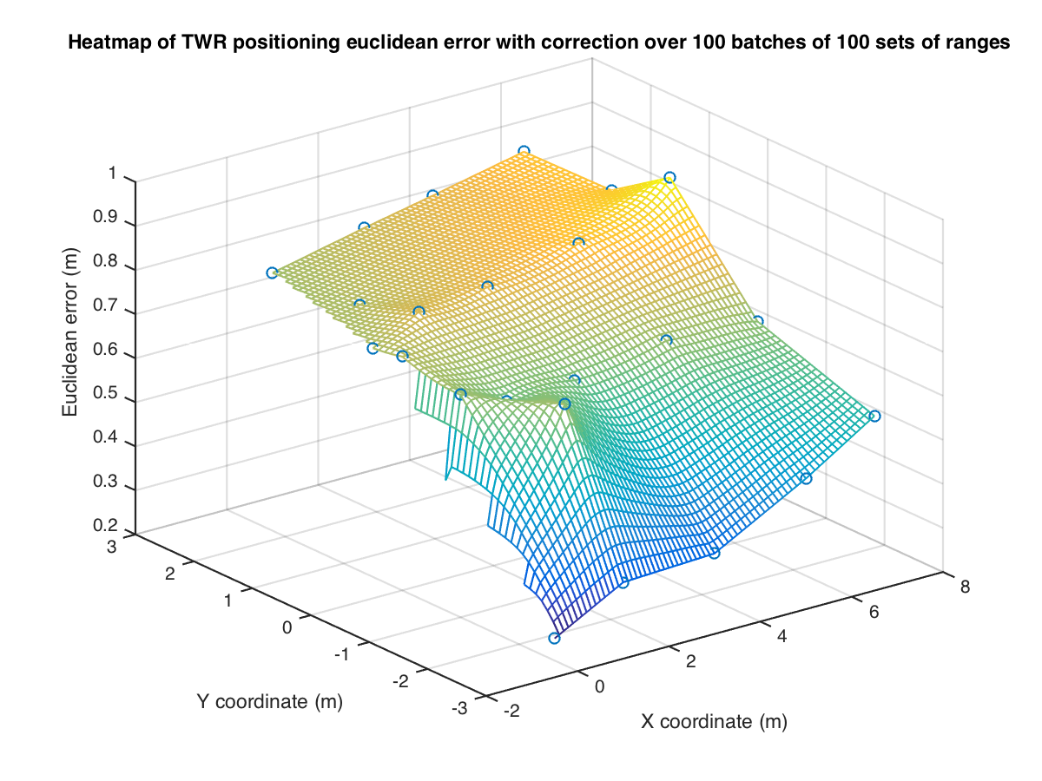
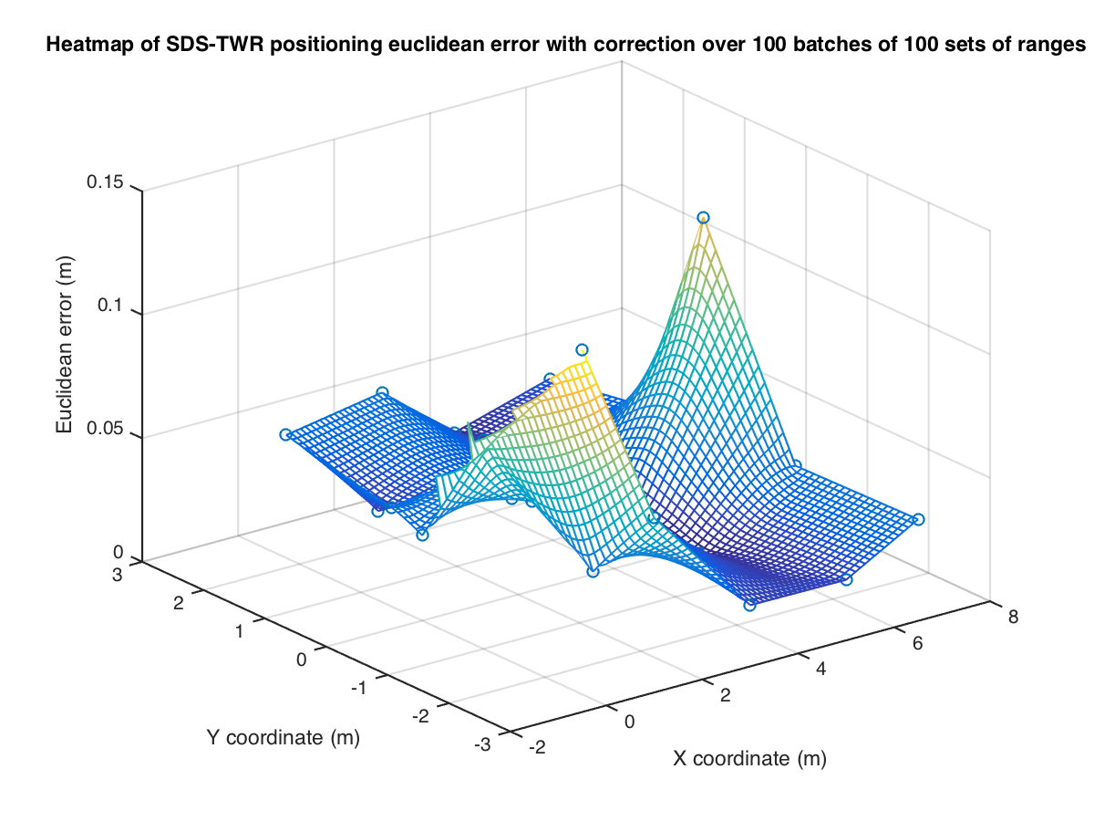
Results-Results after correction

Slide 18
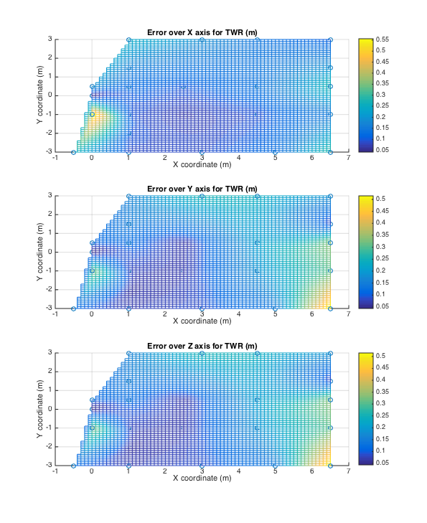

Slide 19
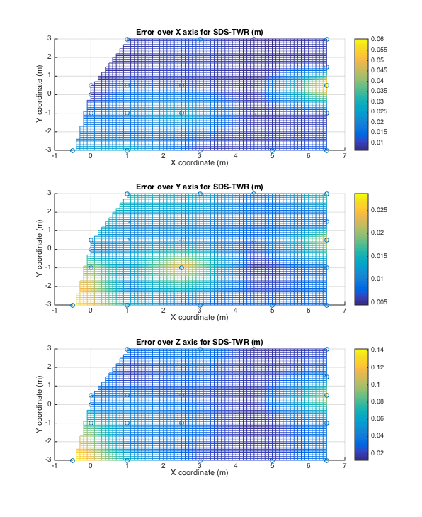

Slide 20
Sources of Error
Clock unsynchronization
Environment

Slide 21
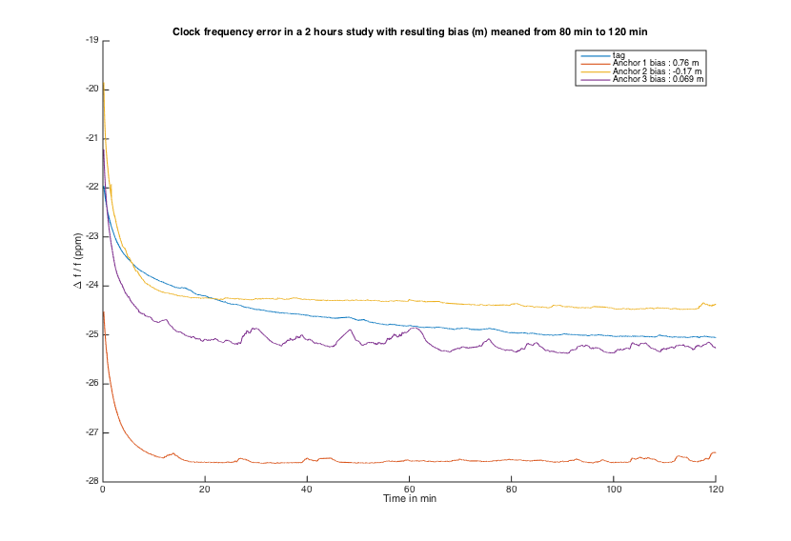
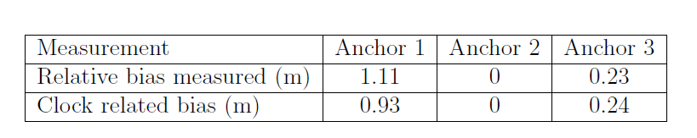
Sources of Error- Clock

Slide 22
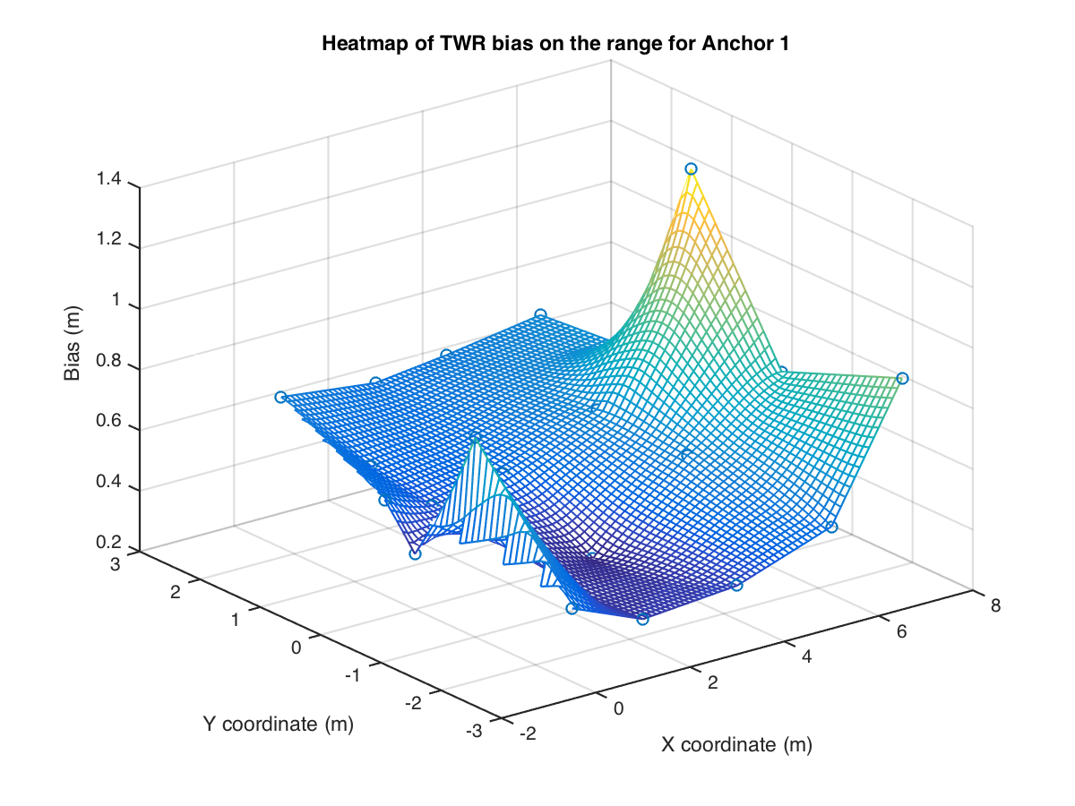
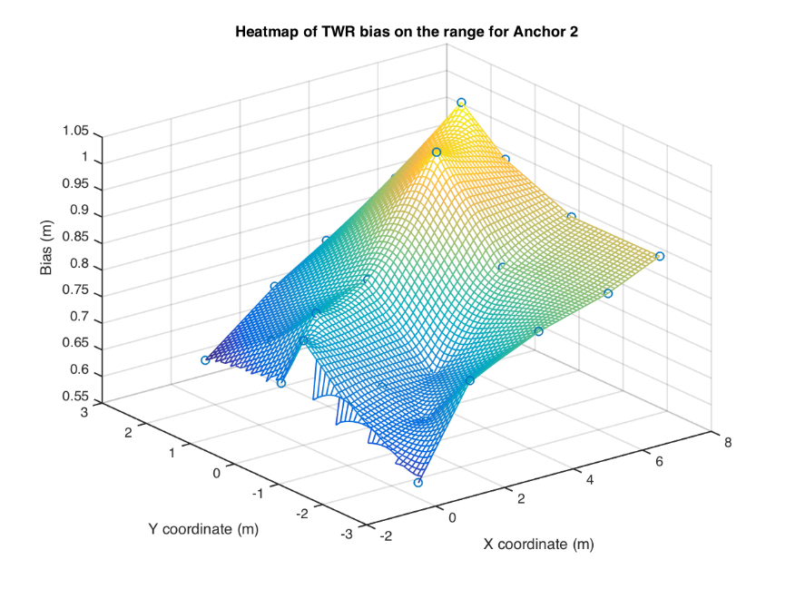
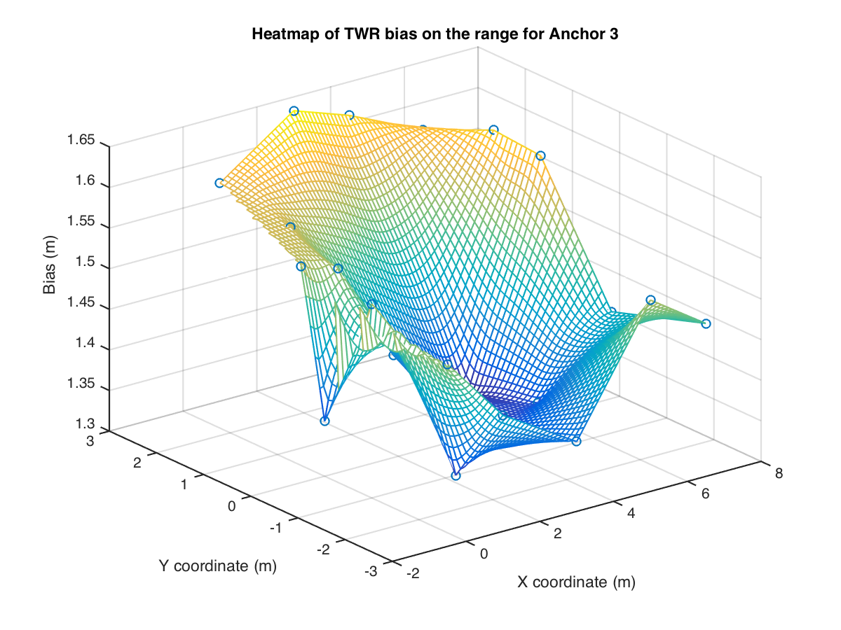
Sources of Error- Environment

Slide 23
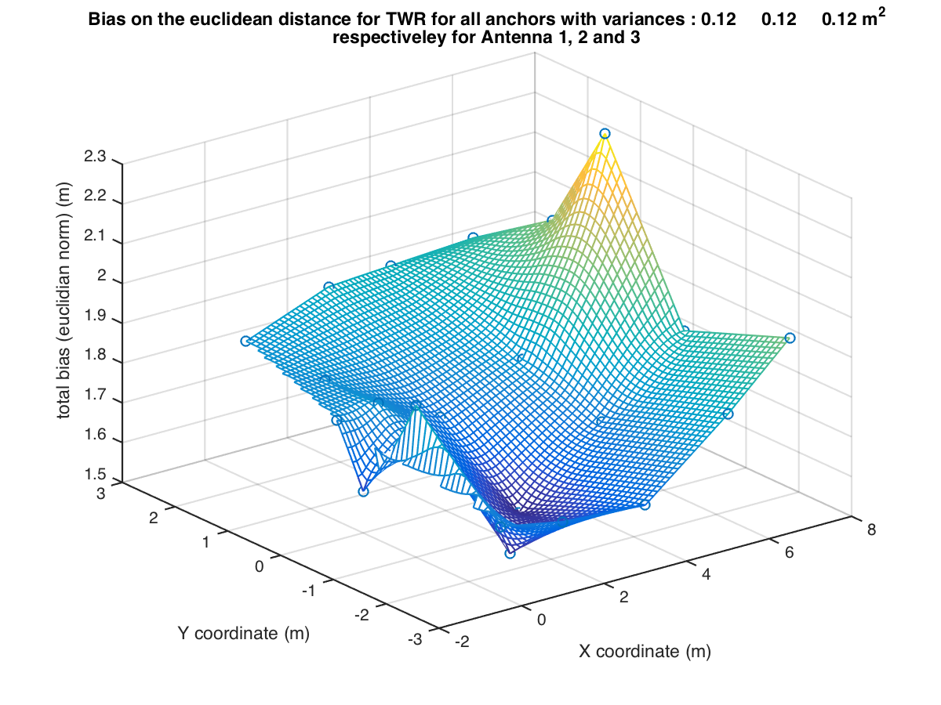
Sources of Error- Environment

Slide 24
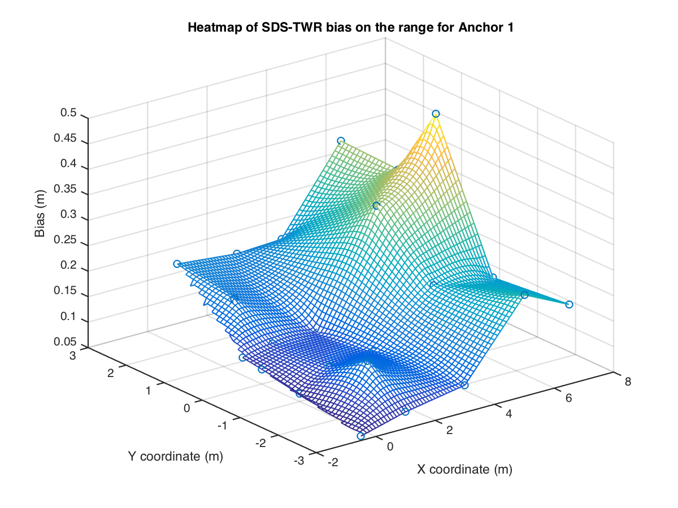
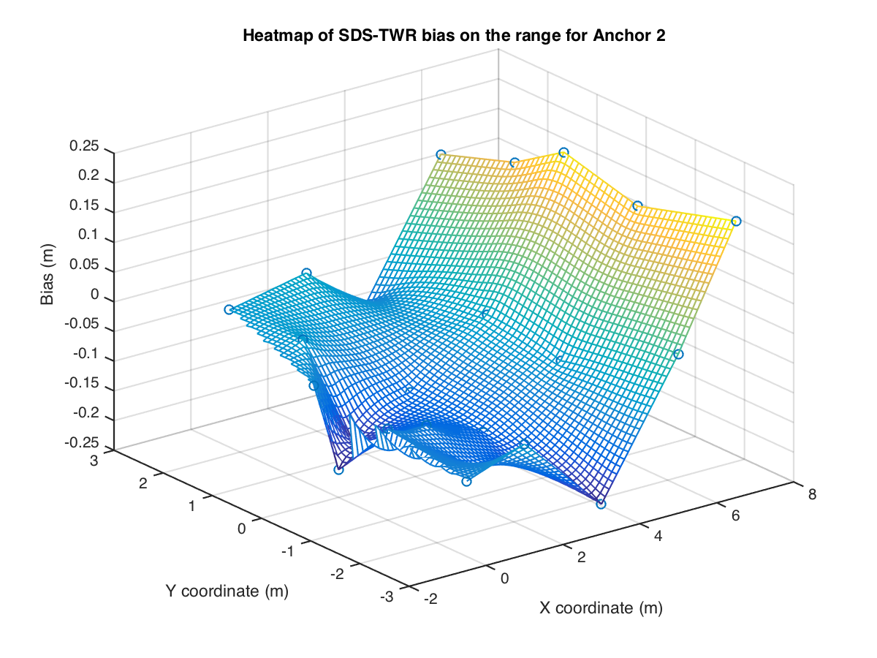
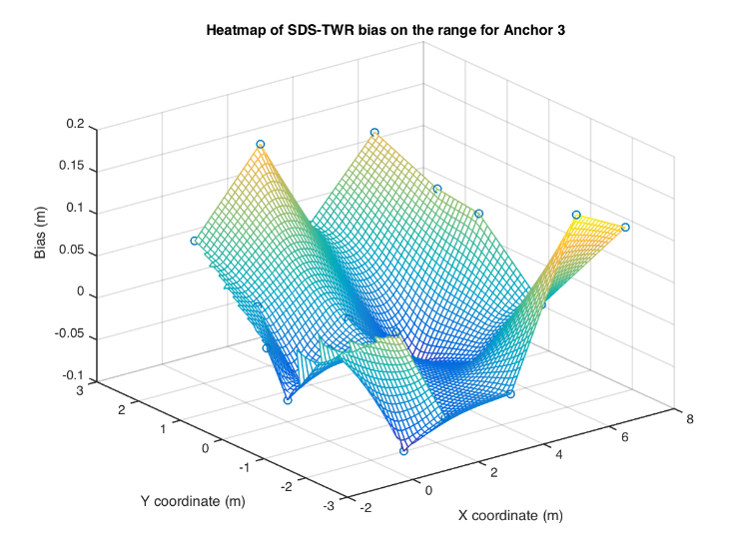
Sources of Error- Environment

Slide 25
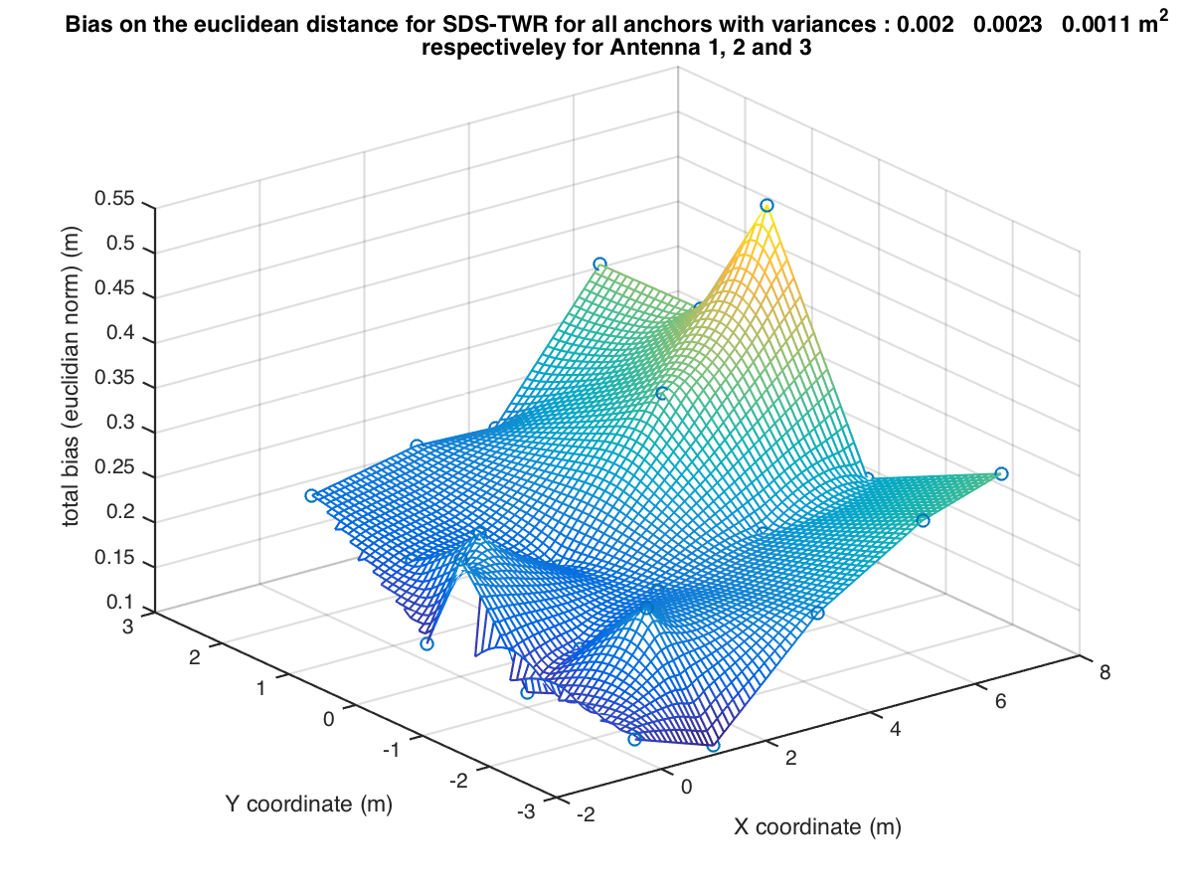
Sources of Error- Environment

Slide 26
Conclusion
Project Objectives
  Centimeter accuracy
  Two way and Symmetric two way ranging
  Static and dynamic positioning
Learnings
  Ranging protocols
  Position estimation – estimation theory
  Sources of error
  Project/Team management

