Slide 1

Welcome to course
DT2350
Human Perception for Information Technology
Roberto Bresin, Ginevra Castellano, Pawel Herman, David House, Jarmo Laaksolahti, Giampiero Salvi, Christopher Peters, Emma Frid
KTH CSC
Copyright (c) 2016 Roberto Bresin
This work is licensed under the Creative Commons Attribution-Noncommercial-Share Alike 3.0 Unported License. To view a copy of this license, visit http://creativecommons.org/licenses/by-nc-sa/3.0/ or send a letter to Creative Commons, 559 Nathan Abbott Way, Stanford, California 94305, USA.

Slide 2
Outlook
About 127 expected participants
Course participants: expectations (5 minutes)
Registration
Short course introduction
Course structure
Communication in the course
DT2350 Human perception

Slide 3
Why choose course DT2350
Human Perception for Information Technology
Roberto Bresin
roberto@kth.se
KTH CSC
Sound and Music Computing

Slide 4
You can help
to
understand and improve the world,
and how
you interact with it!
DT2350 Human perception

Slide 5
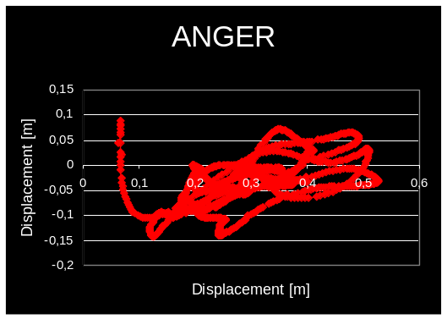
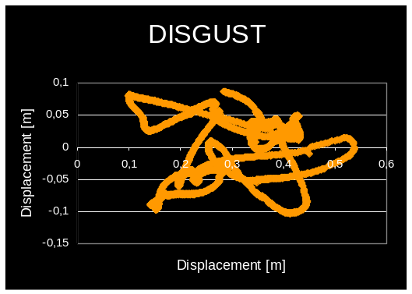
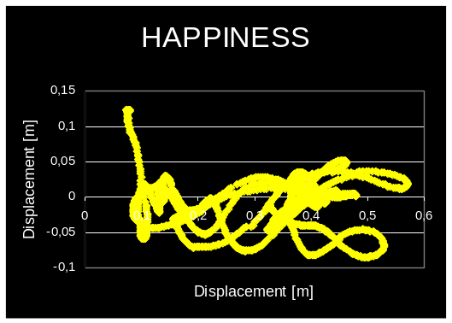
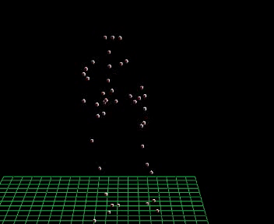

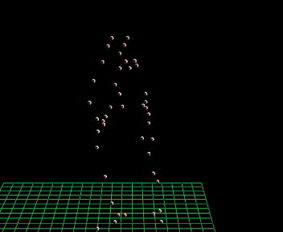
Body-gesture emotion in expressive music performance
R Bresin, K Hellmer, E Schoonderwaldt, J Beskov
Flutist playing with 12 different emotional intentions
DT2350 Human perception

Slide 6
Why choose this course
Human interaction with the environment is based on perception
Current technology relies on a variety of media to display, transmit and exchange information.
DT2350 Human perception

Slide 7
Key course facts
Lecturers are experienced researchers
3 interesting laboratory sessions
Examination form: project
DT2350 Human perception

Slide 8
Course responsible
Roberto Bresin
  email: roberto@kth.se
  mobile: 070 795 7876
Course administrator
Jarmo Laaksolahti
email: jarmola@kth.se
DT2350 Human perception

Slide 9
Course structure 1/2
9 lectures
Including 1 guest lecturer (Ginevra Castellano, Uppsala)
3 laboratory sessions about perception
    Each lab corresponds to 3 lectures
    Web-based
DT2350 Human perception

Slide 10
Course structure 2/2
4 written assignments at regular intervals
Examination form: Project (group of 3-4 people with individual grading)
DT2350 Human perception

Slide 11
Calculation of the final grade
4 assignments
Project draft1: 20 points (10 points for passing)
Paper review: P/F
Paper review: 40 points (20 points for passing)
Final project: 40 points (20 points for passing)
Total points: 100
If an assignment is submitted after the deadline, 2 points will be subtracted from the total points obtained for this assignment.
Grade Limit
  A 90 points
  B 80 points
  C 70 points
  D 60 points
  E 50 points
  Fail below 50 points
DT2350 Human perception

Slide 12
Communication in the course
Course web
https://www.kth.se/social/course/DT2350/
DT2350 Human perception

Slide 13
Important deadlines
Project draft September 18
Paper review 1 September 18
Paper review 2 October 2
Project Poster October 6
Final project report October 16
See course web for more details.
DT2350 Human perception

Slide 14
Welcome to the programme!
TIMTM

Slide 15
Introduction to the programme and first track introduction tomorrow 10-12 in B2

Slide 16


