Slide 1

Multisensory processing: an introduction
DT2350 Human Perception for Information Technology
Roberto Bresin
Copyright (c) 2016 Roberto Bresin
This work is licensed under the Creative Commons Attribution-Noncommercial-Share Alike 3.0 Unported License. To view a copy of this license, visit http://creativecommons.org/licenses/by-nc-sa/3.0/ or send a letter to Creative Commons, 559 Nathan Abbott Way, Stanford, California 94305, USA.

Slide 2
Literature
Charles Spence (2011) Crossmodal correspondences: A tutorial review. Atten Percept Psychophys, 73: 971-995
Weinschenk, S.M. (2011). 100 Things Every Designer Needs to Know About People.
Chapter #100: People value a product more highly when it’s physically in front of them

Slide 3
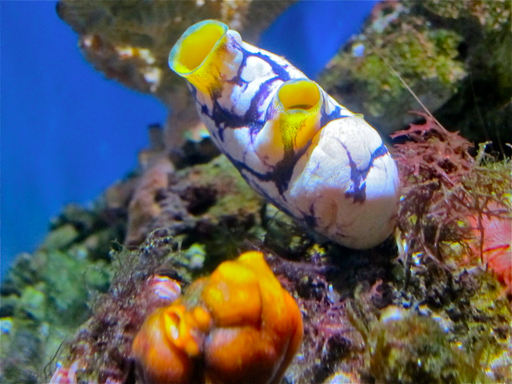
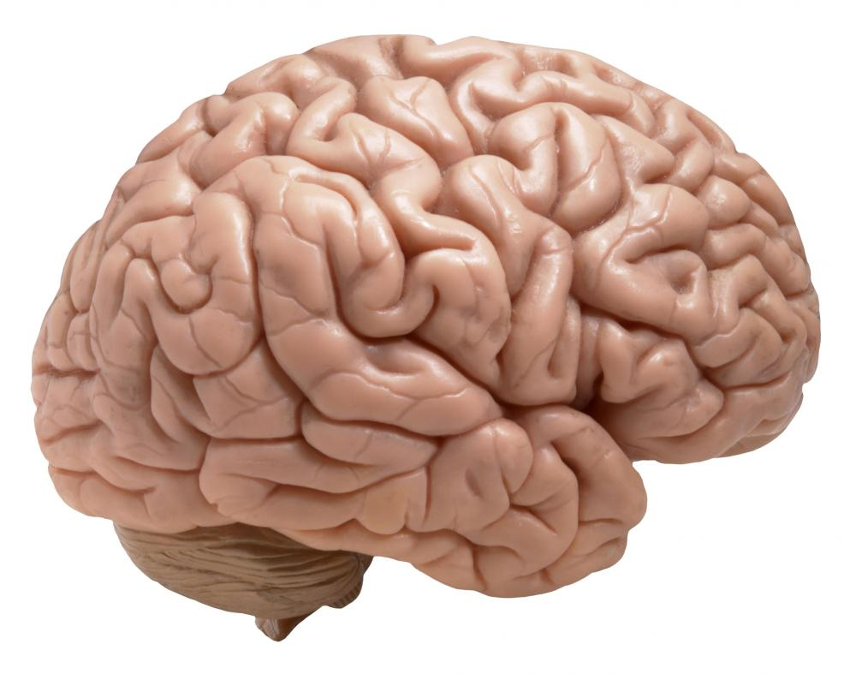
Why do we have a brain?
Sea squirt

Slide 4
Crossmodal correspondences
Charles Spence (2011) Crossmodal correspondences: A tutorial review
How does the brain “know” which stimuli to combine?
Research show that people exhibit consistent crossmodal correspondences between many stimulus features in different sensory modalities.
Example:
high-pitched sounds → small & bright objects, high up in the space

Slide 5
Multisensory integration
Cognitive neuroscience research on the topic of multisensory perception focuses on trying to understand, and to model the spatial and temporal factors modulating multisensory integration.
Temporal factor
Multisensory integration is more likely to occur the closer that the stimuli in different modalities are presented in time.
Spatial factor
Spatial coincidence facilitates multisensory integration.

Slide 6

Other factors influence multisensory integration in humans
Semantic congruency refers to situations in which pairs of auditory and visual stimuli are presented that vary (i.e., match vs. mismatch) in terms of their identity and/or meaning.
Synaesthetic congruency refers to correspondences between more basic stimulus features (e.g., pitch, lightness, brightness, size) in different modalities.
➔ Unity effect: stimuli that are either semantically or synaesthetically congruent will more likely be bound together

Slide 7
Synaesthetic congruency ➔ Crossmodal correspondences

Slide 8
Crossmodal correspondence/association
Def: Compatibility effect between attributes or dimensions of a stimulus (i.e., an object or event) in different sensory modalities (be they redundant or not).
Crossmodal correspondences occur between polarized stimulus dimensions: a more-or-less extreme stimulus on a given dimension should be compatible with a more-or-less extreme value on the corresponding dimension.
Key feature: crossmodal correspondences are shared by a large number of people.
Notes:
A key feature of (or assumption underlying) all such crossmodal correspondences is that they are shared by a large number of people (and some may, in fact, be universal).

Slide 9
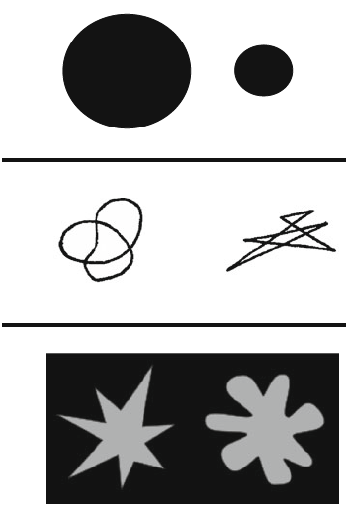
Crossmodal associations
Example: sound symbolism
Mil
Sapir (1929)
Mal
Maluma
Köhler(1929)
Takete
bouba
kiki
Ramachandran & Hubbard (2001, 2003)

Slide 10
Crossmodal associations
Example: sound symbolism
The bouba/kiki effect does not show in:
Children with autism spectrum disorder
People with damage to the angular gyrus (located within the temporal–parietal–occipital [TPO] region)
This suggests that crossmodal correspondences (at least those involving sound symbolism) can occur at quite a high level in the brain.

Slide 11
Crossmodal associations: across groups
Adults and children (5-year-olds) reliably matched brightness with loudness crossmodally:
Light grey patches → Louder sounds
Darker grey patches → Softer sounds

Slide 12
Crossmodal associations
Unidimensional sensory stimuli
high-pitched tones → brighter surfaces
louder sounds → visual stimuli with higher contrast
Complex stimuli
music → pictures

Slide 13
Crossmodal associations
20-30 day-old
Loudness → Brightness
Infants (3-4 month-old)
Pitch → Visual elevation
2 year-old children
Loud sounds → Large shapes
The ability to match other dimensions crossmodally appears to develop somewhat more slowly

Slide 14
Crossmodal associations: other than auditory/visual stimuli
Vision → Touch
Audition → Touch
Taste/Flavours → Sounds
Colour → Odours
Colour → Tastes
Colour → Flavours
Pitch → Smell
Smells → Shapes
Shapes → Tastes/Flavours
Likely that crossmodal correspondences exist between all possible pairings of sensory modalities.

Slide 15
Assessing the impact of crossmodal correspondences
Consolidated correspondence:
Pitch (100 or 1000 Hz) → Elevation (upper or lower corner)
Harder to classify the size of a visual stimulus (as either large or small) when the task irrelevant sound presented on each trial is incongruent in pitch (e.g., when a high-pitched tone is presented at the same time as a large target) than when the distractor sound is congruent (e.g., when a low tone is presented with the large target).

Slide 16
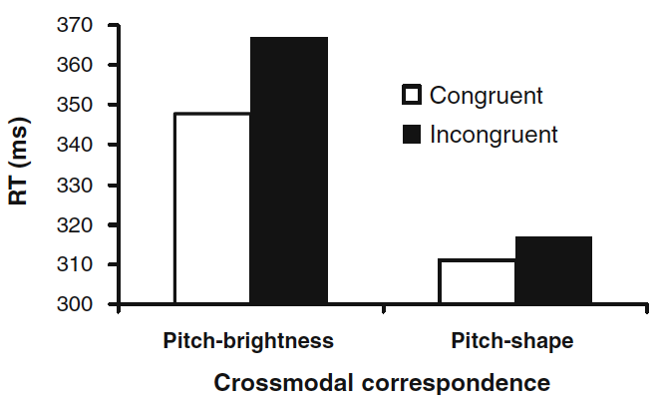
Response time (RT)
Notes:
Participants Response Time for identifying the size of a stimulus when changing it properties.
The visual stimuli varied in either brightness (dim vs. bright) or angularity (rounded vs. sharp), while the auditory stimuli varied in pitch (low vs. high).
.

Slide 17
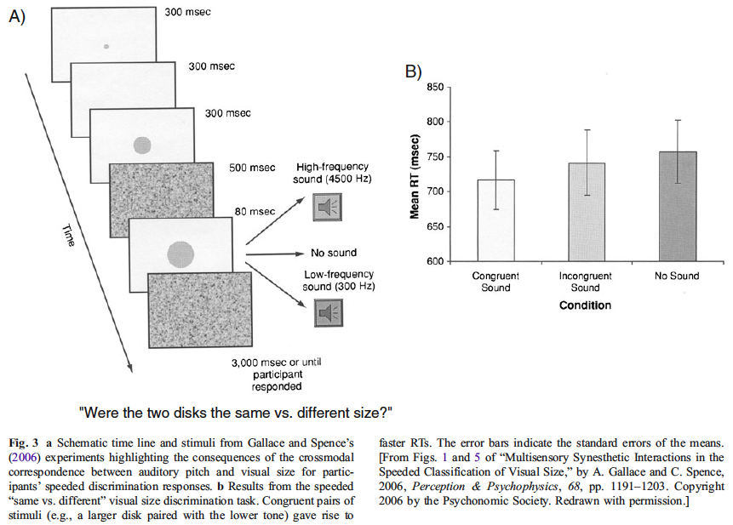
Task irrelevant sound (of either relatively low or high pitch) can significantly influence participants’ responses on a speeded visual size discrimination task
A sound (300 or 4500 Hz)
was presented in synchrony with the second disk (otherwise,
no sound was presented)

Slide 18
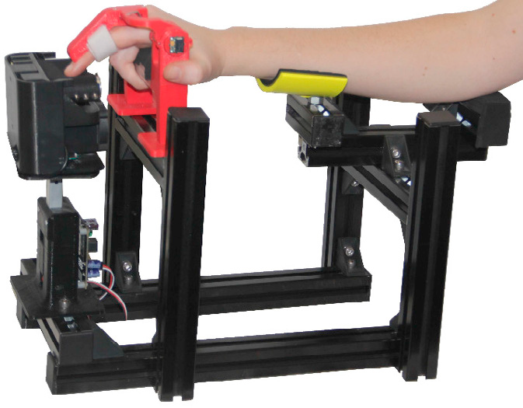
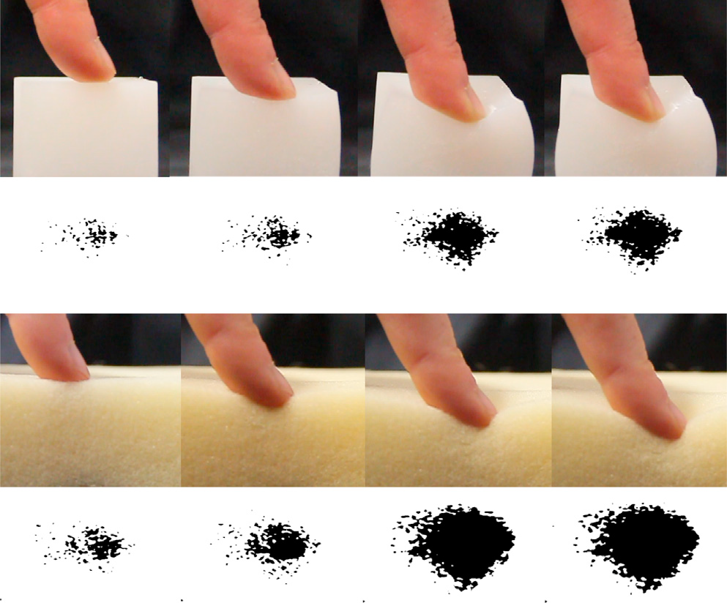
Change in Fingertip Contact Area as a Novel Proprioceptive Cue
Pushing a finger against an external surface provokes an increase of the contact area.
The increase in contact area provides a cue to finger displacement, similarly to looming in vision.
➔ Results show that the change in contact area provides a novel proprioceptive cue.
SOURCE:
The Change in Fingertip Contact Area as a Novel Proprioceptive Cue
Moscatelli, Alessandro et al.
Current Biology , Volume 26 , Issue 9 , 1159 - 1163
Notes:
Looming refers to the rapid expansion in the size of any given image. As the image becomes increasingly large on the perceiver's retina, i.e., when an object looms, there is an automatic physiological response to perceive the object as an approaching object or surface, instead of one that is stationary or receding.
Proprioception is the relative position of neighbouring parts of the body and strength of effort being employed in movement.

Slide 19
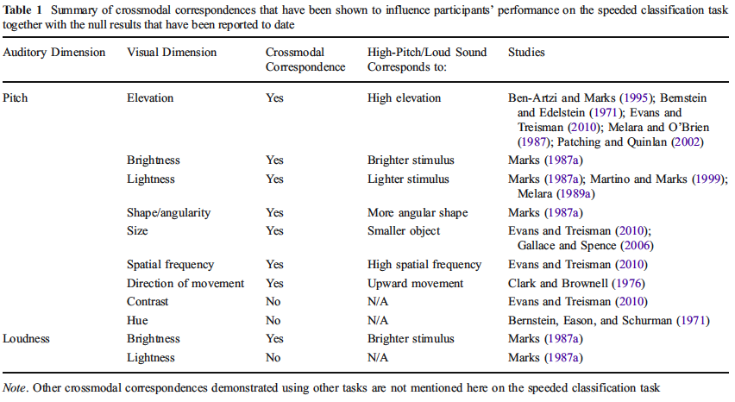
Crossmodal correspondences that have been shown to influence participants’ RT

Slide 20
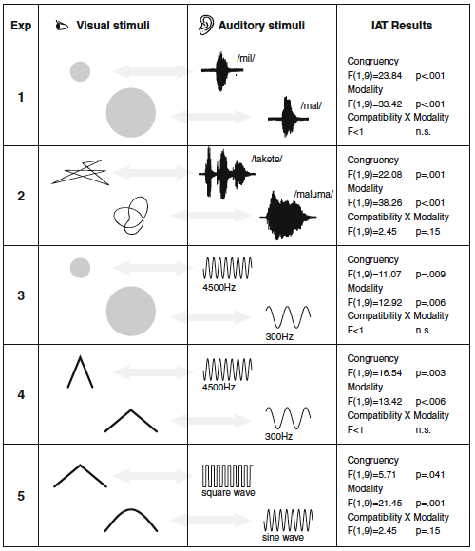
Audiovisual crossmodal correspondenses and sound symbolism
(Parise & Spence 2012)

Slide 21
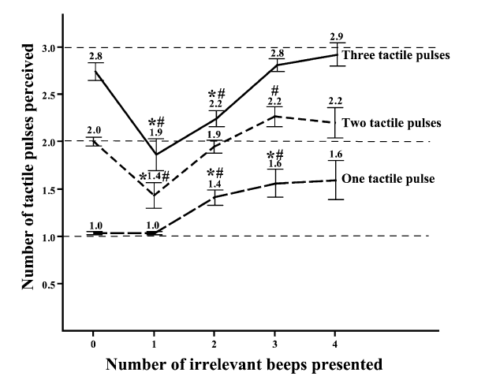
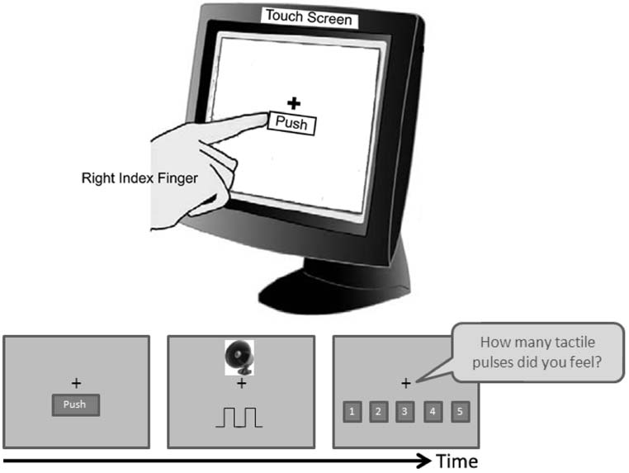
Feeling what you hear: task-irrelevant sounds modulate tactile perception delivered via a touch screen
Lee & Spence (2008)

Slide 22
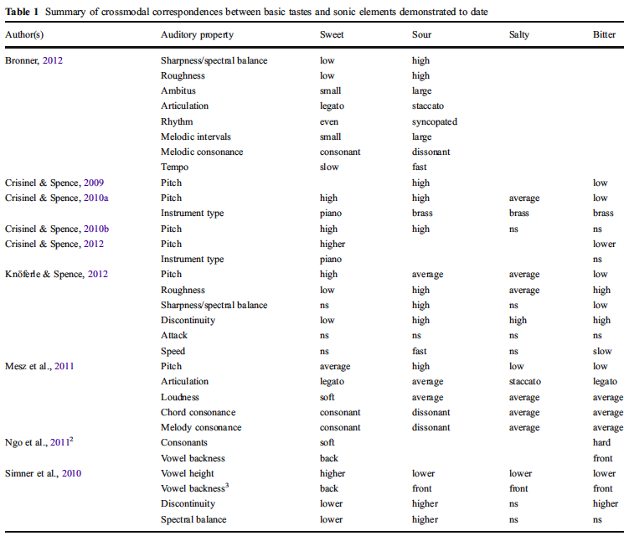
The music of taste
Knöferle & Spence (2012) Crossmodal correspondences between sounds and tastes

Slide 23
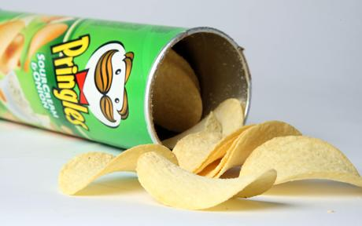
Sonic food: sound for crispy chips
Ig NOBEL NUTRITION PRIZE 2008.
Massimiliano Zampini of the University of Trento, Italy and Charles Spence of Oxford University, UK, for electronically modifying the sound of a potato chip to make the person chewing the chip believe it to be crisper and fresher than it really is.
http://www.improbable.com/ig/winners/#ig2008
http://www.bbc.co.uk/programmes/b00g0nns
(BBC Radio interview with Charles Spence at minute 3:28)

Slide 24
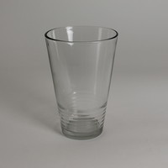
More examples
Hearing temperature of a drink: Hot/Cold pouring sound
http://www.npr.org/2014/07/05/328842704/what-does-cold-sound-like
Music manipulates taste/choice: French vs German wine
North et al. (1999) The influence of in-store music on wine selections. J. of Applied Psychology
Notes:
A sinistra COLD
A destra HOT

Slide 25
Links
Crossmodal processes
https://www.facebook.com/xmodal
Multisensory Perception and Action
http://www.uni-bielefeld.de/(en)/biologie/cns/index.html
The Social Mind and Body Group (SOMBY)
http://somby.info

Slide 26
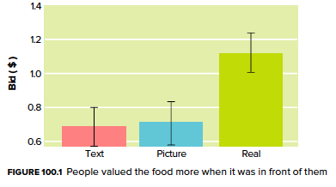
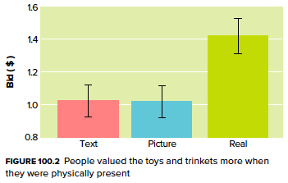
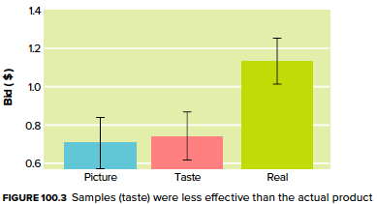
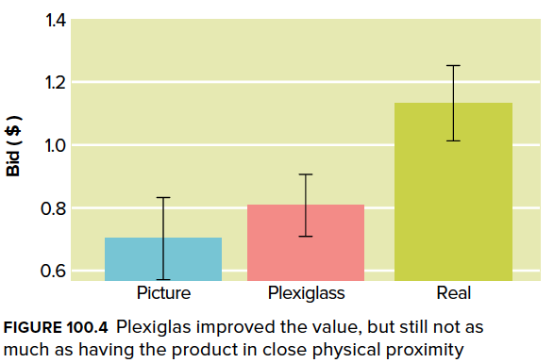
People value a product more highly when it’s physically in front of them
Weinschenk, S.M. (2011). 100 Things Every Designer Needs to Know About People. Chapter #100
Example: bidding for a product (food or toys)

Slide 27
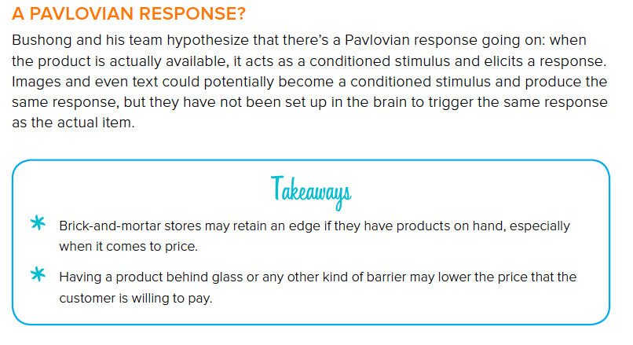
People value a product more highly when it’s physically in front of them
Weinschenk, S.M. (2011). 100 Things Every Designer Needs to Know About People. Chapter #100

Slide 28

The end

