Slide 1
Degree Project Course
BSc of Engineering, Bachelor degree/ Civil engineer year 3
Anne Håkansson
annehak@kth.se
Director of studies for degree projects
Information and Communication Technology, KTH
© 2016 Anne Håkansson All rights reserved.

Slide 2
Prerequisites
To start the degree project course:
Must have at least 120 credits completed courses
This requirement is checked by the administration before the student is registered for the degree project course and can start the course.
”Exceptions permission” – only if the student gets the credits in the beginning of the course & before registration

Slide 3
Degree Project course
Starts three times per year:
Period 3 (Jan) – over two periods
Period 4 (Mars/April) – over one period
Period 1 (Sept) – over one period
-> Start the degree project = start finding a project
2-3 months before the course begins
* Write a project proposal, which is a memorandum for the project.
Hand in 10 of December / 15 of March / 15 of June

Slide 4
Before course starts (P3 Jan / P4 Mars)
Fall
Oct
Nov
10 Dec
VT - Spring
1 Mar
Find and decide degree project
Fill in the registration form and get a stamp from the administrators
Write and hand in a project proposal
via Bilda
Hand in registration form (examinator) and for registreration (Administrator)
New Project proposal
Examiner is matched (maybe assigned)
Negotiate about the topic or PA)
Start degree project (March)
Administrator check credtis and stamps the registration form
Examiner signs the registration form
Negotiate and discuss with examiner and/or supervisor at company
Examiner assigns the KTH supervisor
Administrator controls and registers the student
Student
Examiner
PA / Director of Studies
Administrator
Figure. Start-up phase for degree project, Fall - Spring.

Slide 5
Inför kursen
Antal studenter per examensarbete:
2 studenter per examensarbete
Hitta medarbetare – I Bilda
Ej 3 studenter
- i projektgrupp men ej skribenter på samma uppsatsrapport!

Slide 6
@ICT- school
Task order:
Find a degree project
Registration form
Write a project description (project proposal)
– Negotiate! AND/ OR – Hand it in – in Bilda!
@another KTH-school – talk to them – follow their routines! May have a start early in January, at a certain date with a certain task!

Slide 7
Find and decide on a degree project
ICT- school Degree project Fair
– Today, Electrum
11.30 – 15.30
Meet companies, and researchers
For more information see: kth.se/pdf
Contact - Visit
- companies
- researchers
- teachers

Slide 8
Find degree projects/-thesis projects
Web sites (KTH, ICT KTH, External, Abroad)
http://www.kth.se/samverkan/exjobb/kth-exjobbportal-1.292786
http://www.ict.kth.se/xjobb/
http://www.kth.se/student/program/examensarbete/
https://www.kth.se/student/program/utlandsstudier/examensarbete?programme=tebsm

Slide 9
@ICT-school
How to get the registration form approved?
Fetch the registration form via:
https://www.kth.se/social/group/examensarbete-ict-sk/page/formular-registrering-projektforslag/
Fill it in
Take the registration form to the administrators
Get a stamp!
Then :
Upload a copy of the registration form in Bilda system
& Give it to the examiner for a signature

Slide 10
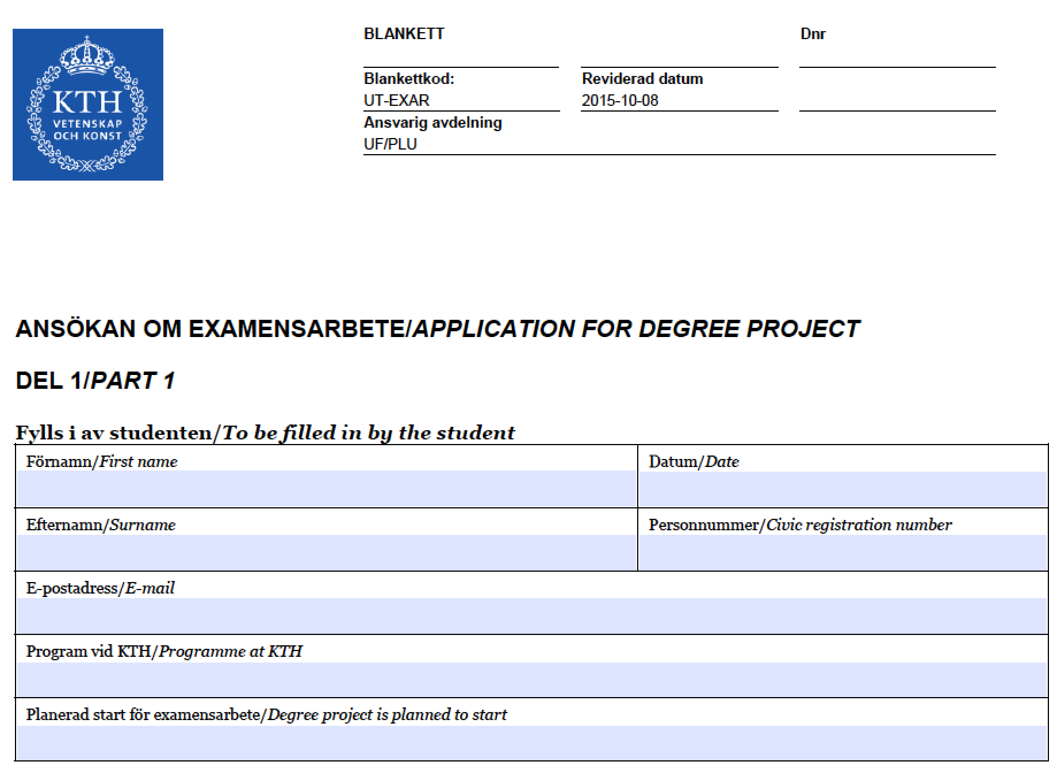
Stamp
&
Signature

Slide 11
Grades: P/F – ECTS A-F
Degrees with P/F or A-F:
Students that have started their education before 2015-07-01 have the right to choose grade A-F
Choice of course code is decided when the course is registered.
Cannot regret the choice later and choose another grade!

Slide 12
Hand in – start period 3 or period 4
HAND in project proposal by upload it in the Bilda system – not later than – 10th of Dec
(https://bilda.kth.se/)
UPLOAD registration form together with project proposal in the Bilda system – 10th of Dec
USE both when talking to examiner! (i.e., if you have a project)
GIVE the registration form to your examiner (for additional information)!
You or the examiner hand in the registration form to the administrators - white post box, 3rd floor, B-elevator

Slide 13
Hand in – start period 1
HAND in project proposal by upload it in the Bilda system – not later than – 15 ^{th} of June
(https://bilda.kth.se/)
UPLOAD registration form together with project proposal in the Bilda system – 15 ^{th} of June

Slide 14
Why hand in a project proposal?
To get suggestions about a possible examiner
Examiners can read the project proposals and discuss the topic with the student
OBS Examiners, themselves, pinpoint supervisors

Slide 15
Project proposal = Announcement, Not registration
(template: https://www.kth.se/social/group/degree-projects-ict-/page/forms-application-form-project-proposa/)
Project Title + Date
Author information (individual work)
Organization and Supervisor, information
KTH Examiner and Supervisor, information
Keywords
1-6 keywords describing the degree project
Background
Short description of the area
Problem
Problem area, focusing on the area to work with
Problem statement
Concrete problem to work with during the project

Slide 16
Project proposal, cont.
Purpose with the degree project (e.g., present a computer system that provides possibilities to a better working process)
Goals
The goals of the project (e.g, an improved computer system that connects several already developed computer systems)
Tasks
Tasks to carry out during the project
Method(s)
Research methods that will be used to carry out the degree project and to write the thesis
Delimitations
What affect the project but will not be included
Milestone chart (time schedule)
Risks, Consequences and Ethics
Summary
short summary of the degree project and work including expected results
Reference(s)

Slide 17
No idea what to work with? But will carry out degree project during spring semester
Hand in - in Bilda with:
Project Title “Not decided”
That is if the degree project is not decided but will be carried out during spring.
Students Name of the students that will carry out the degree project
Keywords
Instead of keywords, write own areas of interests (preferrable several):
1-6 keywords that shows what you are interested of
(t ex, Artificial Intelligence, Programming, Development of a system …)
File name should include following:
“Author1–Author2-Not_decided-Keywords–Date.pdf”
Date is the date for handing in the project plan. Use the format : Year-Month-Day
Bra sätt att hålla reda på versioner

Slide 18
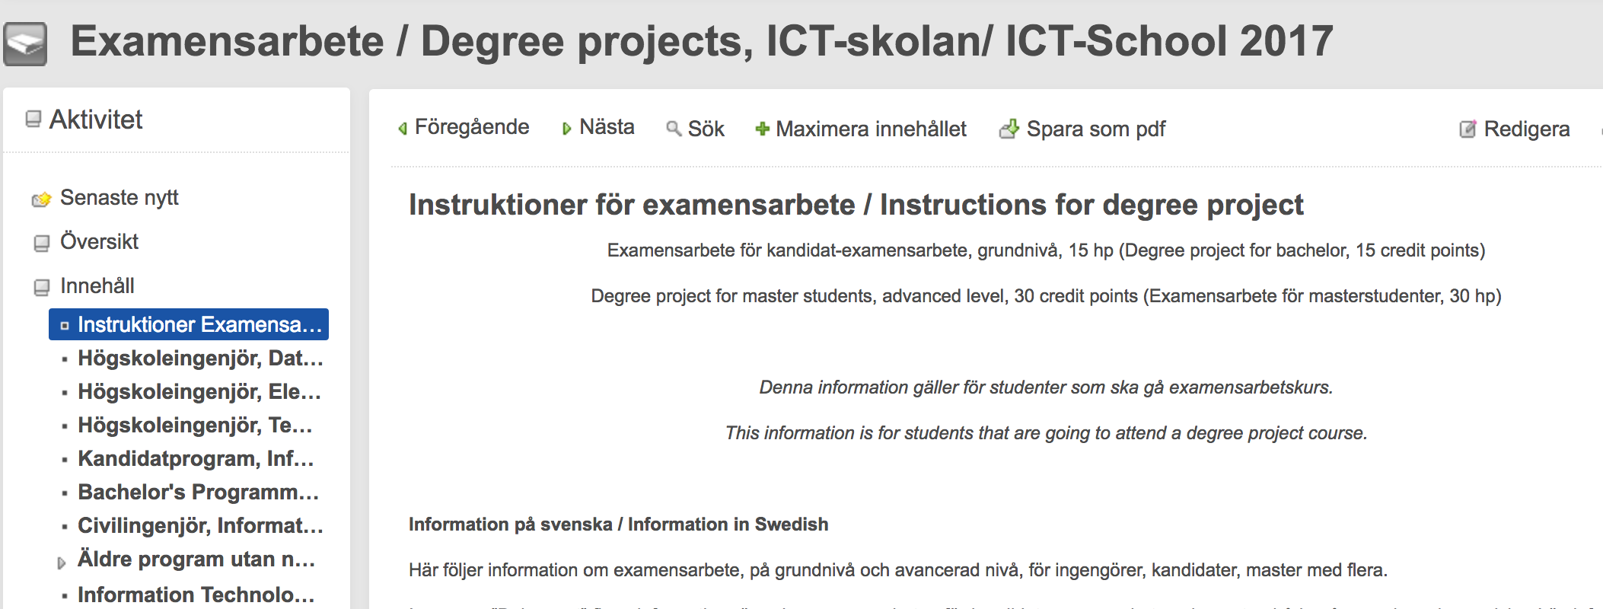
Bilda, Examensarbete / Degree projects, ICT-skolan/ ICT-School 2017 - OBS year!

Slide 19
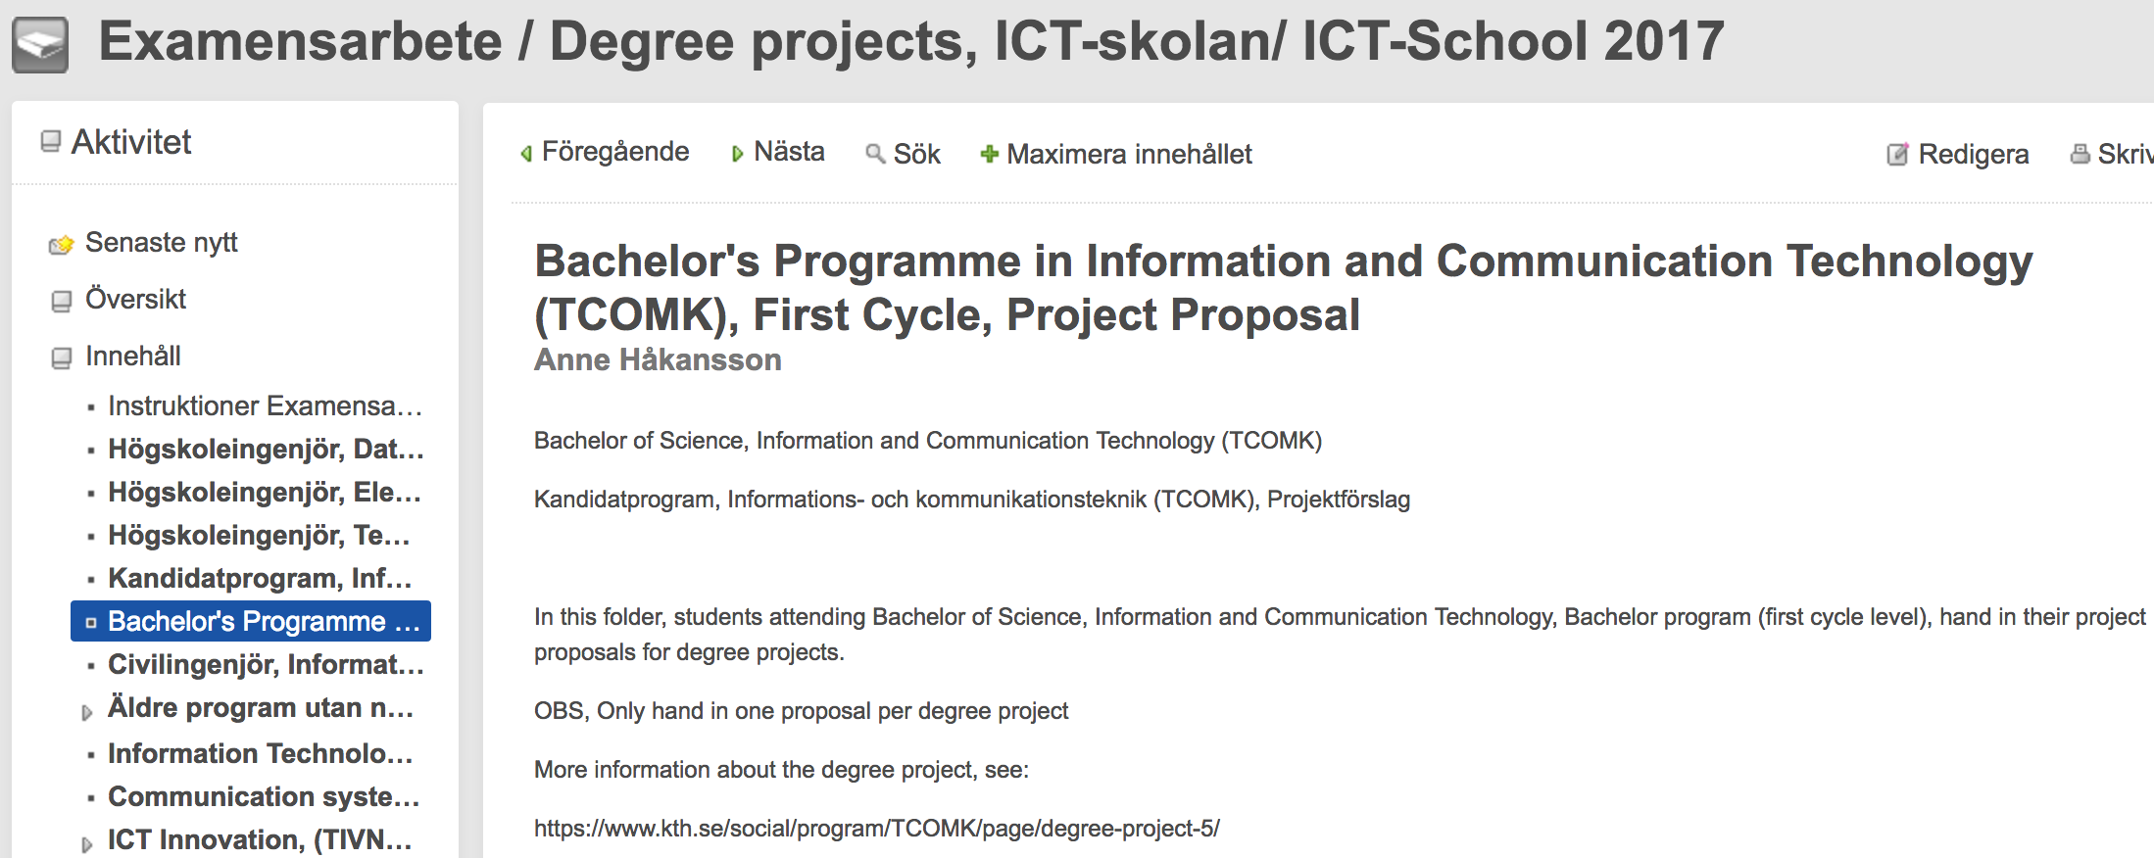
In folder….

Slide 20
Number of project proposals and alterations
Hand in one project proposal in one folder per degree project! Choose the folder that best correspond to education programme!
If different programmes – still choose one folder and tell that several education programmes are involved.
Altered version:
Course that starts in period 3 (January):
– Hand in the altered version not later than10 of January! (if carrying out the degree project in period 3-4)
Period 4 (March):
– Hand in the altered version not later than15 Februari! (om period 4)
Period 1 (September):
– Hand in better version not later than15 of August! (if carrying out the degree project in period 1-2)

Slide 21
Examiner and Supervisors
Examiner and Supervisor at KTH
Supervisor (Company)
Find examiner and supervisor at KTH
Help from Director of Studies – from beginning
  Contact possible Examiner and/or Supervisor
  (Examiner pinpoints supervisor)
  Contact PA (Program Directors)
  Contact Director of studies for the unit, education programme
  Bilda – support if Examiner and Supervisor are missing
  * Examiner signs the registration form

Slide 22
Program Directors (PA)
http://www.kth.se/en/ict/kontakt/programansvariga-1.33074
Bachelor of Science in Engineering, Computer Engineering (TIDAB) Anders Sjögren
Bachelor of Science in Engineering, Electronics and Computer Engineering Bengt Molin
Bachelor of Science, Information and Communication Technology (TCOMK) Paolo Monti
Master of Science in Engineering Information Technology, 3rd year, (CINTE) Robert Rönngren

Slide 23
Program Directors
Older programs with no admission
Bachelor of Science, Information and Communication Technology (TKOMK) Anders Sjögren
Bachelor of Science, Business Engineering (TAFFK) Anders Sjögren
Bachelor of Science in Engineering, Electronics and Communication Engineering (TIEMB) Bengt Molin
Bachelor of Science in Engineering, Business IT Engineering (TIASB) Anders Sjögren
Bachelor of Science in Engineering, Mechatronics and Industrial IT Engineering (TIMIB)ITM-skolan
Master of Science in Engineering, Microelectronics, 3rd year (CMIEL) Robert Rönngren

Slide 24
Director of studies
Software and Computer systems Alf Thomas Sjöland
Communication Systems Fredrik Kilander
Materials- and Nano Physics B Gunnar Malm
Integrated Devices and Circuits B Gunnar Malm
Electronic Systems Fredrik Jonsson
Degree Projects Anne Håkansson
Director of First and Second Cycle Education Anders Västberg

Slide 25
Information about degree project
Find information about degree projects:
https://www.kth.se/social/group/examensarbete-ict-sk/
https://www.kth.se/social/group/examensarbete-ict-sk/page/formular-registrering-projektforslag/
https://www.kth.se/student/program/examensarbete/ict-examensarbete-vid-skolan-for-informations-och-kommunikationsteknik-1.14065
I Bilda:
Examensarbete / Degree projects, ICT-skolan/ ICT-School 2017

Slide 26
Lectures
2017
January – Introduction lecture
February - Misc: Content, Structure, Presentation / Opposition, Writing hints

Slide 27
Questions
?

